Slide 1

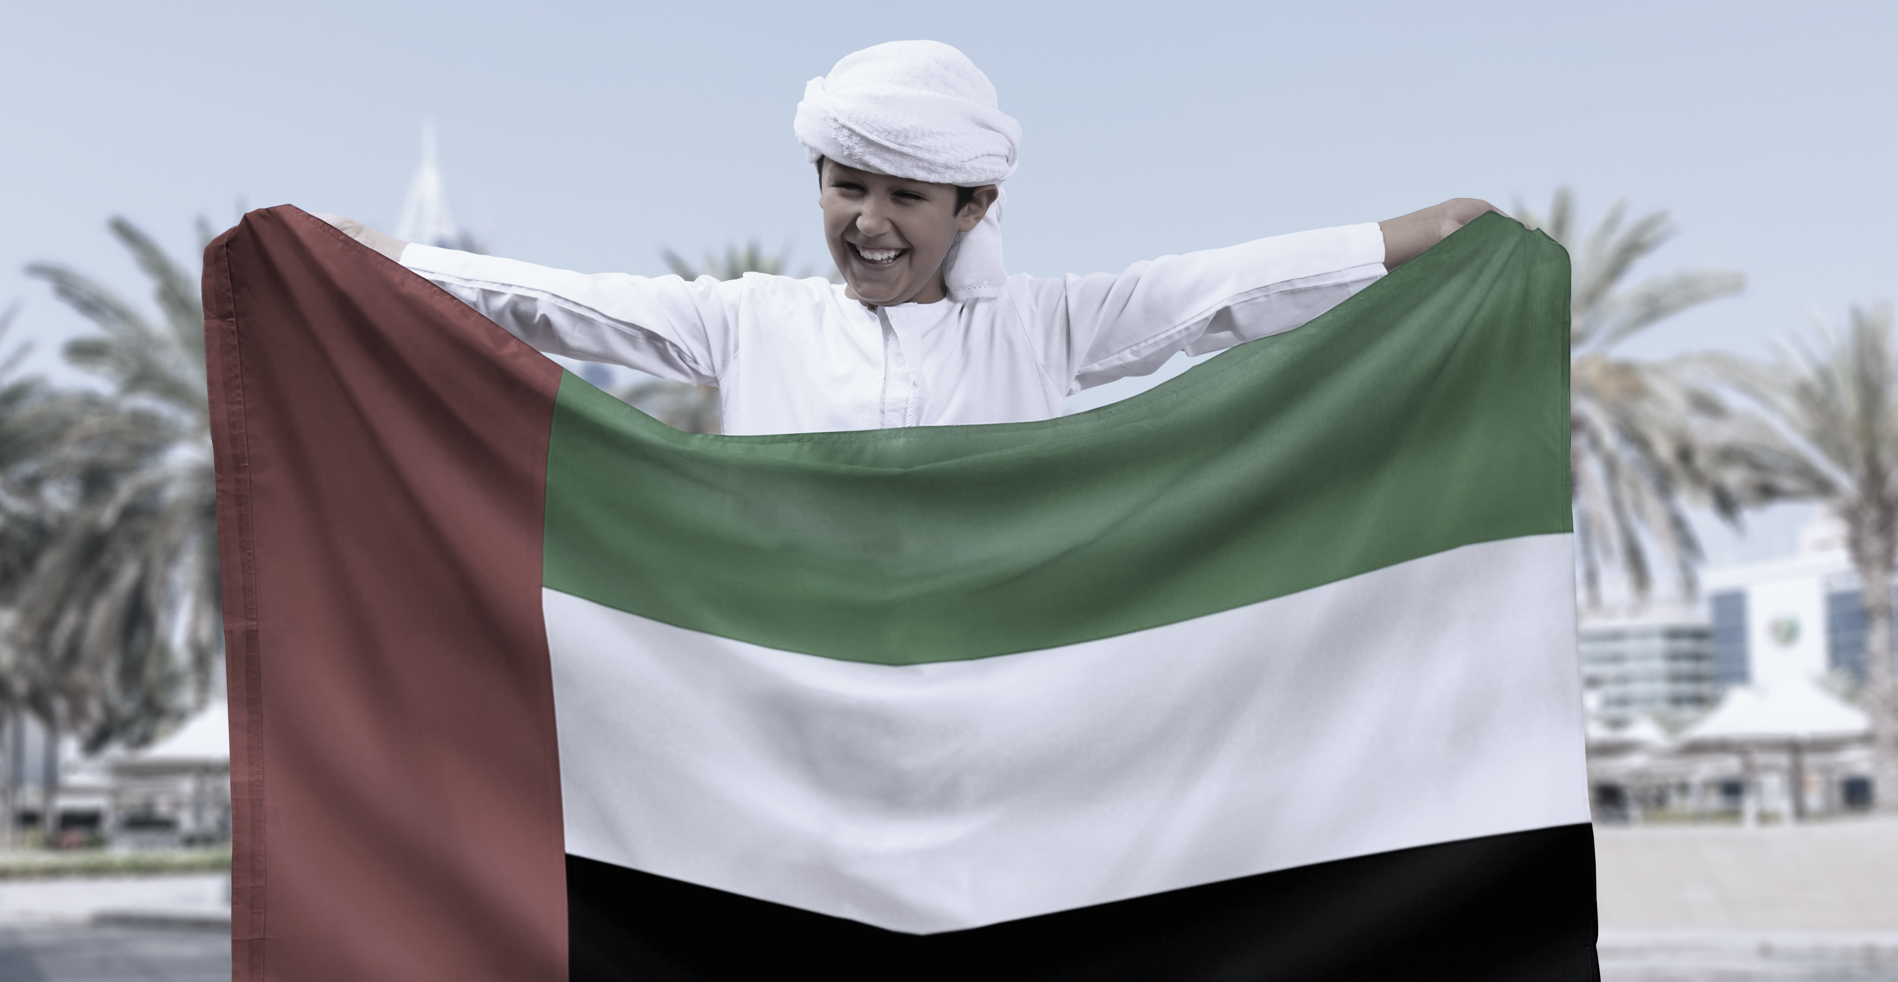

Resource Pack
2025-2026
Term 1
Week 1

Slide 2





School Life: Weekly Plan
(Teacher Guide)
Welcome Back to School
Language |  | Grammar Focus (Develop) | Functional Language
Vocabulary: project, exam, test, subject, science, art, difficult, interesting Language Structures: Which subject...? What do you think of...? I like English more than math. My favourite subject is... My least favourite subject is... High Frequency Words: school, subject, more, than, best, like |  | Adjectives (position) + Wh-questions Examples: Science is interesting and fun. Which subject do you like best? What do you think of art class? Teacher Guidance: Simple adjective combinations: interesting and fun, difficult but good Basic wh-questions: Which, what, why Subject vocabulary: science, maths, art, English, PHE Opinion expressions: "I like...", "I think... is..." Preference language: "more than", "favourite", "best" | F.L. 1 Asking for and giving personal information FL.8 Expressing preference
Competencies
 | UAE Context: Describe how UAE school subjects connect to careers Wellbeing Focus: Set academic goals for the term Sustainability Focus: Create an eco-friendly classroom plan Digital Literacy: Use a basic word processor to list goals and format a class eco-plan
Term 1
Week 1

Slide 3
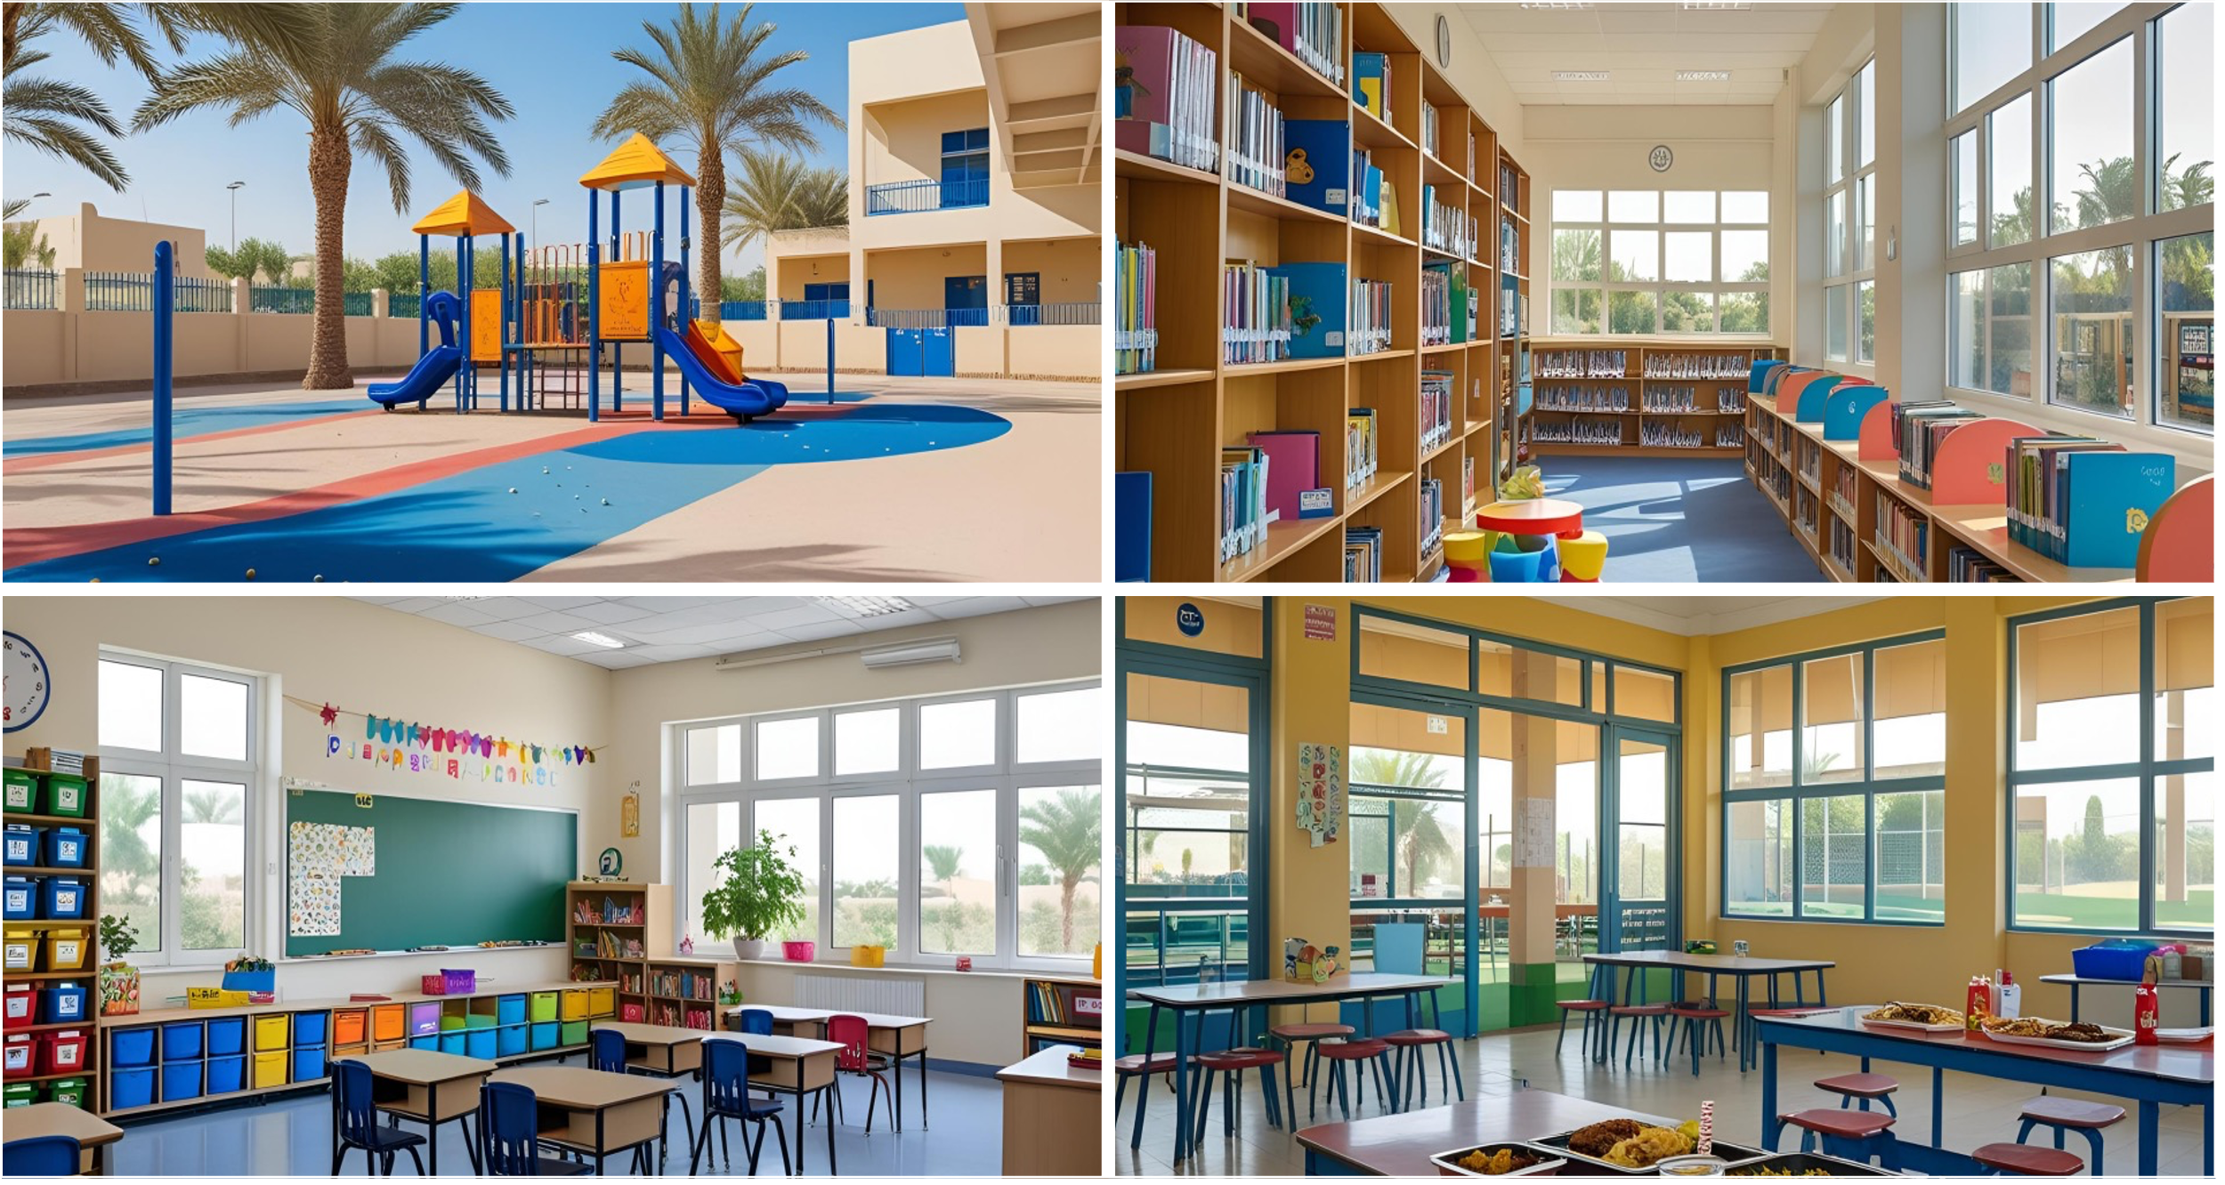
School Life
Term 1
Week 1

Slide 4











Activity: School Subjects
c
Discuss the school subject pictures with a partner. Name the school subjects.
1.
2.
3.
4.
5.
6.
7.
8.
9.
10.
Which subjects do you study in the UAE?

Slide 5
Activity: School Subjects
c
Look at the different places in a school. What are they called?
1.
2.
3.
4.
5.
music
gEihsnl
EHP
Arabic
umcsi
geography
English
PHE
biacAr
ahopggrey
6.
7.
8.
9.
10.
maisIlc ssudite
TI
Islamic
studies
IT
science
ncecsie
rta
tahsm
art
maths

Slide 6

Activity: School Subjects
c
Look, listen and repeat! Then, match the clues with the correct words.
1. We learn about Islam, the life of the Prophet Muhammad (PBUH), and how to follow good values.
Islamic
studies
2. In this lesson, we exercise, play sports, and learn how to stay healthy.
PHE
3. We work with numbers, shapes and solve problems.
maths
4. We listen to tunes, sing songs and play instruments.
music
5. We read books, learn new words and practise speaking and listening in this language.
English

Slide 7
Activity: School Subjects
c
Look, listen and repeat! Then, match the clues with the correct words.
1. We study the UAE’s language, read stories, and learn correct spelling and writing.
Arabic
2. We learn about countries, maps and the weather in different countries.
geography
3. We learn about animals and plants and how the world works.
science
4. We draw, paint and make creative designs.
art
5. In this lesson, we use computers to make projects, learn new programs and learn about how to stay safe online.
How do these subjects connect to future careers?
IT

Slide 8
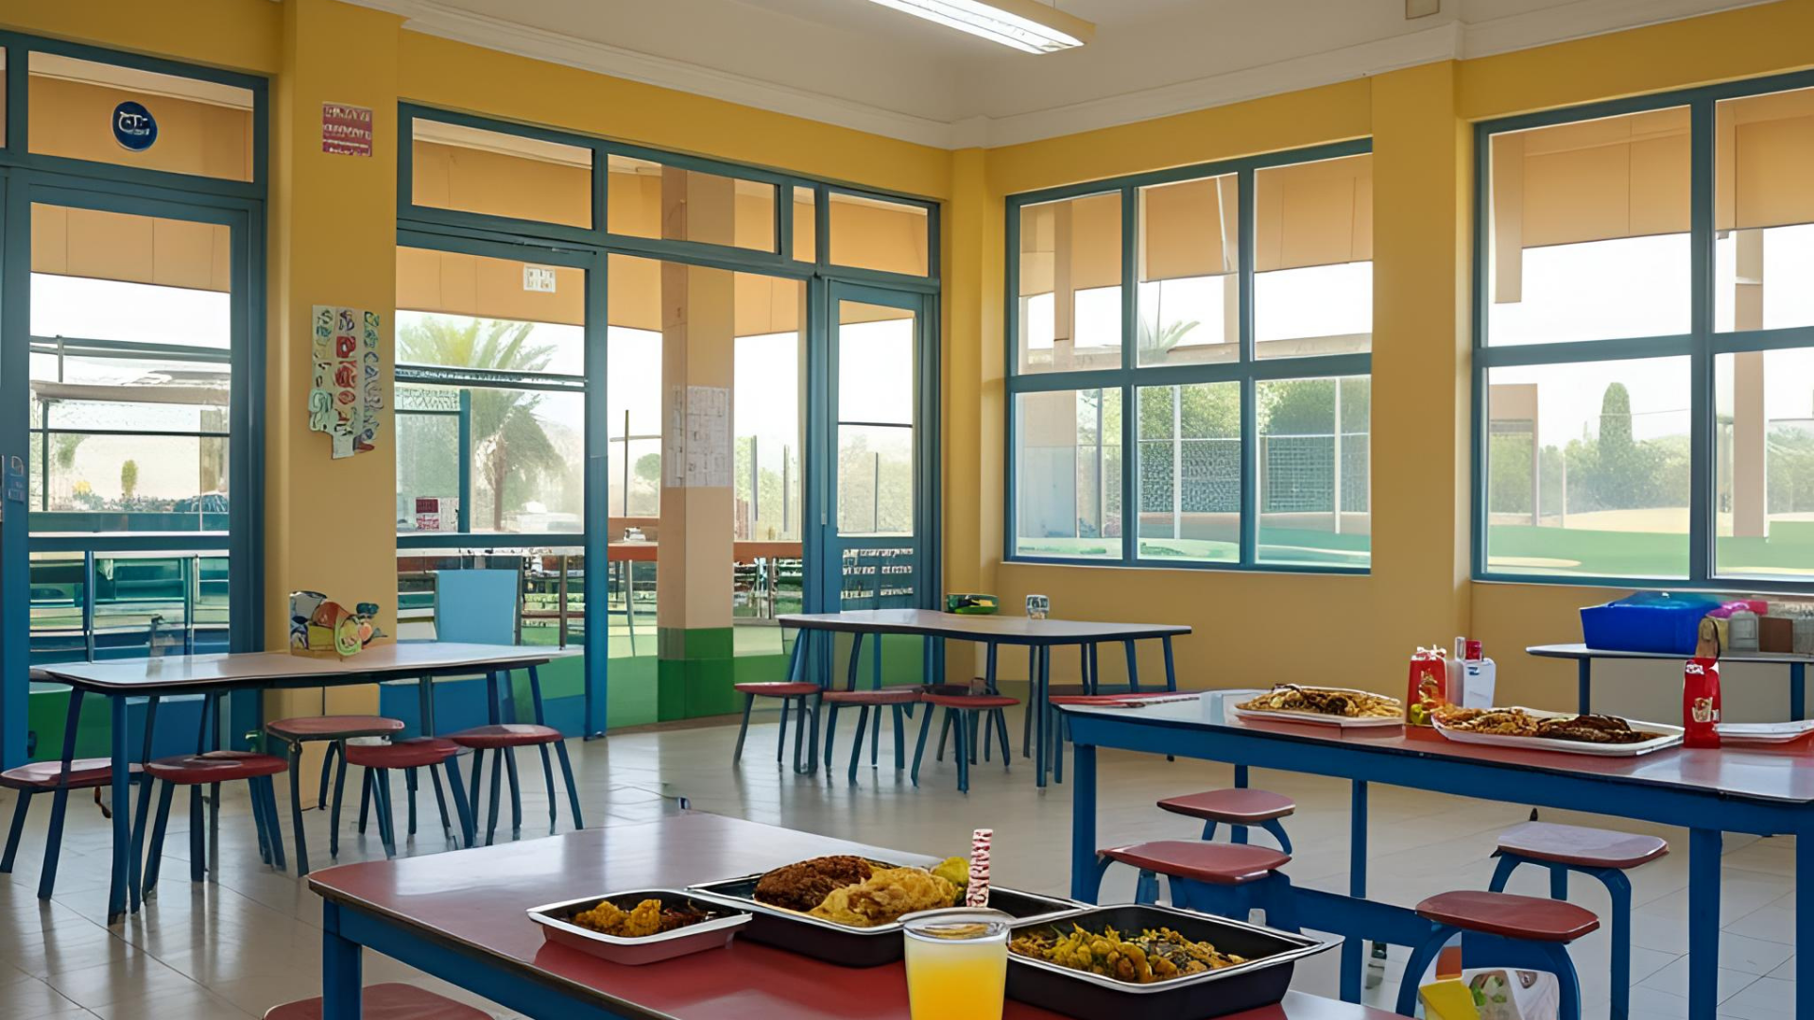
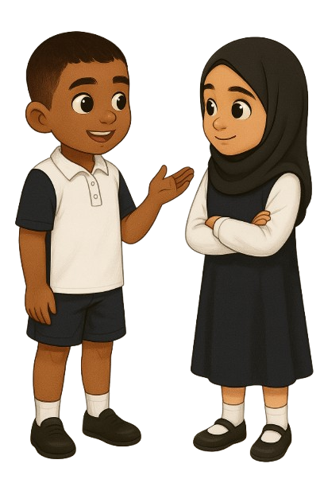
Activity: School Subjects
c
Read the dialogue. Use the language to talk to a partner about school subjects.
My favourite subject is English.
What’s your favourite subject?
Which subject do you like best?
I like PHE. I think’s interesting and fun!

Slide 9
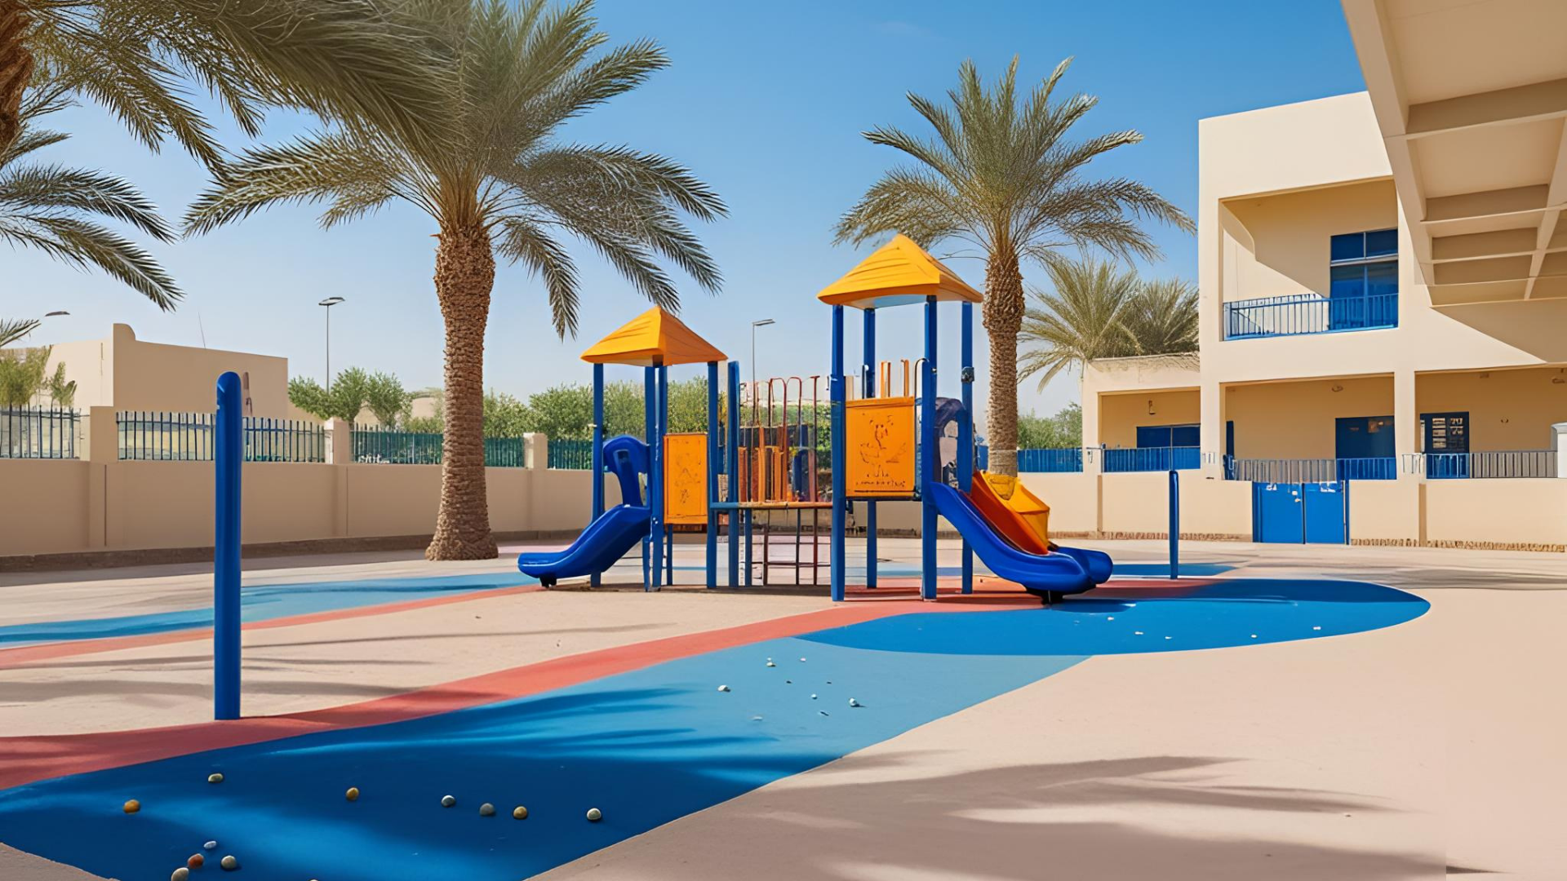
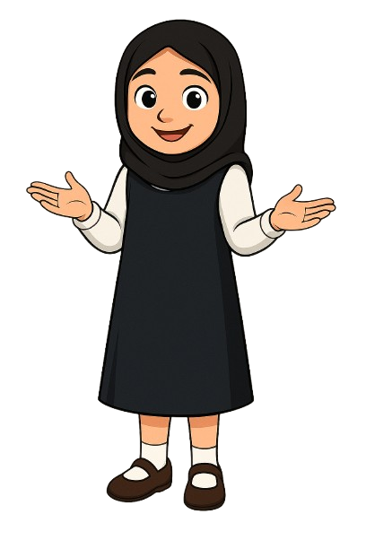
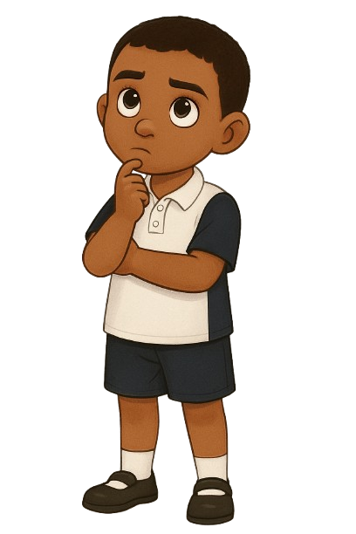
Activity: School Subjects
c
Read the dialogue. Use the language to talk to a partner about school subjects.
What’s your least favourite subject?
My least favourite subject is maths.
Why don’t you
like maths?
I thinks maths is
really difficult!

Slide 10
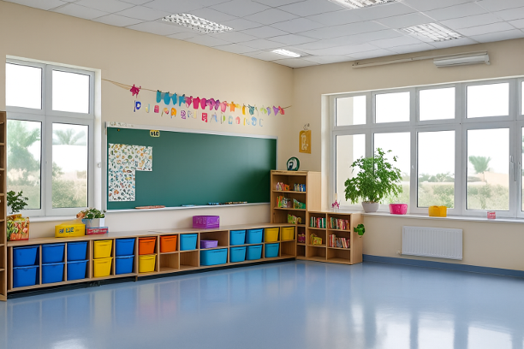

Activity: School Subjects
c
Read the dialogue. Use the language to talk to a partner about school subjects.
What do you think
of Arabic?
I think Arabic is interesting.
I like Arabic more than English.
Really!
I think English
is the best!

Slide 11

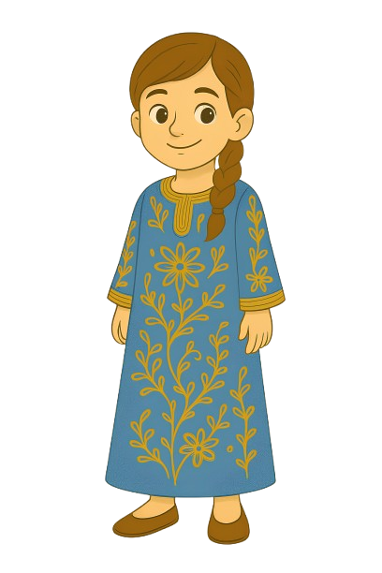

Activity: School Subjects
c
What does Hessa think about school subjects? You can make notes for later.
My favourite subject is Arabic because I enjoy reading stories and learning new words.
I like Arabic more than English, but I like both.
Yesterday, we had a short Arabic test. I think the test was difficult.
What is a test?
What is an exam?
Discuss with your classmates and your teacher.
Hessa

Slide 12
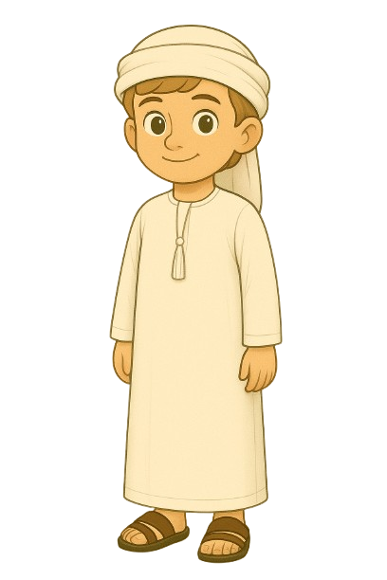
Activity: School Subjects
c
What does Khalifa think about school subjects? You can make notes for later.
Khalifa
I like PHE more than any other subject because it is a fun and exciting lesson.
My least favourite subject is English, but I know it is important.
Next month, I have an English exam, so I am studying every day.
How do you get ready for tests and exams?

Slide 13
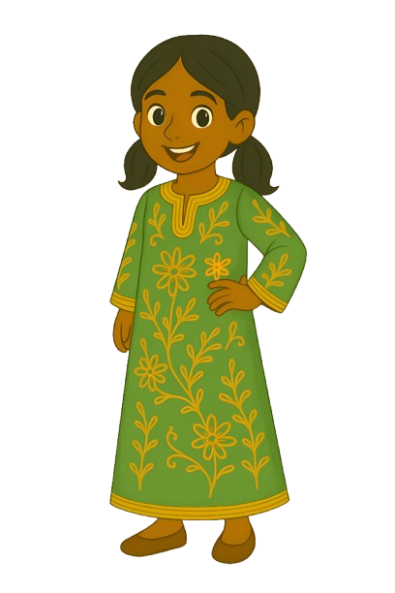
Activity: More School Subjects
c
What does Kawla think about school subjects? You can make notes for later.
Kawla
My favourite subject is maths because it is a difficult but interesting subject.
I like maths more than science, but I think science is important.
Last week, I had a maths test. I hope I did well!
My least favourite subject is PHE because I am not very good at sports.

Slide 14

Activity: School Subjects
c
Read the quotes. Who said what? Was it Kawla, Khalifa or Hessa?
Kawla
“My favourite subject is maths because it is a difficult but interesting subject.”
“I like PHE more than any other subject because it is a fun and exciting lesson.”
“Yesterday, we had a short but difficult Arabic test.”
“Next month, I have an English exam, so I am studying every day.”
“My least favourite subject is PHE because I am not very good at sports.”
Kawla
________________
Khalifa
________________
Khalifa
Hessa
________________
Khalifa
________________
Hessa
Kawla
________________

Slide 15
Activity: School Subjects
c
Read the questions and answer in full sentences.
Kawla
Which is Kawla’s favourite subject? Why?
______________________________________________________________
2. Which subject does Khalifa like more than any other subject? Why?
______________________________________________________________
3. When will Khalifa have his English exam?
______________________________________________________________
4. Who had a difficult Arabic test?
______________________________________________________________
5. Why is PHE Kawla’s least favourite subject?
______________________________________________________________
Khalifa
Hessa

Slide 16
Activity: School Subjects
c
Read the questions and answer in full sentences.
Kawla
Which is Kawla’s favourite subject? Why?
______________________________________________________________
2. Which subject does Khalifa like more than any other subject? Why?
______________________________________________________________
3. When will Khalifa have his English exam?
______________________________________________________________
4. Who had a difficult Arabic test?
______________________________________________________________
5. Why is PHE Kawla’s least favourite subject?
______________________________________________________________
Kawla’s favourite subject is maths because it is interesting.
He likes PHE the most because it is fun and exciting.
Khalifa
Khalifa will have his English exam next month.
Hessa had a difficult Arabic test.
Hessa
PHE is Kawla’s least favourite subject.

Slide 17


Activity: Class Survey
c
Make a survey in your notebook. Ask classmates about school subjects abnd write your answers.
Name | Favourite Subject | Why? | Least Favourite Subject | Why?
Make a graph or write a report about your survey!

