Slide 1




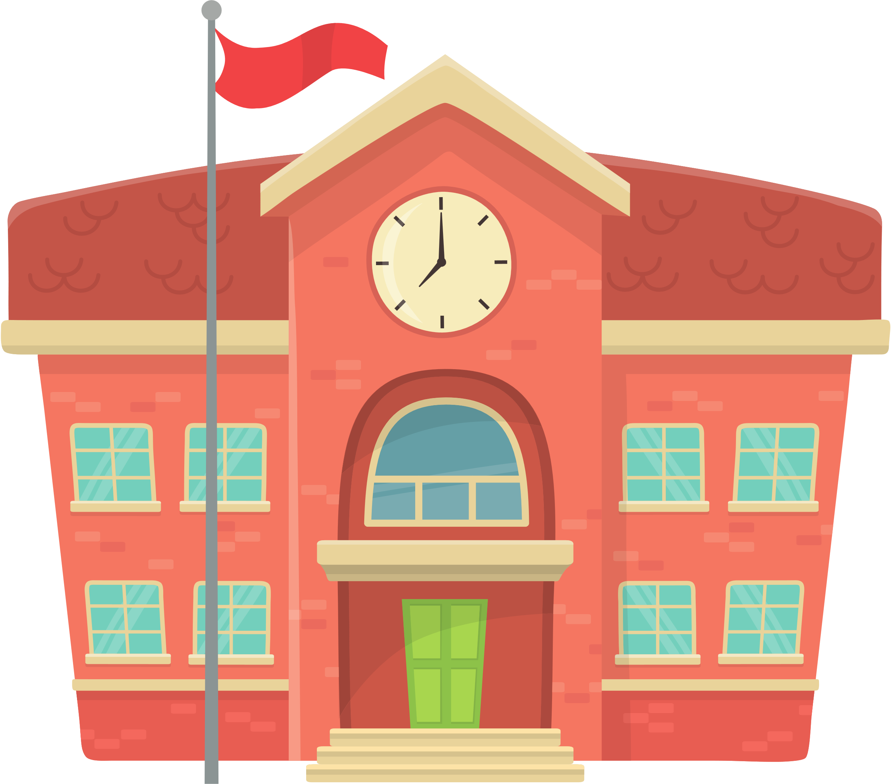
Grade 4 (2025-2026)
UNIT 1: PEOPLE AND PLACES
Making Connections
Week 3

Slide 2



What day is today?
Monday
Tuesday
Wednesday
Thursday
Friday
Saturday
Sunday

Slide 3





What’s the weather like today?
Sunny
Rainy
Cold

Slide 4





What will we learn this week?
New Vocabulary:
friend, chat, message, group, talk, meet, listen, smile
High Frequency Words:
because, friend, share, together, help and
Grammar:
Present Simple + Noun Phrases

Slide 5











VOCABULARY

Slide 6
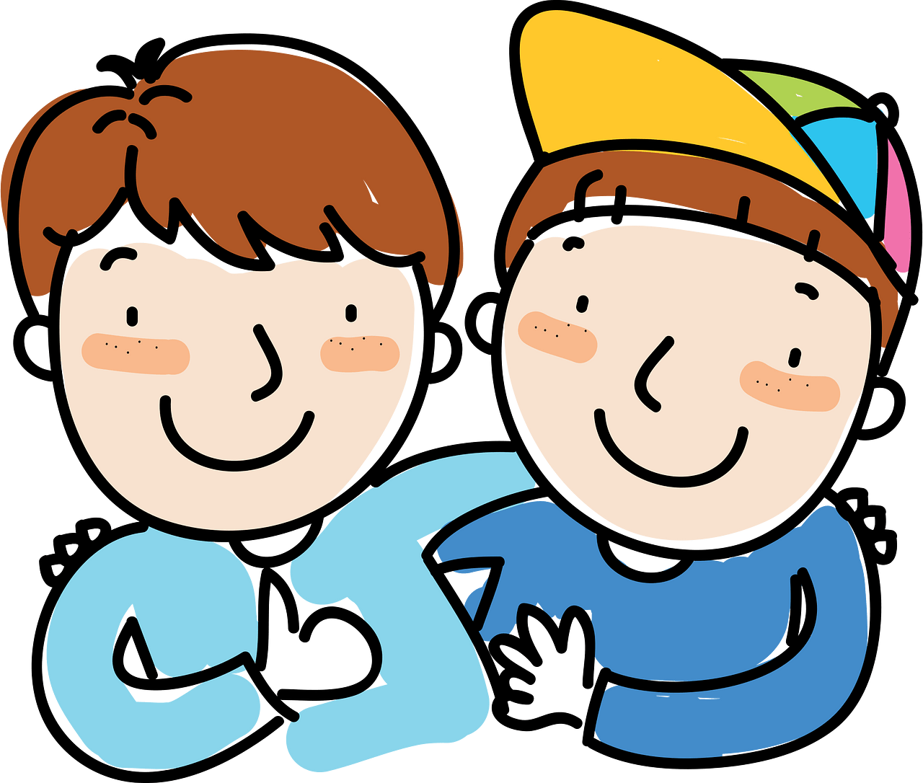
friend

Slide 7

Group work
1-2-3
4-5
6-7
*Create a short text about the importance of friendship in life.
-------------------------------------------------------------------------
---------------------------------
*Name the ways of communication with friends
1-------------------------------------------
2----------------------------------------------
3----------------------------------------------
*What are the characteristics of the
best friend.

Slide 8
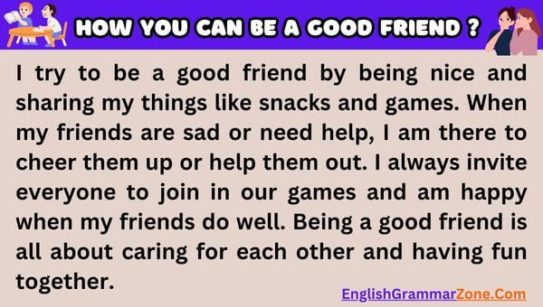
-Write your own ideas how to be good friend.

Slide 9
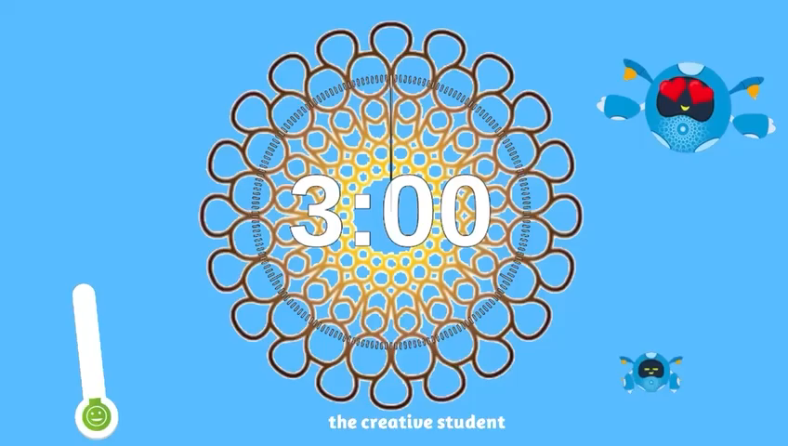
-Put ( chat – friend – talk – because) in a short text.
A
-Complete the following:
We always meet our friends in ---------------------
B
C
Describe your best friend.
-----------------------------

Slide 10

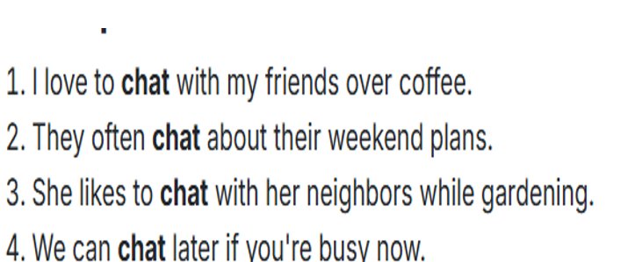
chat

Slide 11
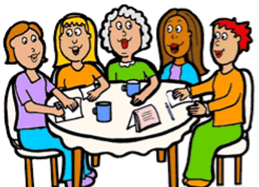
See the picture and write a sentence about it.
meet

Slide 12
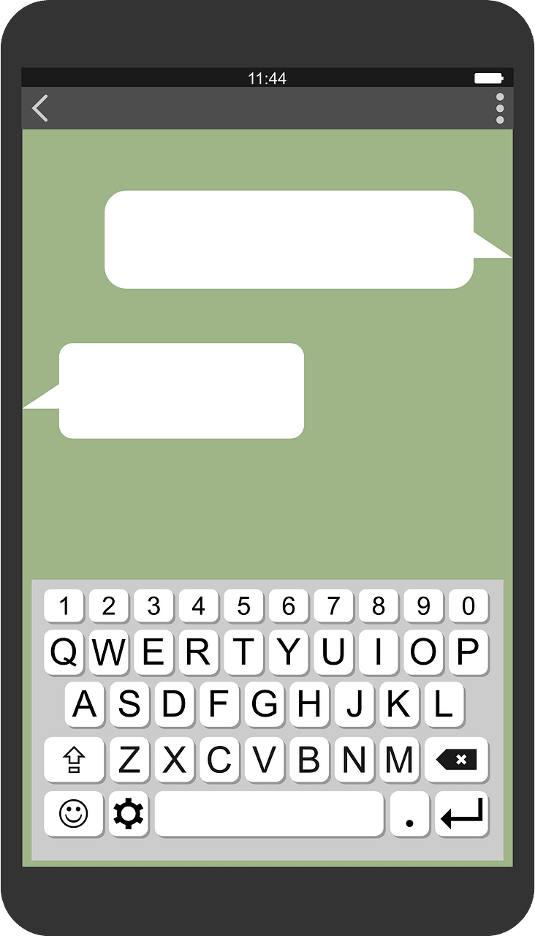
message

Slide 13
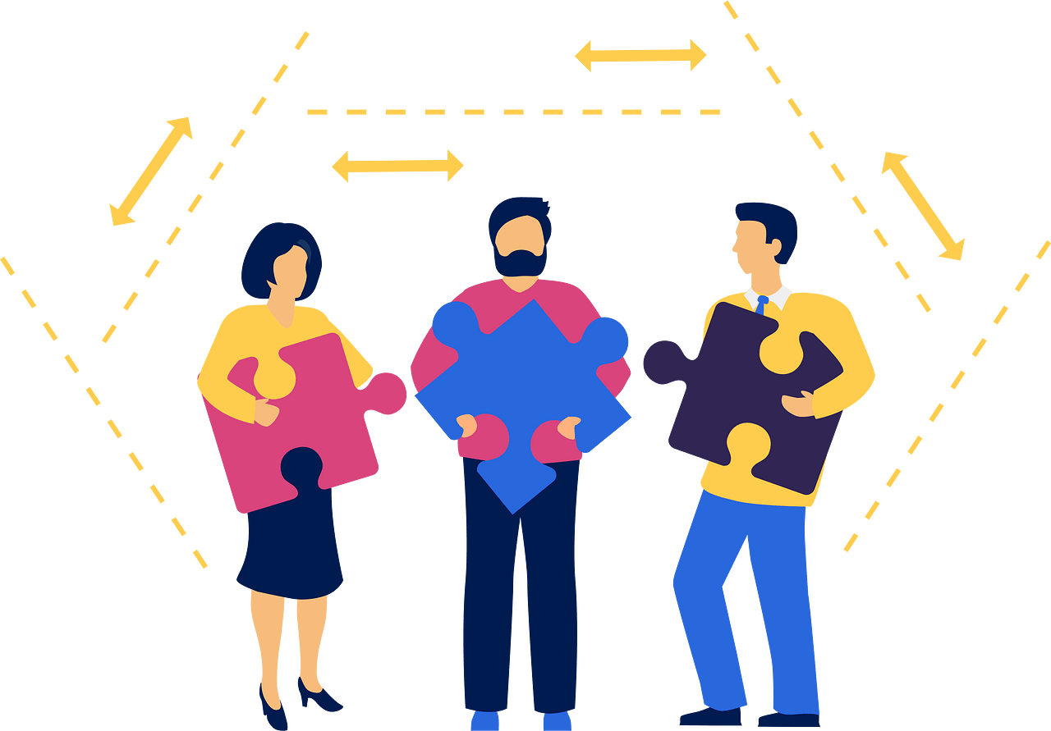
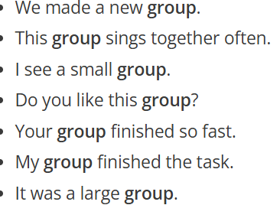
group

Slide 14
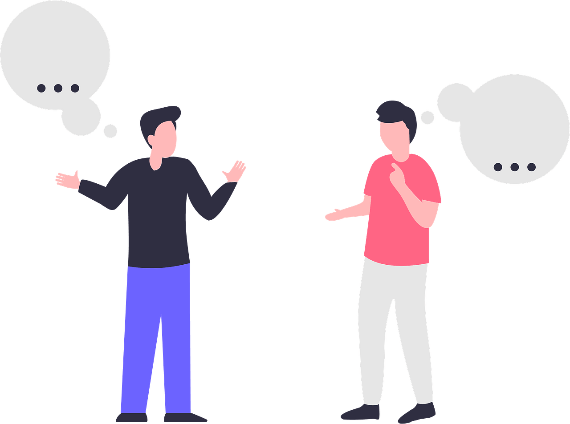
talk

Slide 15
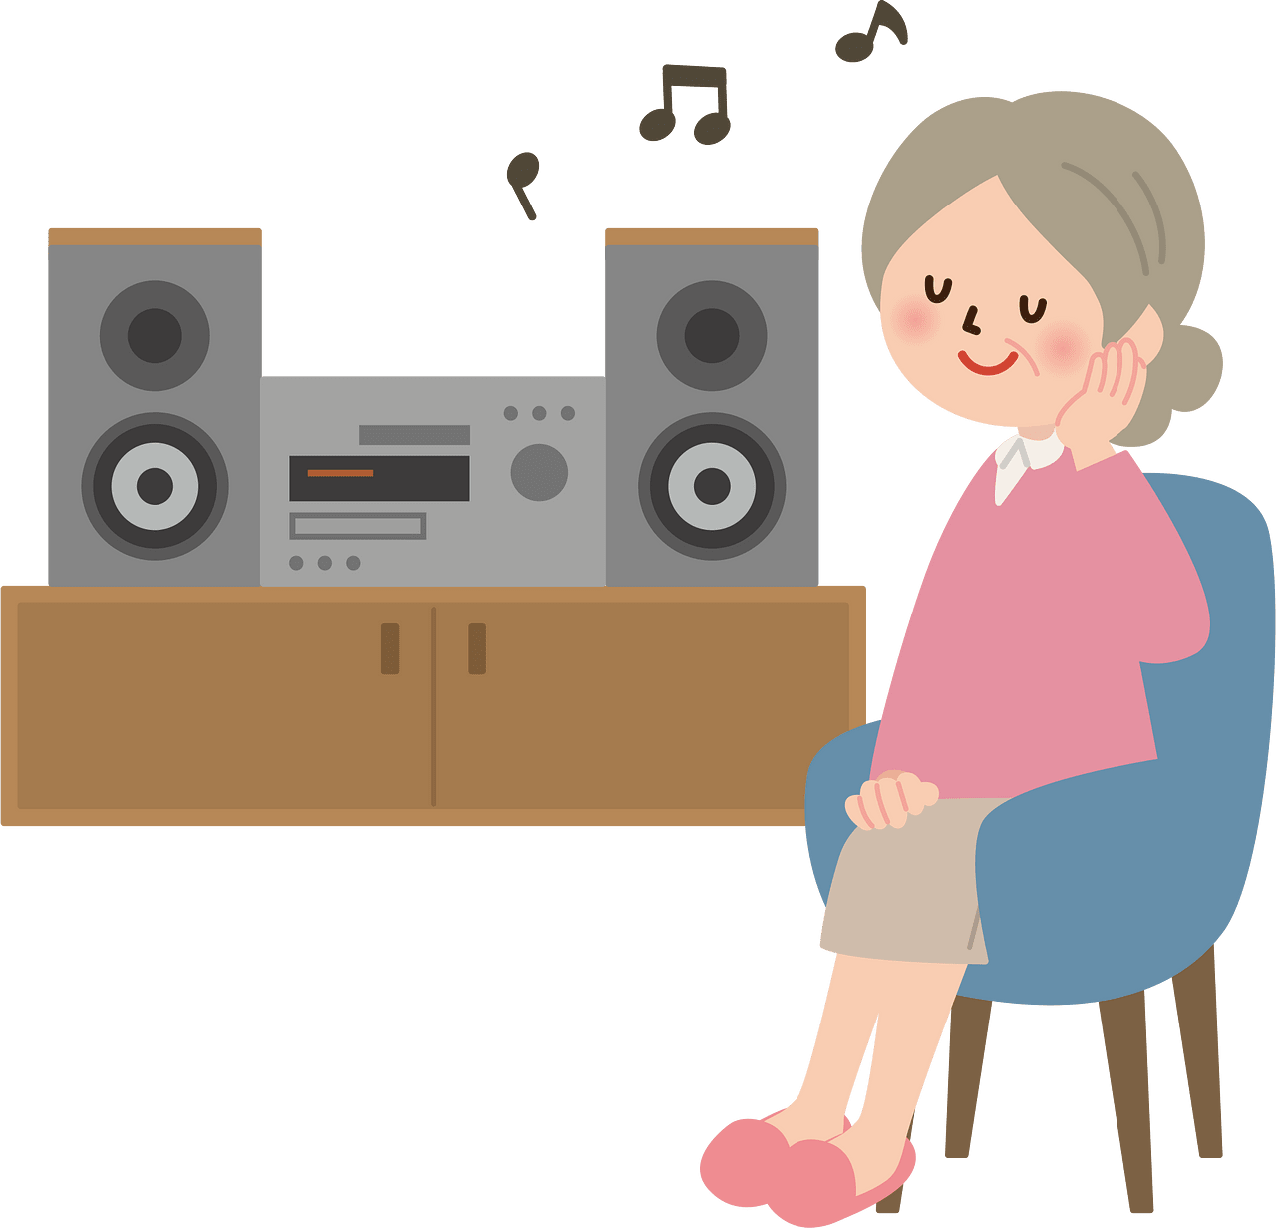
listen

Slide 16

smile

Slide 17

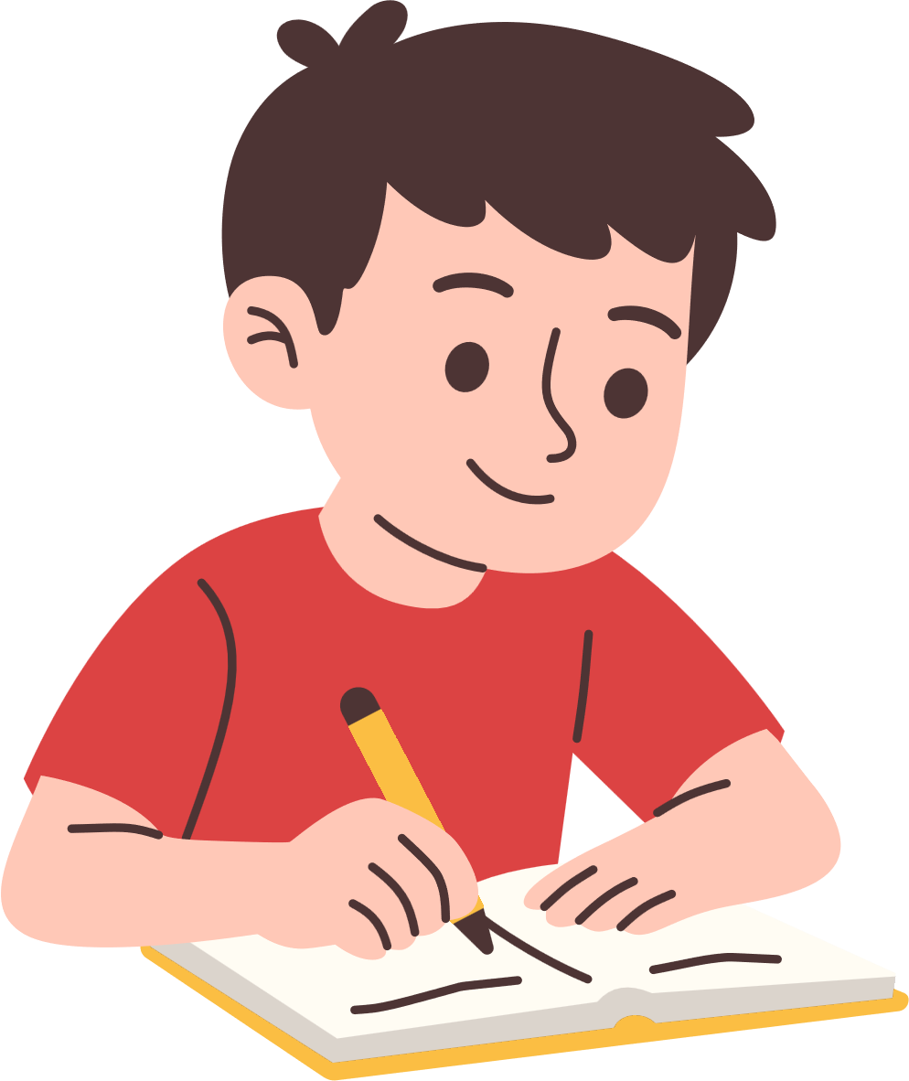
Look and practice writing the words: (Notebook)
friend, chat, message, group, talk,
meet, listen, smile

Slide 18
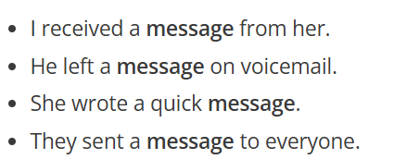
message

Slide 19



High Frequency Words:
because friend share together help
and
Try to come up with some sentences:

Slide 20
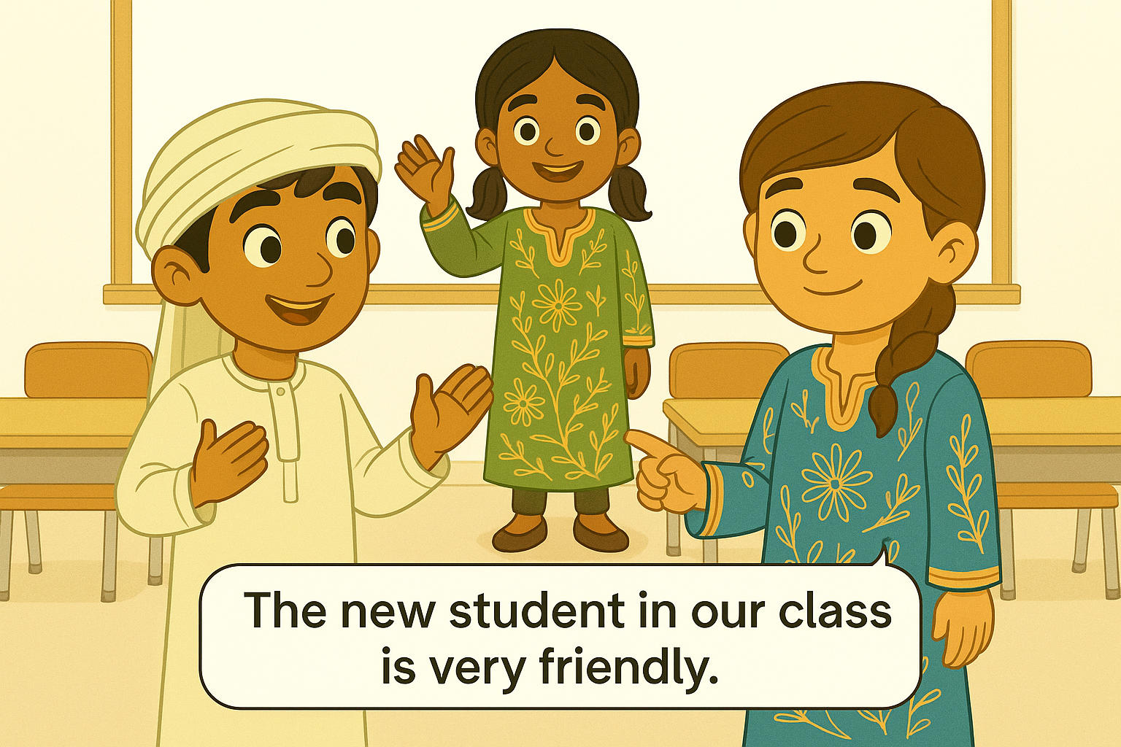

Slide 21
Write a sentence about each word:
Together
message
chat
group
talk
help
share
because

Slide 22
IBT question
What is the opposite meaning of :
Kind #--------------
friendly # -----------

Slide 23
Exit Ticket
How will the world be if there are no friends?
---------------------------------------------------------------

