Slide 1

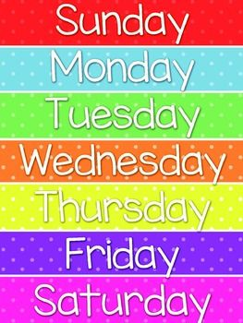
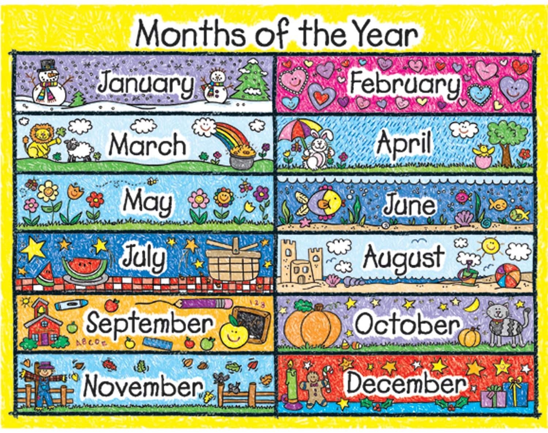
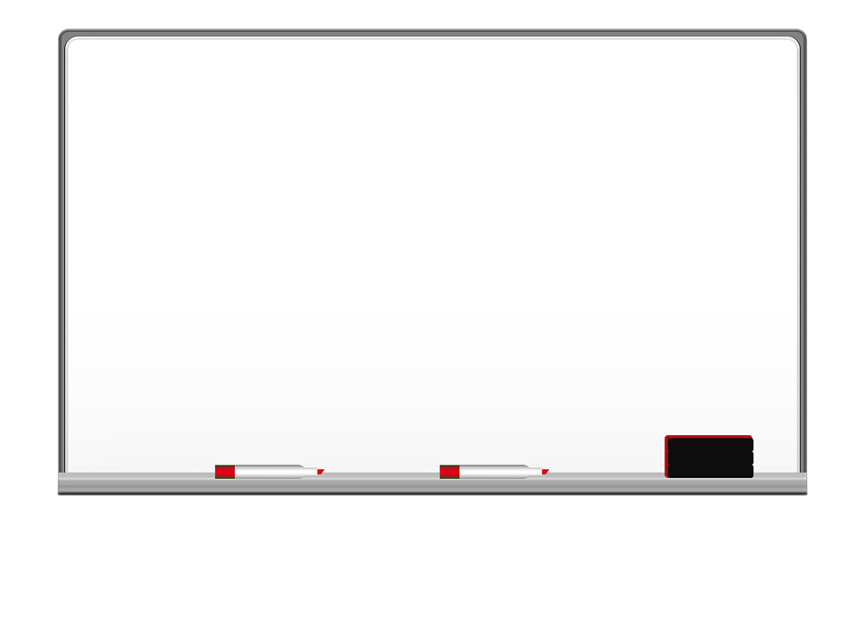


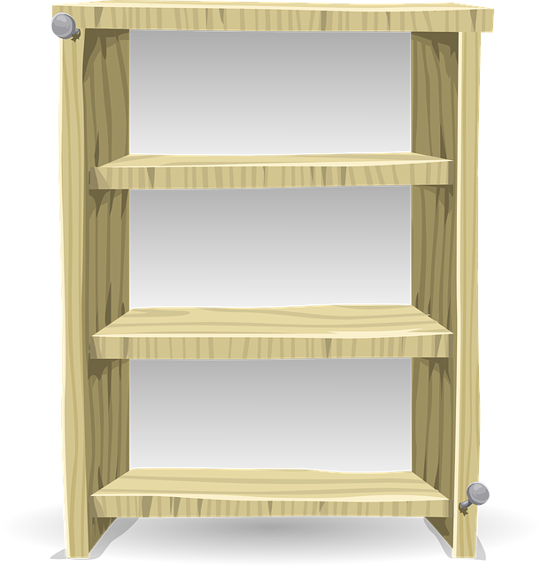

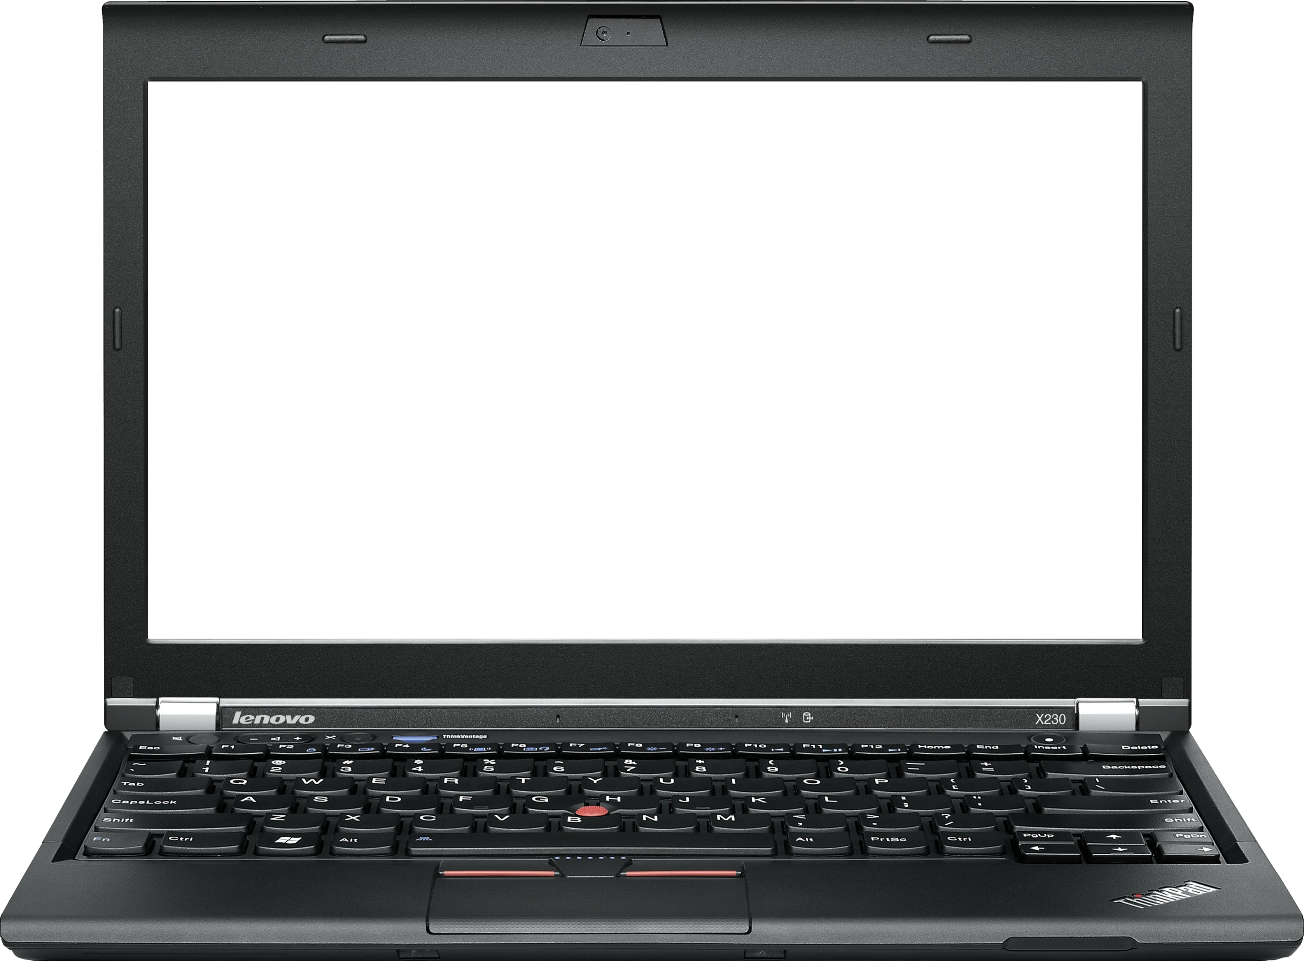

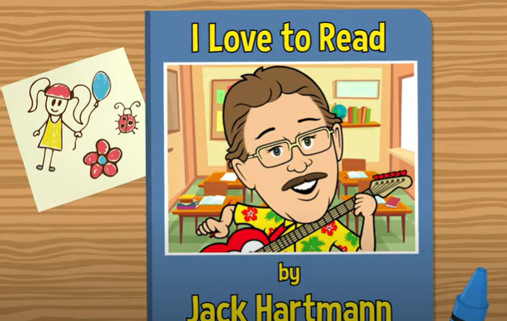

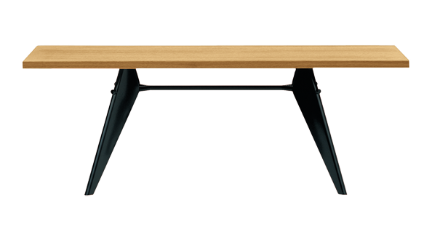
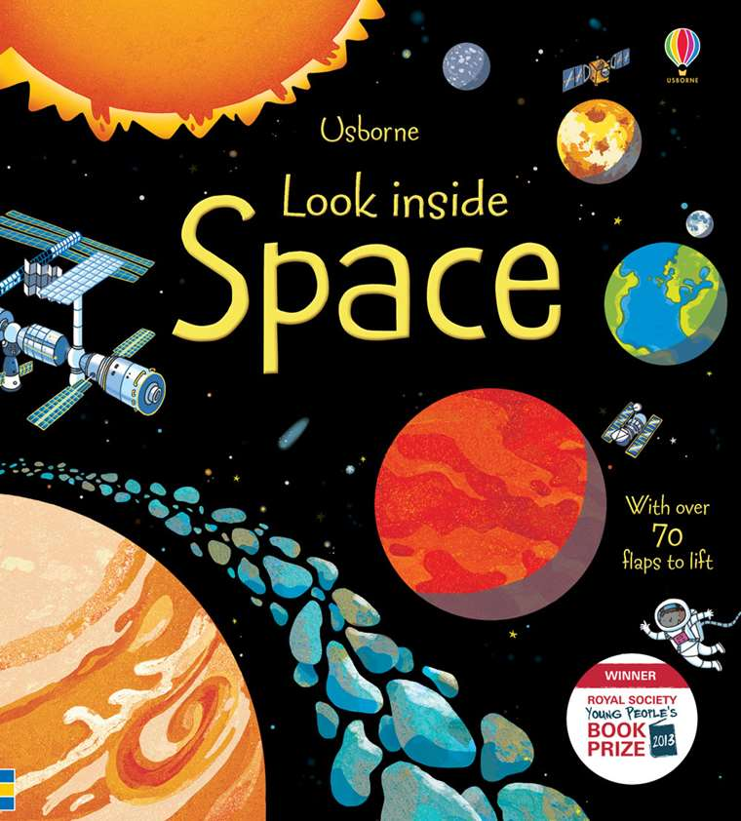

Good Morning Class
This Photo by Unknown Author is licensed under CC BY-NC
Notes:
Outline the 3 golden rules

Slide 2


National Anthem

Slide 3
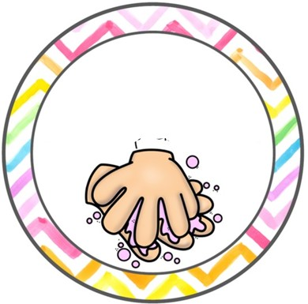

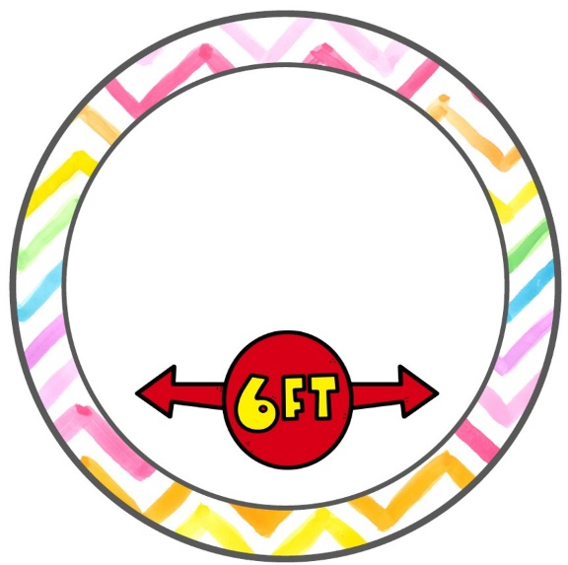


For your safety & the safety of others
Wash hands with
soap and water
Wear a mask when
going outside
Keep physical distancing
Use sterilizer
Take your temperature before leaving the house

Slide 4

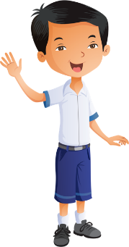
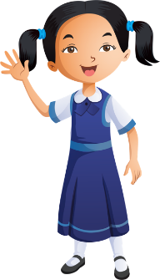

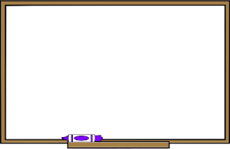


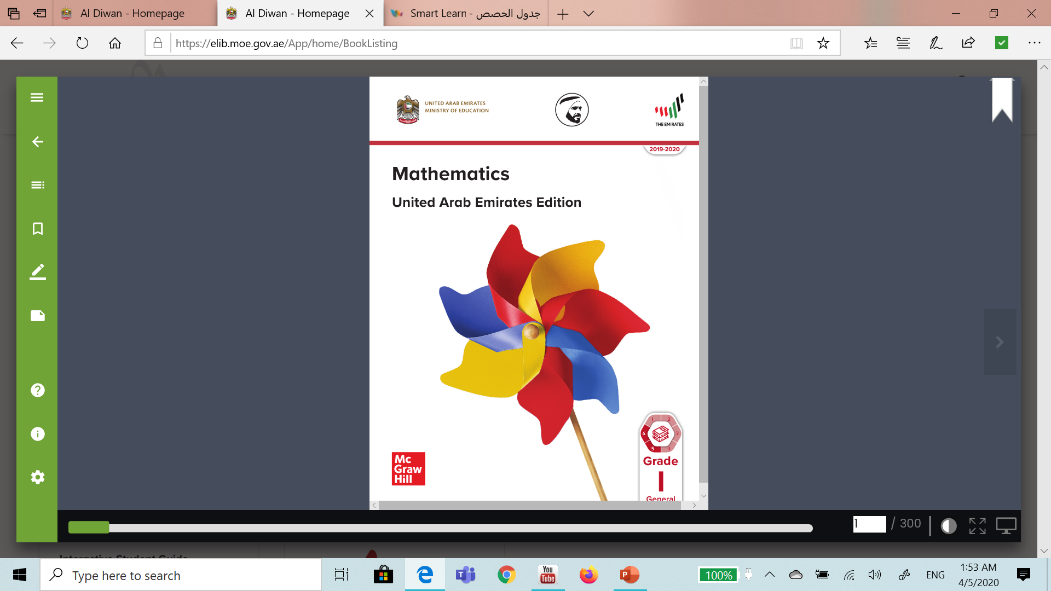

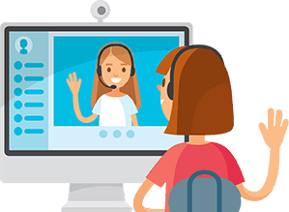

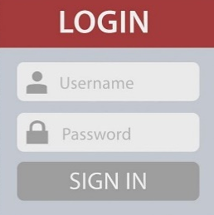

Distance learning and cybersecurity rules
Prepare books and school supplies
Wear school uniform
Be ready and on time
Sit in a quiet place
Open the camera when the teacher asks
Stay on mute & raise your hand to take part
Please do not interrupt anyone
Don’t share account information

Slide 5

Distance Learning: Week 1
3 stars
At the end of the week, I will choose 3 children based on:
Attendance
Participation in lesson
Completed work in books
Completed work on LMS

Slide 6
Starter
PHONICS
New Sound
Green Words
Red Words

Slide 7
Starter
GRAMMAR
We use an apostrophe for contraction words.
I am going to the library.

Slide 8
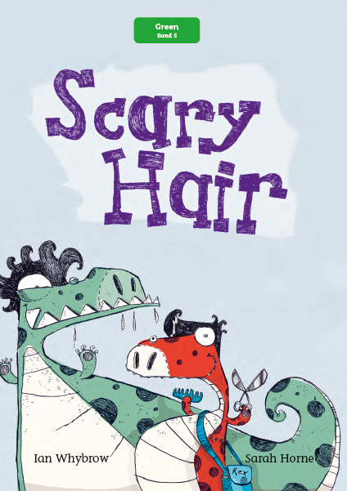

Reading
Practice

Slide 9


lesson 8
Term 2 – Week 2
Access Book 4
Week commencing 10th January 2021
Different Dinosaurs
Page 15 & 16

Slide 10

Lesson Objectives
LISTENING
Discuss parts of a dinosaur's body.
SPEAKING
To describe dinosaurs.
READING
To read about different dinosaurs.
WRITING
To write about a dinosaur.

Slide 11
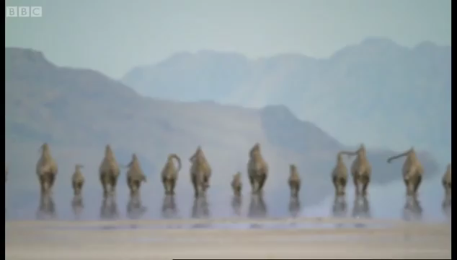
Video

Slide 12
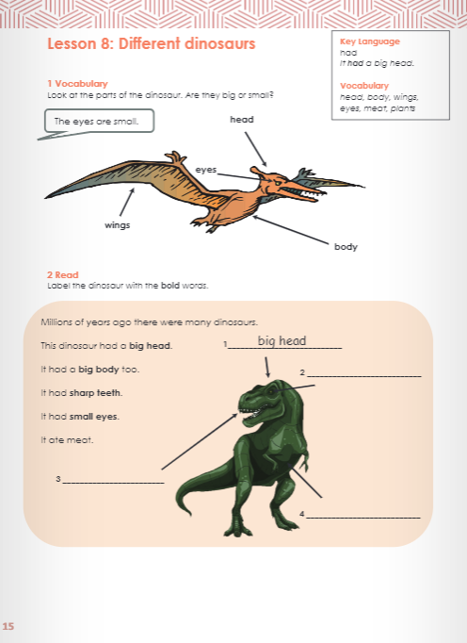
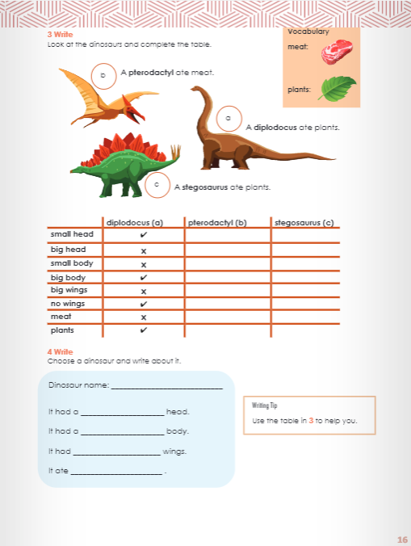
Page 15 & 16

Slide 13
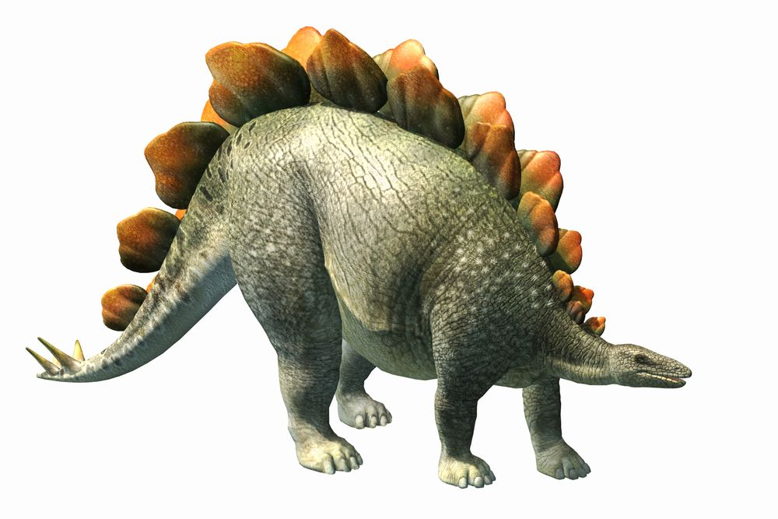
New Words
Stegosaurus

Slide 14
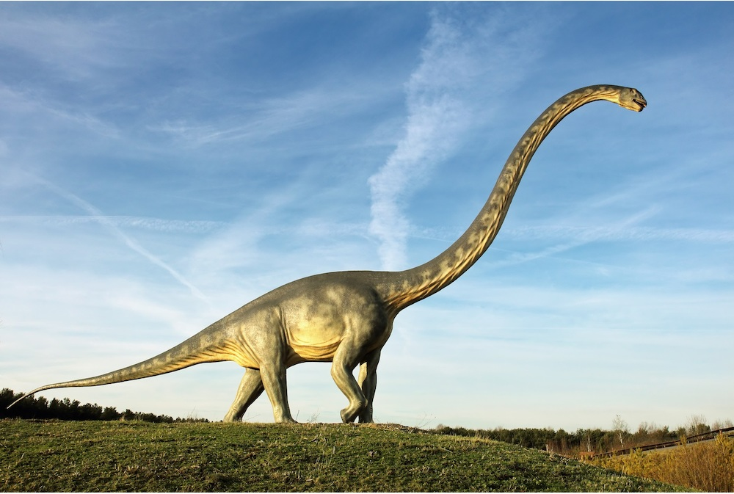
New Words
Diplodocus

Slide 15
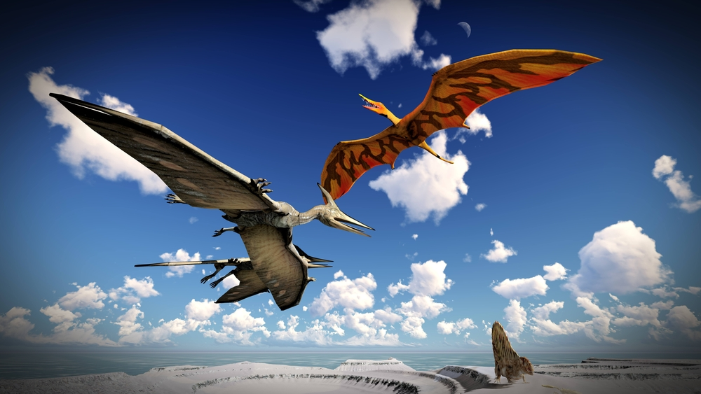
New Words
Pterodactyl

Slide 16
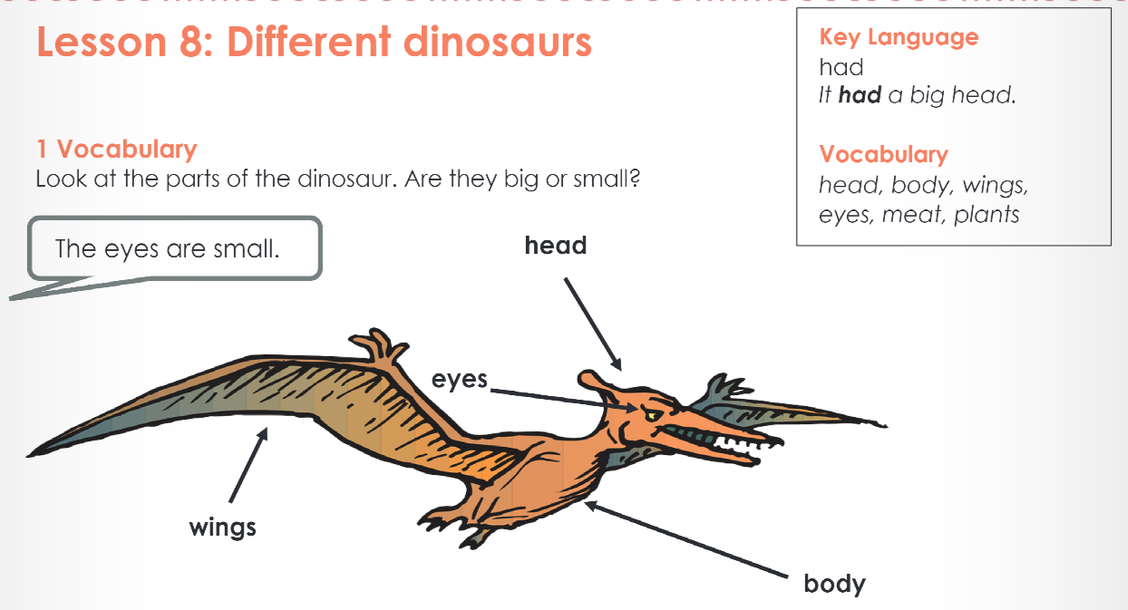
Page 15 & 16

Slide 17
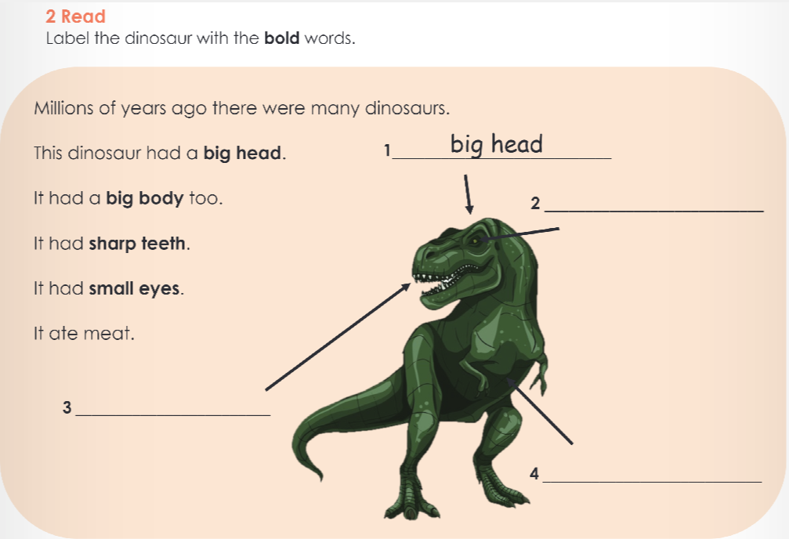
Page 15 & 16
small eyes
sharp teeth
big body

Slide 18
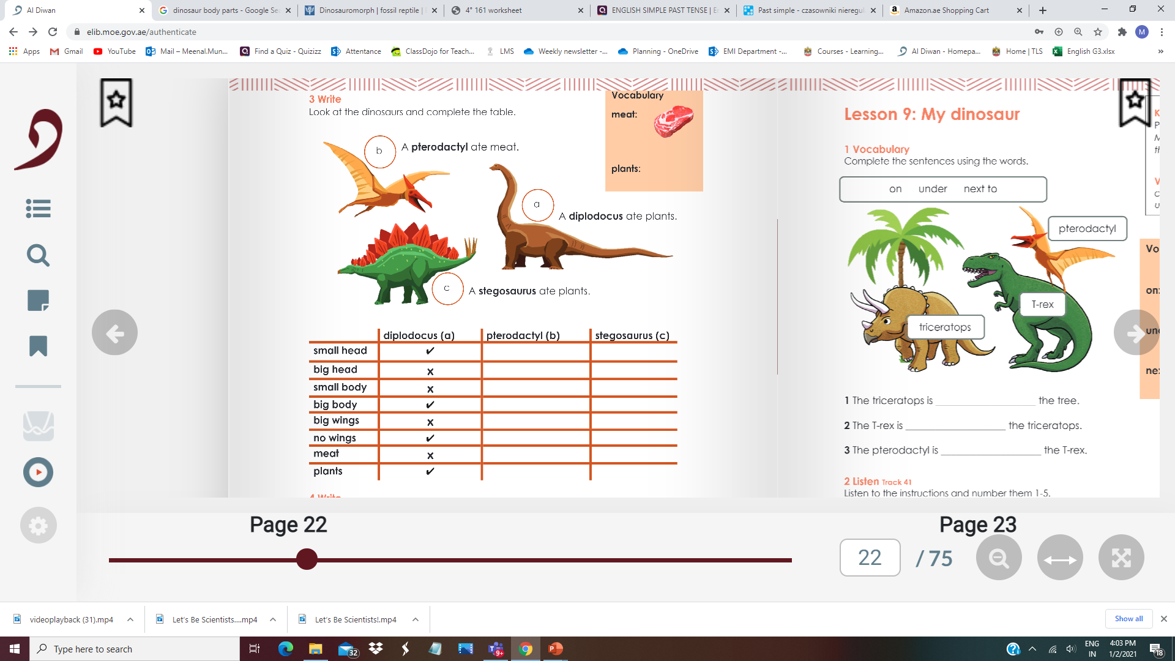


Page 15 & 16

Slide 19
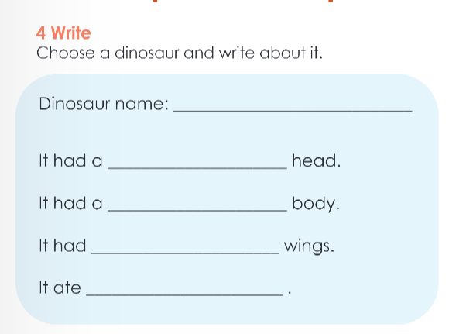
Page 15 & 16
Stegosaurus
small
big
no
plants

Slide 20
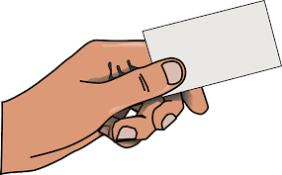
Exit ticket
Write two sentences about a dinosaur you like.

Slide 21


Microsoft Teams
Take a picture!
Take a picture of today’s work in your books and upload it on Microsoft Teams.
Week 2

Slide 22
Please go to LMS
https://lms.moe.gov.ae/
You will find
Week 1 Term 2 Activities

Slide 23
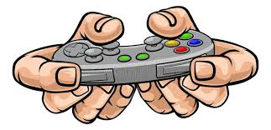
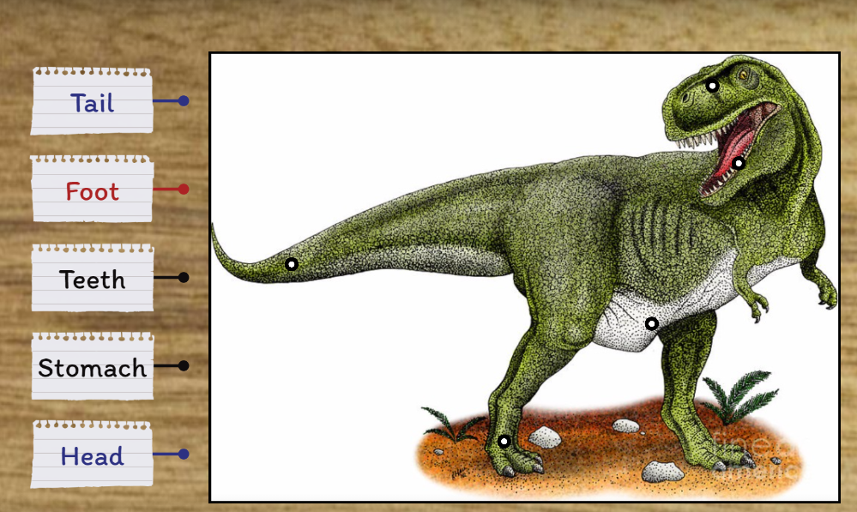
Level 1: Easy
https://wordwall.net/play/141/869/172

Slide 24
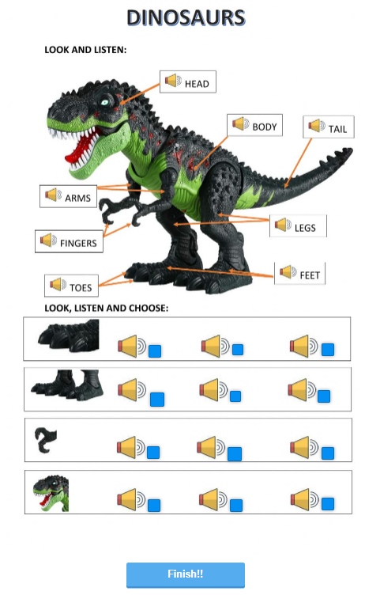
Level 2: Medium
https://www.liveworksheets.com/tu1050650jd

Slide 25
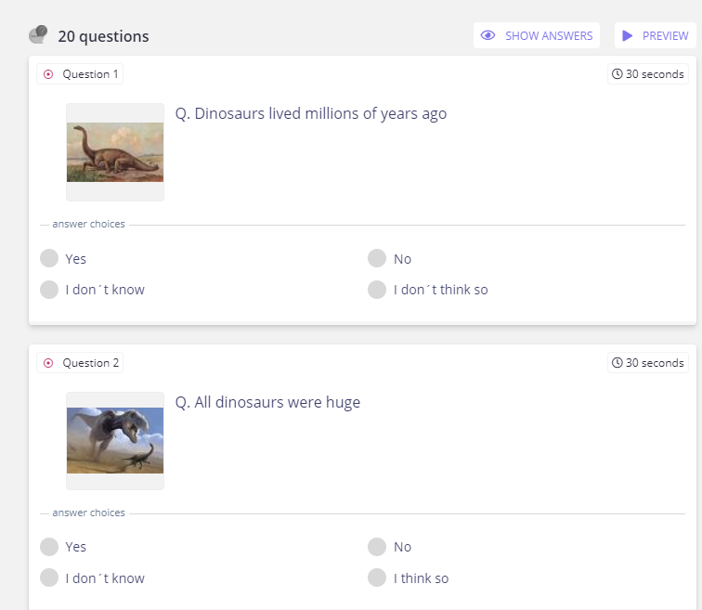
Level 3: Hard
https://quizizz.com/admin/quiz/5ee00b4acc3e8c001bcd1da0/dinosaurs

Slide 26
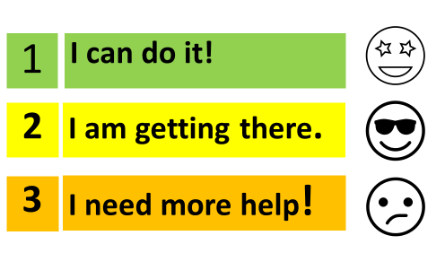
Self - Assess
How do you feel about today’s lesson?

