Slide 1
Super goal 1

Slide 2
Unit 4

Slide 3
o r d a n i a n
r a n c e
u s s i a
m e r i c a n
a n a d a
h i n a
n g l i s h
u r k e y
e n i z u e l a
g y p t

Slide 4
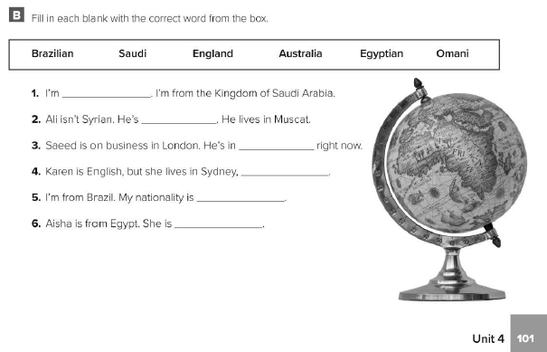
Saudi
Omani
England
Australia
Brazilian
Egyptian

Slide 5
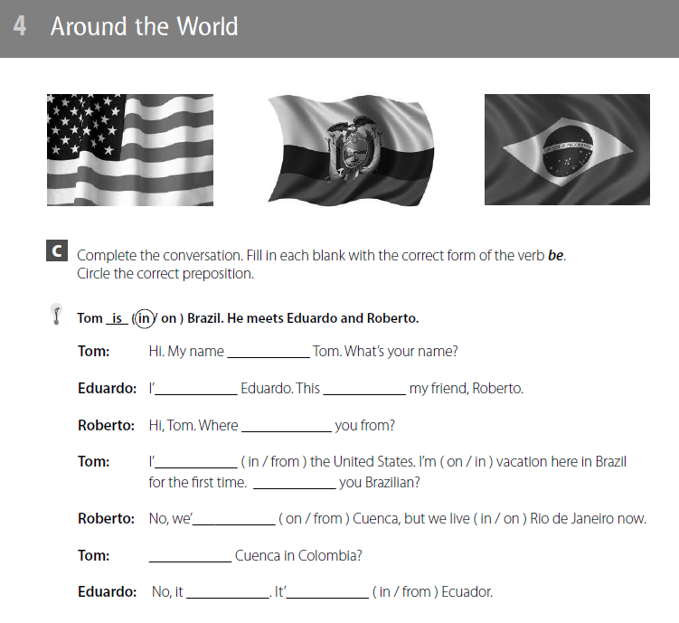
is
m
is
are
m
Are
are
Is
isn’t
is

Slide 6
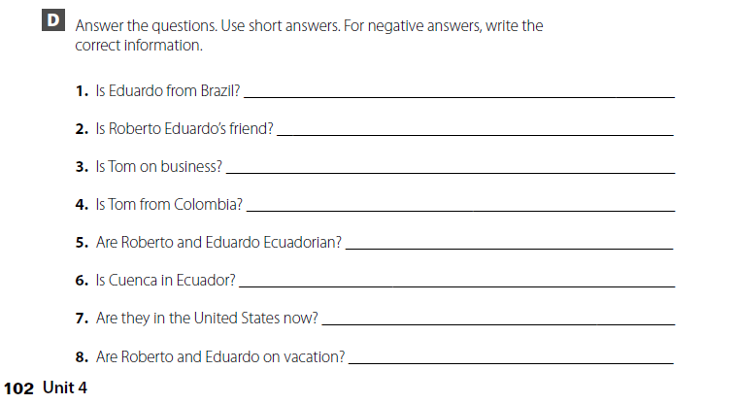
No, he isn’t. He is from Ecuador.
Yes, he is.
No, he isn’t. He’s on vacation.
No, he isn’t. He’s from the United States.
Yes, they are.
Yes, it is.
No, they aren’t. They are in Brazil now.
No, they aren’t. They live in Rio de
Janeiro

Slide 7
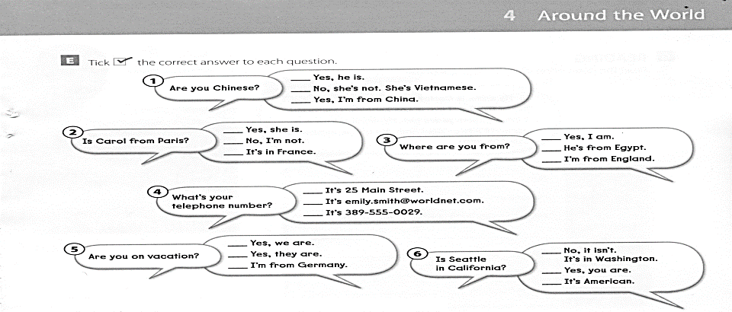

Slide 8
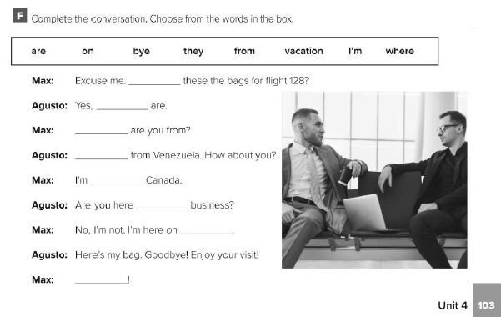
are
they
Where
I’m
from
on
vacation
Bye

Slide 9
Name: Carlos Torres Nationality: Chilean Address: Los Angeles, California, U.S. Age: 18 Email address: carlos123@worldnet.com Phone number: 310-555-9

Slide 10
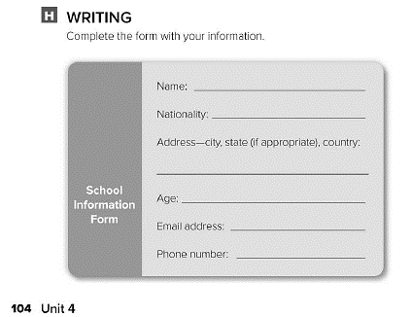
أكمل ببياناتك

Slide 11
Expansion 1

Slide 12
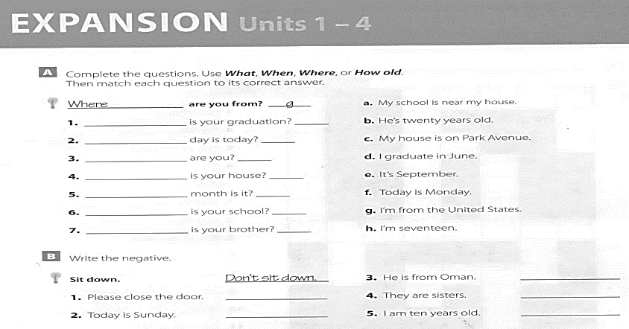
When
What
How old
Where
What
Where
How old
d
f
h
c
e
a
b
He isn’t from Oman
Don’t close the door
They aren’t my sisters
Today isn’t Sunday
I’m not 10 years old

Slide 13
Is it March 17th today ?
Is Sabah 17 years old ?
Are you from Syria ?
Are you Jordanian ?
Is that your pencil ?
Are those you posters ?
Is that a famous painting ?

Slide 14
H e l l o
T
u
e
s
d
a
i
s
c
o
b
e
i t
W
h
a
S a t u r d a y
n
r
e
D o w n
l
d
o

Slide 15
is
is
are
are
is
are
is
are
isn’t
is
is
am

Slide 16
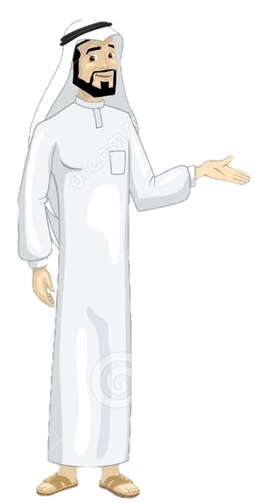
See you later
Take care
Teacher :
Badr Sayid Al-Shehri

