Slide 1
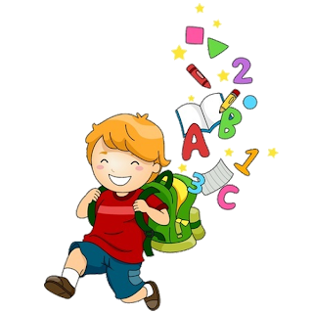
Unit 1
3

Slide 2
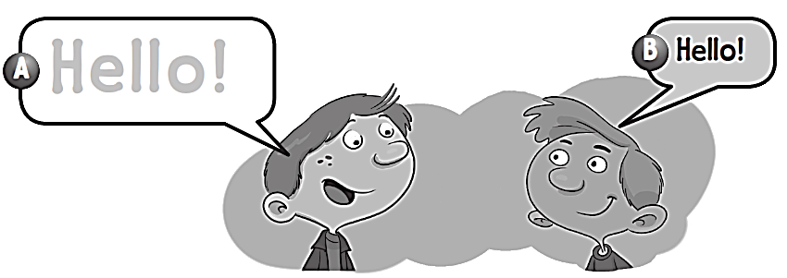
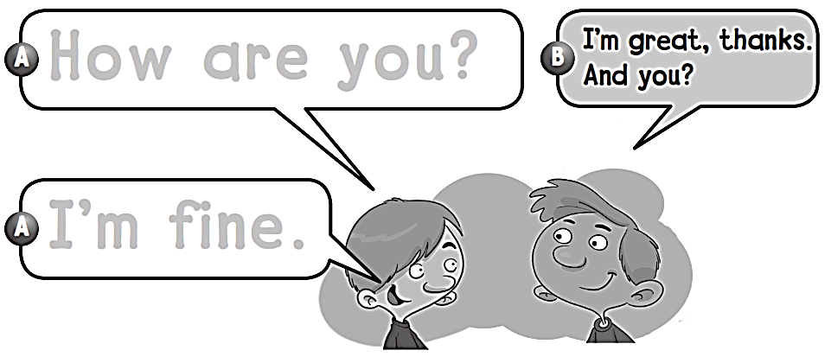
Work book
1 Feelings
Hello!
How are you ?
I΄m fine .

Slide 3
Work book
1 Feelings

Slide 4
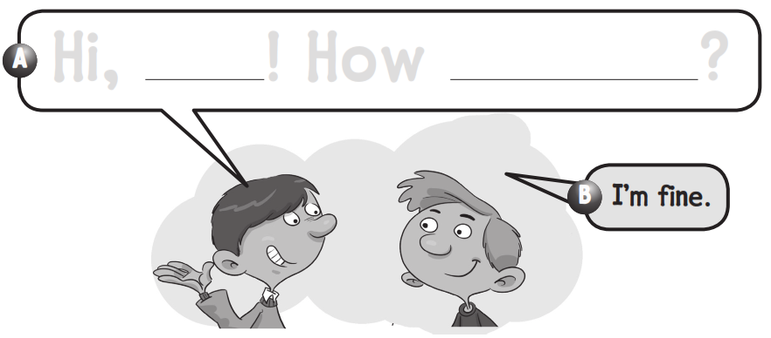
Work book
1 Feelings
Hi , ! How are you ?
اسم الطالب

Slide 5
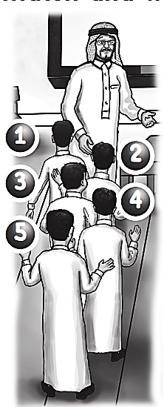
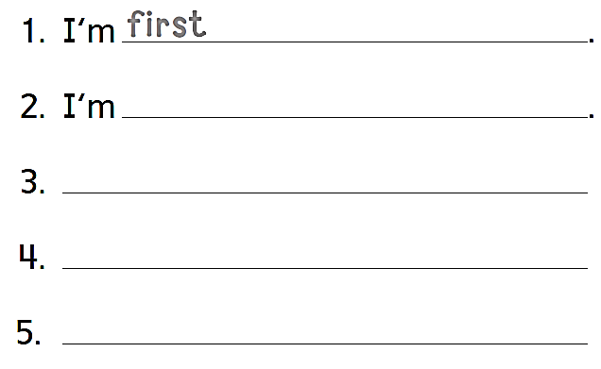
Work book
1 Feelings
2
5
4
3
second
I’m third
I’m fourth
I’m fifth

Slide 6
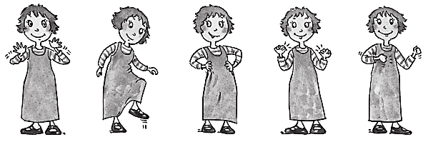
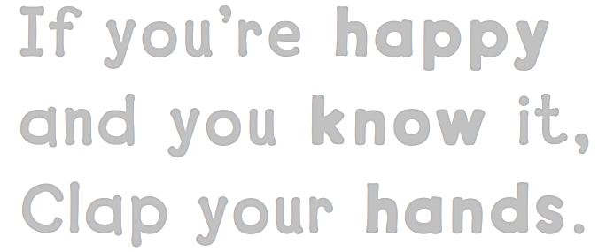
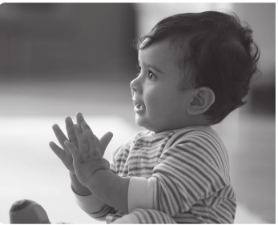
Work book
1 Feelings
If you’re happy
And you know it ,
Clap your hands .

Slide 7
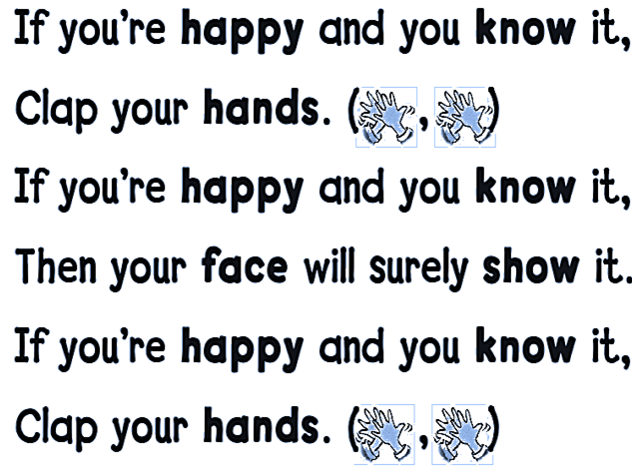
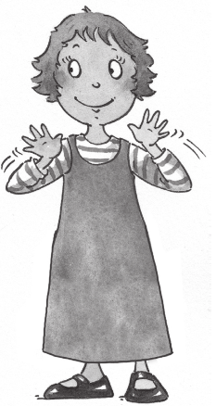
Work book
1 Feelings

Slide 8
Work book
1 Feelings
fifth
eighth letter of the alphabet
is the ninth letter of the alphabet

Slide 9
Work book
1 Feelings
1
6
2
7
3
8
4
9
5
10

Slide 10
Work book
1 Feelings
o o t
a n d

Slide 11
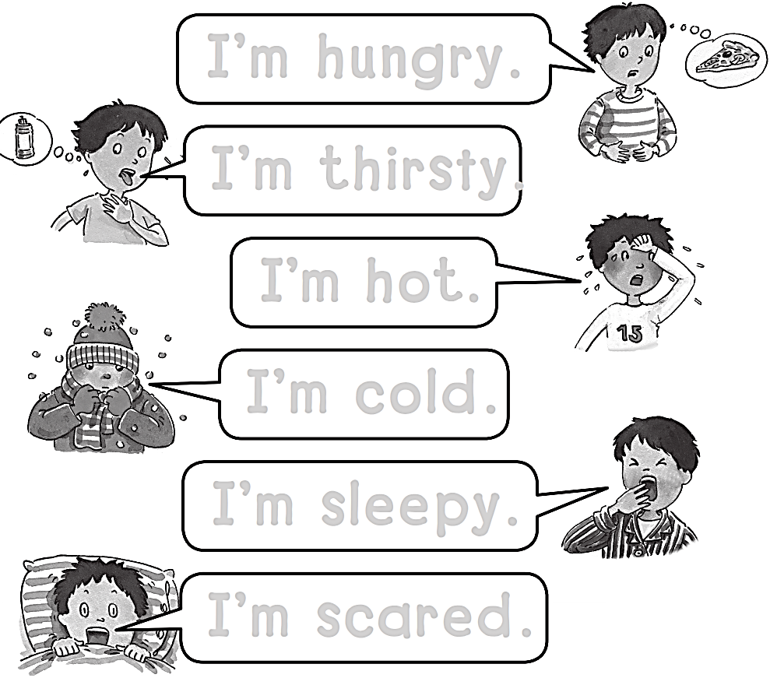
Work book
1 Feelings
I’m hungry.
I’m thirsty.
I’m hot.
I’m cold.
I’m sleepy.
I’m scared.

Slide 12
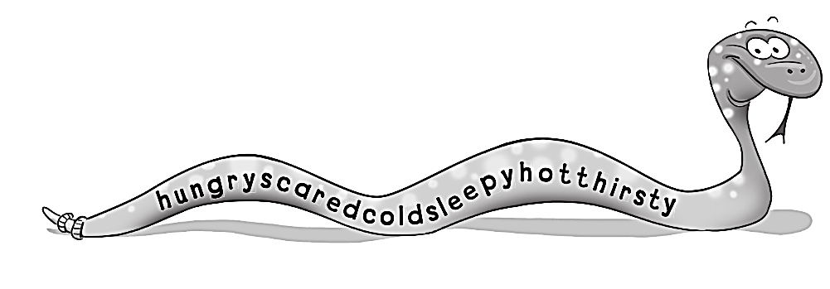
Work book
1 Feelings
1- hungry
2- scared
3- cold
4- sleepy
5- hot
6- thirsty

Slide 13
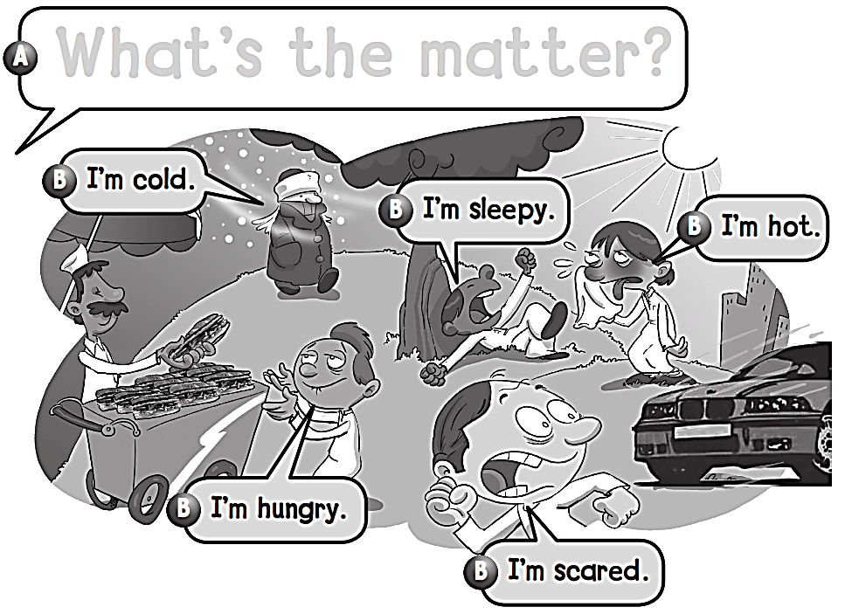
Work book
1 Feelings
What’s the matter ?

Slide 14
Work book
1 Feelings
cold
hungry
sleepy
hot

Slide 15
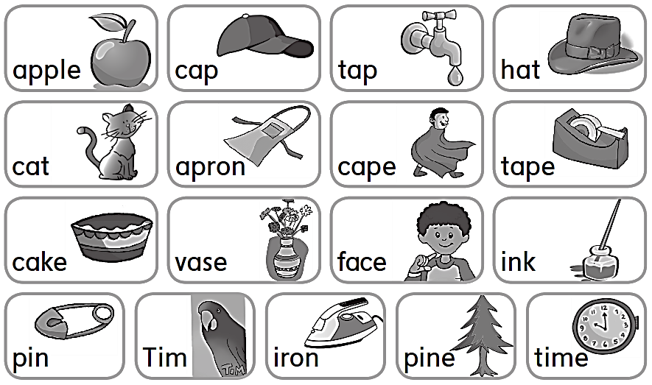
Work book
1 Feelings

Slide 16
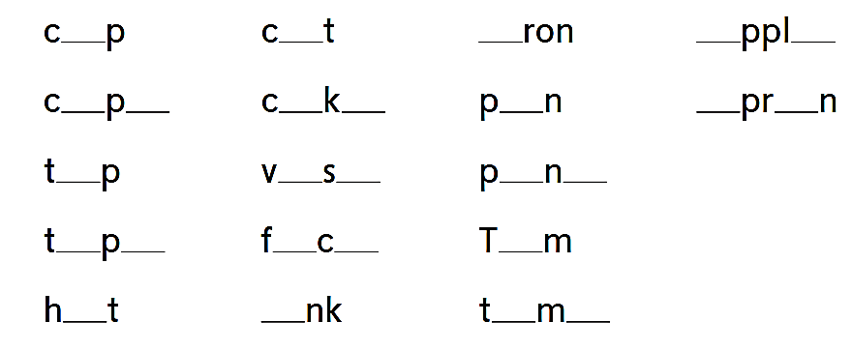
Work book
1 Feelings
a
a
i
a
e
a
e
a
e
i
a
o
a
a
e
i
e
a
e
a
e
i
o
i
i
e

Slide 17
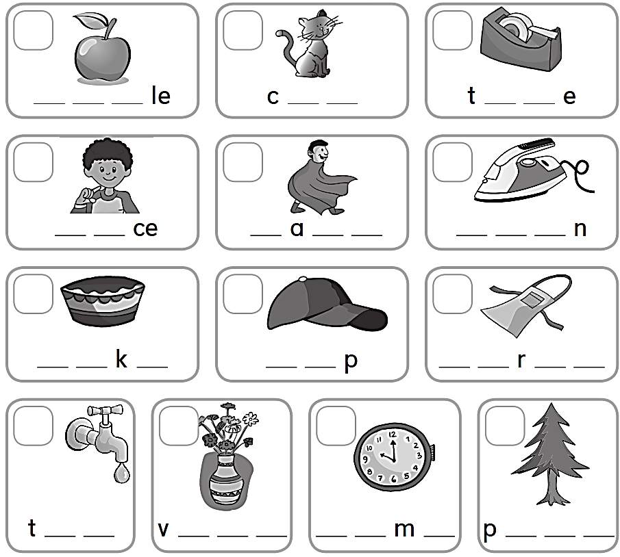
Work book
1 Feelings
1
3
7
A p p
a t
a p
9
6
11
F a
C p e
I r o
8
4
2
C a e
C a
A p o n
5
10
13
12
a p
a s e
T i e
i n e

Slide 18
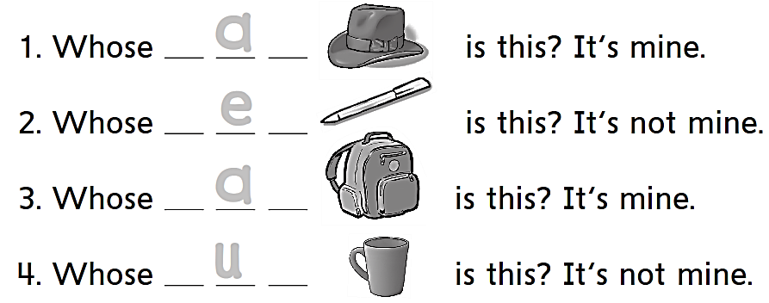
Work book
1 Feelings
h a t
p e n
b a g
c u p

Slide 19
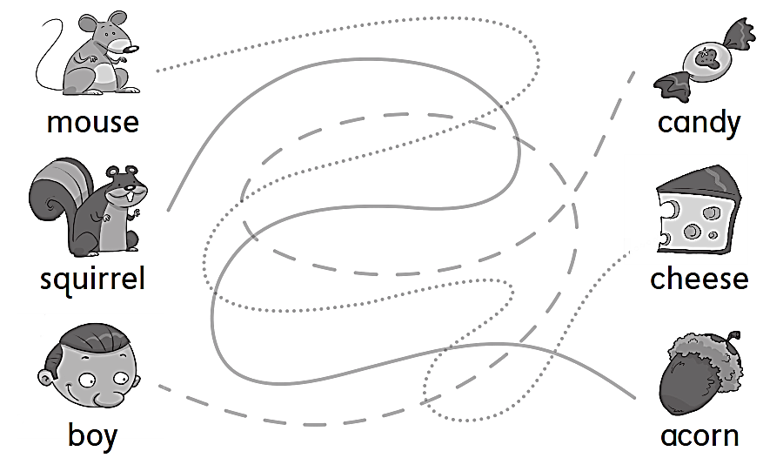
Work book
1 Feelings

Slide 20
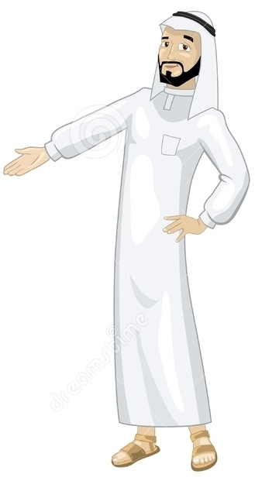
See you later
Goodbye
Teacher :
Badr Sayid Al-Shehri

