Slide 1


3
Unit 4

Slide 2
Beautiful Nature
الطبيعة الجميلة

Slide 3
Talk Time
وقت التحدث

Slide 4
Materials :
Opposites flashcards – big/small, long/short, beautiful/ugly
Beautiful Nature poster

Slide 5
Strategy
A nature walk :
First, review the vocabulary on the Beautiful Nature poster. Give each student a piece of paper and tell them to draw something from the poster. (For a small class, give them two pieces of paper.) Encourage the students to not draw the same thing their neighbor is drawing. Set a timer for 5 or 10 minutes . When students have finished drawing, have them put their pictures around the room and tell you what they drew. If they don’t know a word, teach them. The teacher should also draw a picture and put it somewhere in the room. Once everyone has put their picture around the room, say, “Stand up. Get in line. Let’s go on a nature walk!”

Slide 6

Review the previous unit
مراجعة سريعة للوحدة السابق

Slide 7
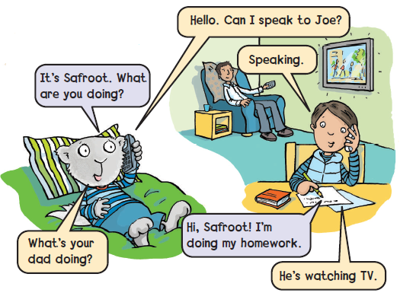
Listen and say

Slide 8
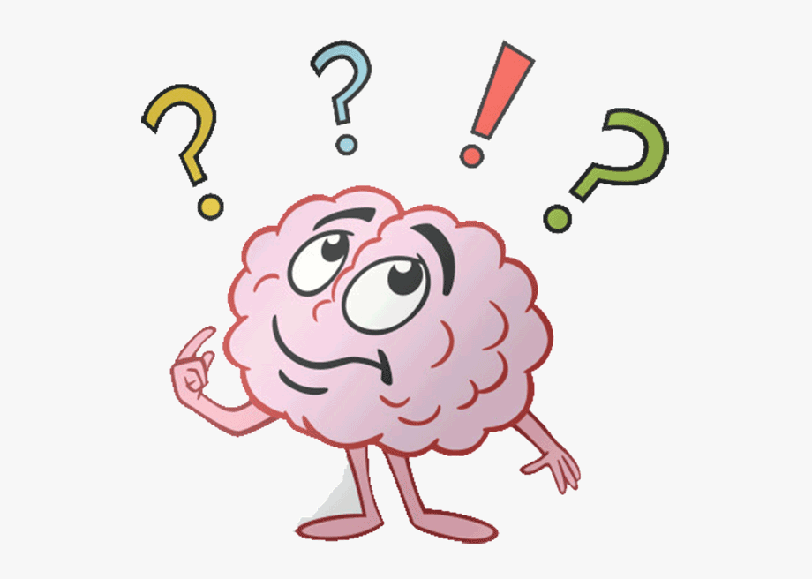
What are you doing ?
What is he doing ?

Slide 9
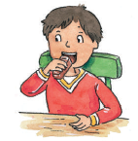

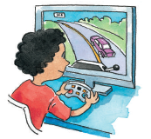

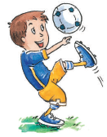
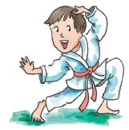

Slide 10
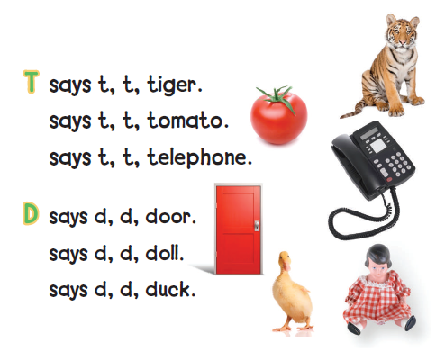

Listen and say
D or T

Slide 11
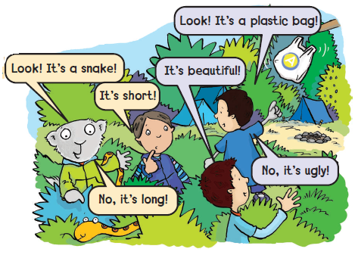

1
Listen and point
استمع ثم تبع

Slide 12
Practice and act out the talks in pairs
تدرب على المحادثة مع زميلك
2

Slide 13
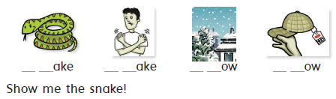
Sounds and Letters
3
Listen, point , and say. Then write sn – sh
استمع ، تبع ، ثم اقراء الكلمات. بعد ذلك أكمل الفراغات sh – sn
s n s h s n s h

Slide 14

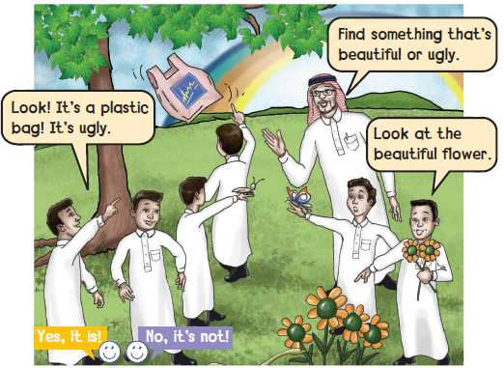

وقت المرح
Find something beautiful ! ابحث عن أي شيء جميل
Look around and find a beautiful or an ugly object.
انظر حولك وابحث عن شيء جميل وآخر بشع
4

Slide 15

Goal Check
التحقق من الهدف

Slide 16
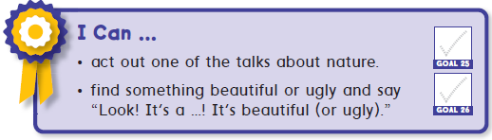
الهدف :
أن يتمكن الطالب من تطبيق المحادثة مع زميله
أن يقوم الطالب بالبحث عن شيء جميل أو بشع ويقوم بالتحدث عنه و وصفه

Slide 17
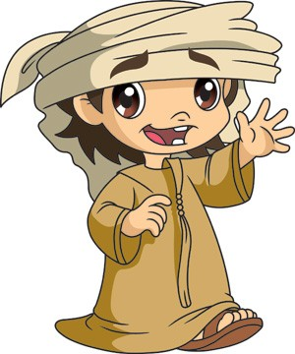
Have a nice day
See you next class

