Slide 1
3
Unit 2

Slide 2
Things We Wear
الأشياء التي نرتديها

Slide 3
Phonics
الأصوات

Slide 4
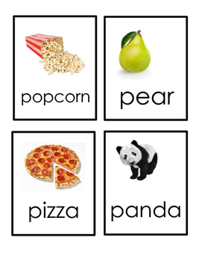
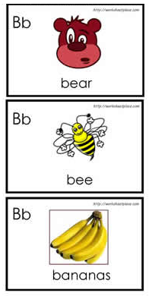
Materials :
Flashcards for clothes
Flashcards for the lesson
Tissues
Alphabet poster

Slide 5
Strategy
Letter guessing game :
Hand out alphabet cards in random order to students. If your class is small, each student will get more than one card. Have the students think of a word that begins with the letter they see on the card and write it, leaving out the letter . “ _anana ” . Have the students work in groups and prepare a list with all their incomplete words. Then have them exchange lists and try to write the missing letters. After they finish, check the answers in class or ask students to hand back the completed list to the group that made it so they can check and compare with their original words.

Slide 6
Review the previous lesson
مراجعة سريعة للدرس السابق

Slide 7
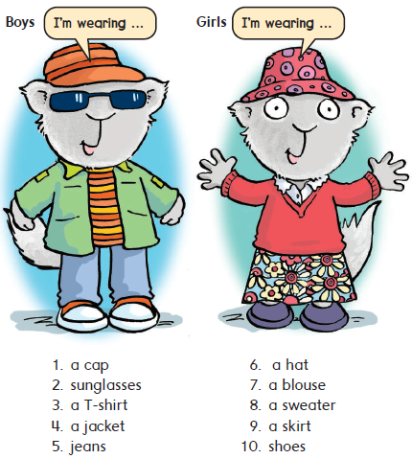

Slide 8
1
Listen , read , and say
استمع ، اقراء ، ثم انطق الكلمات

Slide 9
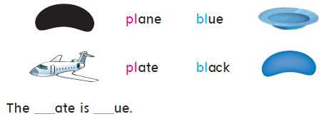
Sounds and Letters
2
Listen, say, and match. Then write the missing letters
استمع ، اقراء ، ثم صل الكلمات للصور . بعد ذلك أكمل الحروف الناقصة
pl bl

Slide 10
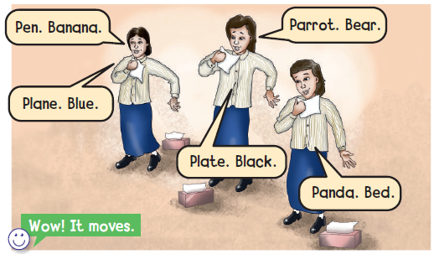
وقت المرح
Does it moveهل يتحرك
Hold a tissue in front of your mouth and say the words
احمل المنديل أمام فمك ثم انطق الكلمات وشاهد هل يتحرك المنديل أو لا
3

Slide 11
Goal Check
التحقق من الهدف

Slide 12
الهدف
أن يتمكن الطالب من تحديد الحرف الأول للكلمة b – p
أن ينطق الطالب كلمتين تبدأ بحرف b وكلمتين تبدأ بحرف p

Slide 13
ارتد ملابسك بشكل لائق

Slide 14
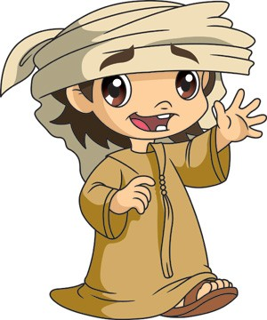
Have a nice day
See you next class

