Slide 1
3
Unit 4

Slide 2
Beautiful Nature
الطبيعة الجميلة

Slide 3
Phonics
الأصوات

Slide 4
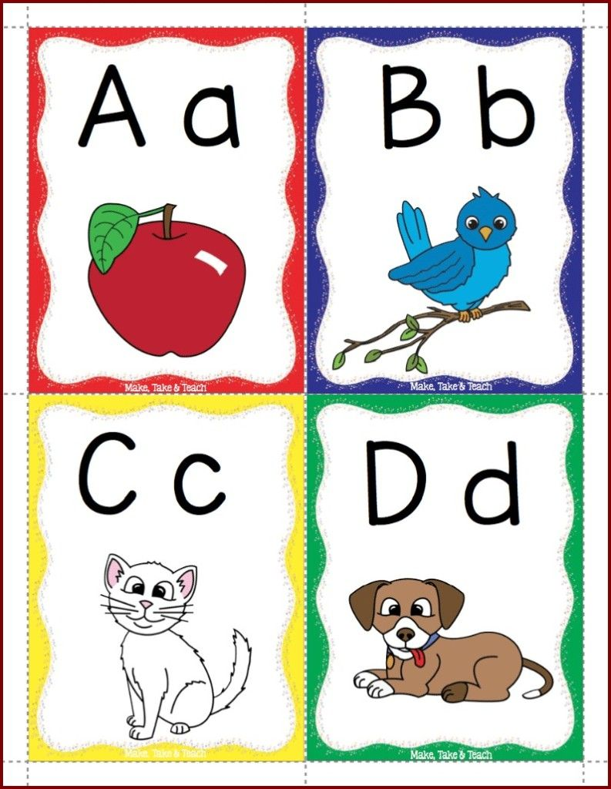
Materials :
Alphabet flashcards
Alphabet poster

Slide 5
Strategy
Word family relay teams :
Ask five student volunteers to come to the front of the class. Hand out the a, b, c, m, and t cards out at random to the students. First, say, “/m/, /a/, /t/, mat” (repeat if necessary) and have the three students holding those cards put themselves in the correct order. Have the rest of the class read the word together . Then, line up the students holding the c and b cards behind the student holding the m card. The student holding the m card goes to the end of the line and the student holding the c card comes to the front. Read as a class, “/c/, /a/, /t/, cat”. Finally, the student holding the c card goes to the end of the line and the student holding the b card comes to the front.

Slide 6
Review the previous lesson
مراجعة سريعة للدرس السابق

Slide 7
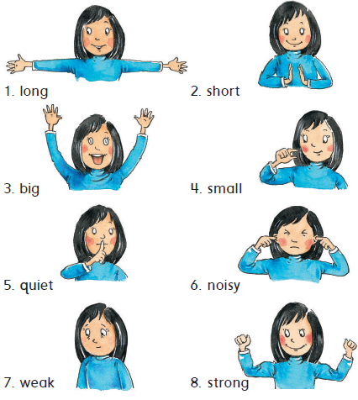

Slide 8
1
Listen , read , and say
استمع ، اقراء ، ثم انطق الكلمات

Slide 9
Sounds and Letters
2
Listen, point, and say. Then write gr – cr – gl – cl .
استمع ، تبع ، ثم اقراء الكلمات . بعد ذلك أكمل الفراغات بالحرفين gr – cr – gl – cl
c l c r g l g r

Slide 10
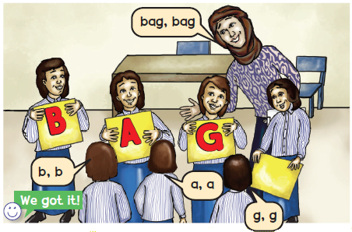
وقت المرح
Word making game . لعبة تكوين الكلمة
Listen to the teacher and hold up the letters.
استمع للمعلم ثم ارفع الحروف
3

Slide 11
Goal Check
التحقق من الهدف

Slide 12
الهدف
أن يتمكن الطالب من تحديد الحرف الأول للكلمة c – g
أن ينطق الطالب كلمتين تبدأ بحرف c وكلمتين تبدأ بحرف g

Slide 13
الطبيعة هي منزلك الثاني ؛ فحافظ عليها

Slide 14
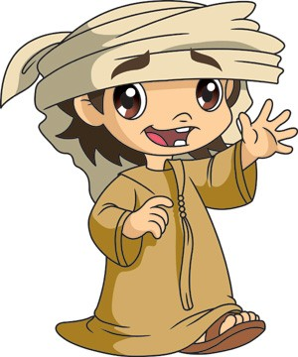
Have a nice day
See you next class

