Slide 1
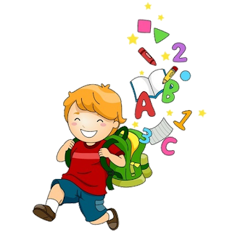
Unit 4
3

Slide 2
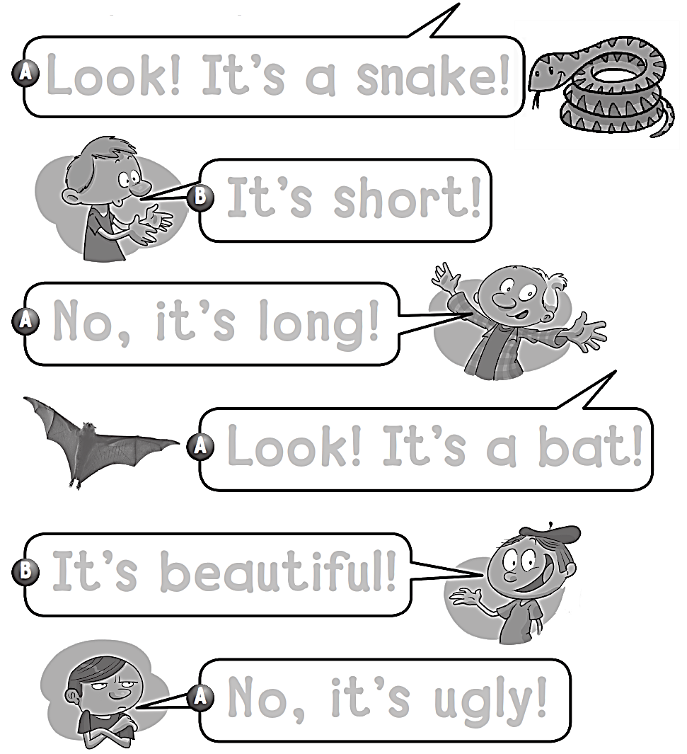
Workbook
4 Beautiful Nature
Look ! It’s a snake !
It’s short !
No , it’s long !
Look ! It’s a bat !
It’s beautiful !
No , it’s ugly !

Slide 3
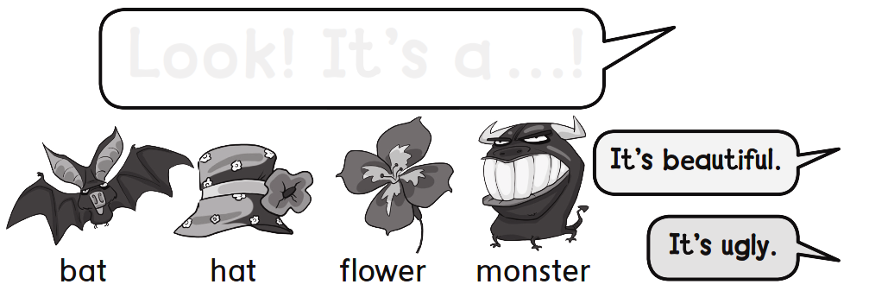
Workbook
4 Beautiful Nature
Look ! It’s a … !

Slide 4
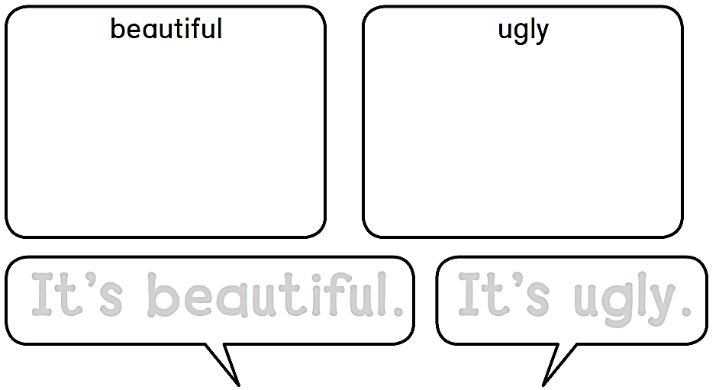
Workbook
4 Beautiful Nature
It’s beautiful.
It’s ugly.

Slide 5
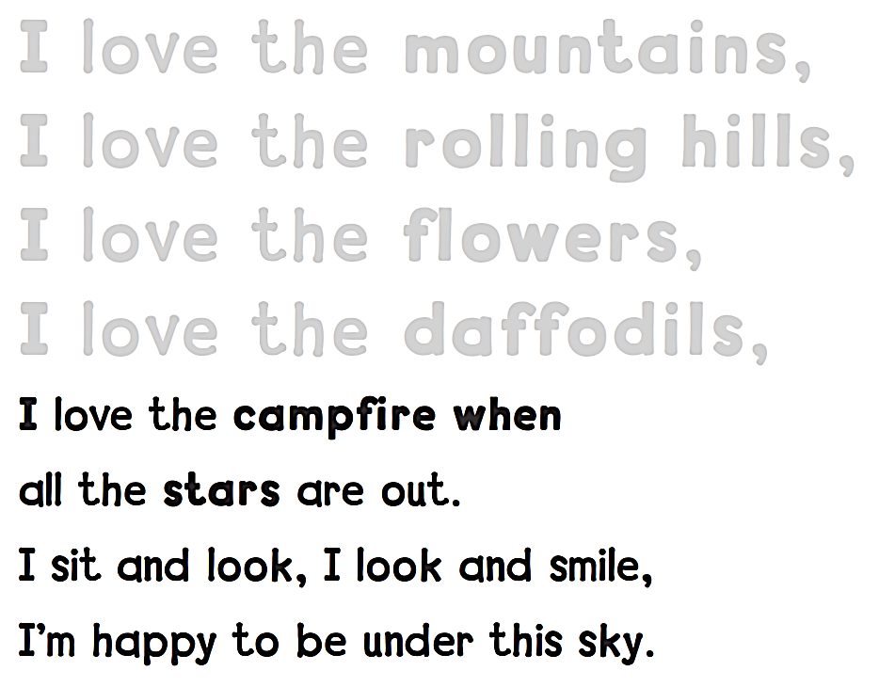
Workbook
4 Beautiful Nature
I love the mountains,
I love the rolling hills,
I love the flowers,
I love the daffodils,

Slide 6
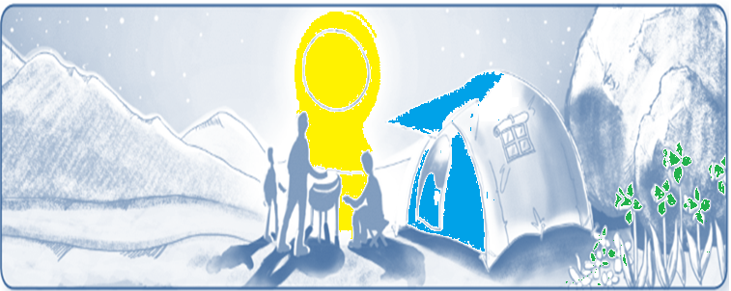
Workbook
4 Beautiful Nature

Slide 7
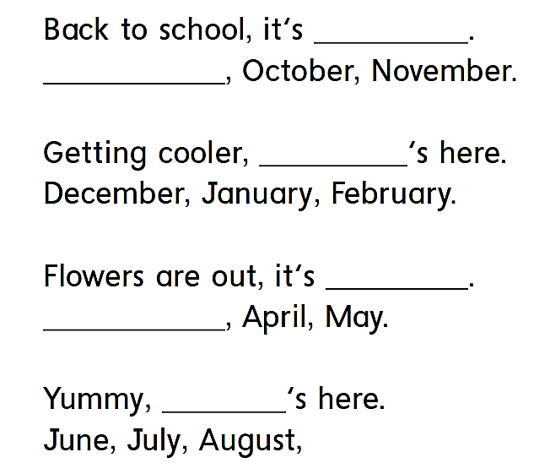
Workbook
4 Beautiful Nature
fall
September
winter
spring
March
summer

Slide 8
Workbook
4 Beautiful Nature

Slide 9
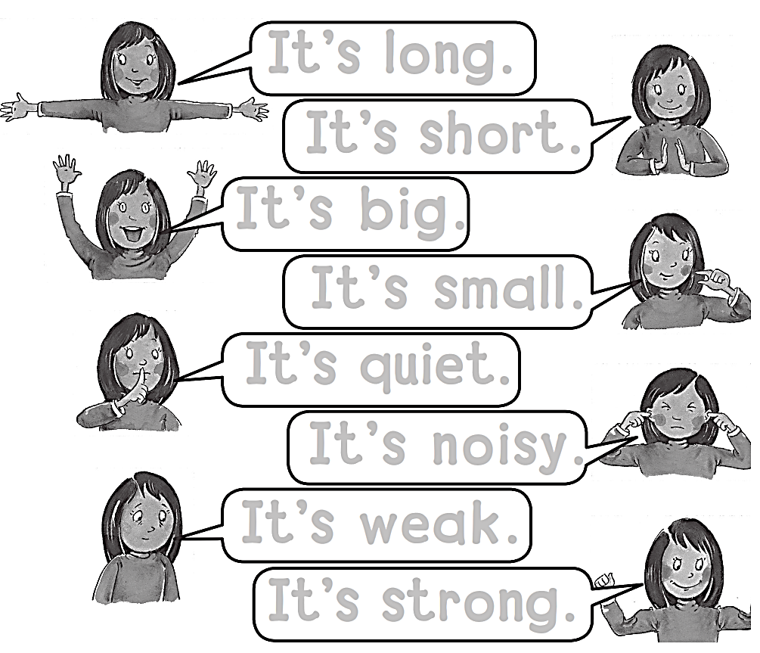
Workbook
4 Beautiful Nature
It’s long.
It’s short.
It’s big .
It’s small.
It’s quite.
It’s noisy.
It’s weak.
It’s strong.

Slide 10
Workbook
4 Beautiful Nature
Short
small

Slide 11
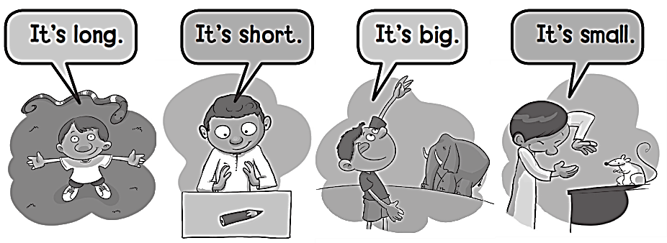
Workbook
4 Beautiful Nature

Slide 12
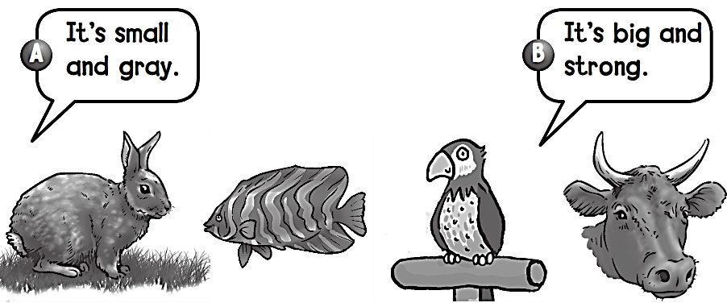
Workbook
4 Beautiful Nature

Slide 13
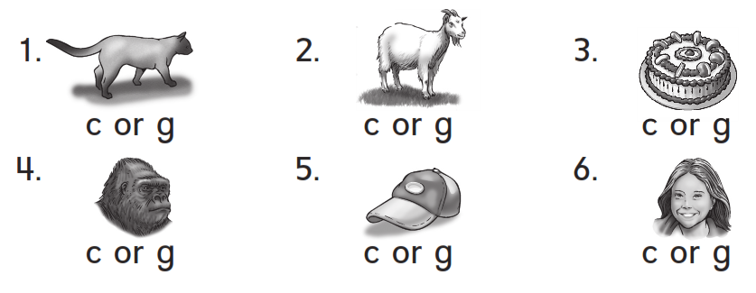
Workbook
4 Beautiful Nature

Slide 14
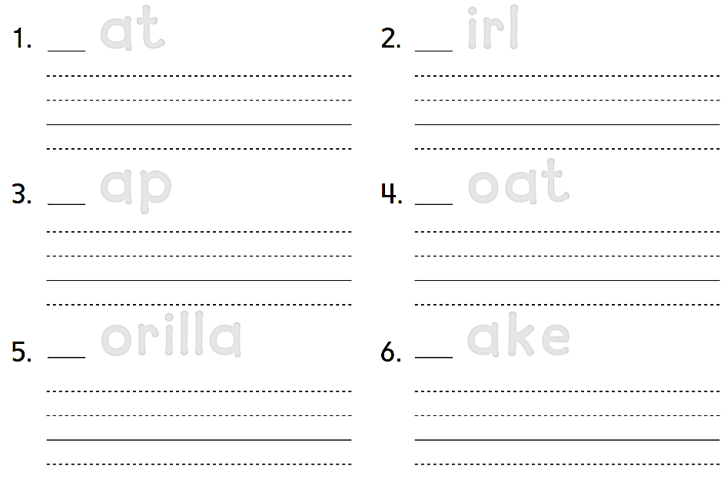
Workbook
4 Beautiful Nature
C at
G irl
Cat
Girl
C ap
G oat
Cap
Goat
G orilla
C ake
Gorilla
Cake

Slide 15
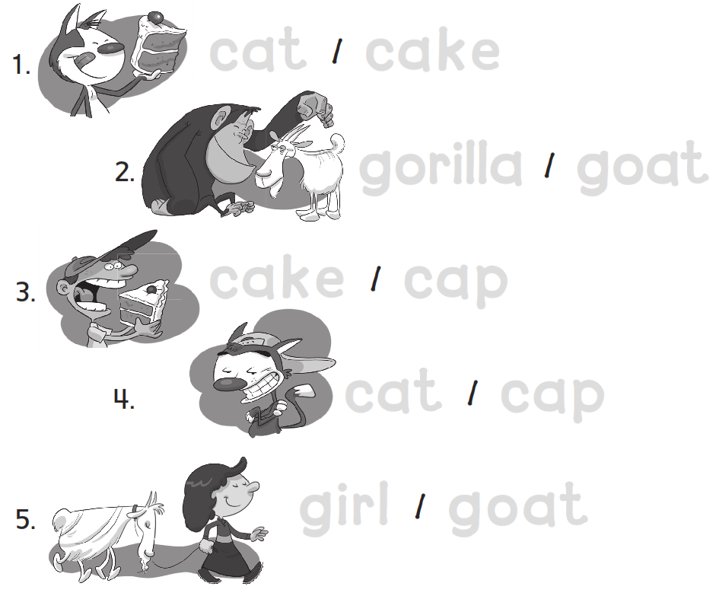
Workbook
4 Beautiful Nature
cat cake
gorilla goat
cake cap
cat cap
girl goat

Slide 16
Workbook
4 Beautiful Nature

Slide 17
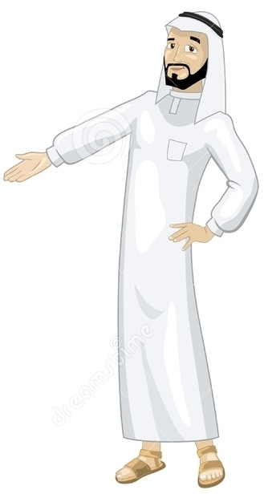
See you later
Goodbye
Teacher :
Badr Sayid Al-Shehri

