Slide 1
Super goal 3

Slide 2
Unit 3

Slide 3
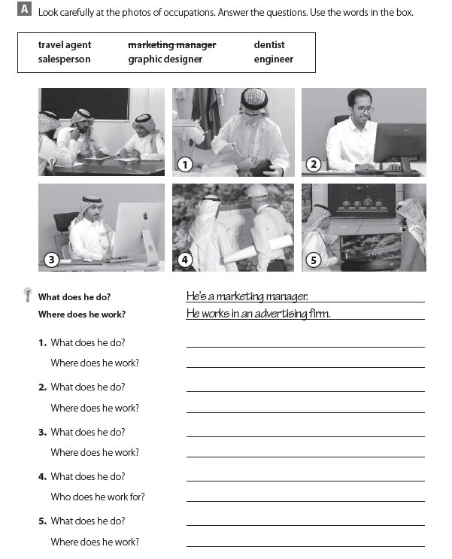
He is a dentist
He works at a dental clinic
He is a travel agent
He works at a travel agency
He is a graphic designer
He works at an advertisement firm
He is an engineer
He works for a construction company
He is a salesperson
He works in a store

Slide 4
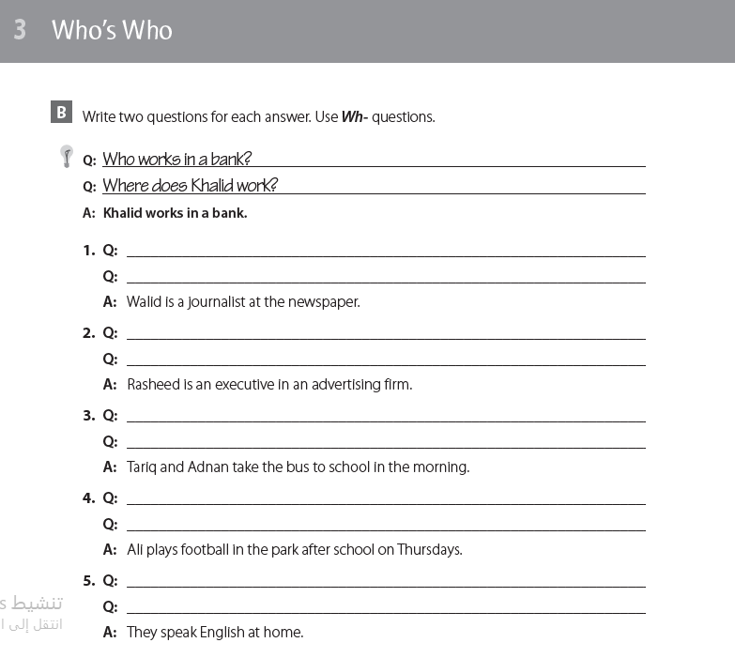
What does Walid do ?
Where does Walid work ?
What does Rasheed do ?
Where does Rasheed work ?
Where do Tariq and Adnan take the bus to ?
Who takes the bus to school ?
Who plays football in the park ?
When does Ali play football ?
Where do they speak English ?
What do they speak at home ?

Slide 5
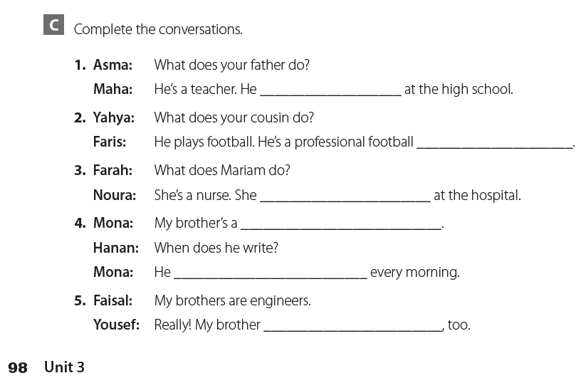
teaches
player
works
writer
writes
is an engineer

Slide 6
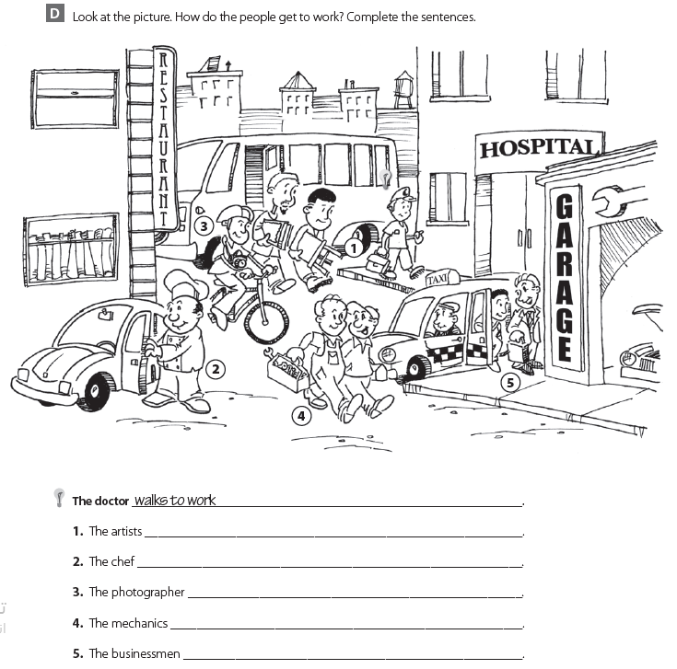
takes the bus to work
drives his car to work
rides his bike to work
walk to work
takes a taxi to work

Slide 7
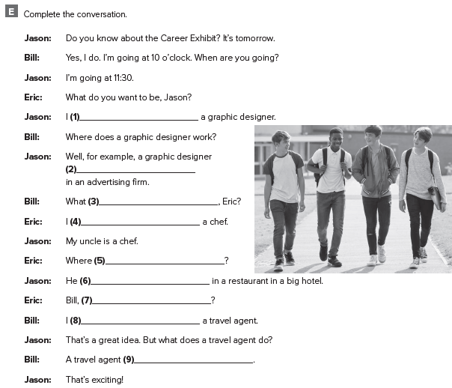
I want to be
works
do want to be
want to be
does he work
works
what do you want to be ?
want to be
arranges trips for customers

Slide 8
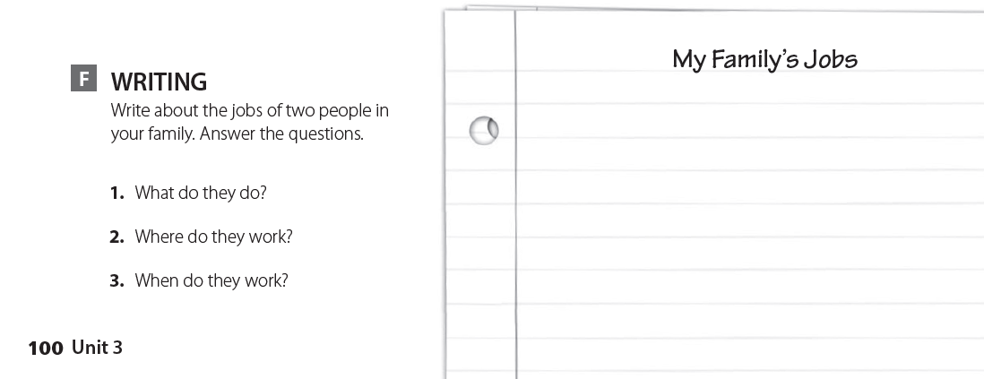
اكتب عن مهنة اثنين من أفراد عائلتك

Slide 9
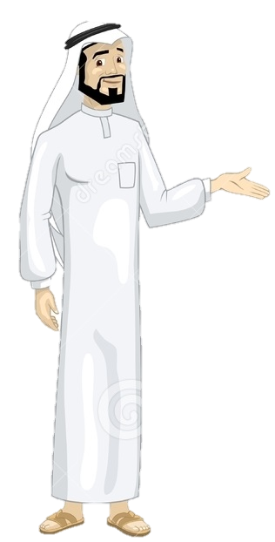
See you later
Take care
Teacher :
Badr Sayid Al-Shehri

