Slide 1
Super goal 3

Slide 2
Unit 8

Slide 3
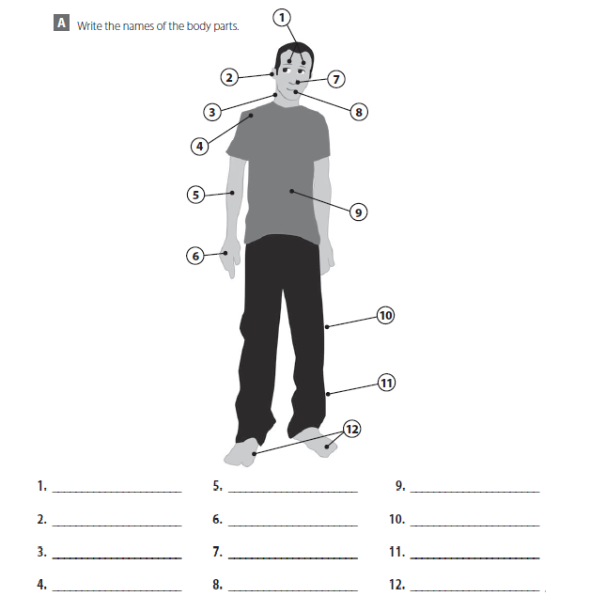
Eyes
Ear
Neck
Shoulder
Arm
Hand
Nose
Mouth
Stomach
Knee
Leg
Feet

Slide 4
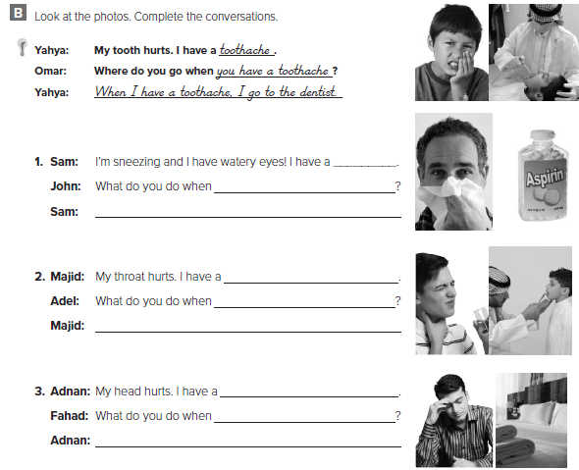
cold
a cold
When I have cold I take aspirin
sore throat
sore throat
When I have a sore throat , I go to the doctor
headache
headache
When I have a headache , I go to bed

Slide 5
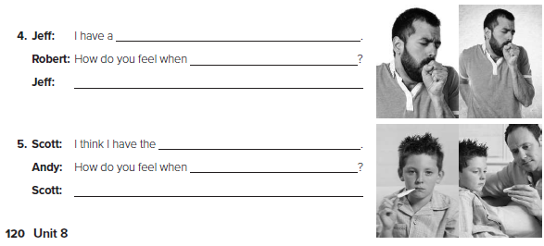
cough
you have a cough
When I have a cough , my chest hurt
flu
have the flu
When I have the flu , I feel fever and tired

Slide 6
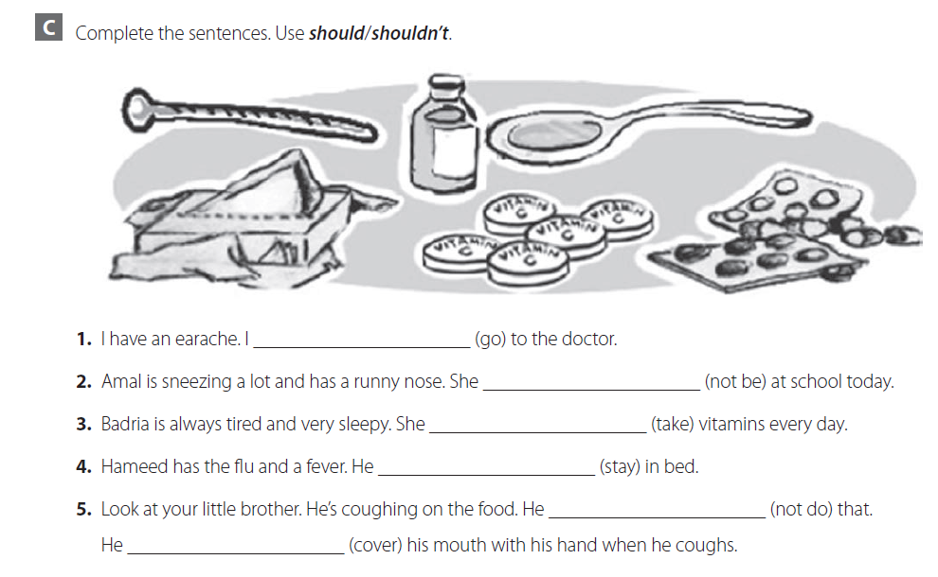
should go
shouldn’t be
should take
should stay
shouldn’t do
should cover

Slide 7
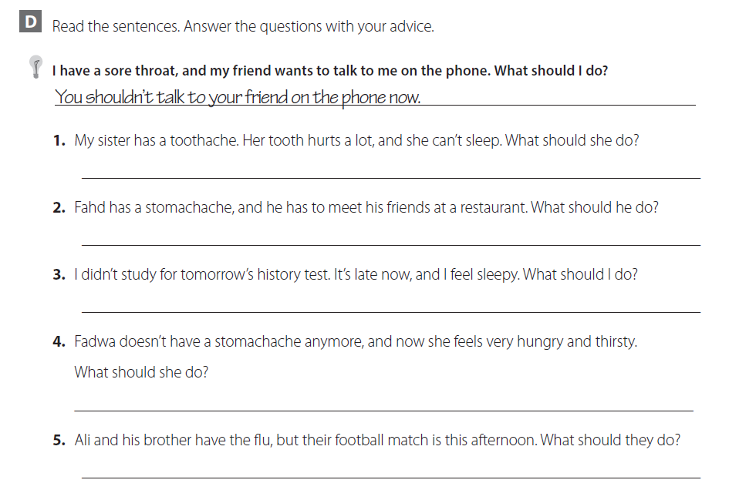
She should go to the dentist
He should apologize to his friends
You should go to sleep and wake early to study
She should eat some healthy food with fresh juice
They should stay in bed

Slide 8
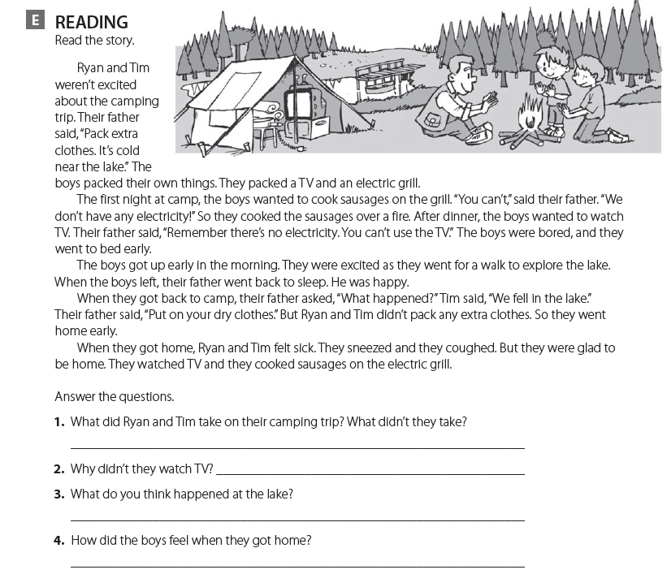
They took the TV and the grill but didn’t take extra clothes
Because there was no electricity
They swam in the cold water
They felt sick

Slide 9
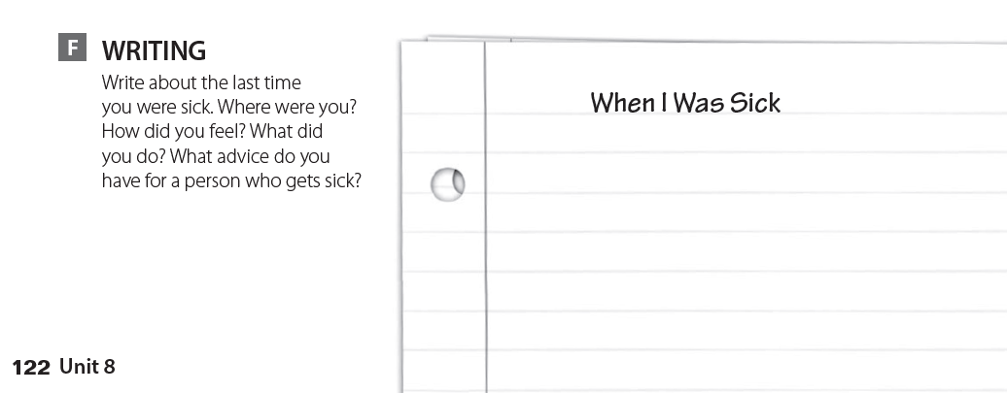
قم بالكتابة عن المرض الذي أصبت به

Slide 10
expansion 2

Slide 11
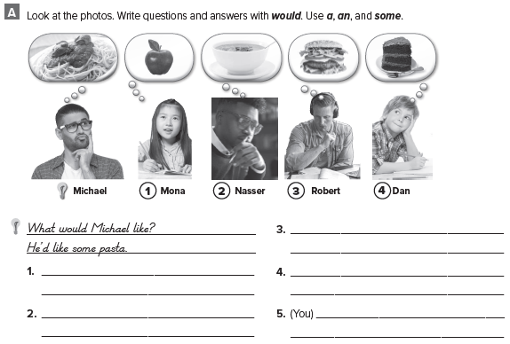
What would Robert like ?
He’d like a burger
What would Mona like ?
She’d like an apple
What would Dan like ?
He’d like a cake
What would Nasser like ?
He’d like some soup
تحدث عن نفسك ؟

Slide 12
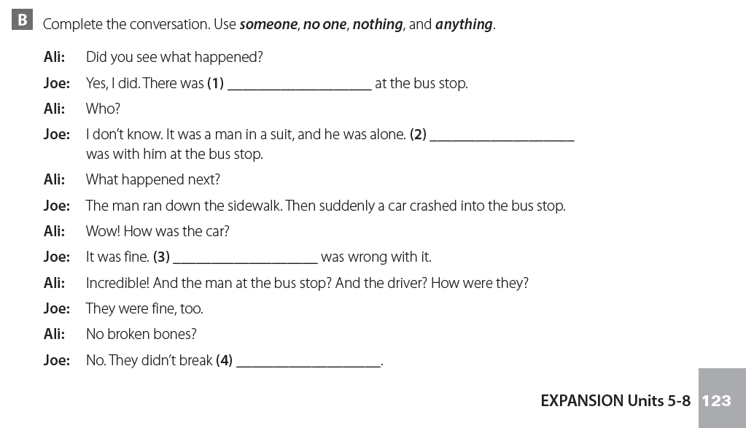
someone
No one
Nothing
anything

Slide 13
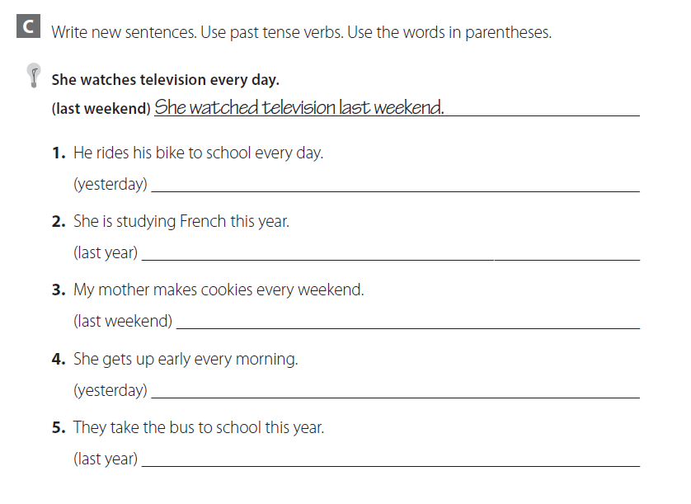
He rode his bike to school yesterday
She studied French last year
My mother made cookies last weekend
She got up early yesterday
They took the bus to school last year

Slide 14
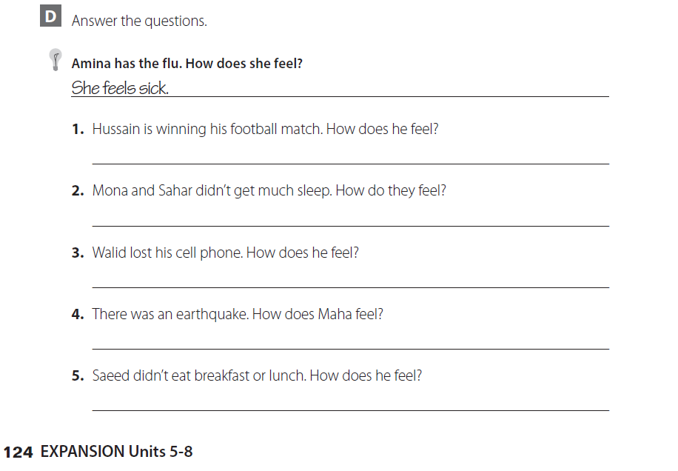
He feels happy
They feel tired
He feels sad
She feels scary
He feels hungry

Slide 15
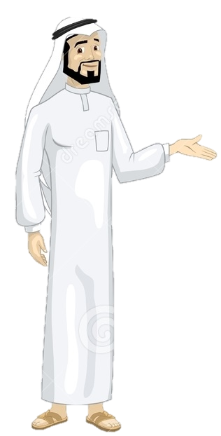
See you later
Take care
Teacher :
Badr Sayid Al-Shehri

