Slide 1
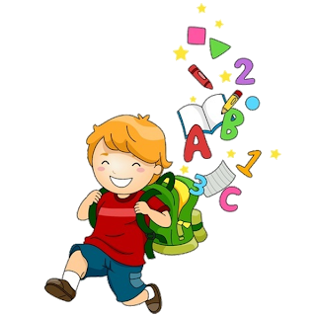
5
Unit 3

Slide 2
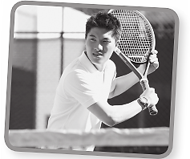
Workbook
Sports and Activities
I like tennis.
I like tennis.
I like tennis.

Slide 3
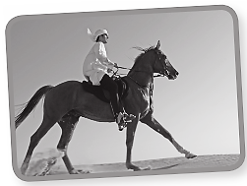
Workbook
Sports and Activities
He likes horse riding
He likes horse riding
He likes horse riding

Slide 4
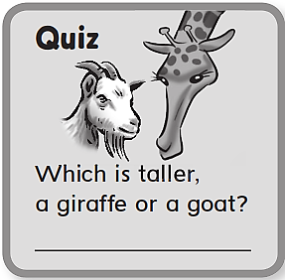
Workbook
Sports and Activities
A giraffe

Slide 5
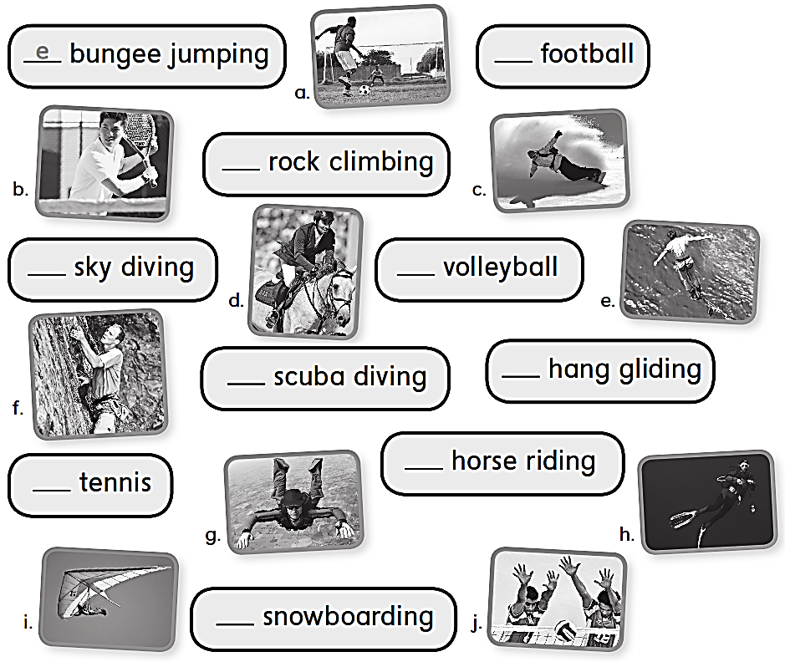
Workbook
Sports and Activities
a
f
g
i
h
j
b
d
c

Slide 6
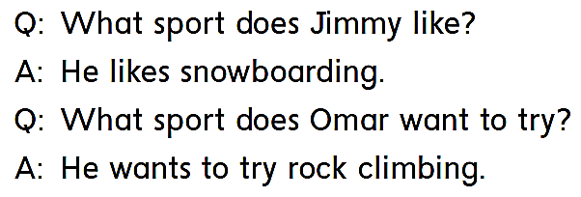
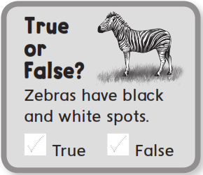
Workbook
Sports and Activities

Slide 7
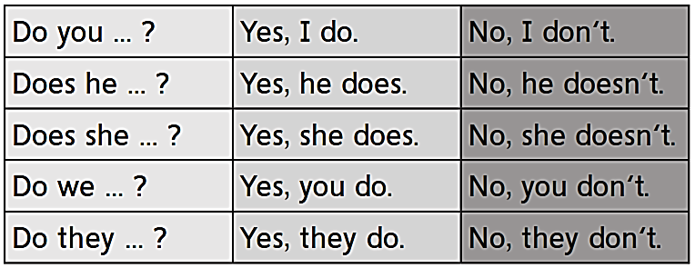
Workbook
Sports and Activities

Slide 8
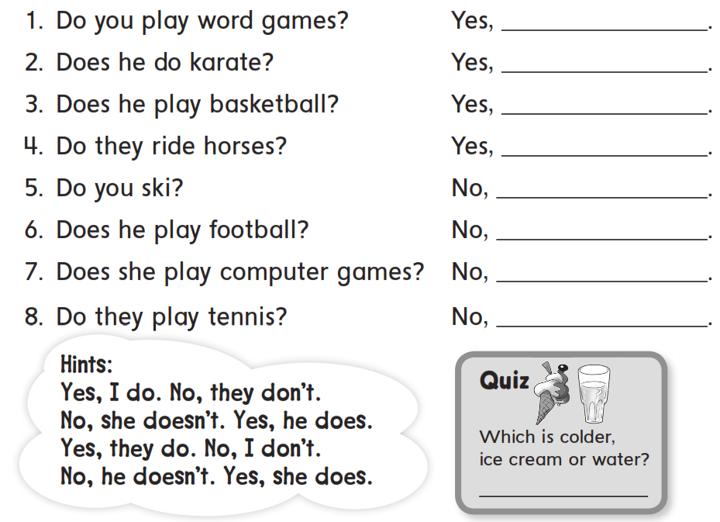
Workbook
Sports and Activities
I do
he does
he does
they do
I don’t
he doesn’t
she doesn’t
they don’t
Ice cream

Slide 9
Workbook
Sports and Activities

Slide 10
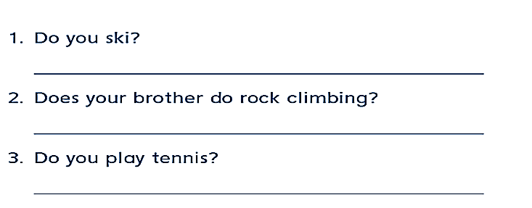
Workbook
Sports and Activities
Yes , I do .
No , he doesn’t
Yes , I do .

Slide 11
Workbook
Sports and Activities
No , I don’t
No , he doesn’t
A jet
Yes , he does

Slide 12
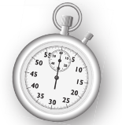
Workbook
Sports and Activities

Slide 13
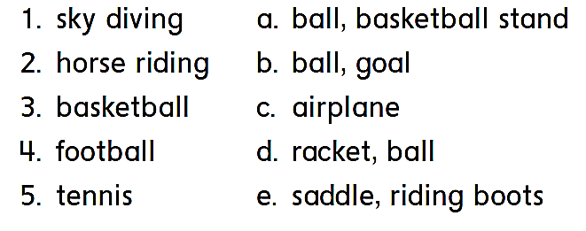
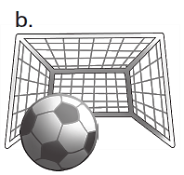
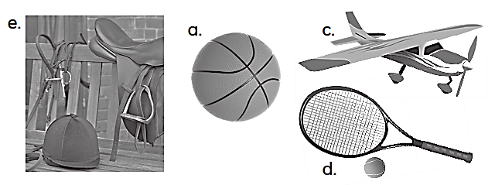
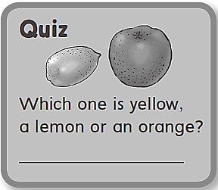
Workbook
Sports and Activities
c
e
a
b
d
A lemon

Slide 14
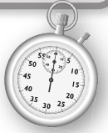
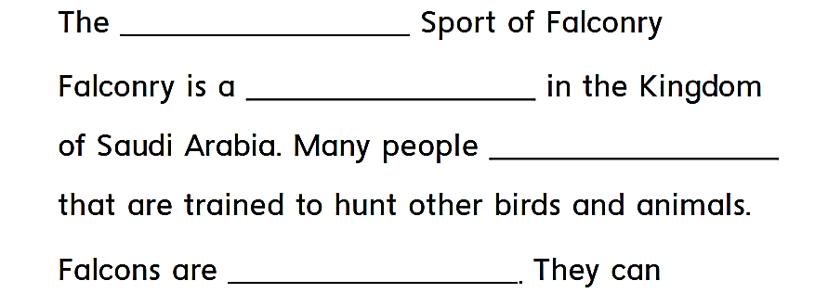
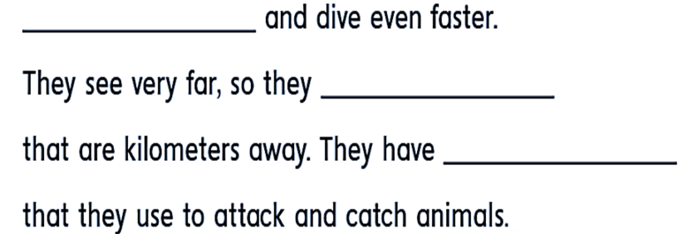
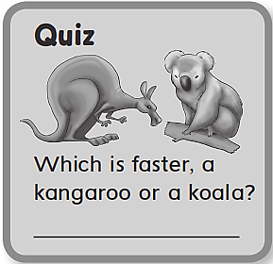
Workbook
Sports and Activities
traditional
popular sport
have falcons
very strong birds
fly fast
can spot animals
very sharp talons
A kangaroo

Slide 15
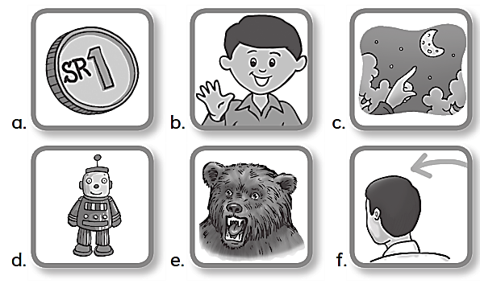
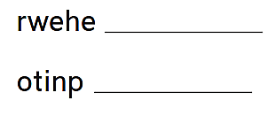
Workbook
Sports and Activities
Where
Pear
Chair
Point
There
Coin

Slide 16
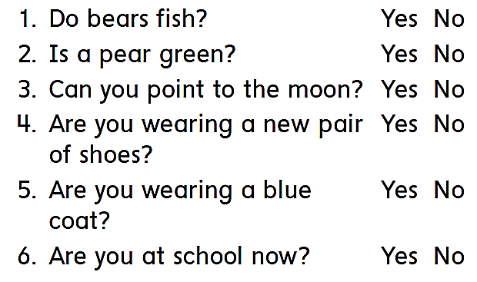
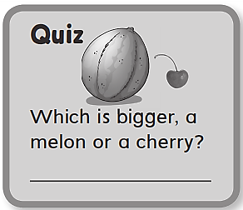
Workbook
Sports and Activities
A melon

Slide 17
Workbook
Sports and Activities
I’d like to play tennis but I have no racket
I’d like to try falconine but I have np falcon
I’d like to try riding but I have no horse
I’d like to try scuba diving but there is no sea
I’d like to try rock climbing but there is no rock
I’d like to try sky diving but there is no plane
I’d like to try cooking but I don’t know how
I’d like to try painting but I don’t know how

Slide 18
Workbook
Sports and Activities
Nine

