Slide 1
Super goal 1

Slide 2
Unit 5

Slide 3
No
Yes
Yes
Yes
son
grandson
brother
cousin

Slide 4
إجابات متنوعة من قبل الطلاب

Slide 5
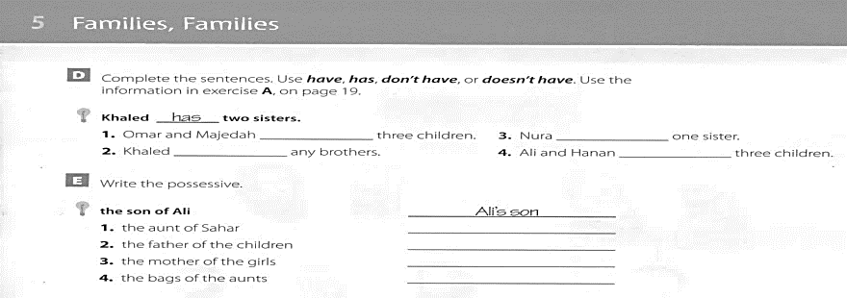
have
has
doesn’t have
don’t have
Sahar’s aunt
The children’s father
The girls’ mother
The aunts’ bags

Slide 6
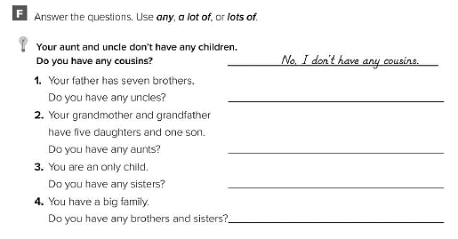
Yes, I have a lot of uncles.
Yes, I have lots of aunts.
No, I don’t have any sisters.
Yes, I have a lot of brothers and sisters

Slide 7
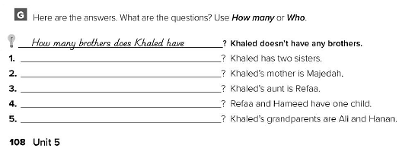
How many sisters does he have? Who is Khaled’s mother? Who is Khaled’s aunt? How many children do they have? Who are Khaled’s grandparents?

Slide 9
No
Yes
No
No
No
G r a n d m o t h e r
S o n
A u n t
H u s b a n d
U n c l e
P a r e n t s
Mother

Slide 10
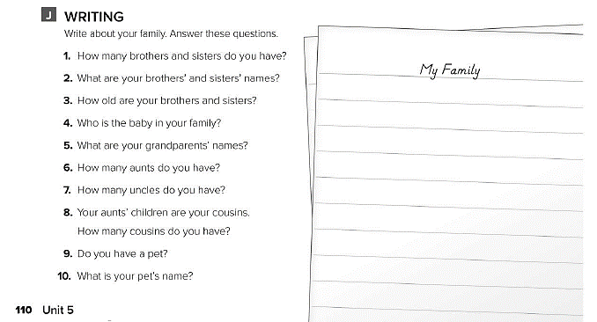
اكتب عن عائلتك

Slide 11
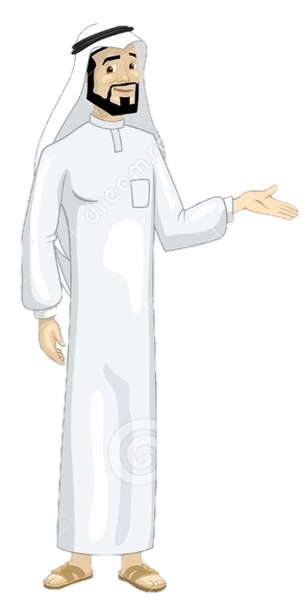
See you later
Take care
Teacher :
Badr Sayid Al-Shehri

