Slide 1
Super goal 3

Slide 2
Unit 7

Slide 3
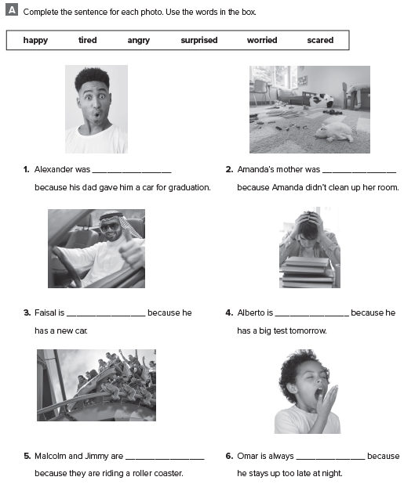
surprised
angry
happy
worried
scared
tired

Slide 4
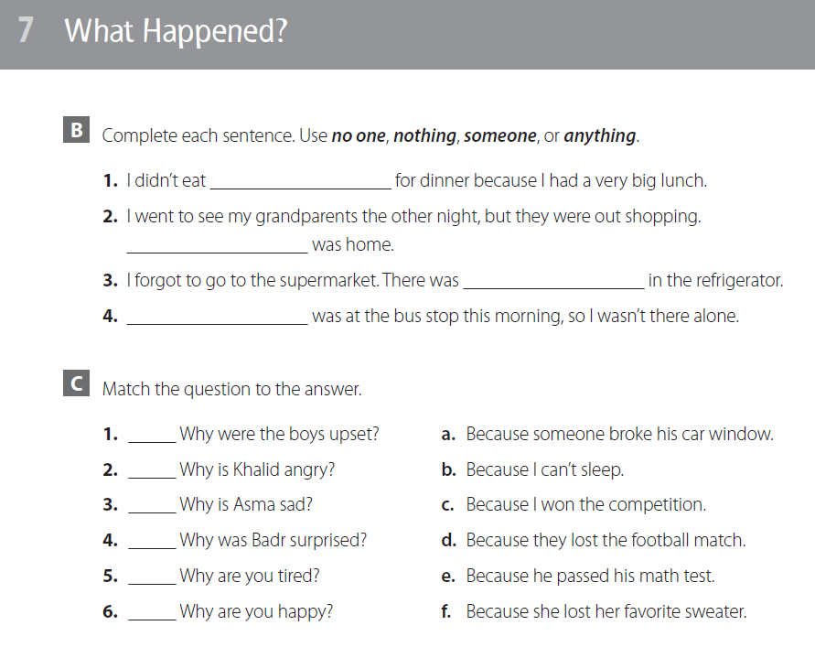
anything
No one
nothing
Someone
d
a
f
e
b
c

Slide 5
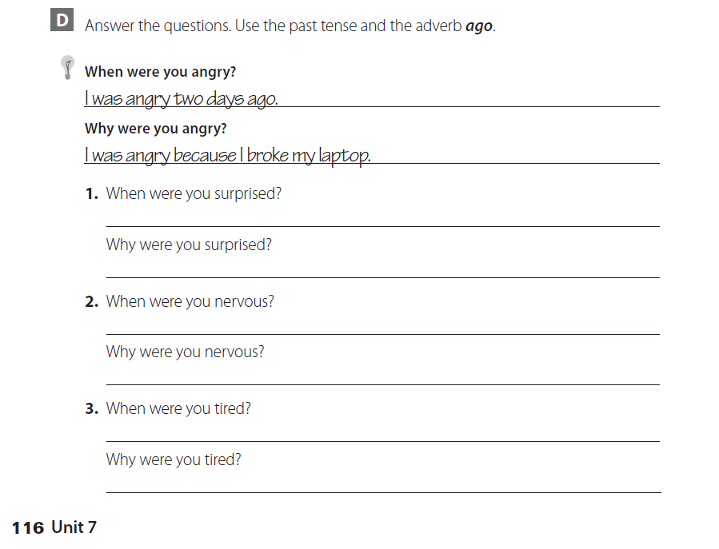
إجابات عشوائية من قبل الطلاب

Slide 6
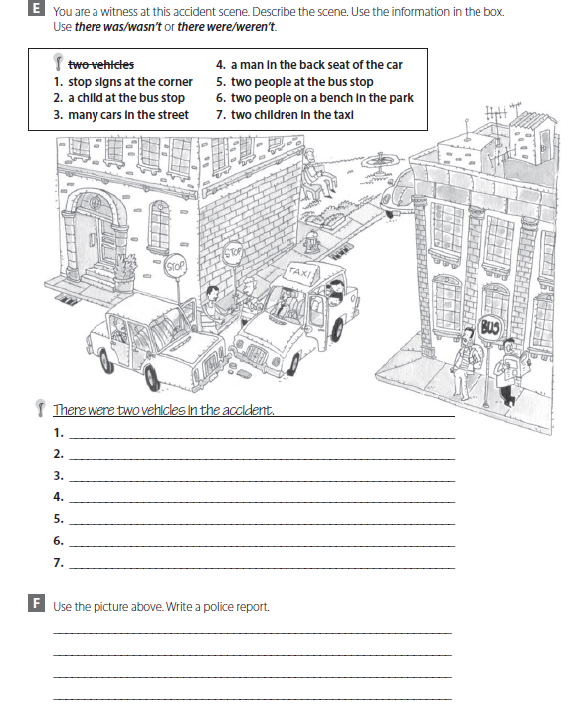

Slide 7
There were stop signs at the corner
There wasn’t a child at the bus stop
There weren’t many cars in the street
There was a man in the back seat of the car
There 2 people at the bus stop
There weren’t 2 people on a bench in the park
There were two children in the taxi
There were an accident at the corner . A taxi crashed into another car . Thank god no one was hurt . It was both the drivers fault because the didn’t see the stop signs .

Slide 8
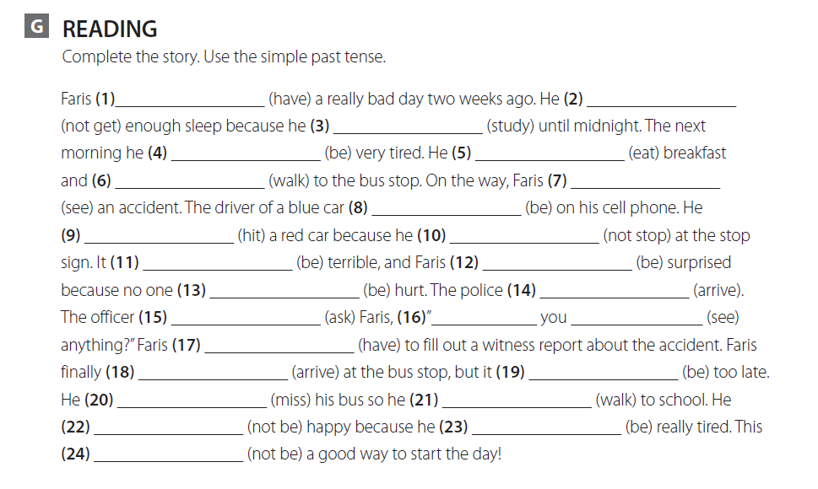
had
didn’t get
studied
was
ate
walked
saw
was
hit
didn’t stop
was
was
was
arrived
asked
Did see
had
arrived
was
missed
walked
was not
was
was not

Slide 9
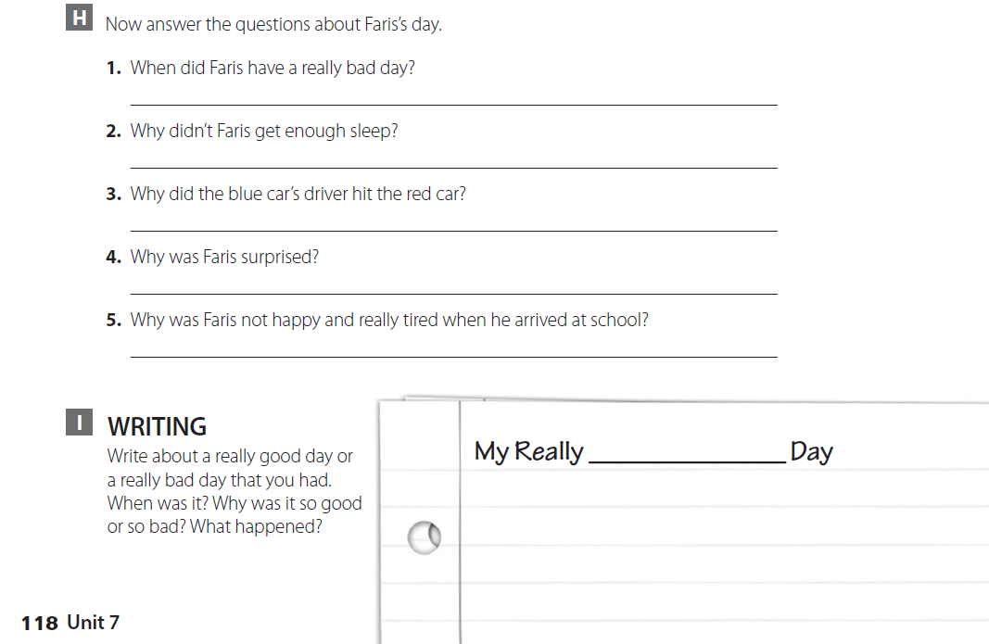
Two weeks ago
Because he was studying until midnight
Because he didn’t stop at the stop sign
Because no one was hurt
Because he missed the bus and had to walk to school
اكتب عن يومك الجيد أو السيء وماذا حدث خلال هذا اليوم

Slide 10
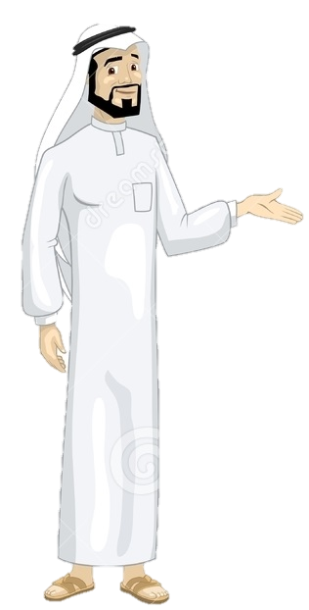
See you later
Take care
Teacher :
Badr Sayid Al-Shehri

