Slide 1
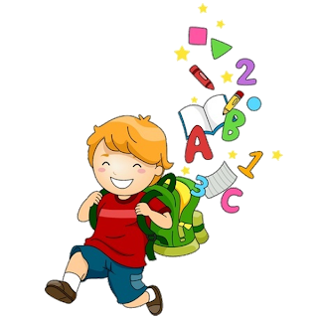
Unit 1
1

Slide 2
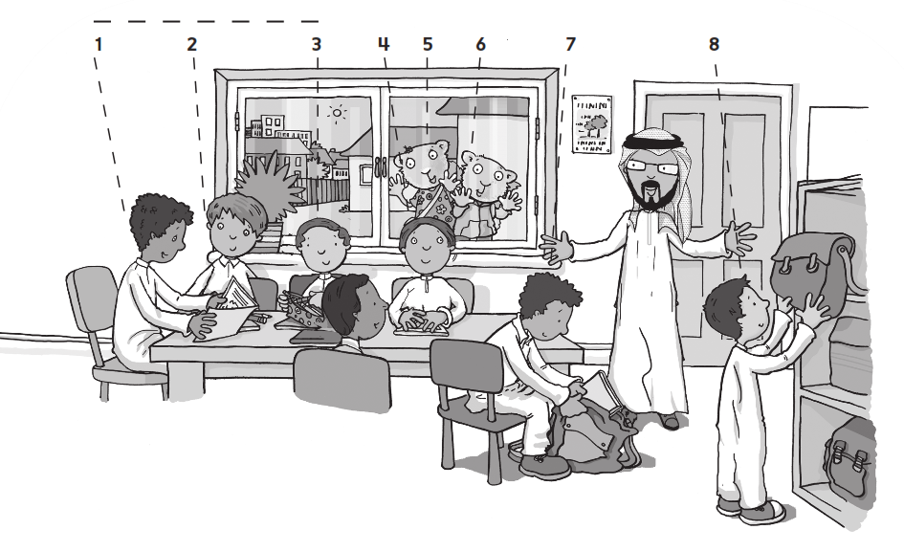
Work book
1 My friends

Slide 3
Work book
1 My friends

Slide 4
Work book
1 My friends

Slide 5
Work book
1 My friends

Slide 6
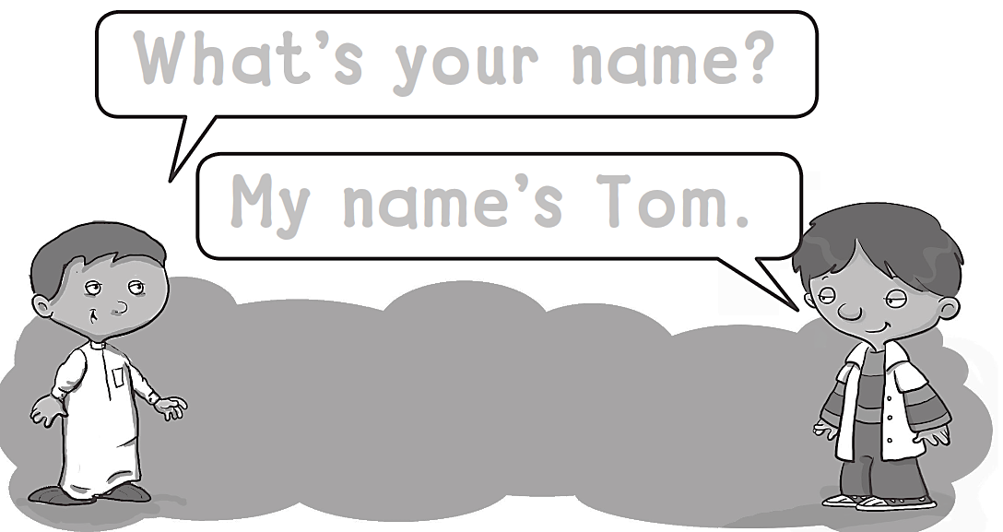
Work book
1 My friends
What΄s your name?
My name΄s tom.

Slide 7
Work book
1 My friends
A A A A A A A A

Slide 8
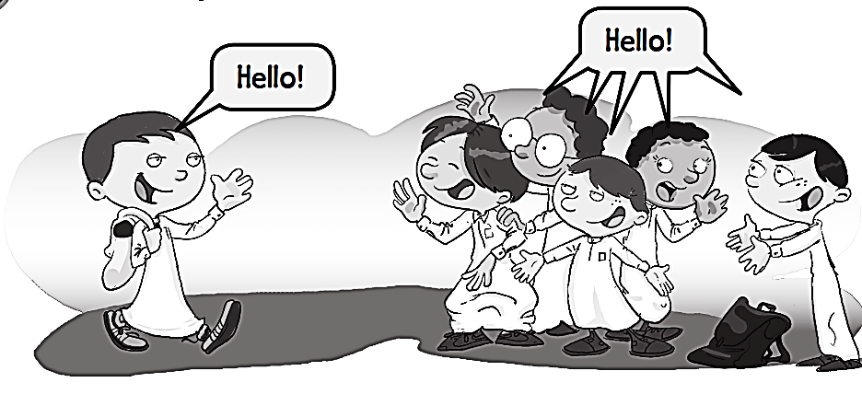
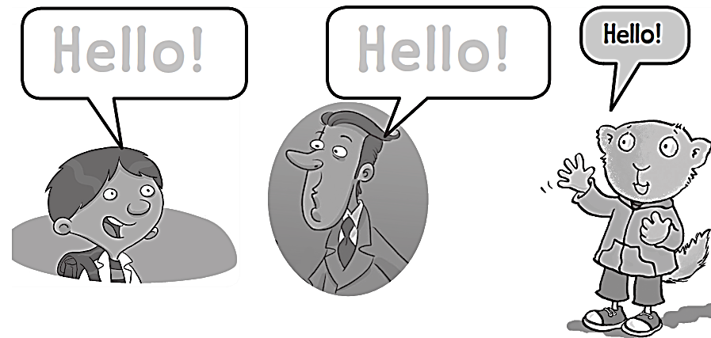
Work book
1 My friends
Hello !
Hello !

Slide 9
Work book
1 My friends
B B B B B B B B B

Slide 10
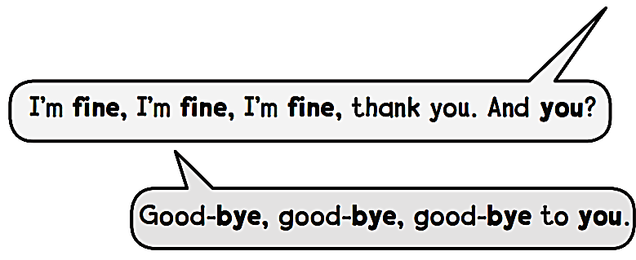
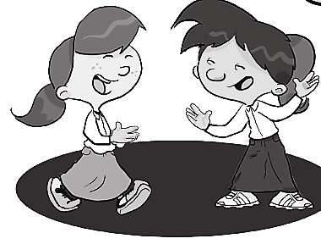
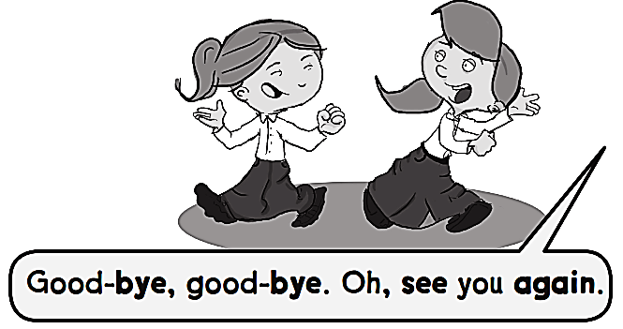
Work book
1 My friends
Hello, hello, hello.
How are you ?

Slide 11
Work book
1 My friends
C C C C C C C C

Slide 12
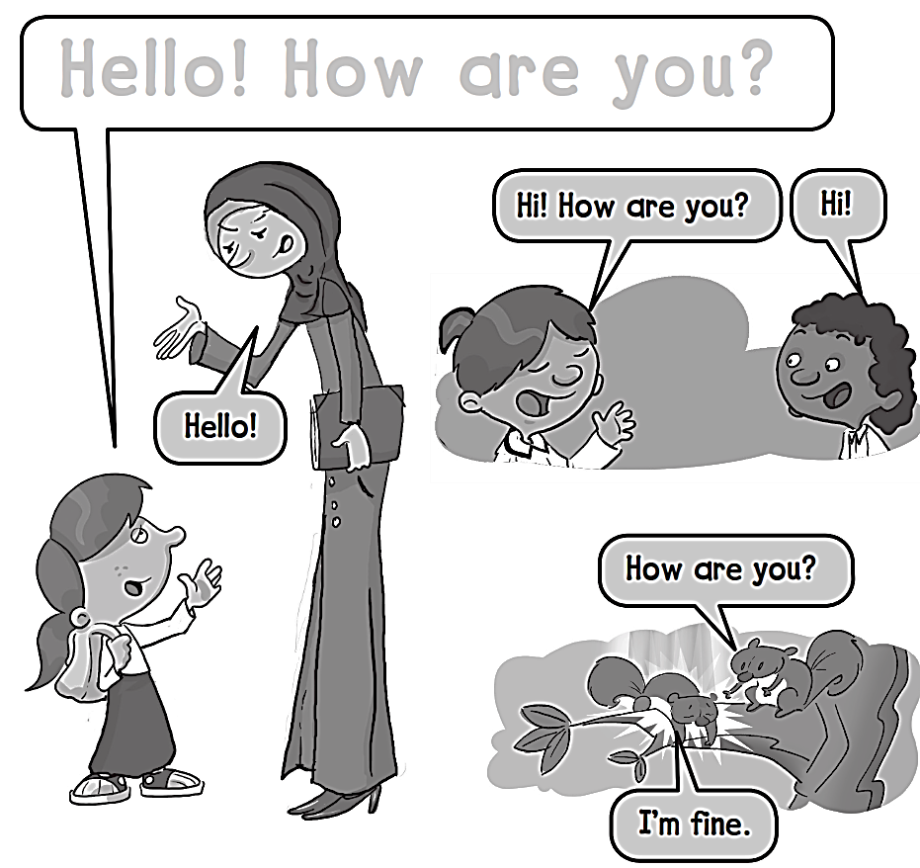
Work book
1 My friends
Hello ! How are you ?

Slide 13
Work book
1 My friends
D D D D D D D D

Slide 14
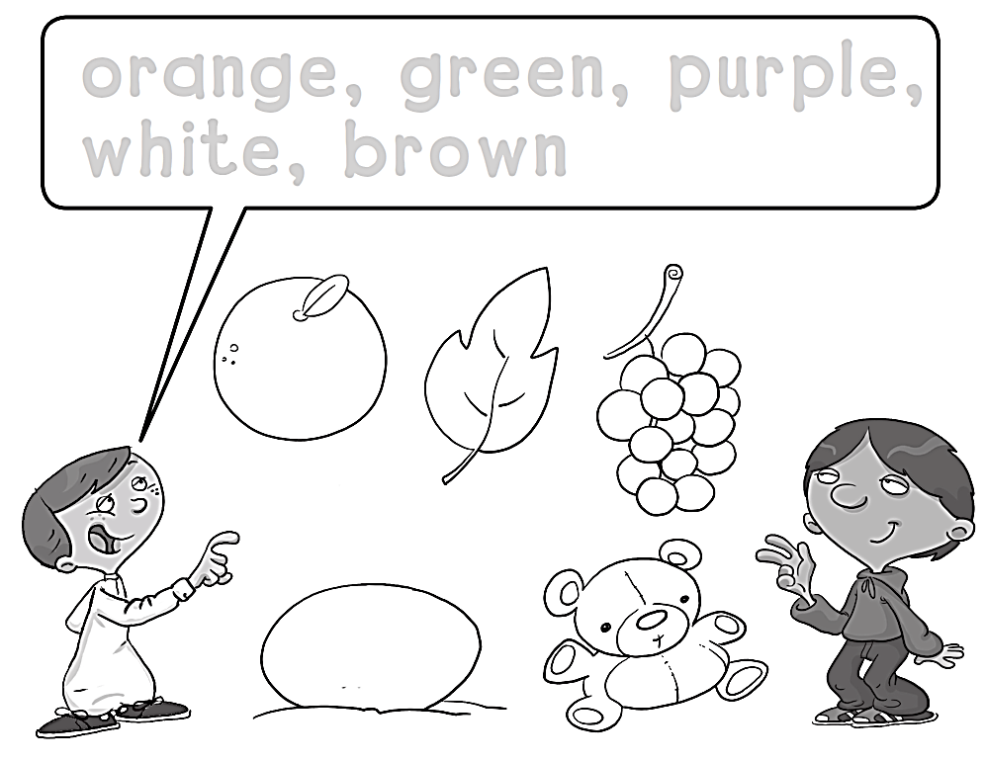
Work book
1 My friends
Orange , green , purple ,
white , brown

Slide 15
Work book
1 My friends
E E E E E E E E E E

Slide 16
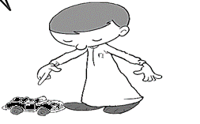
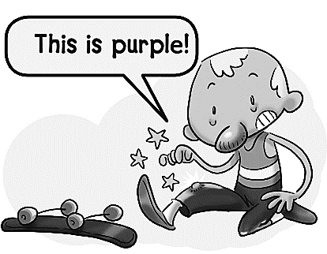
Work book
1 My friends
This is black .
This is pink .
This is purple.

Slide 17
Work book
1 My friends
F F F F F F F F F F F

Slide 18
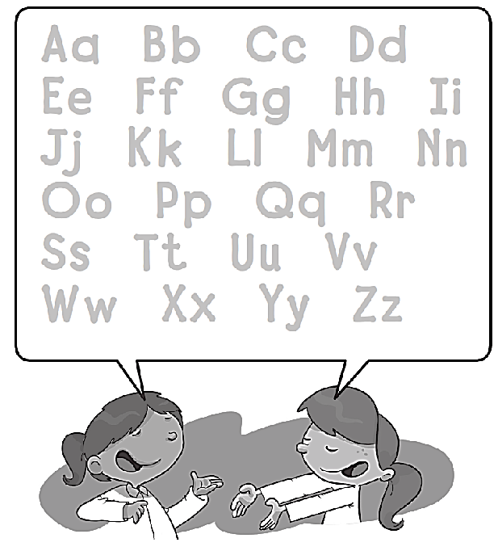
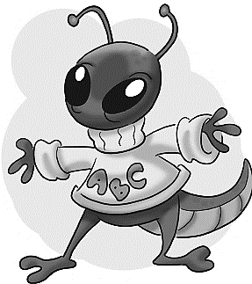
Work book
1 My friends
Aa Bb Cc Dd
Ee Ff Gg Hh Ii
Jj Kk Ll Mm Nn
Oo Pp Qq Rr
Ss Tt Uu Vv
Ww Xx Yy Zz

Slide 19
Work book
1 My friends
G G G G G G G G

Slide 20
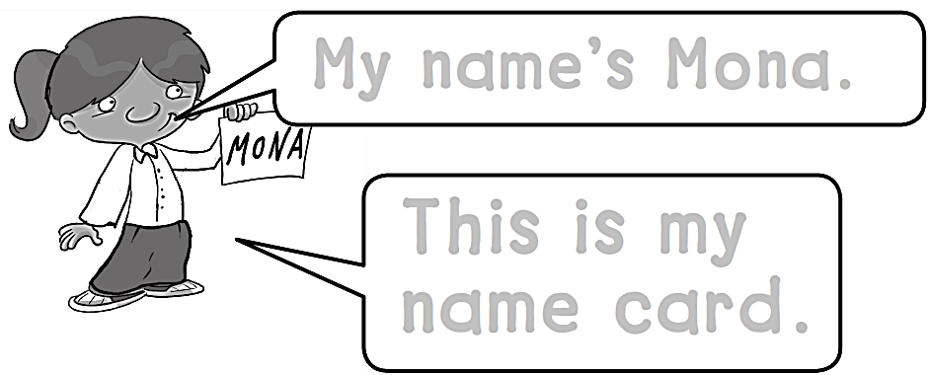
Work book
1 My friends
My name’s Mona.
This is my
Name card .

Slide 21
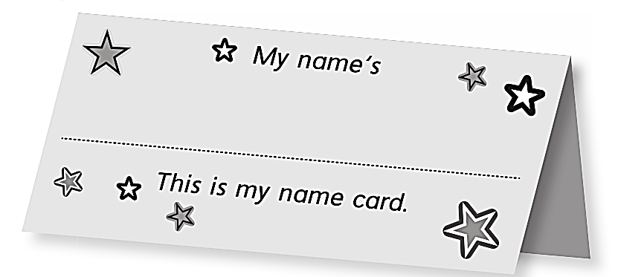
Work book
1 My friends
FAHAD

Slide 22
Work book
1 My friends
H H H H H H H H

Slide 23
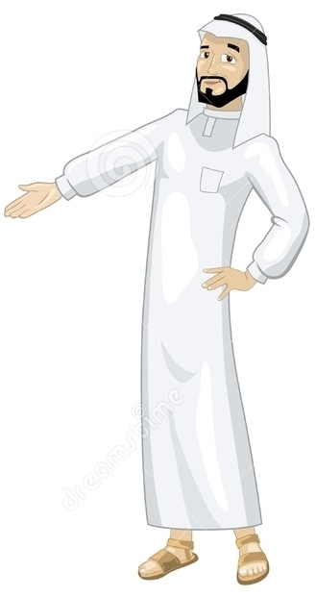
See you later
Goodbye
Teacher :
Badr Sayid Al-Shehri

