Slide 1
Unit 3
1

Slide 2
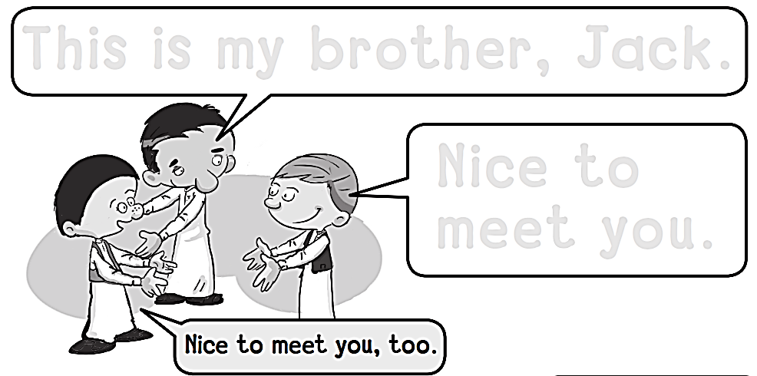
Workbook
3 My Family
This is my brother, jack.
Nice to
Meet you.

Slide 3
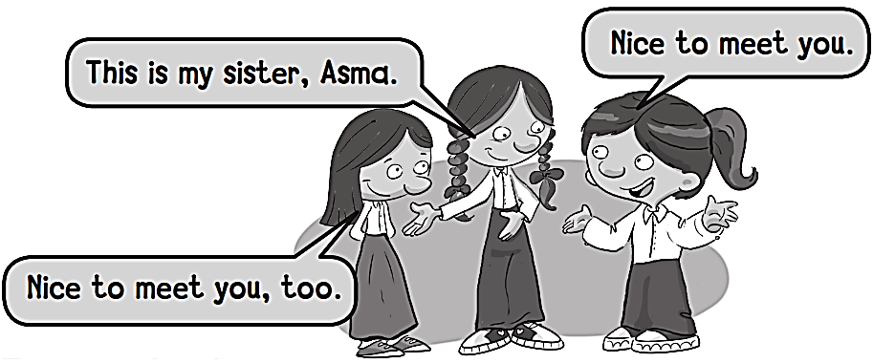
Workbook
3 My Family

Slide 4
Workbook
3 My Family
Q Q Q Q Q Q

Slide 5
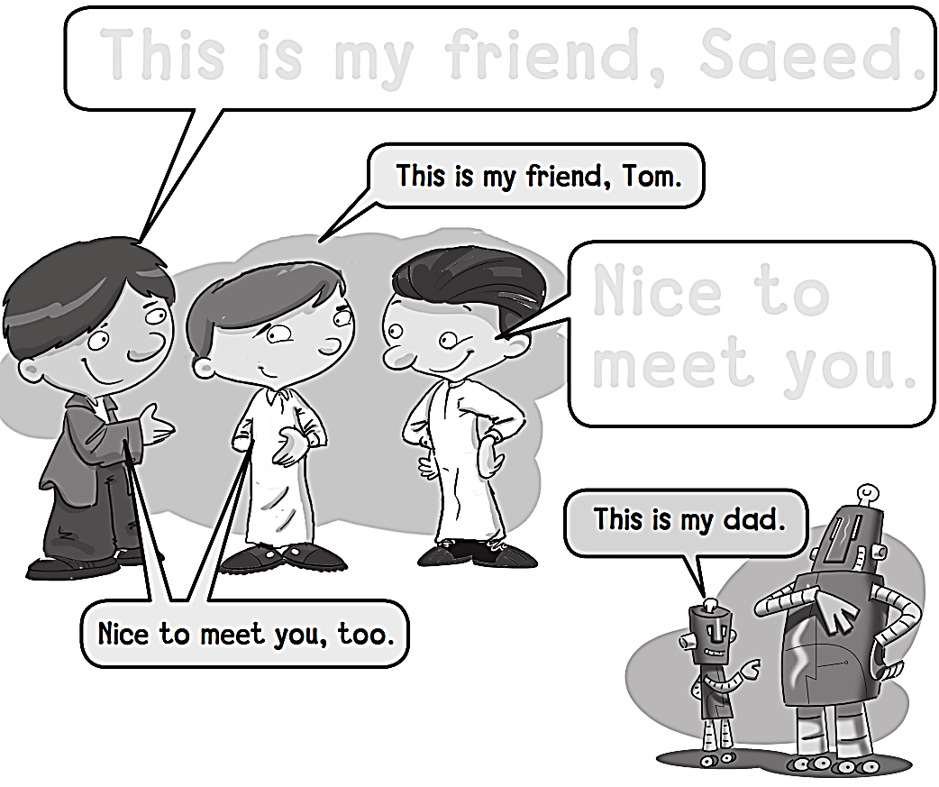
Workbook
3 My Family
This is my friends, saeed.
Nice to
Meet you.

Slide 6
Workbook
3 My Family
R R R R R R R

Slide 7
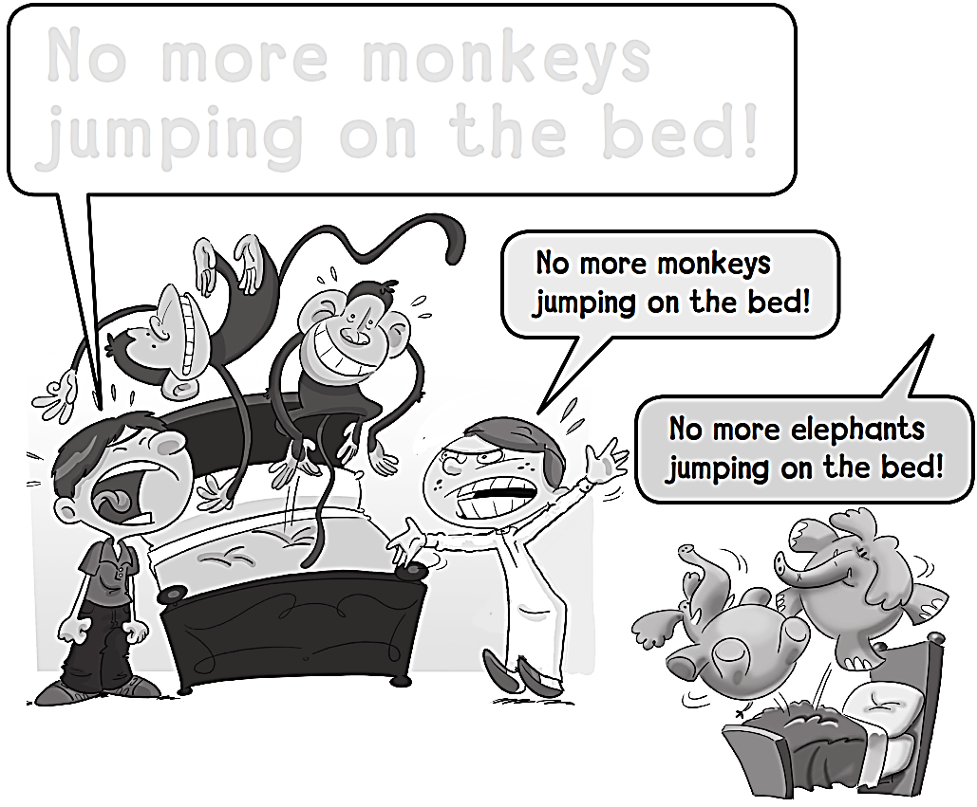
Workbook
3 My Family
NO MORE MONKEYS JUMPING ON THE BED!

Slide 8
Workbook
3 My Family
S S S S S S S

Slide 9
Workbook
3 My Family
Five little monkeys
jumping on the bed

Slide 10
Workbook
3 My Family
T T T T T T T T

Slide 11
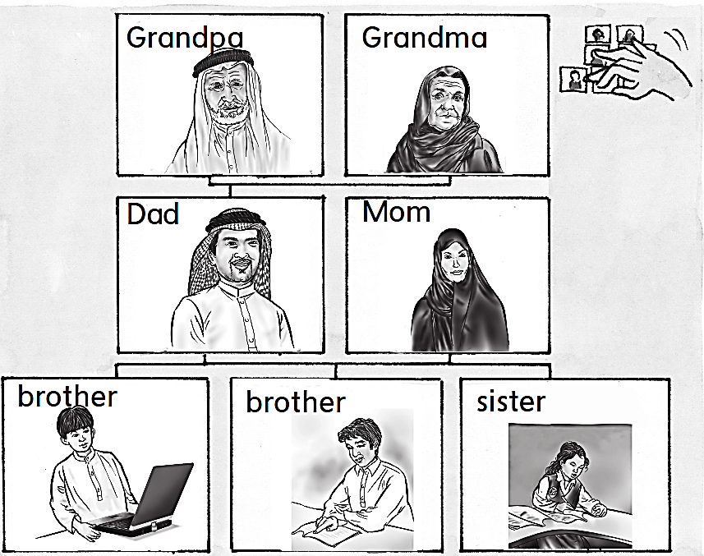
Workbook
3 My Family

Slide 12
Workbook
3 My Family
U U U U U U U

Slide 13
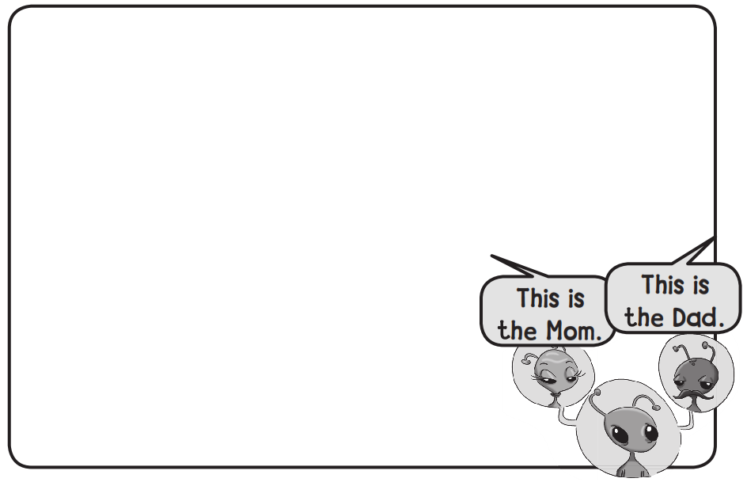
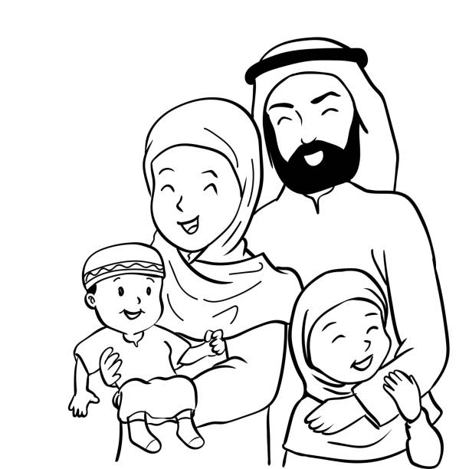
Workbook
3 My Family

Slide 14
Workbook
3 My Family
V V V V V V V V

Slide 15
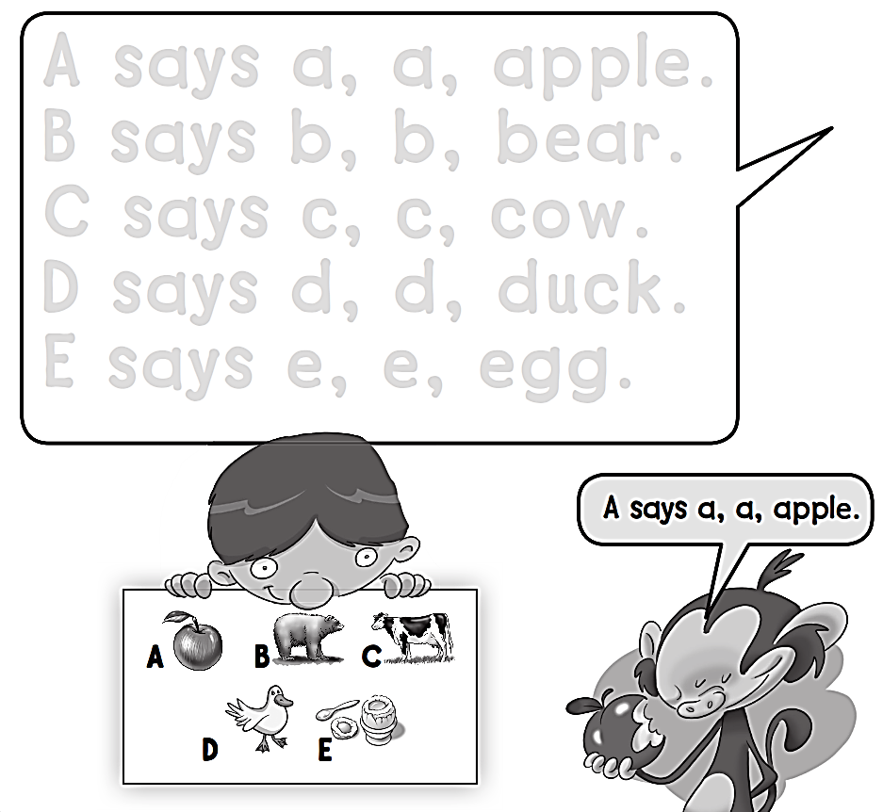
Workbook
3 My Family

Slide 16
Workbook
3 My Family
W W W W W W

Slide 17
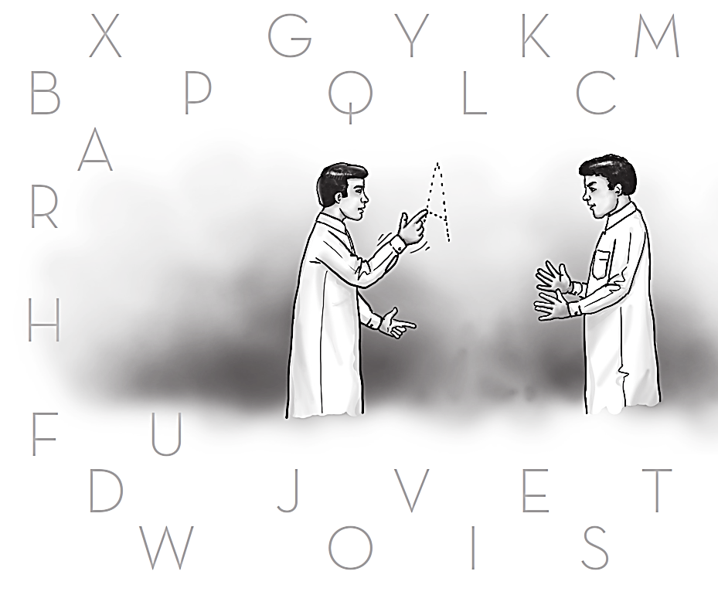
Workbook
3 My Family
X
Z
G
M
Y
K
B
P
Q
L
C
A
R
H
F
U
D
N
J
V
E
T
W
O
I
S

Slide 18
Workbook
3 My Family
X X X X X X X X

Slide 19
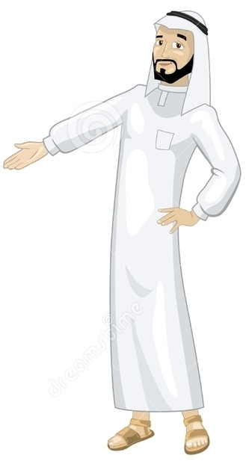
See you later
Goodbye
Teacher :
Badr Sayid Al-Shehri

