Slide 1
Super goal 1

Slide 2
Unit 6

Slide 4
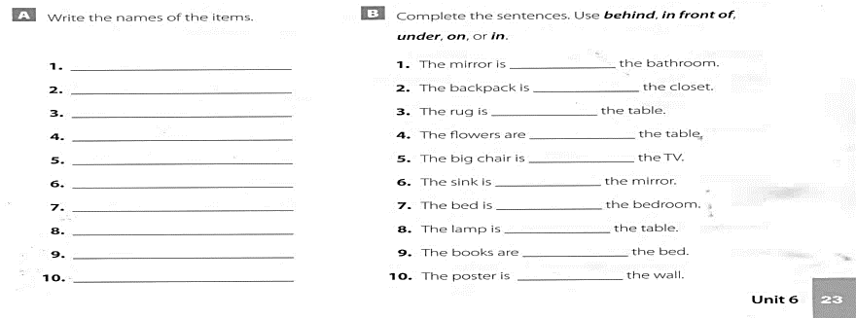
Stove
Rug
Vase
Lamp
Chair
TV
Mirror
Sink
Bed
Closet
in
in
under
on
in front of
under
in
behind
on
behind

Slide 5
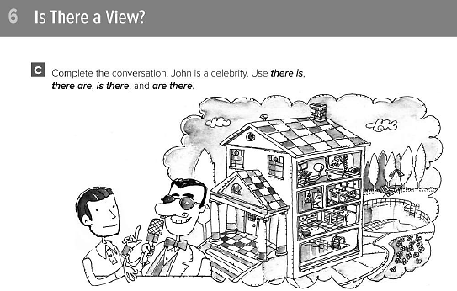

Slide 6
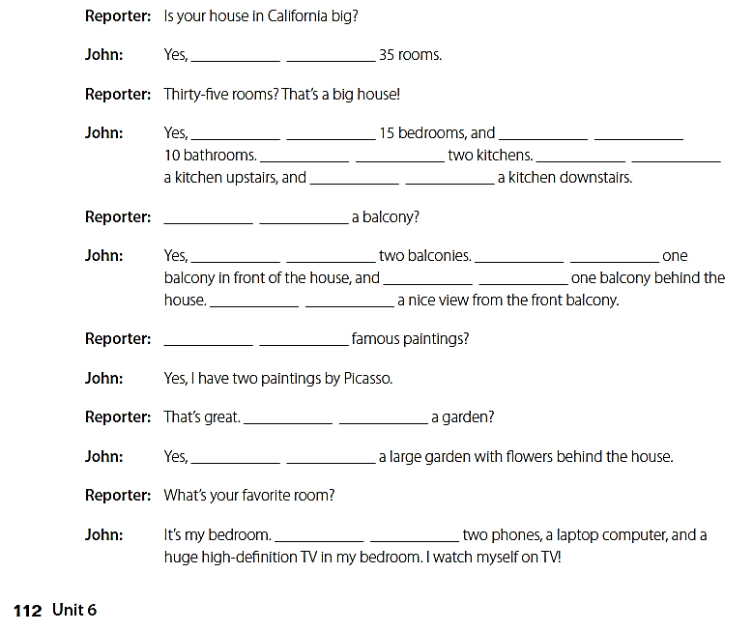
there are
there are
there are
There are
there is
there is
Is there
there are
there is
there is
there is
Are there
Is there
there is
there are

Slide 7
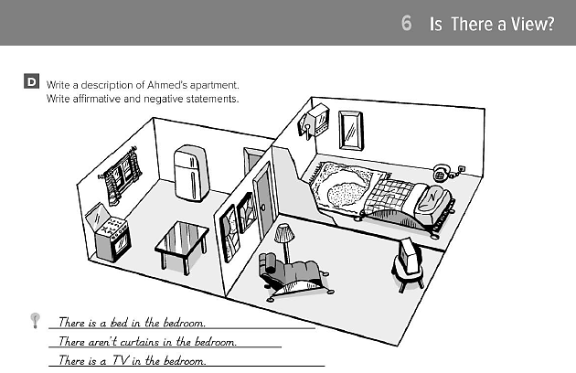

Slide 8
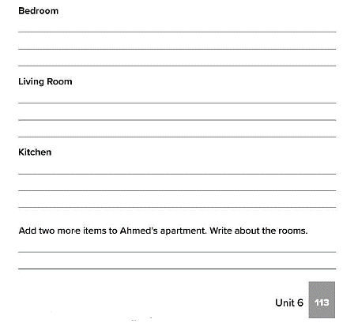
إجابات متنوعة

Slide 9
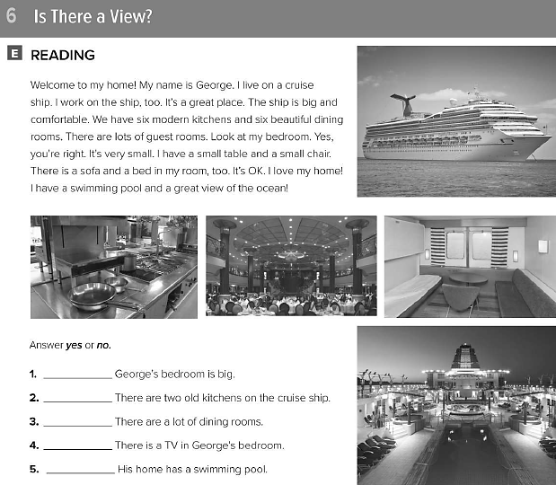
No
No
Yes
No
Yes

Slide 10
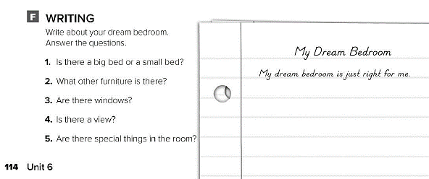
اكتب عن غرفة نومك التي تحلم بها

Slide 11
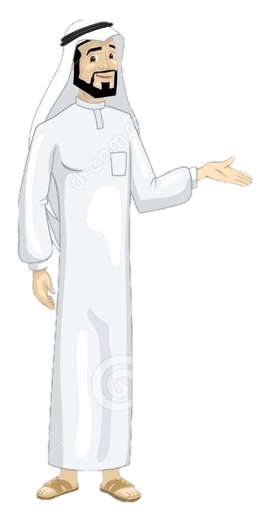
See you later
Take care
Teacher :
Badr Sayid Al-Shehri

