Slide 1
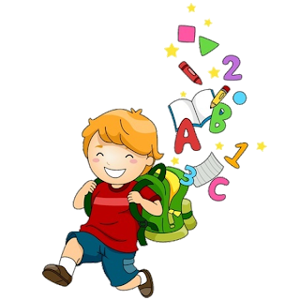
Unit 5
3

Slide 2
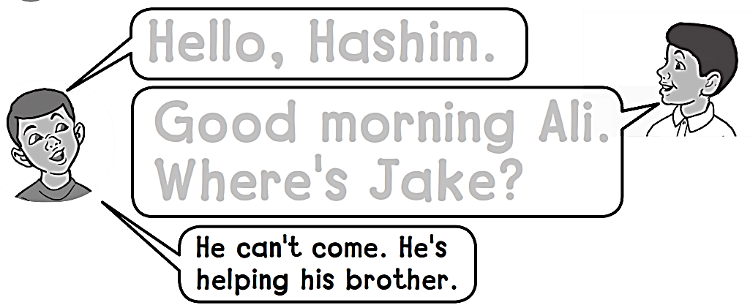
Workbook
5 Friends, Actions, Things
Hello, Hashim.
Good morning Ali .
Where’s Jake ?

Slide 3
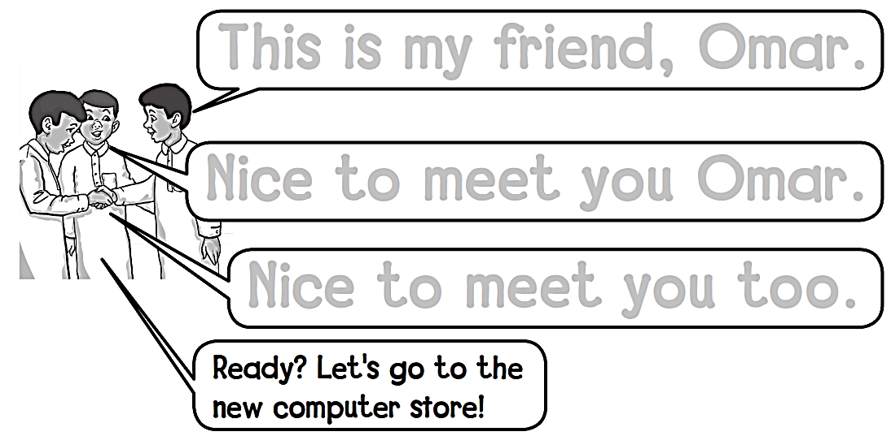
Workbook
5 Friends, Actions, Things
This is my friend Omar .
Nice to meet you Omar .
Nice to meet you too .

Slide 4
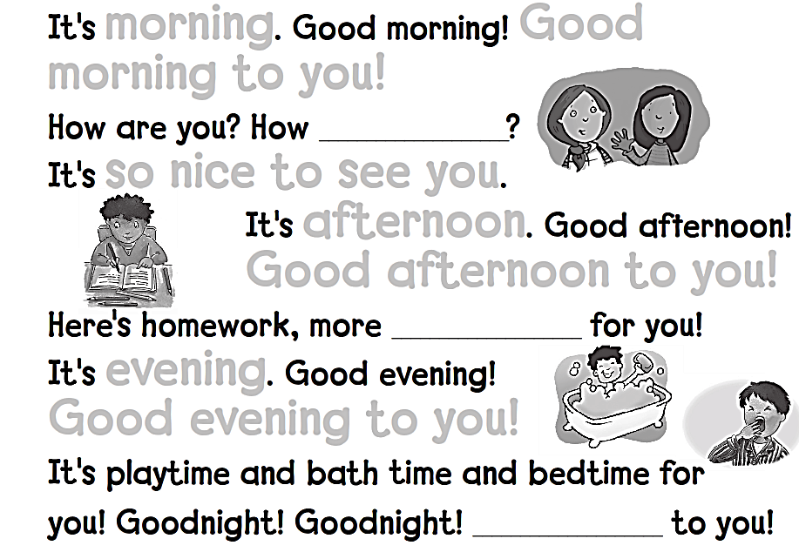
Workbook
5 Friends, Actions, Things
morning Good
morning to you !
are you
so nice to see you
afternoon
Good afternoon to you !
homework
evening
Good evening to you !
Goodnight

Slide 5
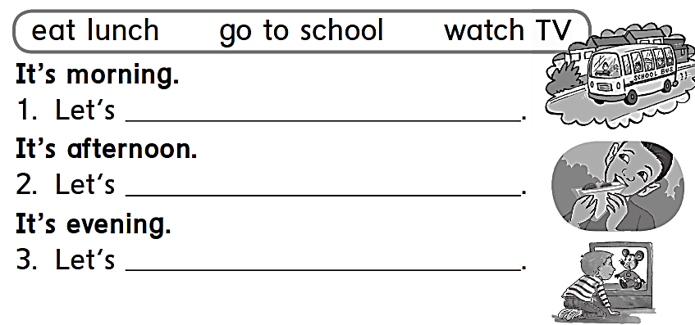
Workbook
5 Friends, Actions, Things
go to school
eat lunch
watch TV

Slide 6
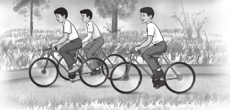
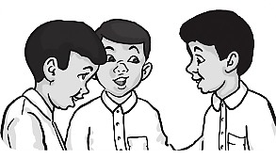
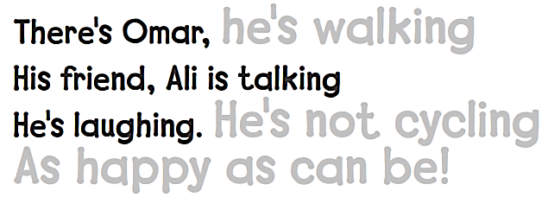
Workbook
5 Friends, Actions, Things
They’re jumping , they’re cycling
he’s walking
He’s not cycling
As happy as can be !

Slide 7
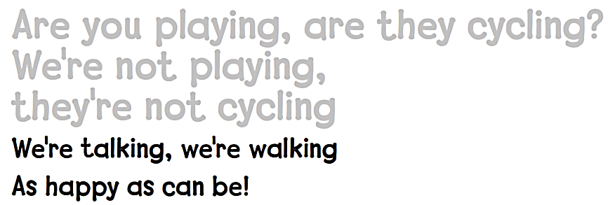
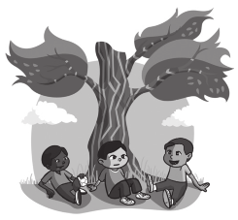
Workbook
5 Friends, Actions, Things
Are you playing , are they cycling ?
We’re not playing .
They’re not cycling

Slide 8
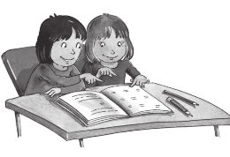
Workbook
5 Friends, Actions, Things
They΄re pointing
They΄re not writing

Slide 9
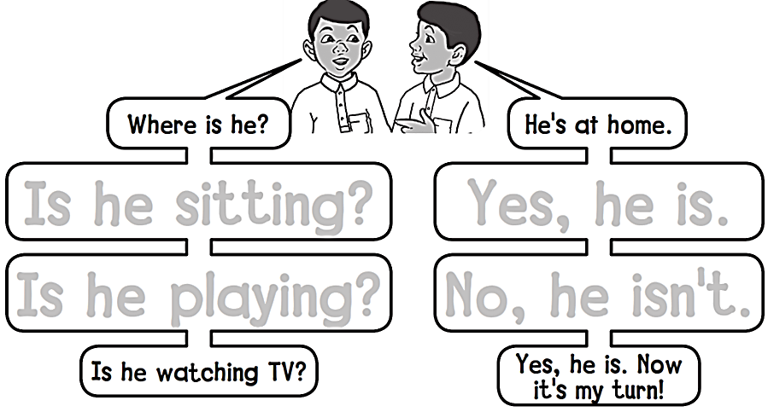
Workbook
5 Friends, Actions, Things
Is he sitting? Yes, he is.
Is he playing? No, he isn’t.

Slide 10
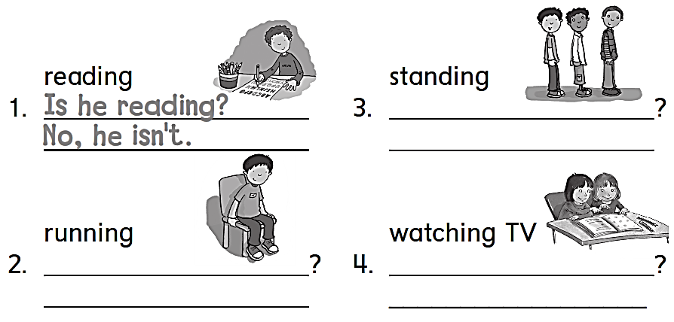
Workbook
5 Friends, Actions, Things
Are they standing
Yes , they are
Is he running
Are they watching TV
No , he isn’t
No , they aren’t

Slide 11
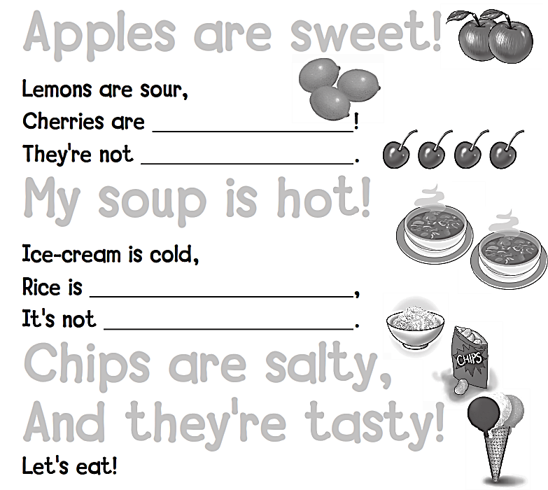
Workbook
5 Friends, Actions, Things
Apples are sweet !
sweet
sour
My soup is hot !
hot
cold
Chips are salty ,
And they’re tasty !

Slide 12
Workbook
5 Friends, Actions, Things
sour
tasty
are sweet
hot

Slide 13
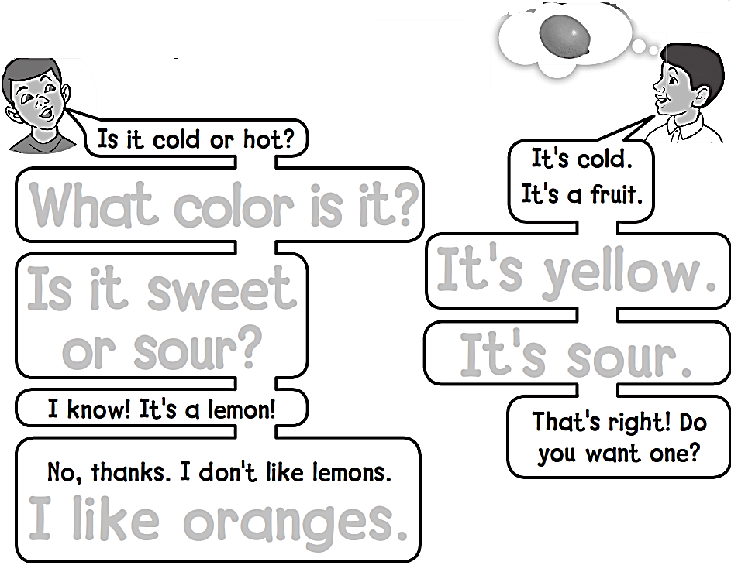
Workbook
5 Friends, Actions, Things
What color is it ?
Is it sweet
or sour ?
It’s yellow .
It’s sour .
I like oranges .

Slide 14
Workbook
5 Friends, Actions, Things
It is hot
It is salty
No , it isn’t
It is white and brown
Yes , it is
Kabsa

Slide 15
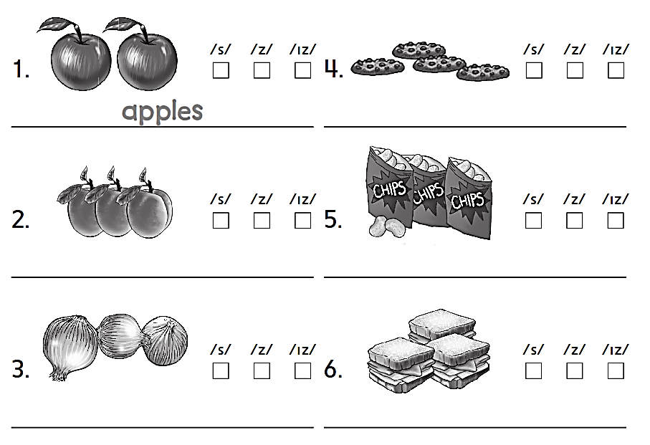
Workbook
5 Friends, Actions, Things
Cookies
Apricots
Chips
Onions
Sandwiches

Slide 16
Workbook
5 Friends, Actions, Things
No , I don΄t
Yes , I do .
Yes , I do .

Slide 17
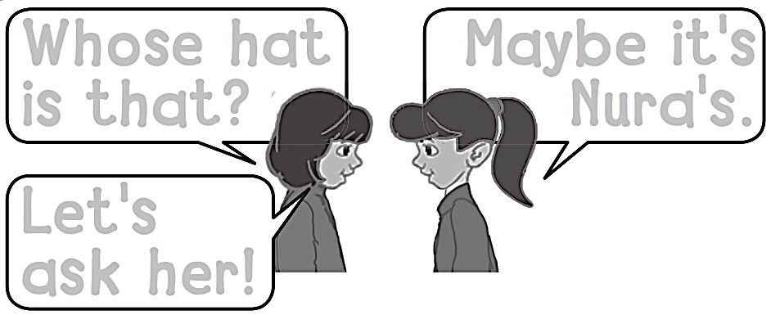
Workbook
5 Friends, Actions, Things
Whose hat
is that ?
Maybe it’s
Nora's.
Let’s
ask her !

Slide 18
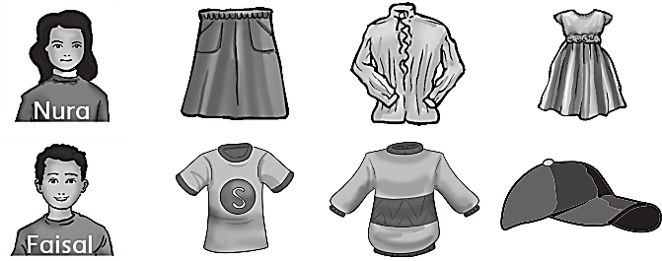
Workbook
5 Friends, Actions, Things
Whose blouse is this ?
It΄s nura΄s
Whose dress is this ?
It΄s nura΄s
Whose t-shirt is this ?
It΄s faisal΄s
Whose sweater is this ?
It΄s faisal΄s
Whose cap is this ?
It΄s faisal΄s

Slide 19
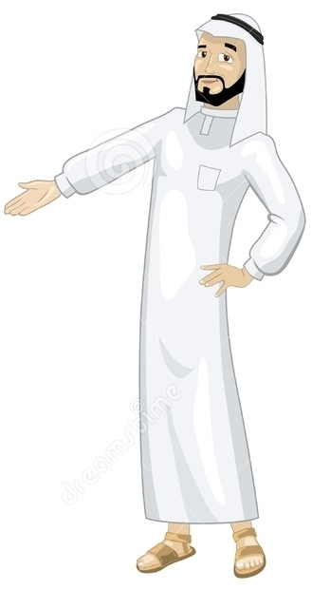
See you later
Goodbye
Teacher :
Badr Sayid Al-Shehri

