Slide 1


3
Unit 3

Slide 2
Things We Do
الأشياء التي نمارسها

Slide 3
Rhythms and Sounds
الايقاعات والأصوات

Slide 4
Materials :
Colors flashcards
Clothes flashcards
Things we do flashcards

Slide 5
Strategy :
The teacher says :
The object of the game is to follow what “the Teacher” says to do. You must only do the action when it is prefaced with, “The Teacher says…” If just the action is said and the student does the action, that student is out of the game and must sit down. When playing this game, “the Teacher” always does the actions to try and trick the players into doing what he says, even when they aren’t supposed to.

Slide 6

Review the previous lesson
مراجعة سريعة للدرس السابق

Slide 7
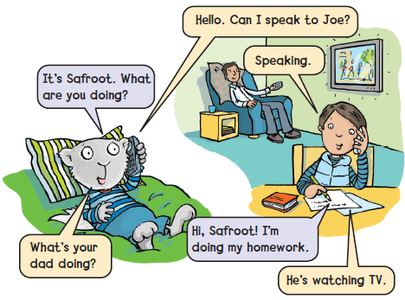

Slide 8
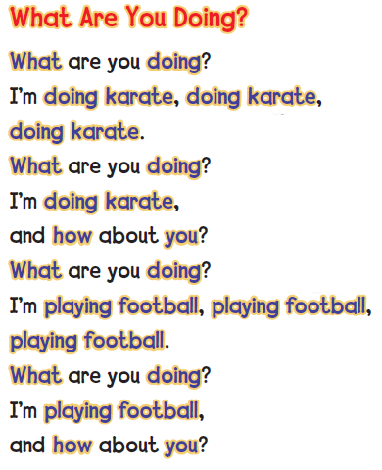
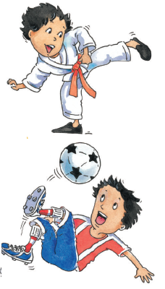

1
Listen and chant
استمع ثم ردد الأنشودة

Slide 9
2
Chant again and do
كرر الأنشودة مع تمثيل الحركات

Slide 10

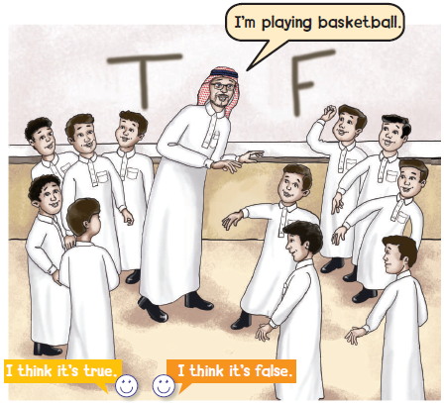



وقت المرح
True of False action game لعبة الصح أو الخطأ
Run to the T or F when your teacher does the action
اختر حرف T أو حرف F عندما يحدد معلمك الفعل الذي يمثله
3
T =
F =

Slide 11

Goal Check
التحقق من الهدف

Slide 12
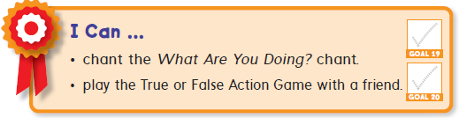
الهدف
أن يردد الطالب الأنشودة
أن يطبق الطالب لعبة T - F مع زميله

Slide 13

Have a nice day
See you next class

