Slide 1
3
Unit 1

Slide 2
Feelings
المشاعر

Slide 3
Rhythms and Sounds
الايقاعات والأصوات

Slide 4
Materials :
Classroom English poster
My body flashcard

Slide 5
Strategy :
The Teacher Says :
The object of the game is to follow what “The Teacher” says to do. You must only do the action when it is prefaced with, “The Teacher says…” If just the action is said and the student does the action, that student is out of the game and must sit down. When playing this game, “Teacher” always does the actions to try and trick the players into doing what he/she says, even when they aren’t supposed to.

Slide 6
Review the previous lesson
مراجعة سريعة للدرس السابق

Slide 7
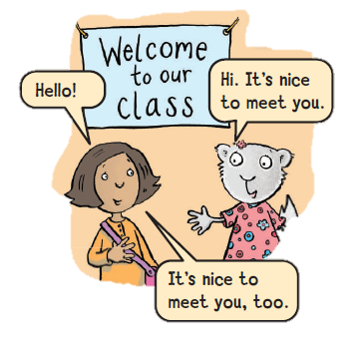
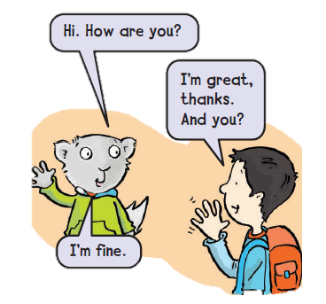

Slide 8
1
Chant and do
ردد الأنشودة مع تطبيق الحركات

Slide 9
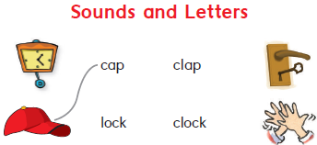
2
Listen , say , and match
استمع ، انطق ، ثم صل الكلمة للصورة

Slide 10
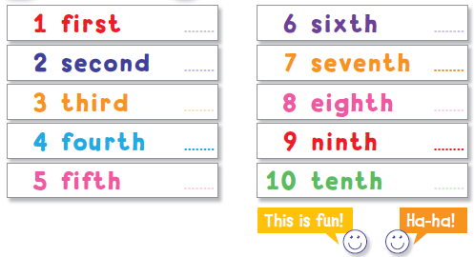
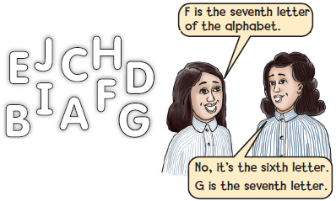
وقت المرح
3
Confusing Game لعبة التفكير
Try and trick your partner . حاول أن تخدع زميلك

Slide 11
Goal Check
التحقق من الهدف

Slide 12
الهدف
أن يردد الطالب الأنشودة مع زميله
أن يطبق الطالب لعبة التفكير مع زميله

Slide 13
Have a nice day
See you next class

