Slide 1
Super Goal 5

Slide 2
UNIT 6

Slide 3
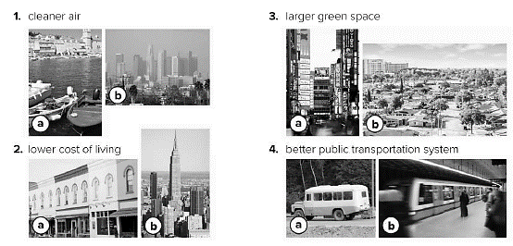

Slide 4
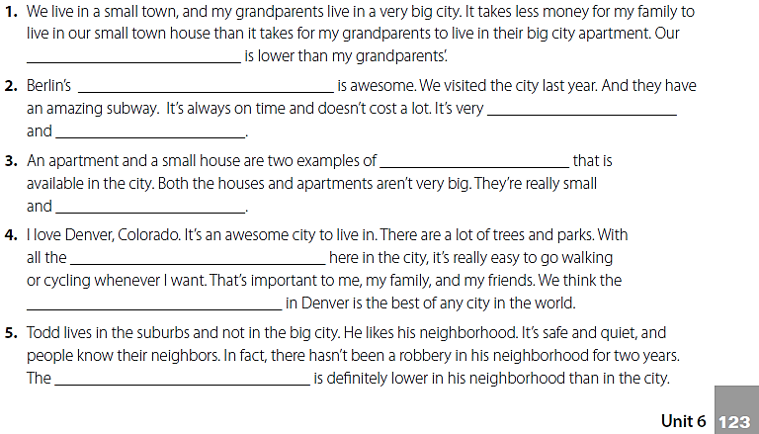
cost of living
public transportation system
punctual
efficient
housing
cozy
green spaces
quality of life
crime rate

Slide 5
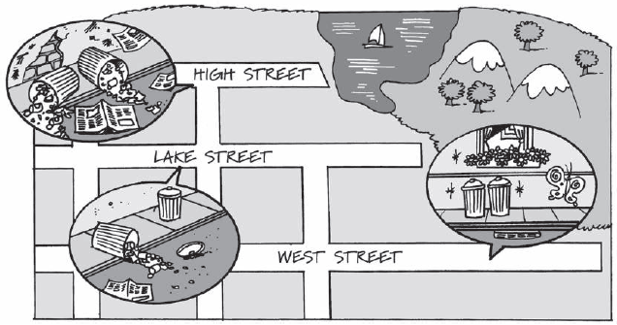
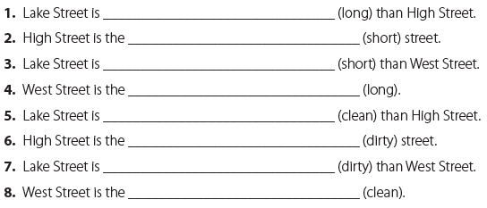
longer
shortest
shorter
longest
cleaner
dirtiest
dirtier
cleanest

Slide 6
more expensive
less expensive
the most expensive

Slide 7
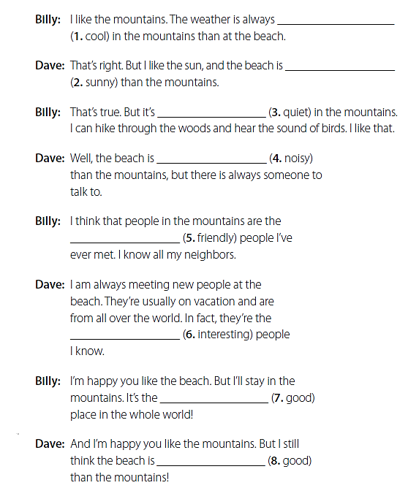
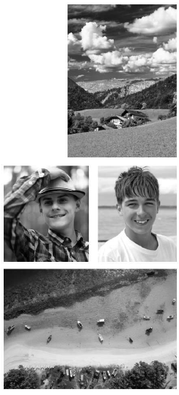
cooler
sunnier
quieter
noisier
friendliest
most interesting
best
better

Slide 8
I prefer to live in the mountains because the weather is cooler .
I prefer to live in the mountains because the air is cleaner .
I prefer to live in the mountains because the people are friendlier .

Slide 9
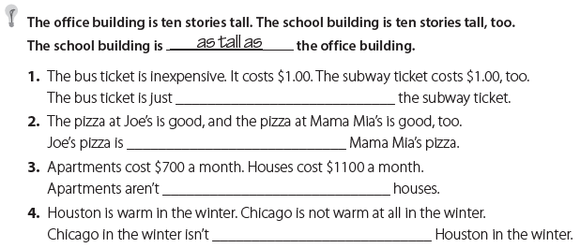
as expensive as
as good as
as expensive as
as warm as

Slide 10
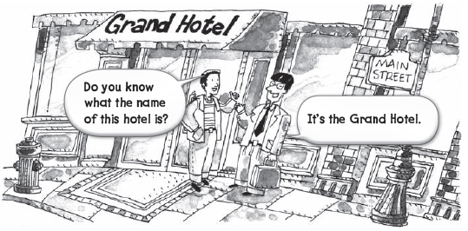
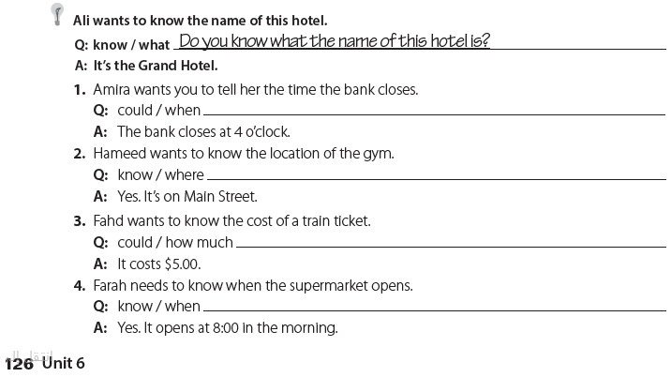
Could you tell me when the bank closes ?
Do you know where the gym is ?
Could you tell me how much a train ticket costs ?
Do you know when the supermarket opens ?

Slide 11
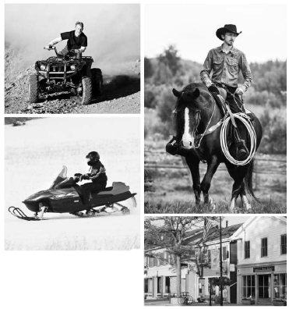
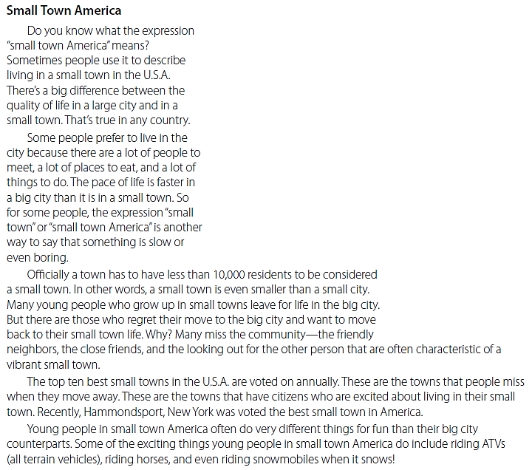

Slide 12
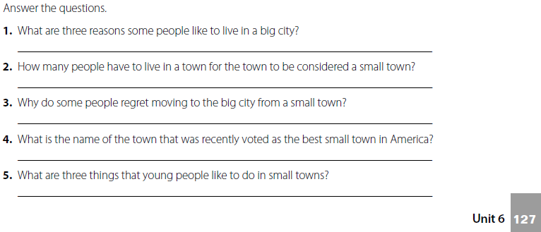
There are a lot of people to meet, a lot of places to eat, and a lot of things to do.
Less than 10,000 people .
because they miss the community of a small town .
Hammondsport , New York .
Riding the ATVs , horses , and the snowmobiles .

Slide 13
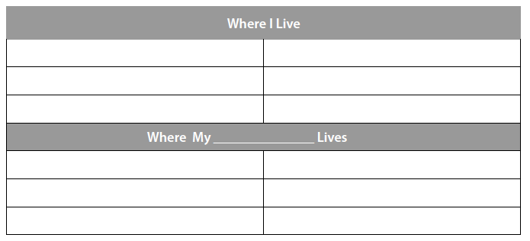
تحدث عن المكان الذي تسكن فيه
تحدث عن المكان الذي يسكن فيه صديقك

Slide 14
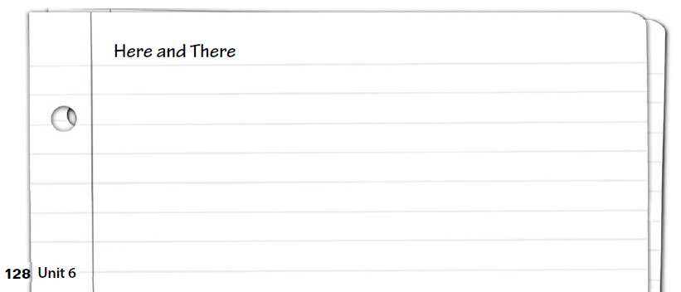
قارن بين المكان الذي تسكن فيه والمكان الذي يسكن به صديقك

Slide 15
EXPANSION 4-6

Slide 16
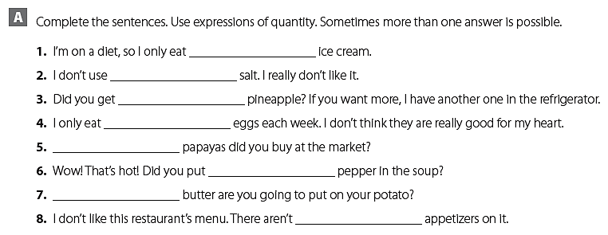
a little
much
enough
a few
How many
a lot of
How much
many
something
anything
nothing
anything
something

Slide 17
First, crack four eggs into a bowl.
Then stir the eggs for one minute.
After that, pour the eggs into a frying pan.
Finally, cook the eggs for three minutes

Slide 18
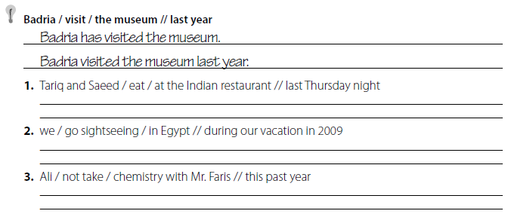
Tariq and Saeed have eaten at the Indian restaurant.
Tariq and Saeed ate at the Indian restaurant last Thursday night.
We have gone sightseeing in Egypt.
We went sightseeing in Egypt during our vacation in 2009.
Ali hasn’t taken chemistry with Mr. Faris.
Ali didn’t take chemistry with Mr. Faris this past year.

Slide 19
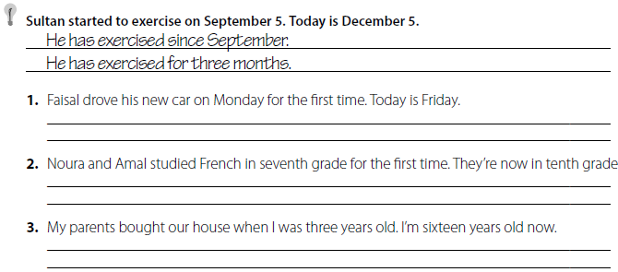
He has driven his new car since Monday .
He has driven his new car for fie days .
They have studied French since seventh grade .
They have studied French for three years.
We have lived in our house since I was three years old .
We have lived in our house for 13 years.

Slide 20
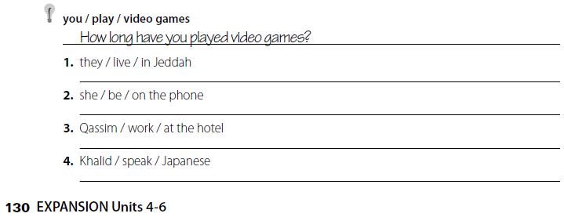
How long have they lived in Jeddah ?
How long has she been on the phone ?
How long has Qassim worked at the hotel ?
How long has Khalid spoken Japanese ?

Slide 21
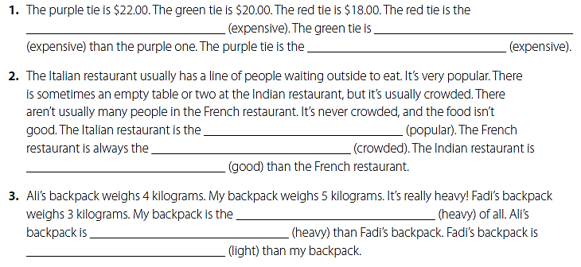
least expensive
less expensive
most expensive
most popular
least crowded
better
heaviest
heavier
lighter

Slide 22
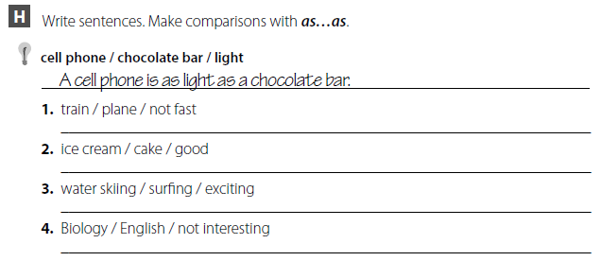
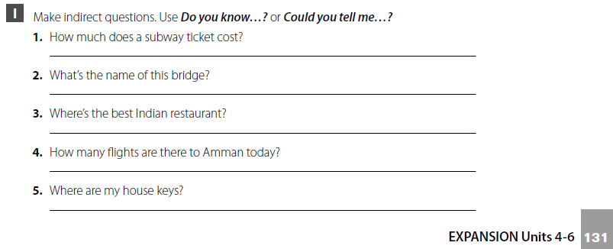
A train is not as fast as a plane.
Ice cream is as good as cake.
Water skiing is as exciting as surfing.
Biology is not as interesting as English
Do you know how much a subway ticket costs?
Do you know what the name of this bridge is?
Could you tell me where the best Indian restaurant is?
Do you know how many flights there are to Amman today?
Do you know where my keys are?

Slide 23
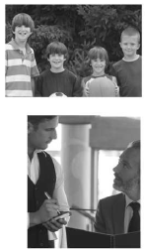
Do you know what the most popular sport in the world is?
Well, I think basketball is more popular than baseball.
And basketball isn’t as popular as football.
So, football is the most popular sport in the world. It’s also the best!
Could you tell me what fresh fish you have today?
The tuna is fresh, but the salmon is fresher.
OK, I’ll have the salmon. Could you tell me what it comes with?
It comes with salad and rice or baked potato. I recommend the baked potato. It’s much better than the rice..

Slide 24
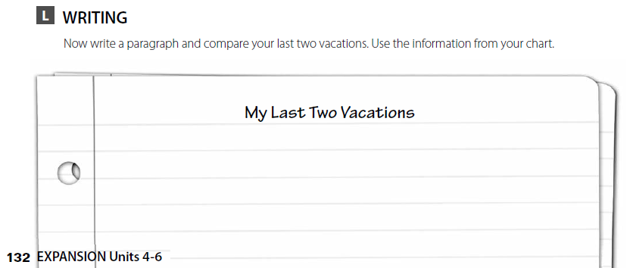
تحدث عن اخر إجازتين قضيتها
قم بكتابة قطعة عن الاجازتين من خلال الجدول السابق

Slide 25
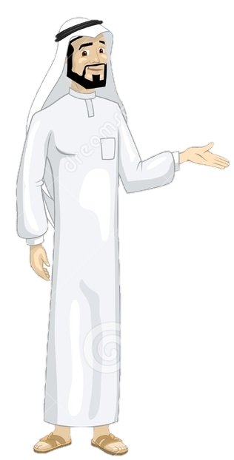
See you later
Take care
Teacher :
Badr Sayid Al-Shehri

