Slide 1
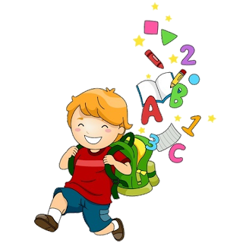
5
Unit 4

Slide 2
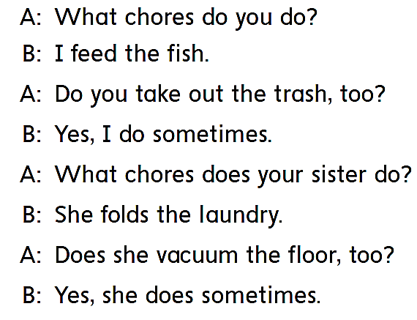
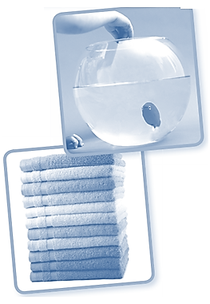
Workbook
Chores

Slide 3
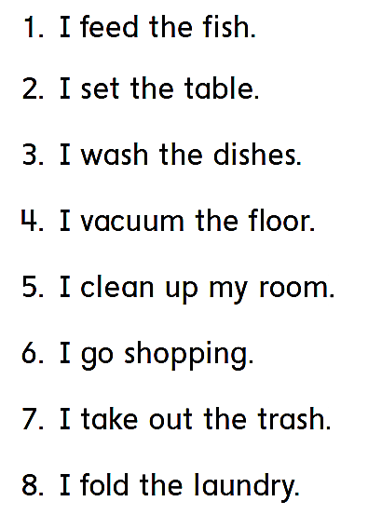
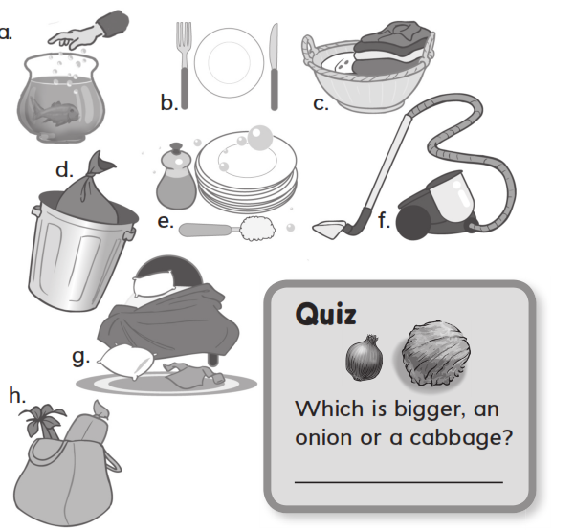
Workbook
Chores
a
b
e
f
g
h
d
A cabbage
c

Slide 4
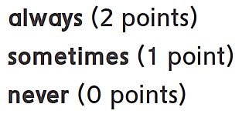
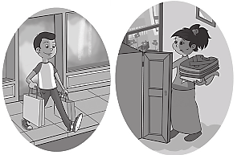
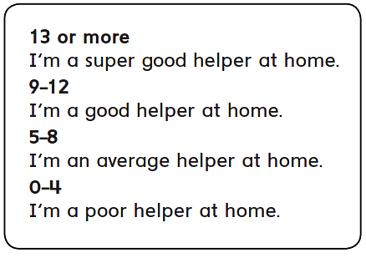
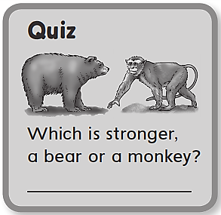
Workbook
Chores
always feed
sometimes set
always wash
sometimes vacuum
always clean
sometimes go
always take
never fold
11
A bear

Slide 5
Workbook
Chores

Slide 6
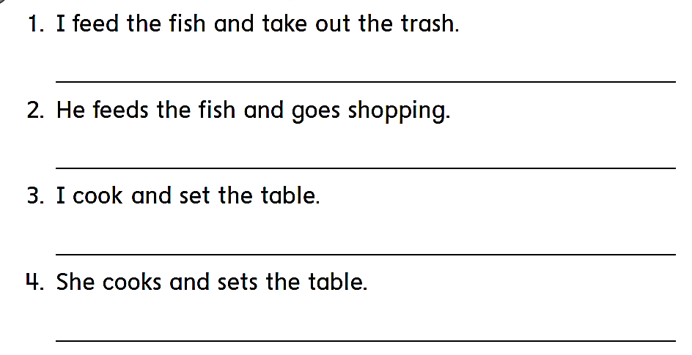
Workbook
Chores
I feed the fish and take out the trash .
He feeds the fish and goes shopping .
I cook and set the table .
She cooks and sets the table .

Slide 7
Workbook
Chores
fold
folds
walk
walks
go
goes

Slide 8
Workbook
Chores
I wash the dishes .
You wash the dishes .
He washes the dishes .
She washes the dishes
We wash the dishes .
They wash the dishes .

Slide 9
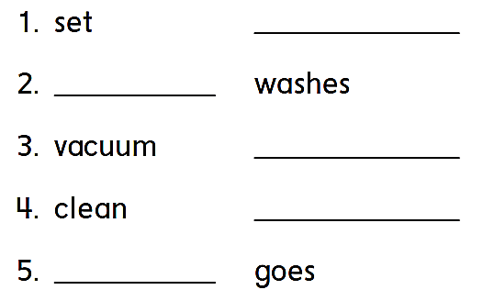
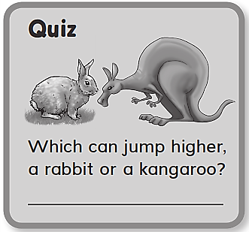
Workbook
Chores
sets
wash
vacuums
cleans
go
A kangaroo

Slide 10
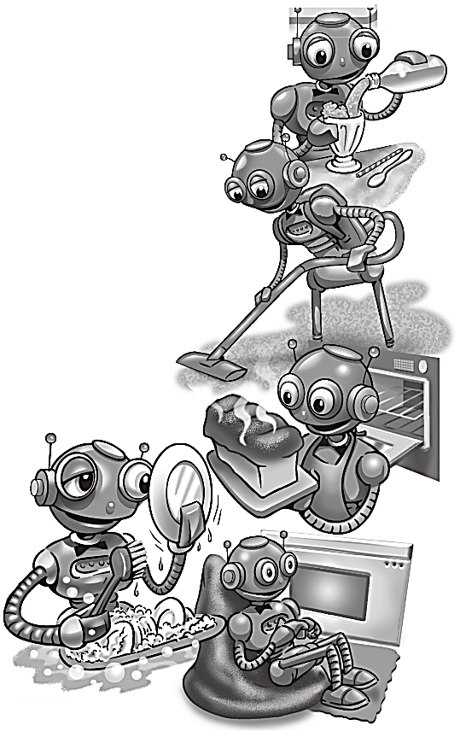
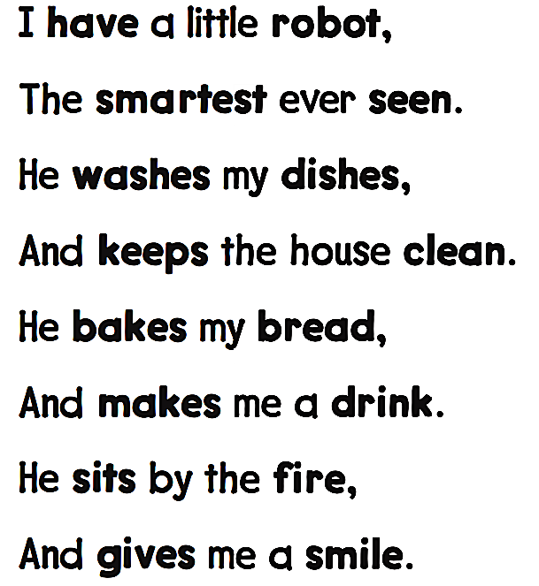
Workbook
Chores

Slide 11
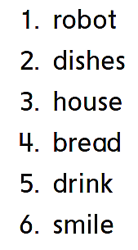
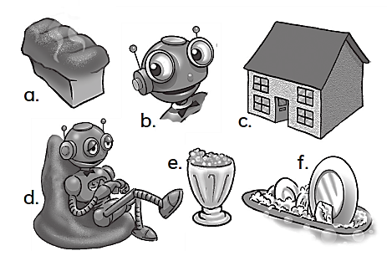
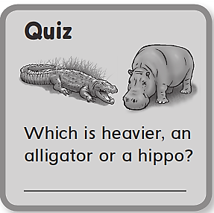
Workbook
Chores
d
f
c
a
e
b
A hippo

Slide 12
Workbook
Chores

Slide 13
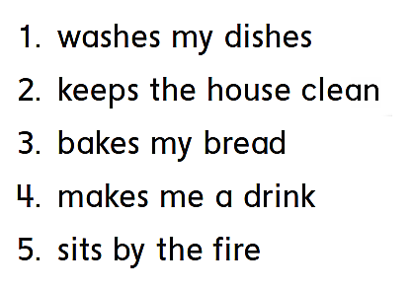
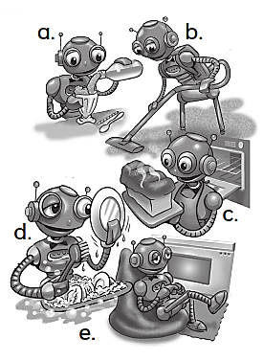
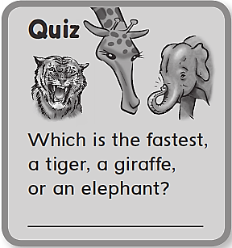
Workbook
Chores
d
b
C
a
e
A tiger

Slide 14
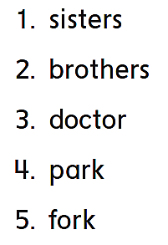
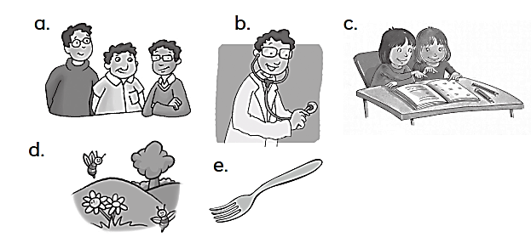
Workbook
Chores
c
a
b
d
e

Slide 15
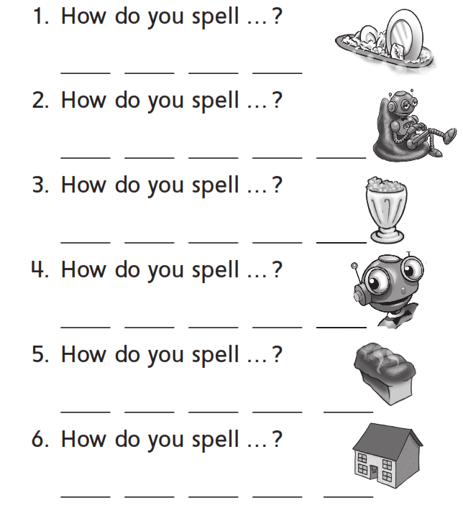
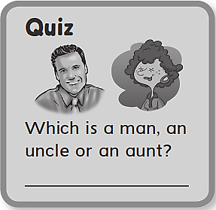
Workbook
Chores
W a s h
R o b o t
d r i n k
S m i l e
b r e a d
h o u s e
An uncle

Slide 16
Workbook
Chores
car
doctor
teacher
computer
horse
farm

Slide 17
Workbook
Chores
Car
Jar
Star
Scar
Door
Floor
Actor
Color
Over
Ever
Under
Power
Danger
Teacher
Doctor
Calendar

Slide 18
Workbook
Chores
car
fork
farm
Teacher
A volcano

