Slide 1
Super goal 3

Slide 2
Unit 2

Slide 3
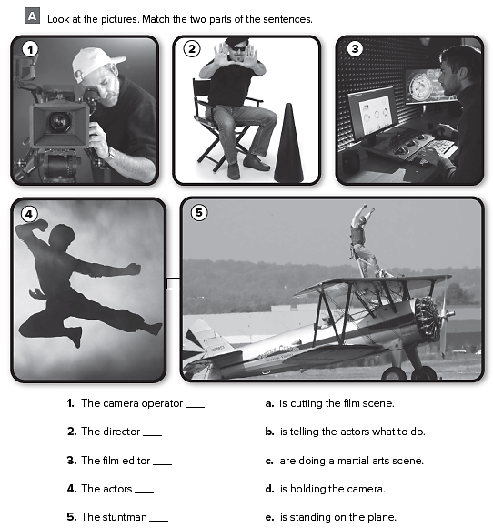
d
b
a
c
e

Slide 4
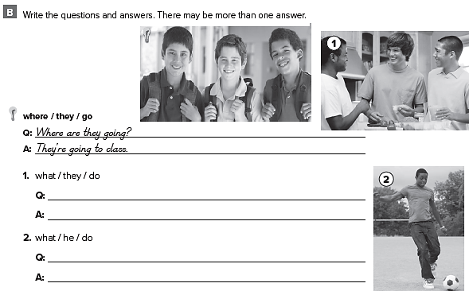
What are they doing ?
They are eating
What is he doing ?
He is playing football

Slide 5
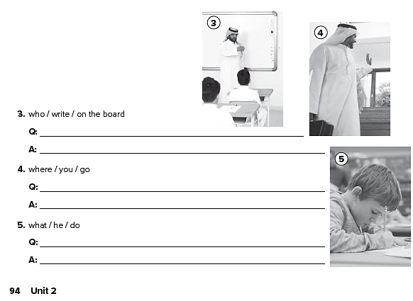
Who is writing on the board ?
My English teacher
Where are you going ?
I am going to the airport
What is he doing ?
He is doing his homework

Slide 6
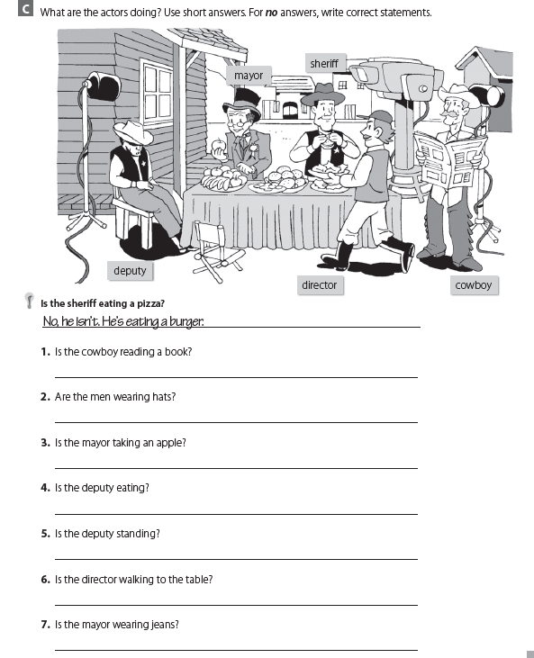
No , he isn’t , he is reading a newspaper .
Yes , they are
Yes , he is
Yes , he is
No , he isn’t , he is sleeping
Yes , he is
No , he isn’t , he is wearing a suit

Slide 7
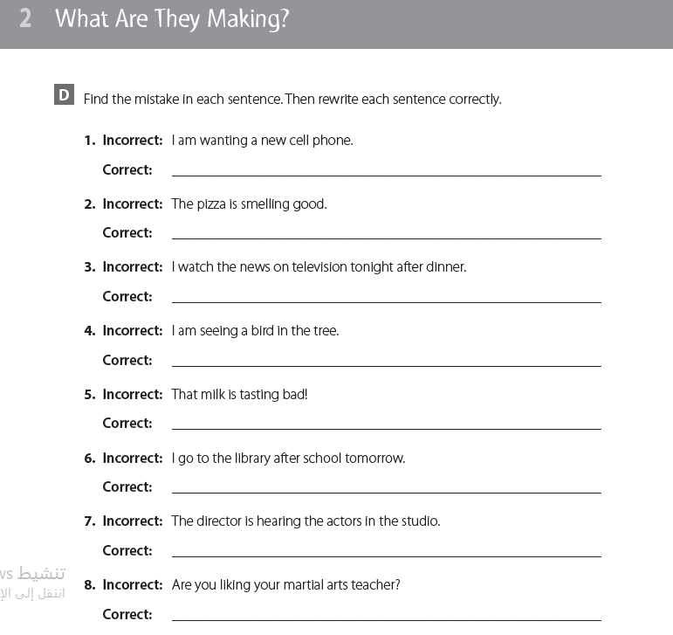
I want a new cell phone
The pizza smells good
I am watching the news on TV tonight after dinner
I see a bird on the tree
That milk tastes bad
I am going to the library tomorrow after school
The director hears the actors in the studio
Do you like your martial arts teacher ?

Slide 8
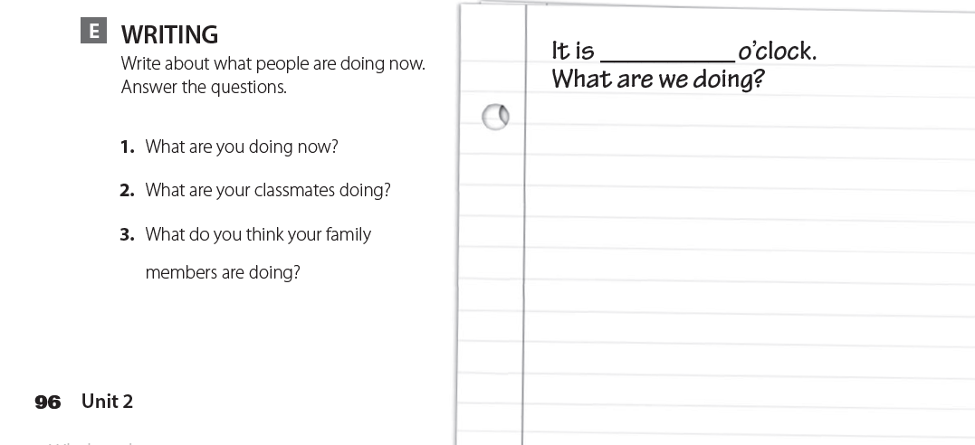
8
I am at school at this time . My classmates and I are practicing some football during PE class . Right now I think my father has arrived to his work . He works in the bank , and my mother probably doing the laundry at home .
تحدث عن ما يجري معك في هذه اللحظة

Slide 9
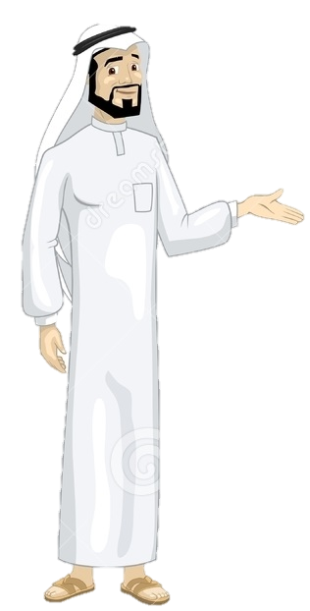
See you later
Take care
Teacher :
Badr Sayid Al-Shehri

