Slide 1
3
Unit 4

Slide 2
Beautiful Nature
الطبيعة الجميلة

Slide 3
Words in Action
كلمات فعلية

Slide 4
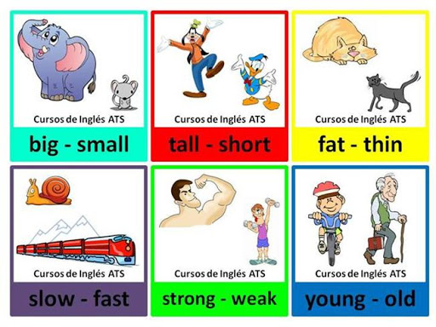
Materials :
Opposites flashcards

Slide 5
Strategy :
Opposites Matching Game :
Divide the class into two teams. The first team will say one of the words and do the action. The second team has to say the opposite word and do that action. If the second team says the correct opposite word, they get a point. If they do not, the first team has a chance to do the action and say the word to get a point. In the next round, the second team will say a word and make the action and the first team has to say the opposite. Continue until all of the opposite words have been used. The team with the most points wins.

Slide 6
Review the previous lesson
مراجعة سريعة للدرس السابق

Slide 8
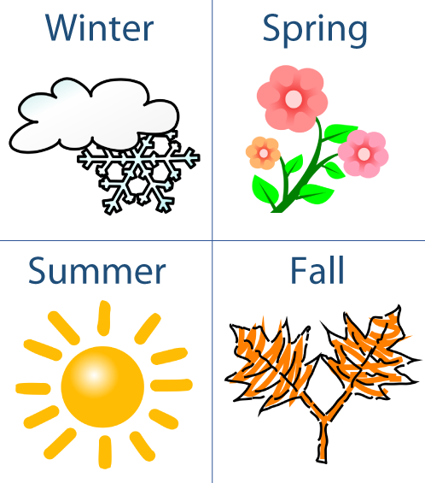
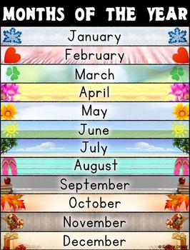

Slide 9
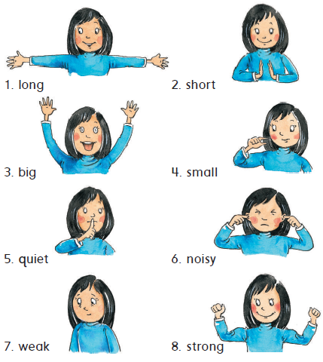
1
Listen , point , and say
استمع ، تبع ، ثم اقراء

Slide 10
2
Shout the opposites in two groups
كرر الكلمات من خلال مجموعتين
Practice the action in pairs
طبق الحركات مع زميلك
3

Slide 11
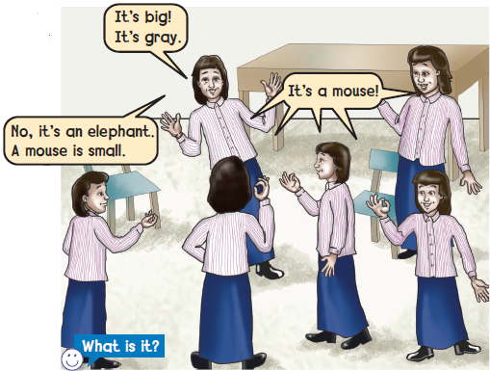
وقت المرح
4
Guess what it is احزر ما هو
Do the opposite action طبق الحركة المعاكسة

Slide 12
Goal Check
التحقق من الهدف

Slide 13
الهدف
أن يطبق الطالب لعبة الصفة المعاكسة
أن يصف الطالب شيء ما

Slide 14
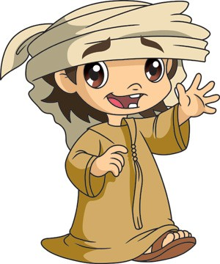
Have a nice day
See you next class

