Slide 1
Super goal 1

Slide 2
Unit 8

Slide 3
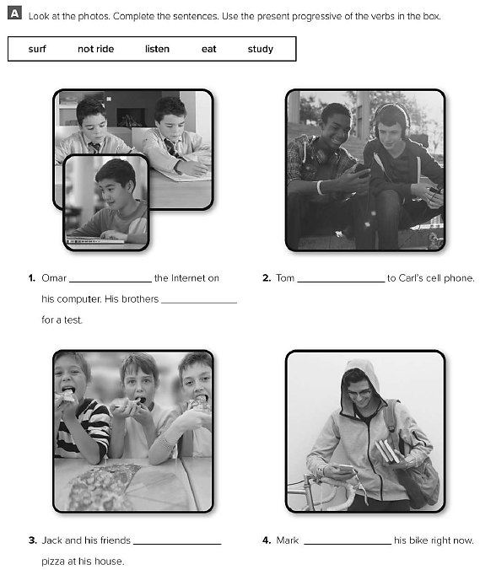
is surfing
is listening
are studying
are eating
is not riding

Slide 4
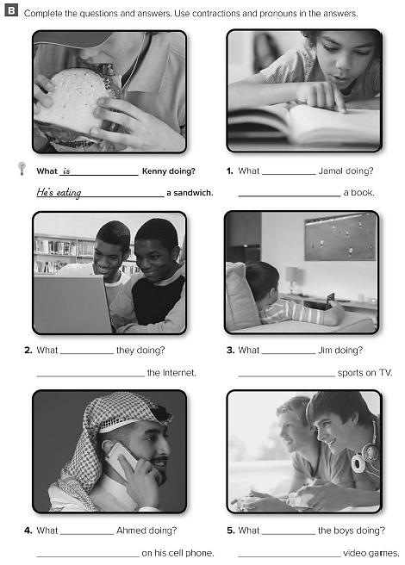
is
He’s reading
are
They’re surfing
is
He’s watching
is
He’s talking
are
They’re playing

Slide 5
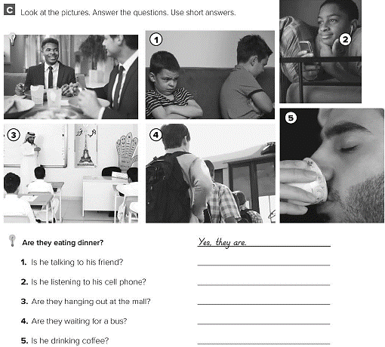
No , he isn’t
Yes , he is
No , they aren’t
Yes , they are
Yes , he is

Slide 6
What is Asma doing
What are they doing
What are you doing
What are you doing

Slide 7
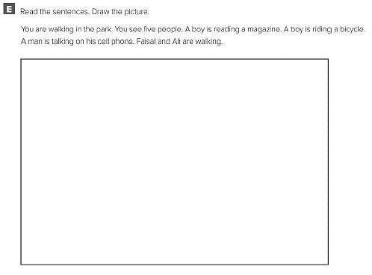
اقراء النص ثم ارسم الصورة عما قرأت

Slide 8
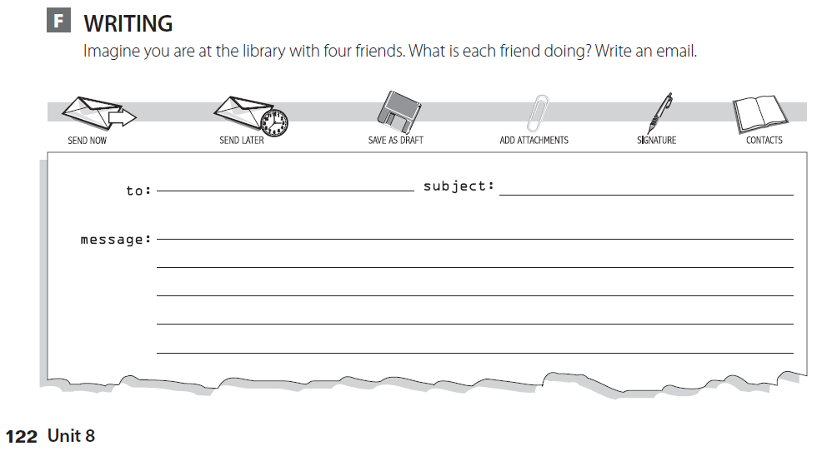
Ali fun at the library
Hello Ali , I’m writing to you from the school library . I’m here with my friends . Faisal is reading a story . Fahad is doing his homework .
Omar is studying for his exam . And I’m surfing the internet . What are doing ?

Slide 9
Expansion 2

Slide 10
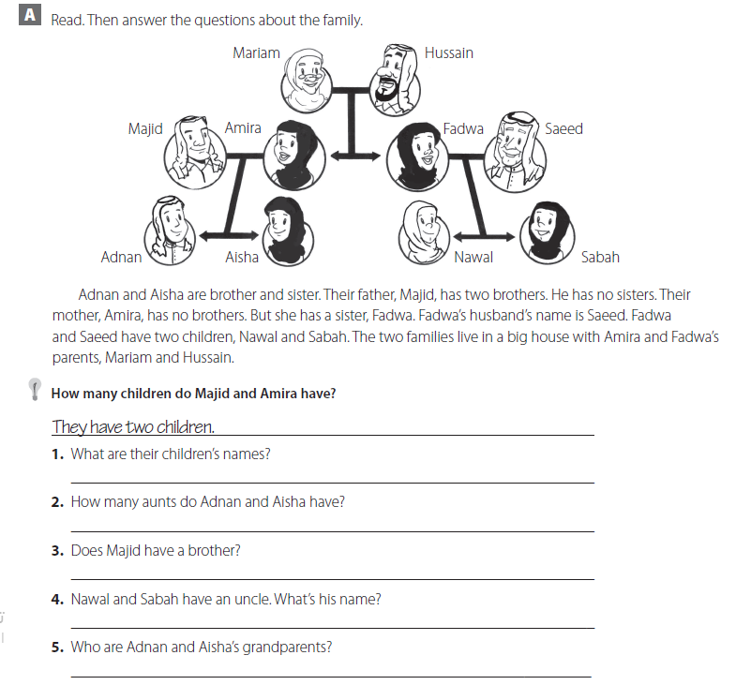
Adnan and Aisha
Only one
No he doesn’t
Majid
Mariam and Hussain

Slide 11
There is
There is
There is
There are

Slide 12
They’re eating
He’s surfing
He’s talking
He’s writing

Slide 13
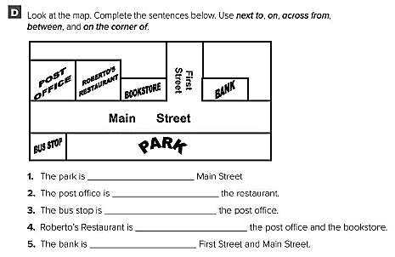
on
next to
across from
between
on the corner

Slide 14
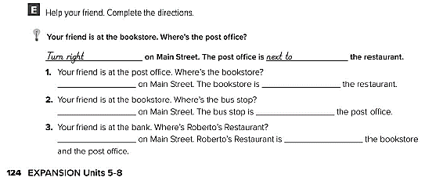
Turn left next to
Turn right across from
Turn right next to

Slide 15
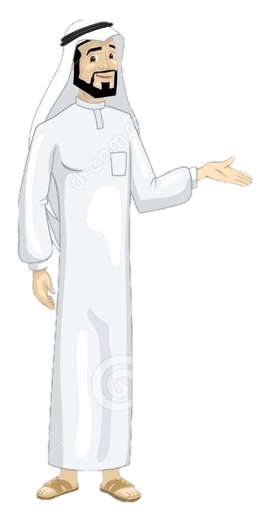
See you later
Take care
Teacher :
Badr Sayid Al-Shehri

