Slide 1

Super goal 1

Slide 2
Unit 2

Slide 3
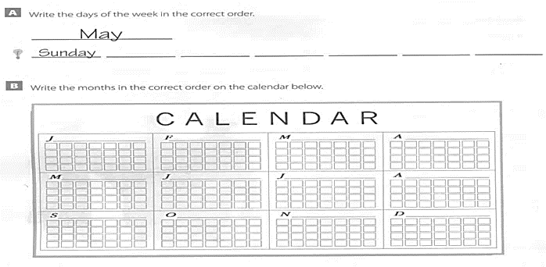
Monday Tuesday Wednesday / Thursday / Friday Saturday
January February March April
May June July August
September October November December

Slide 4
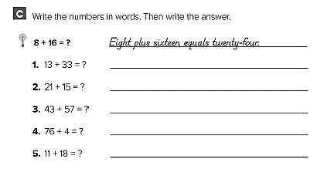
Thirteen plus thirty-three equals forty-six.
Twenty-one plus fifteen equals thirty-six.
Forty-three plus fifty-seven equals one hundred
Seventy-six plus four equals eighty.
Eleven plus eighteen equals twenty-nine.

Slide 5
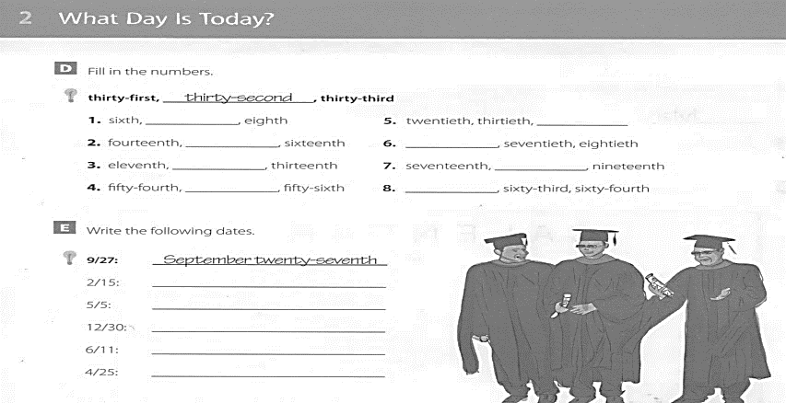
Seventh
Fortieth
Fifteenth
Sixtieth
Twelfth
Eighteenth
Fifty-fifth
Sixty-second
February fifteenth
May fifth
December thirtieth
June eleventh
April twenty-fifth

Slide 6
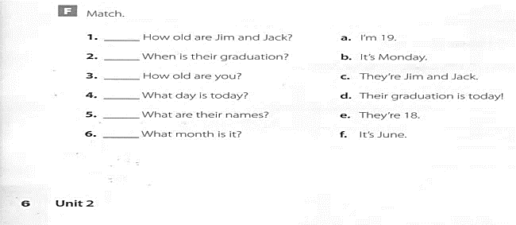
e
d
a
b
c
f

Slide 7
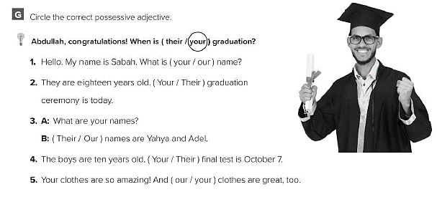

Slide 8
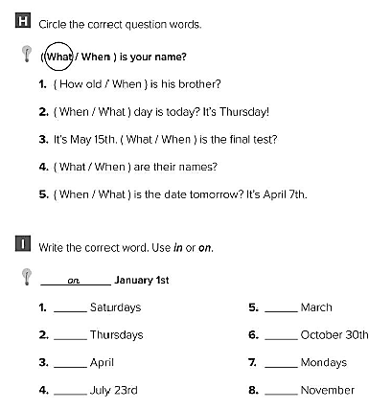
on
on
in
on
in
on
on
in

Slide 9
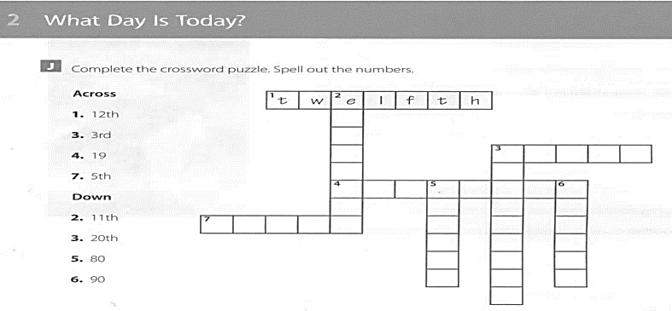
l
e
v
e
t
t h i r d
w
n
t
i
e
t
h
n i n e t e e n
i
g
h
t
y
i
n
e
t
y
f i f t h

Slide 10
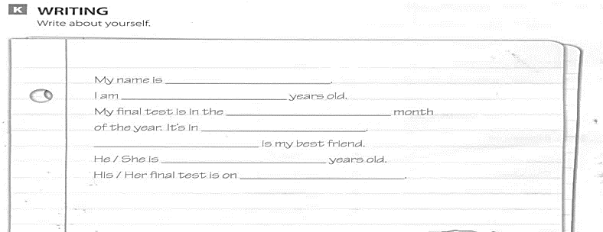
كل طالب يكمل ببياناته
الاسم
العمر
الشهر الذي فيه الاختبار
موعد الاختبار النهائي
اسم صديقك
عمر صديقك
موعد الاختبار لصديقك

Slide 11
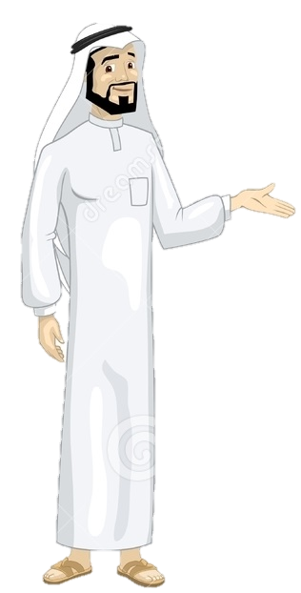
See you later
Take care
Teacher :
Badr Sayid Al-Shehri

