Slide 1
Super goal 1

Slide 2
Unit 1

Slide 3
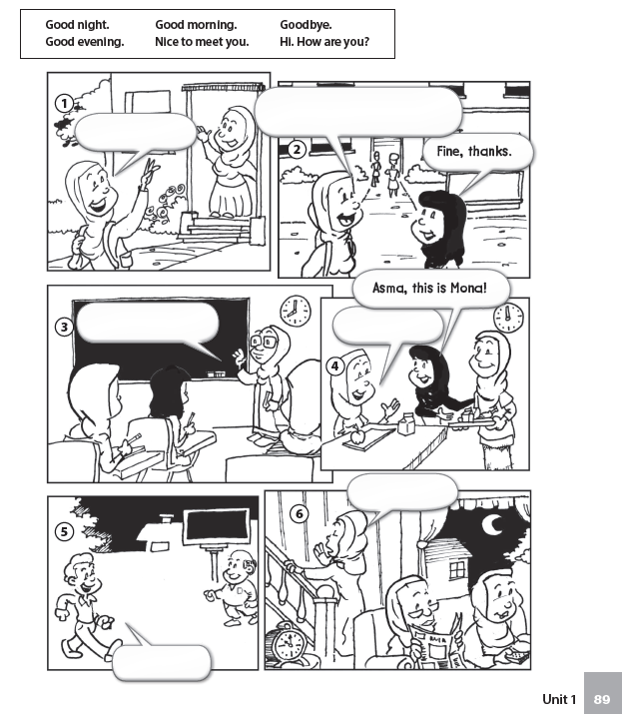
Hi , how are you ?
Goodbye
Good morning
Nice to meet you
Good night
Good evening

Slide 4
is
are
is
is
are
are
is
are
am

Slide 5
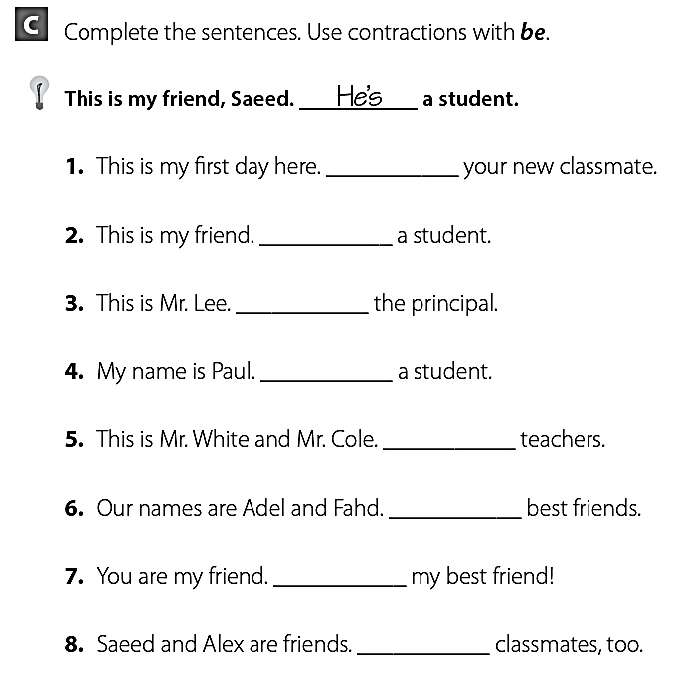
I’m
He’s
He’s
I’m
They’re
We’re
You’re
They’re

Slide 6
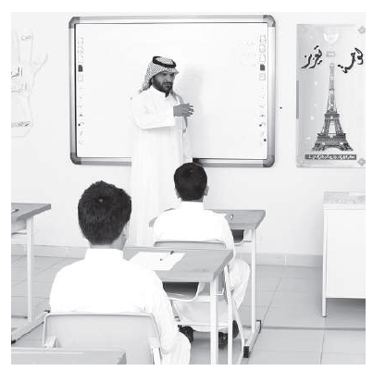
Her
His
My
His
Your
Her
My
Your

Slide 7
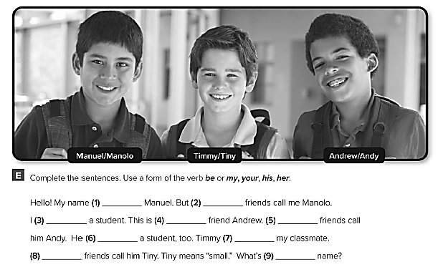
is
my
am
my
His
is
is
His
your

Slide 8
S c h o o l
S t u d e n t
S p e l l
M e e t
F r i e n d
N i g h t
Y o u r
e a r
L a t e
Super goal

Slide 9
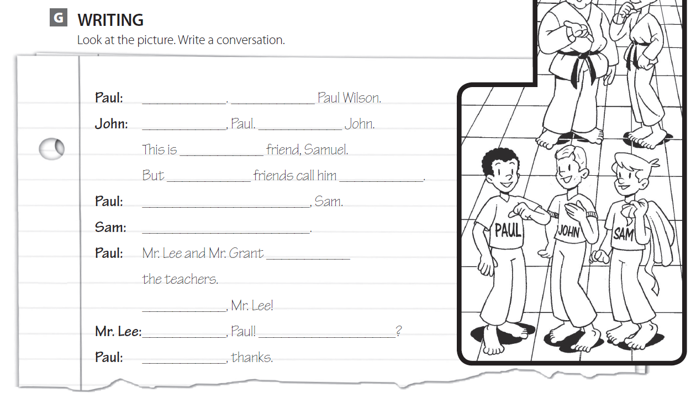
Hello my name
Hi I’m
my
his Sam
Nice to meet you
Nice to meet you too
are
Good morning
Good morning / How are you
I’m fine

Slide 10
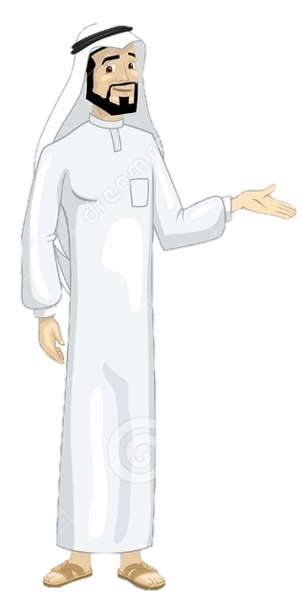
See you later
Take care
Teacher :
Badr Sayid Al-Shehri

