Slide 1
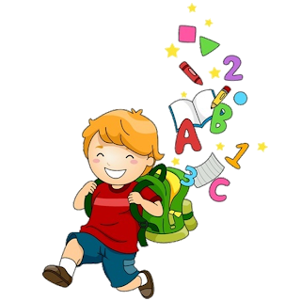
5
Unit 6

Slide 2
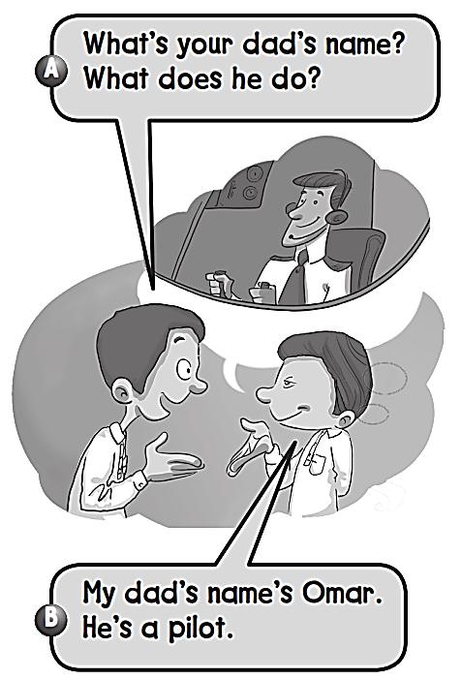
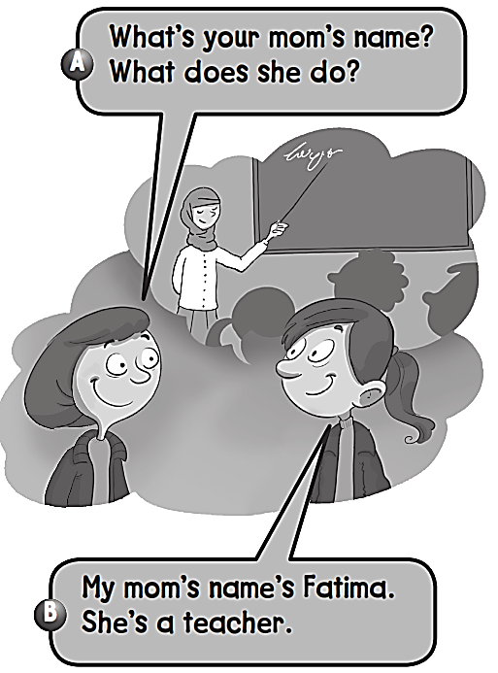
Workbook
Jobs

Slide 3
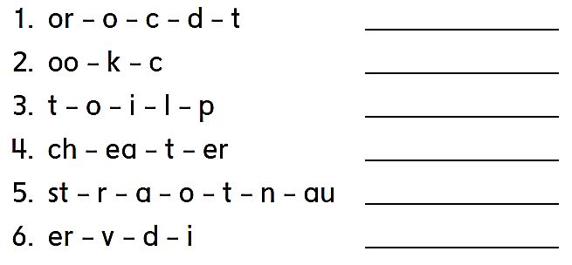
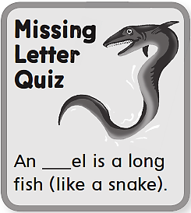
Workbook
Jobs
Doctor
Cook
Pilot
Teacher
Astronaut
Diver
e

Slide 4
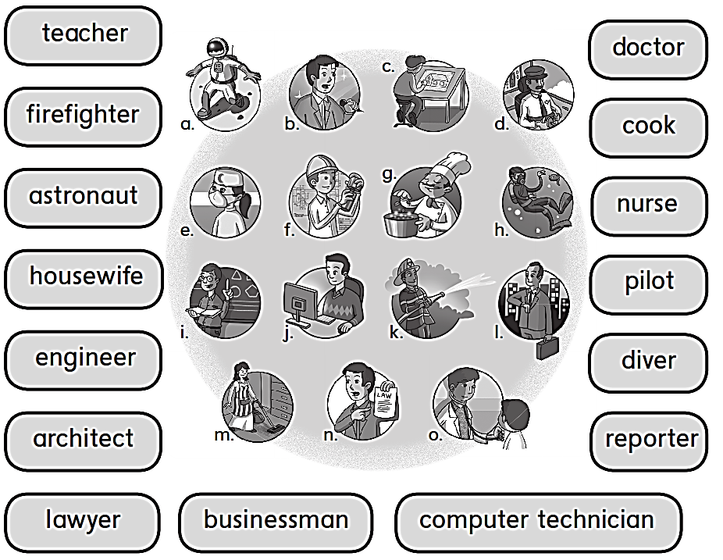
Workbook
Jobs
i
o
k
g
a
e
m
d
f
h
c
b
n
l
j

Slide 5
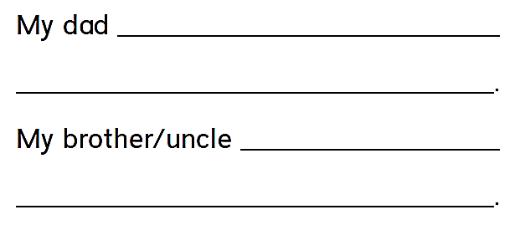
Workbook
Jobs
is a doctor .
He helps sick people .
is a pilot .
He flies planes .
F

Slide 6
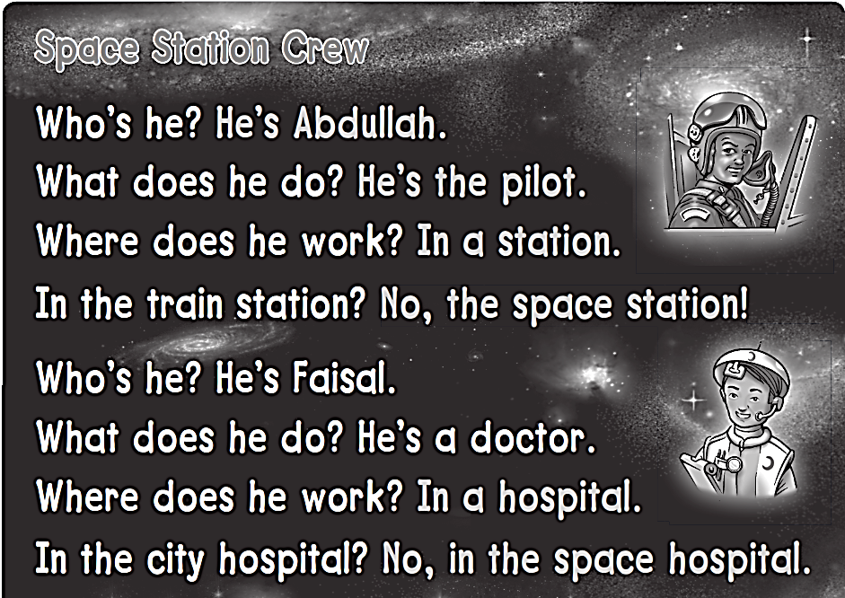
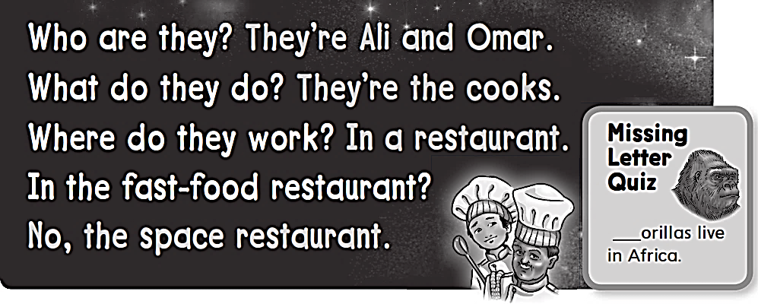
Workbook
Jobs
G

Slide 7
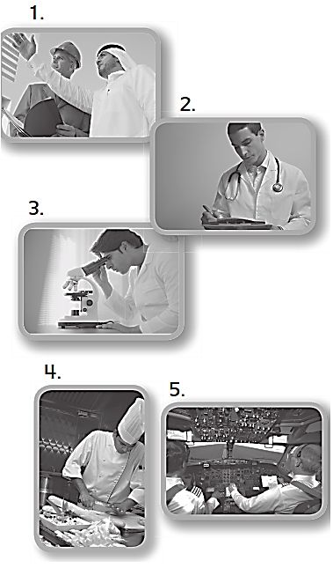
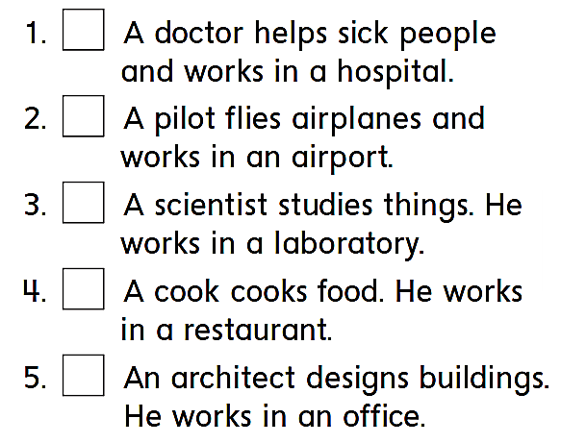
Workbook
Jobs
2
5
3
4
1

Slide 8
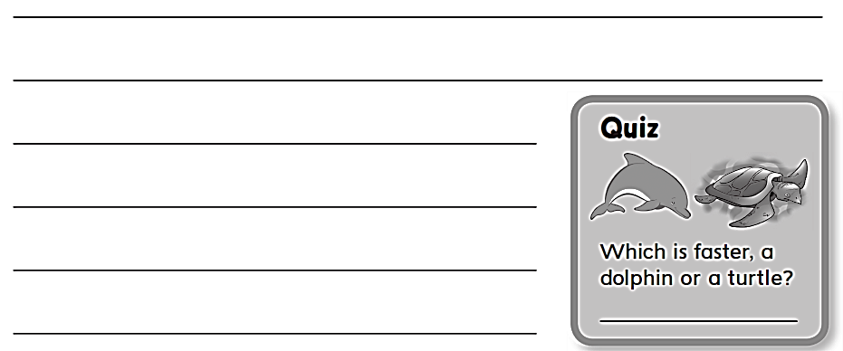
Workbook
Jobs
A dolphin

Slide 9
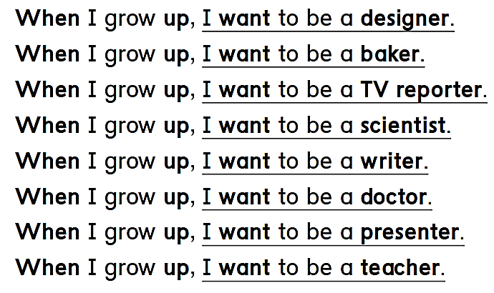
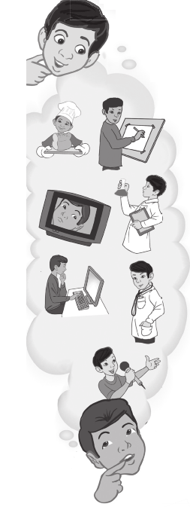
Workbook
Jobs

Slide 10
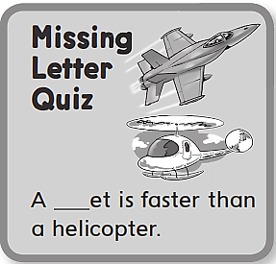
Workbook
Jobs
I want to be a designer .
I want to be a baker .
I want to be a TV reporter.
I want to be a scientist.
I want to be a writer.
I want to be a doctor.
I want to be a presenter.
j
I want to be a teacher.

Slide 11
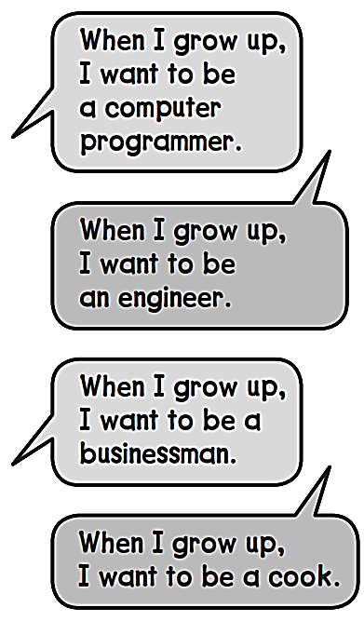
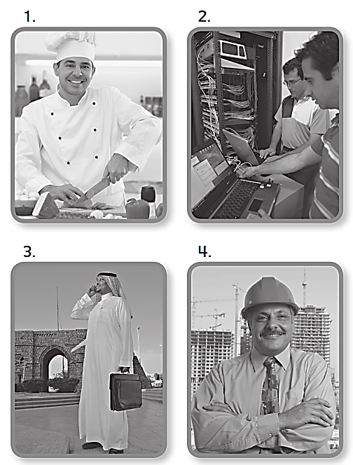
Workbook
Jobs
2
4
3
1

Slide 12
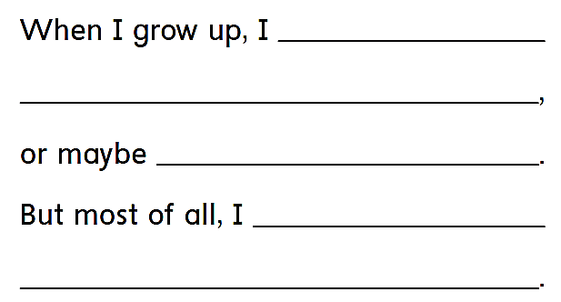
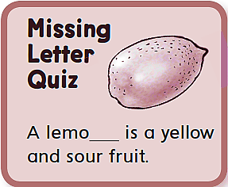
Workbook
Jobs
want to be a designer .
I want to be a writer.
I want to be a designer .
n

Slide 13
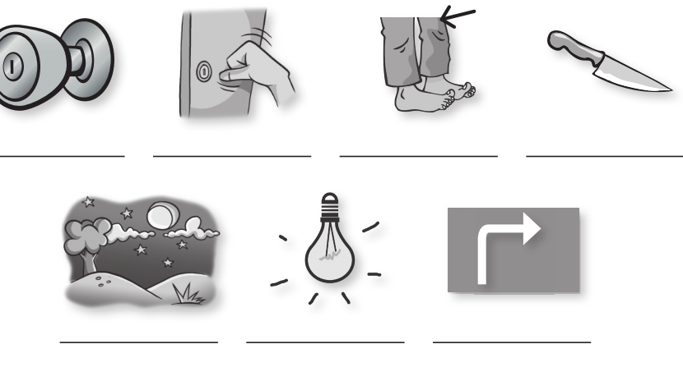
Workbook
Jobs
knob
knock
knee
knife
night
light
right

Slide 14
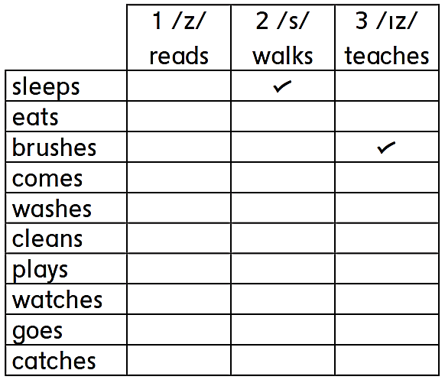
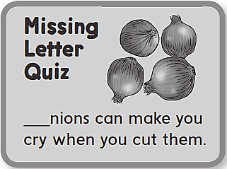
Workbook
Jobs
O

Slide 15
Workbook
Jobs
I like to count the stars at night .. Ten at a time,
Ten, twenty, thirty, forty, fifty, sixty, seventy, eighty, ninety,
ONE HUNDRED!

Slide 16
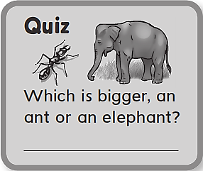
Workbook
Jobs
An elephant

