Slide 1
5
Unit 5

Slide 2
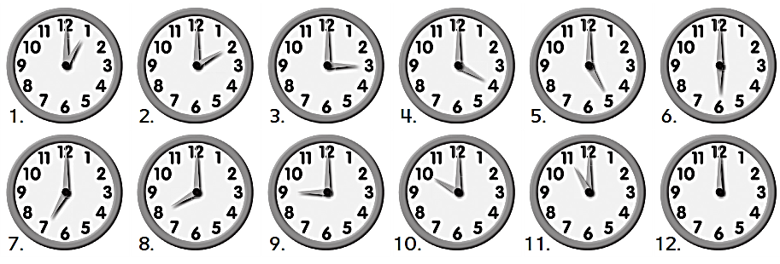
Workbook
Yesterday and Today

Slide 3
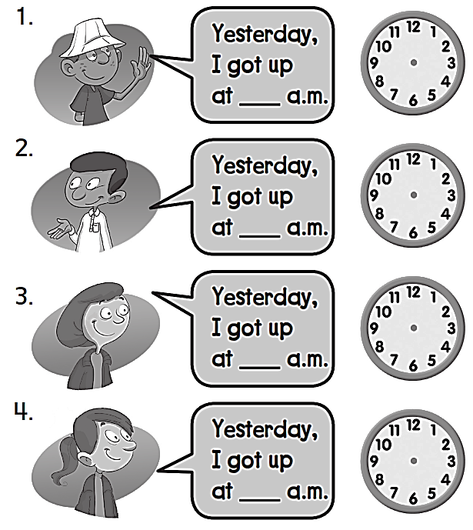
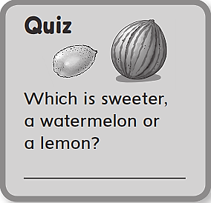
Workbook
Yesterday and Today
7
6
5
9
A watermelon

Slide 4
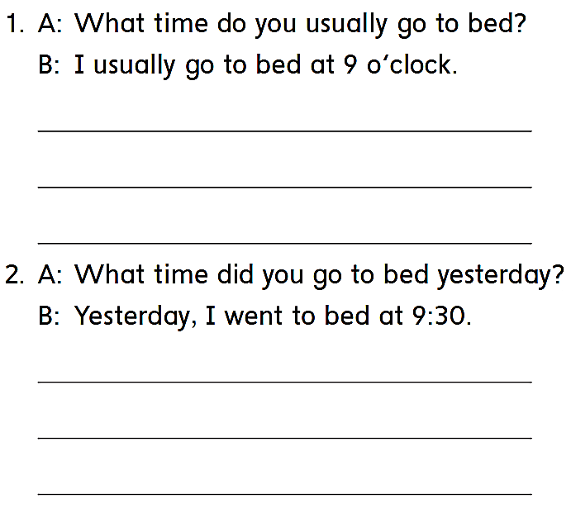
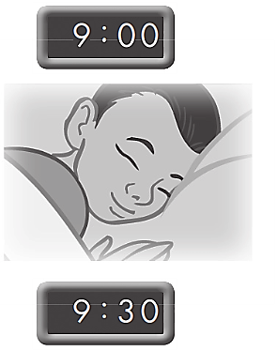
Workbook
Yesterday and Today
I usually go to bed at 9 o’clock
I usually go to bed at 9 o’clock
I usually go to bed at 9 o’clock
Yesterday , I went to bed at 9:30
Yesterday , I went to bed at 9:30
Yesterday , I went to bed at 9:30

Slide 5
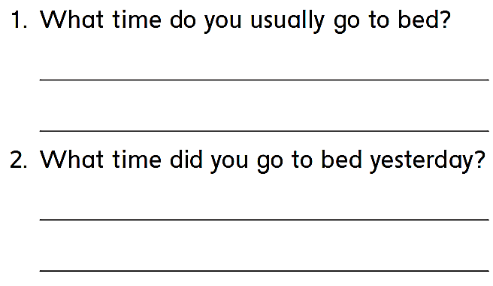
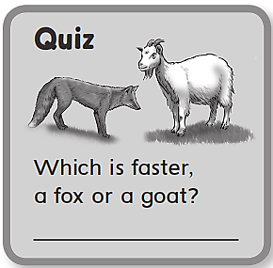
Workbook
Yesterday and Today
I usually go to bed at nine o’clock
Yesterday, I went to bed at ten o’clock.
A fox

Slide 6
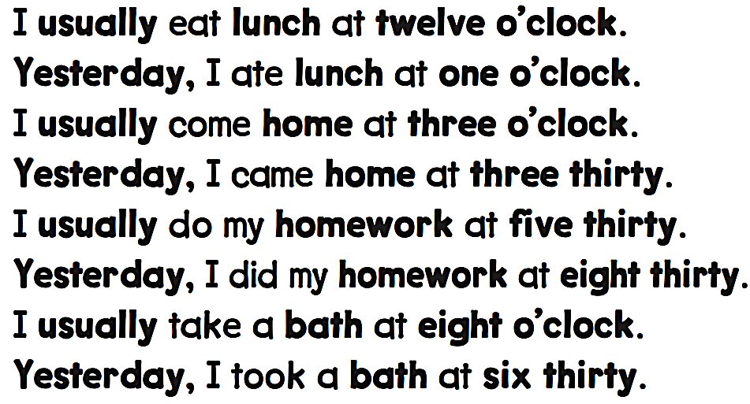
Workbook
Yesterday and Today

Slide 7
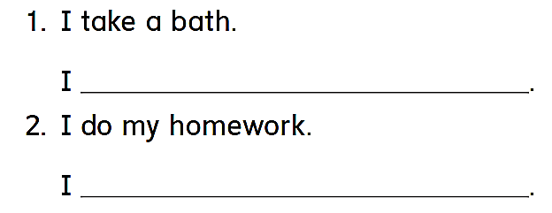
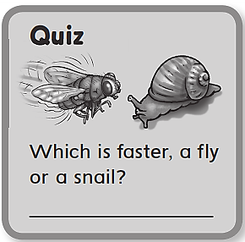
Workbook
Yesterday and Today
took a bath
did my homework
A fly

Slide 8
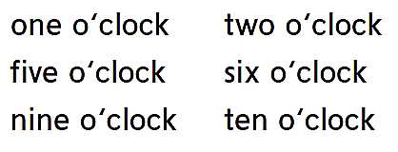
Workbook
Yesterday and Today

Slide 9
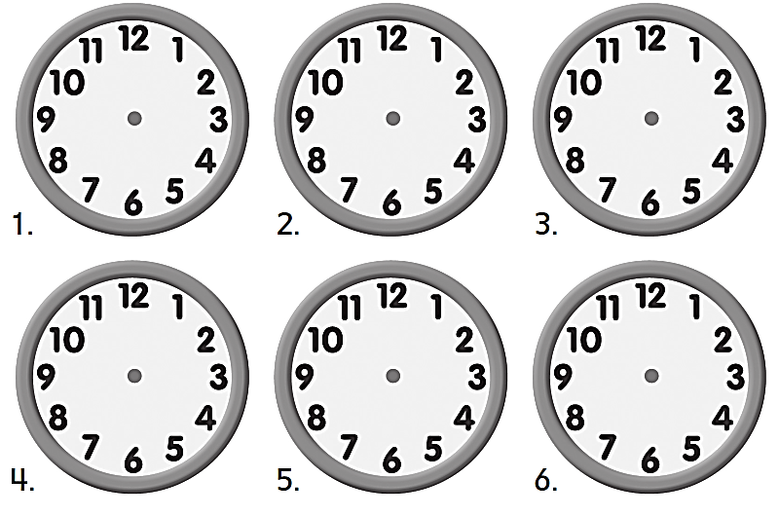
Workbook
Yesterday and Today

Slide 10
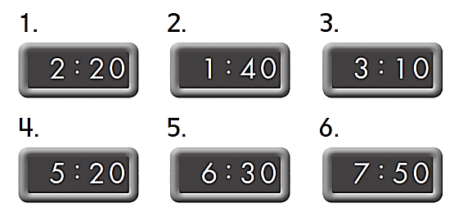
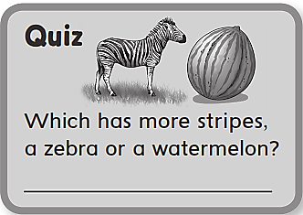
Workbook
Yesterday and Today
A zebra

Slide 11
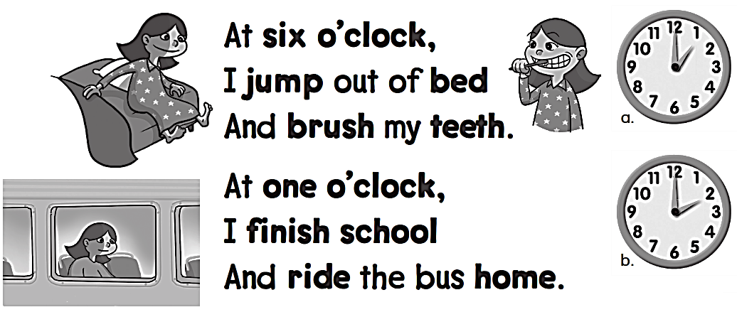
Workbook
Yesterday and Today
a

Slide 12
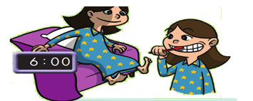
Workbook
Yesterday and Today

Slide 13
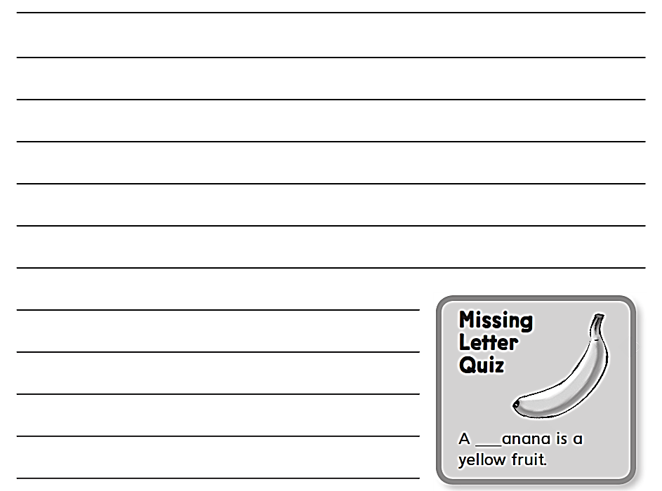
Workbook
Yesterday and Today
b

Slide 14
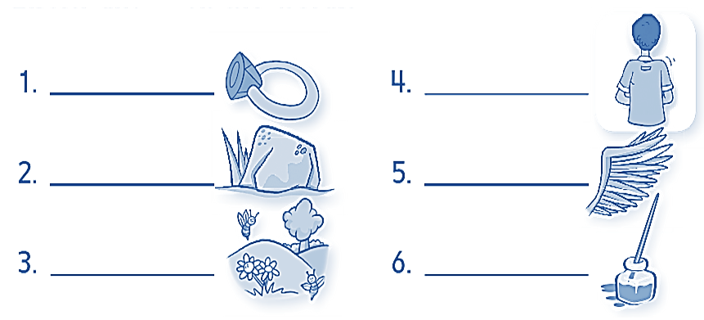
Workbook
Yesterday and Today
Ring
Back
Rock
Wing
Spring
Ink

Slide 15
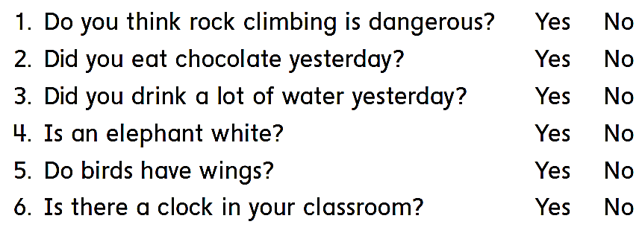
Workbook
Yesterday and Today

Slide 16
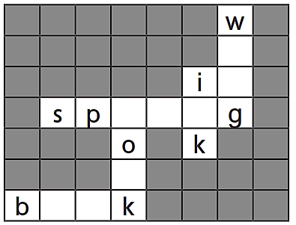
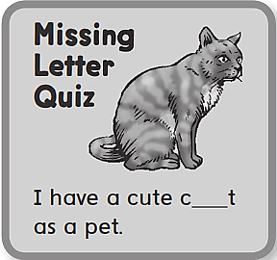
Workbook
Yesterday and Today
i
n
r i n
c
a
o o

Slide 17
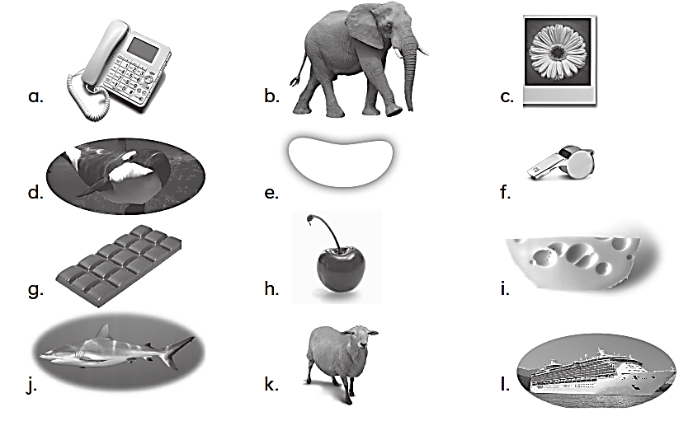
Workbook
Yesterday and Today
k – l – j
i – g – h
a – c – b
e – d – f

Slide 18
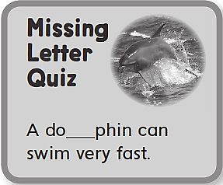
Workbook
Yesterday and Today
shark
ship
cheese
chocolate
phone
photo
whale
white
l

