Slide 1
Super goal 1

Slide 2
Unit 3

Slide 3
Radio
Television
Car
Key chains
Air plane
Bicycle
Camera
Calculator
Watch
Robot

Slide 4
a bicycle a calculator a watch an airplane a radio a key chain a car a camera a robot a television

Slide 5
What are those ?
They’re calculators
They’re pencils
They’re my keys
Those are cars
They’re her paintings

Slide 6
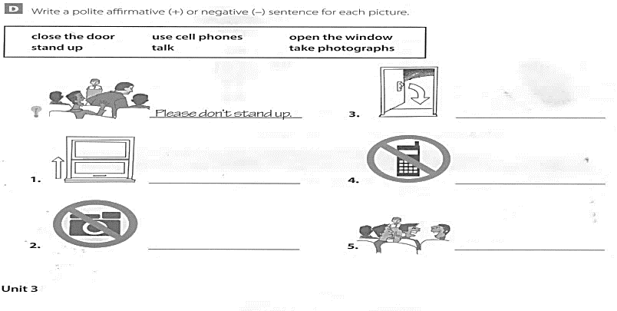
Please close the door
Please open the window
Please no cell phones
Please no photographs
Please don’t talk

Slide 7
What is this ?
It is a key chain
What are these ?
They are eggs

Slide 8
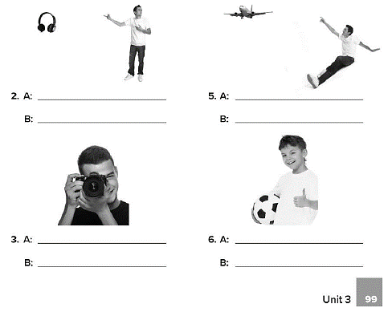
What is that ?
It is a headphone
What’s that ?
It’s an airplane
What’s this ?
It’s a camera
What is this ?
It’s a ball

Slide 9
These telephones
That pencil
These watches
That dinosaur
These radios
a key
a puppet
a key chain
a car

Slide 10
شراء هدية لكل فرد من العائلة وتحديد نوع الهدية
A watch my father
A perfume my mom
A DVD Ali

Slide 11
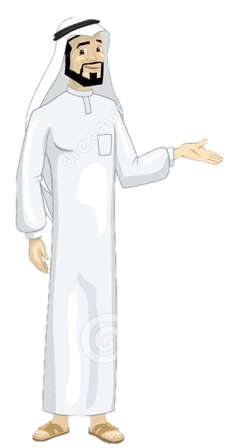
See you later
Take care
Teacher :
Badr Sayid Al-Shehri

