Slide 1
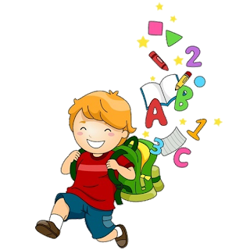
Unit 4
1

Slide 2
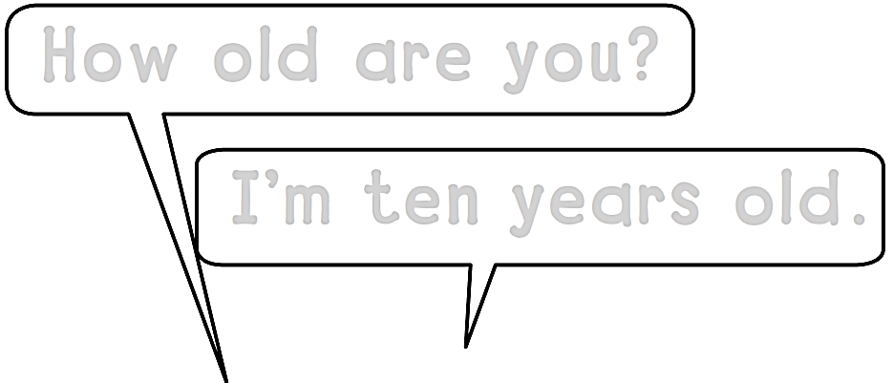
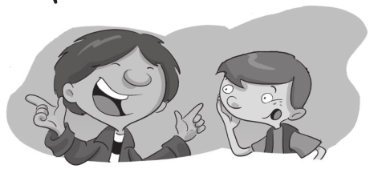
Workbook
How Old Are You ?
How old are you?
I΄m ten years old.
I΄m nine years old.

Slide 3
Workbook
How Old Are You ?
Y Y Y Y Y Y Y Y

Slide 4
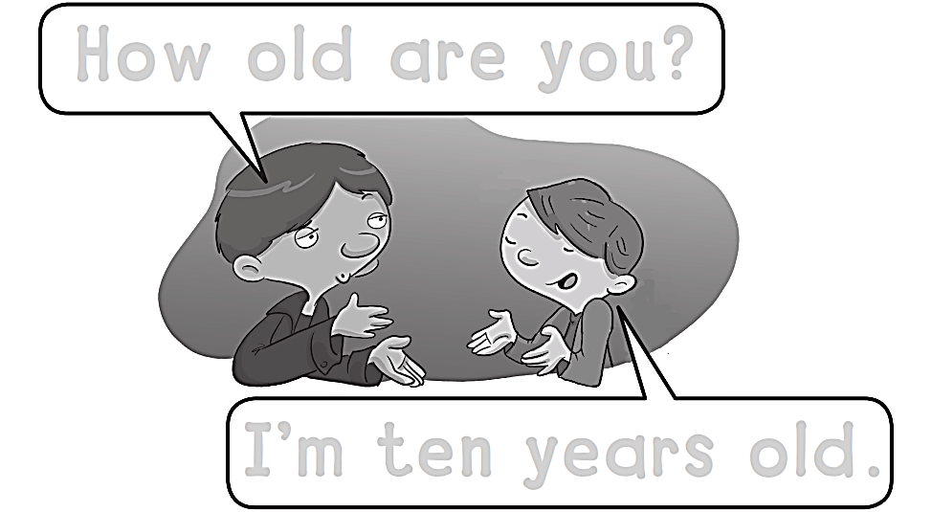
Workbook
How Old Are You ?
How old are you?
I΄m ten years old.

Slide 5
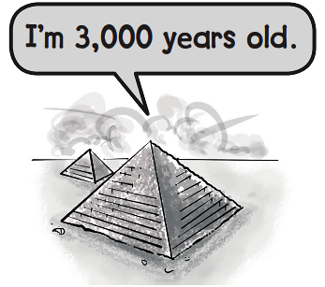
Workbook
How Old Are You ?
TEN

Slide 6
Workbook
How Old Are You ?
Z Z Z Z Z Z Z

Slide 7
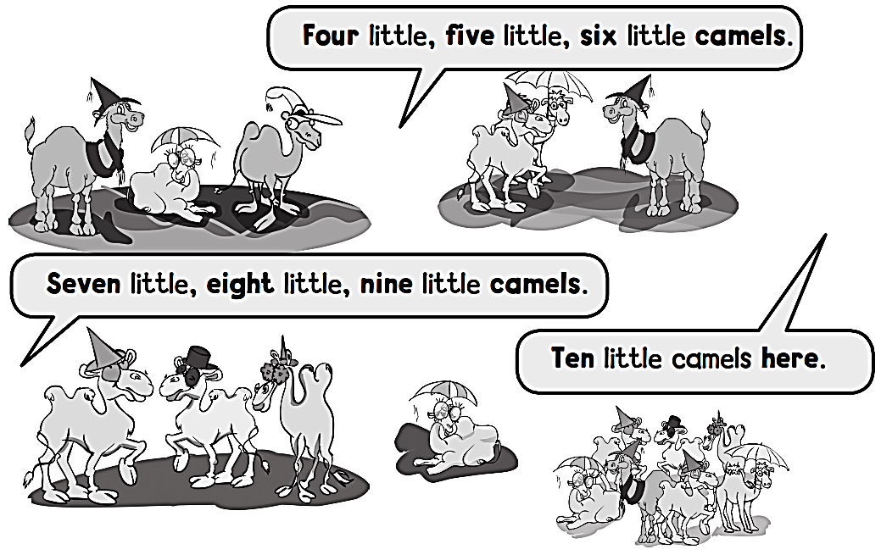
Workbook
How Old Are You ?
One little , two little,
Three little camels.

Slide 8
Workbook
How Old Are You ?
a a a a a a a a a a

Slide 9
Workbook
How Old Are You ?
1 2 3 4 5
6 7 8 9 10

Slide 10
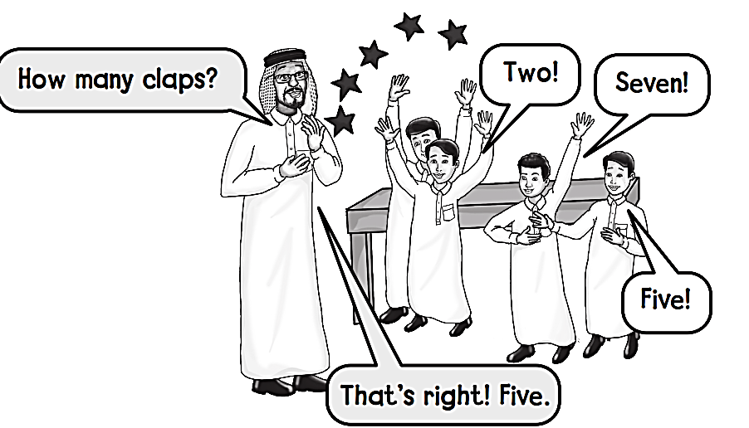
Workbook
How Old Are You ?

Slide 11
Workbook
How Old Are You ?
b b b b b b b b b

Slide 12
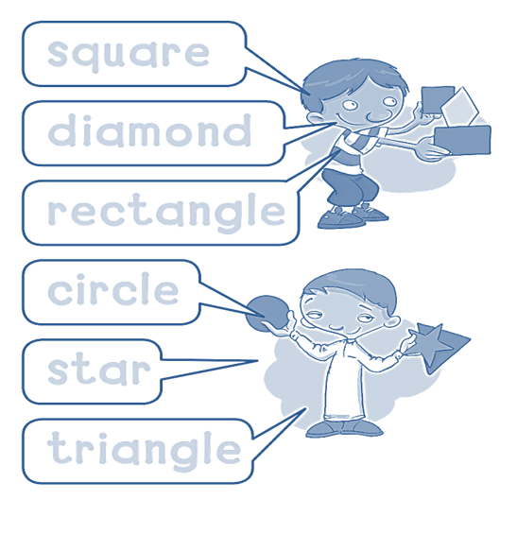
Workbook
How Old Are You ?
square
diamond
rectangle
circle
star
triangle

Slide 13
Workbook
How Old Are You ?
c c c c c c c c c c

Slide 14
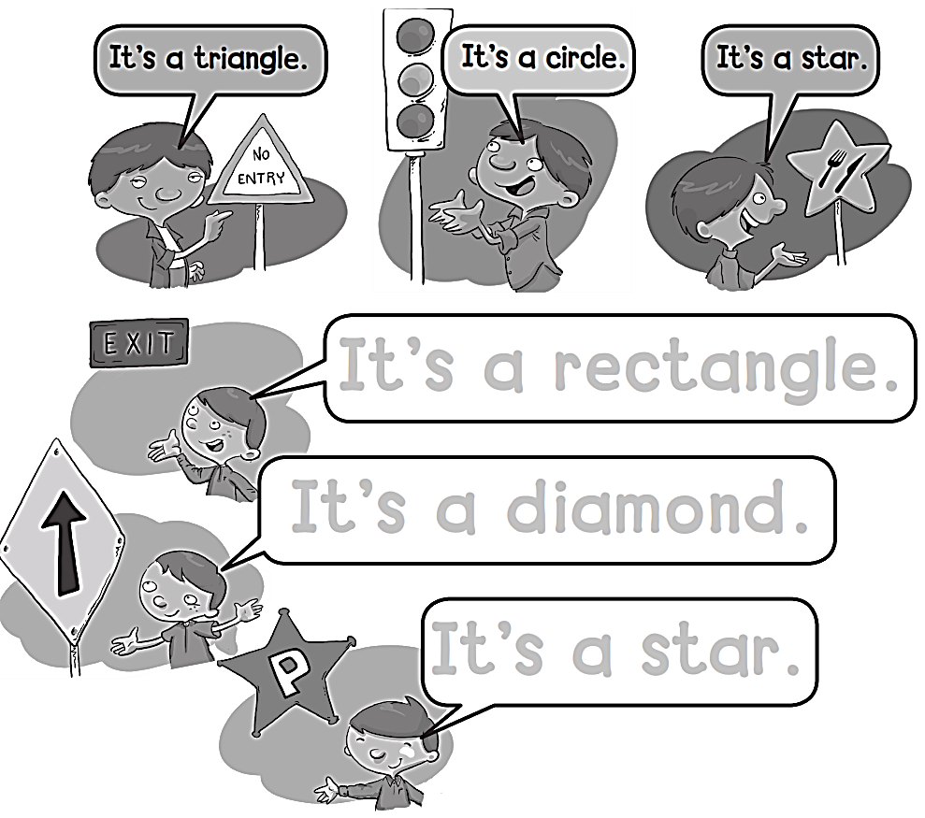
Workbook
How Old Are You ?
It’s a rectangle .
It’s a diamond .
It’s a star .

Slide 15
Workbook
How Old Are You ?
d d d d d d d d d d

Slide 16
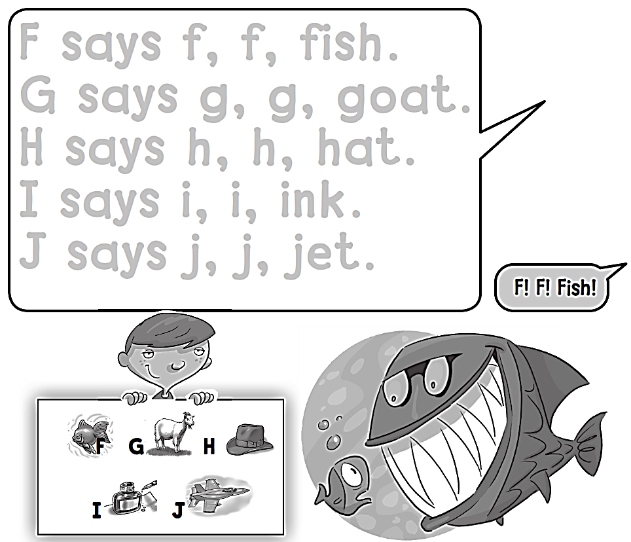
Workbook
How Old Are You ?

Slide 17
Workbook
How Old Are You ?
e e e e e e e e e e

Slide 18
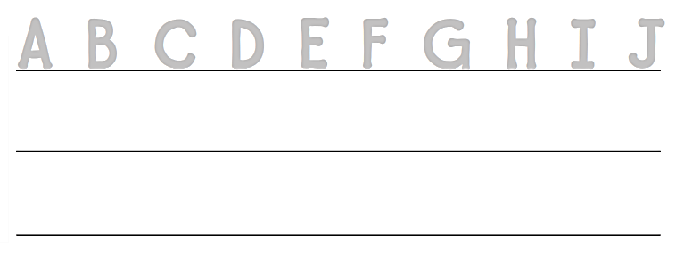
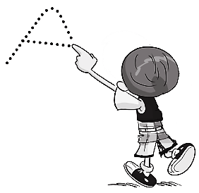
Workbook
How Old Are You ?
A B C D E F G H I J
A B C D E F G H I J

Slide 19
Workbook
How Old Are You ?
A B C D E F G H I J
A B C D E F G H I J

Slide 20
Workbook
How Old Are You ?
f f f f f f f f f f f f f f

Slide 21
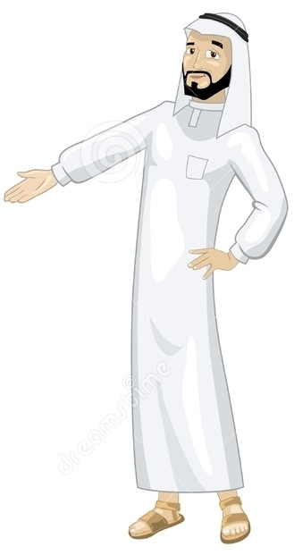
See you later
Goodbye
Teacher :
Badr Sayid Al-Shehri

