Slide 1
3
Unit 5

Slide 2
Friends , Actions , Things
الأصدقاء ، الأحداث ، الأشياء

Slide 3
Phonics
الأصوات

Slide 4
Materials :
Alphabet flashcards
Food flashcards

Slide 5
Strategy
An apple – more apples …
Divide the class into two teams. Ask team A to write a word on a slip of paper, fold it and put it in a bag or a box. Tell them to only write one object they choose . Ask team B to write a word on a slip of paper, fold it and put it in a bag or a box. Tell them to only write one object they choose . Have team A pick a folded slip of paper from team B’s bag and
provide / write the singular word on the other side of the slip. Have team B pick a folded slip of paper from team A’s bag provide/ write the plural word on the other side of the slip. When both teams have finished writing all the words have them return the bags. The teams have to check and make sure that the words have been written correctly. The team with the fewest mistakes is the winner.

Slide 6
Review the previous lesson
مراجعة سريعة للدرس السابق

Slide 7
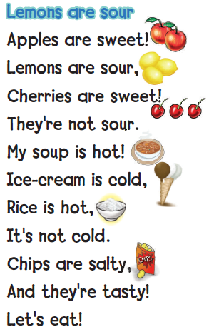

Slide 8
1
Listen and check Say
استمع ، ثم علامة صح في المكان الصحيح واقراء الكلمات

Slide 9
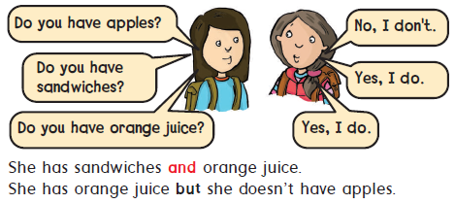
What’s in your bag ?
2
Listen, point, and say. استمع ، تبع ثم اقراء

Slide 10
3
Ask your friend. Check YES or NO. اسأل صديقك ثم أجب بنعم أو لا

Slide 11
وقت المرح
Whose .. Is that ? لمن ... هذا الشيء ؟
Listen , point and say استمع ، تبع ثم اقراء
4

Slide 12
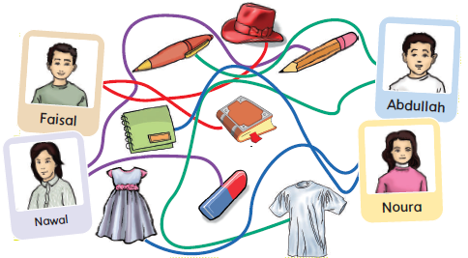
5
Trace . Ask and answer أعد الكتابة على الخطوط . اسأل ثم أجب

Slide 13
Goal Check
التحقق من الهدف

Slide 14
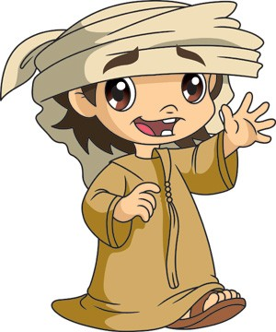
Have a nice day
See you next class

