Slide 1
MEGA GOAL 5

Slide 2
UNIT 1

Slide 3
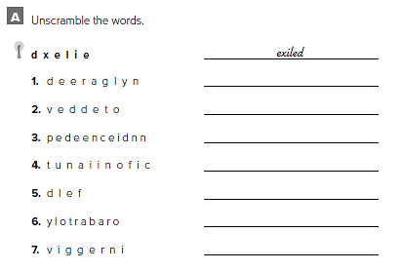
legendary
devoted
independence
unification
fled
laboratory
grieving

Slide 4
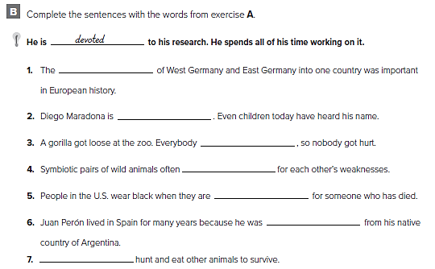
unification
legendary
fled
compensate
grieving
exiled
predators

Slide 5
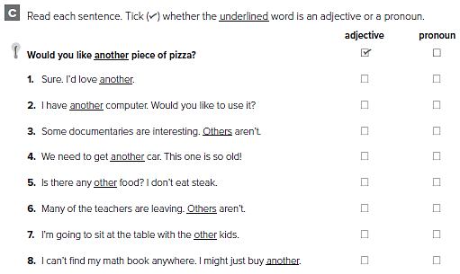

Slide 6
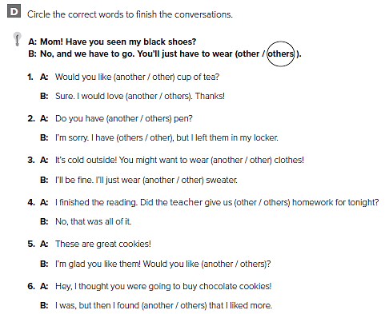

Slide 7
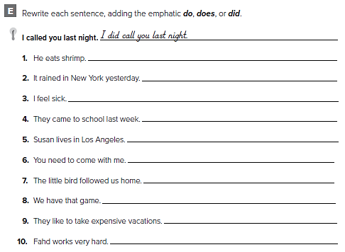
He does eat shrimp .
It did rain in New York yesterday .
I do feel sick .
They did come to school last week .
Susan does live in Los Angeles .
You do need to come with me .
The little bird did follow us home .
We do have that game .
They do like to take expensive vacations .
Fahd does work very hard .

Slide 8
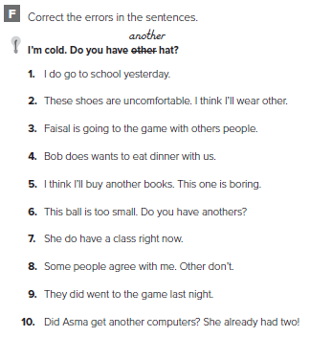
did
others
other
want
book
another
does
Others
go
computer

Slide 9
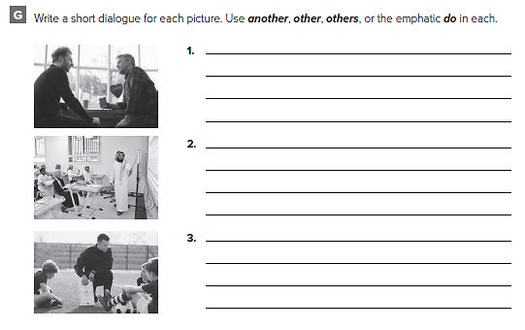
الإجابات من الممكن أن تختلف
Would you like another cookie?
No, thanks.
Don’t you like them?
I do like them, but I’m full!
I can’t believe you didn’t do the homework
I did do it, but I couldn’t find it.
Where do you think you left it?
Probably in my other bag.
OK, guys, you must not want to win!
We do want to win, Coach!
Well then, you’d better get another goal

Slide 10
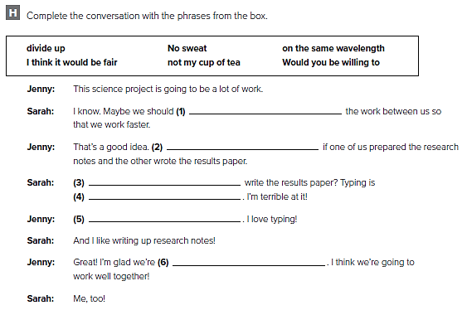
divide up
I think it would be fair
Would you be willing to
not my cup of tea
No sweat
on the same wavelength

Slide 11
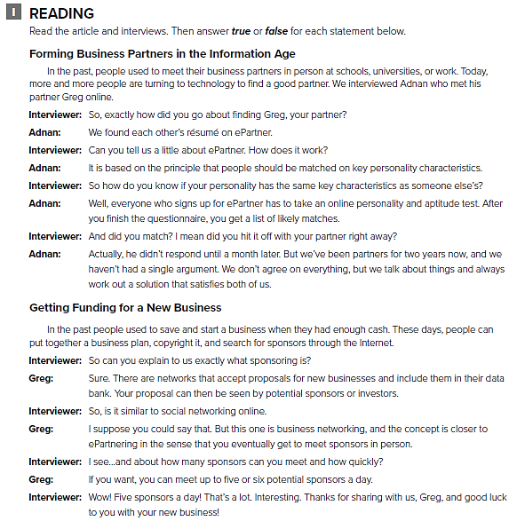

Slide 12
F
F
F
T

Slide 14
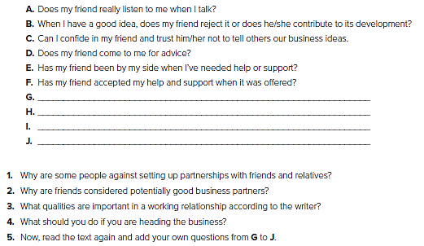
الإجابات في الشريحة التالية

Slide 15
1. Because they feel that there cannot be clear boundaries between friendship and work, and things can go wrong if there is disagreement.
2. Because there is a real relationship and a sense of loyalty and willingness to share.
3. Self-confidence, an awareness of one’s strengths and weaknesses as well as feeling of confidence about abilities.
4. You should discuss responsibilities beforehand, agree on details and put everything on paper. Also you need to find out if your friends respect you as much as you respect them.
5. الإجابات قد تختلف

Slide 16
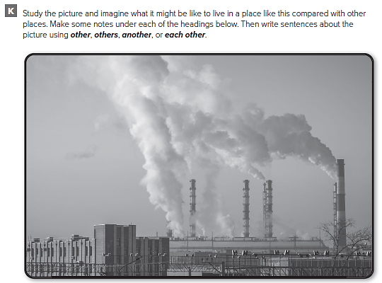

Slide 17
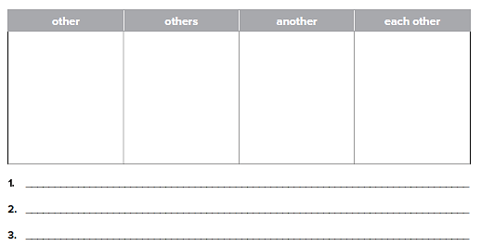
Industrial city
Difficult to find another job
Most people work in factories
People live very close to each other
Industrial plants make this city very polluted
Most local people probably work at the factories
الإجابات من الممكن أن تختلف

Slide 18
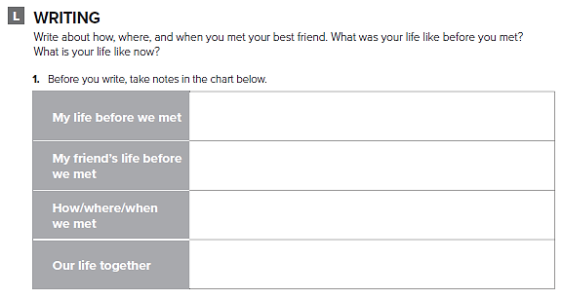
تحدث عن أفضل أصدقائك

Slide 19
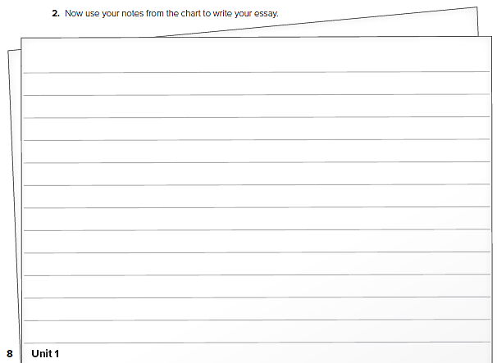
قم بكتابة مقال عن أفضل أصدقائك

Slide 20
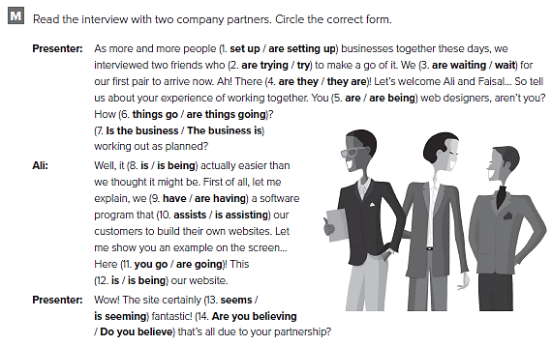

Slide 21
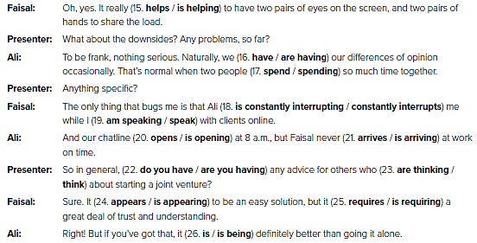

Slide 23
Archaeological
History – culture – antiques – pottery – jewelry – exhibitions – ruins
Technological
Space – robots – science – seminars - 3-D digital cinema - educational books
National
Antiques – manuscripts – documents - state-of-the-art - informative exhibits - interactive displays

Slide 24
كلا الاجابتين صحيحة

Slide 25
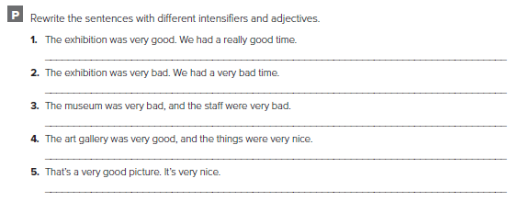
كل طالب يجيب عن نفسه

Slide 26
UNIT 2

Slide 27
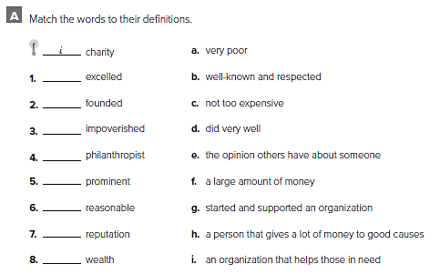
d
g
a
h
b
c
e
f

Slide 28
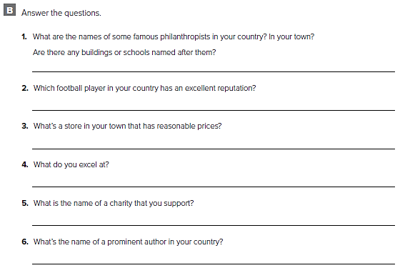
من الممكن أن تختلف الاجابات

Slide 29
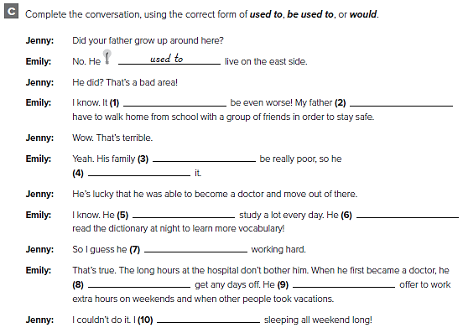
used to
would / used to
used to
was used to
would / used to
would / used to
is used to
Wouldn't / didn’t use to
would / used to
am used to

Slide 30
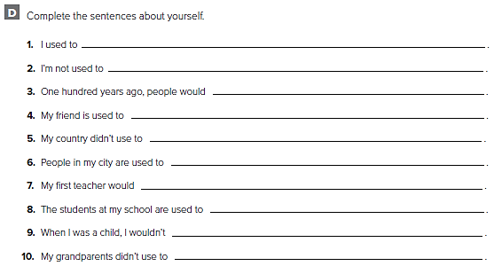
كل طالب يجيب عن نفسه

Slide 31
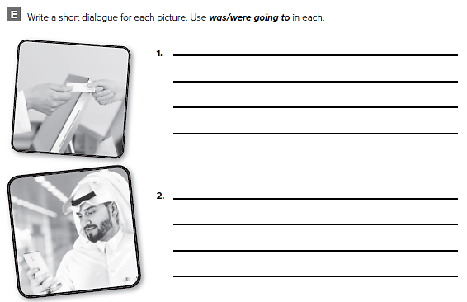
What did you buy at the store?
Bread and cheese.
I thought we were going to have chicken.
We were, but I changed my mind.
من الممكن أن تختلف الاجابات
Where are you?
Still at home.
I thought you were going to come over.
I was going to call you. I don’t feel well.

Slide 32
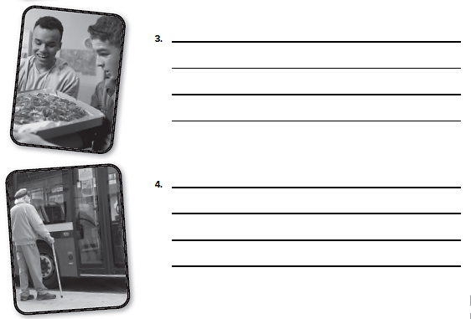
What did you get on the pizza?
Vegetables.
I thought we were going to have pepperoni.
Sorry. The vegetables taste better
من الممكن أن تختلف الاجابات
How did you get here?
I took the bus.
I was going to give you a ride, but you didn’t answer your phone.
You called me? I didn’t hear my phone

Slide 33
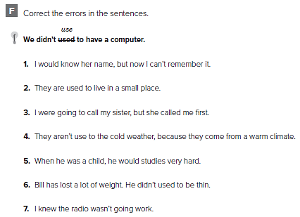
used to
living
was
used
study
use
going to work

Slide 34
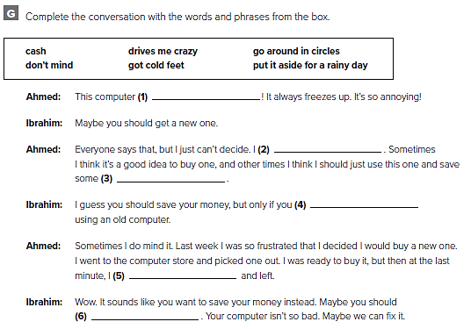
drives me crazy
Go around in circles
cash
don’t mind
got cold feet
put it aside for a rainy day

Slide 35
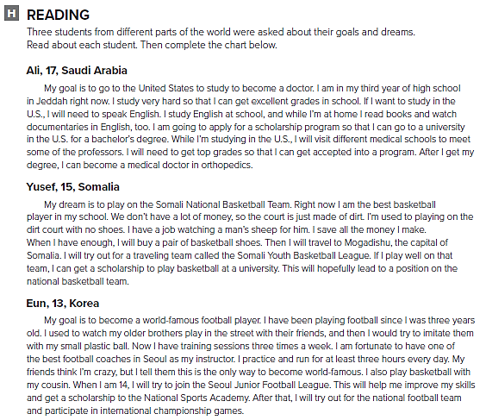

Slide 36
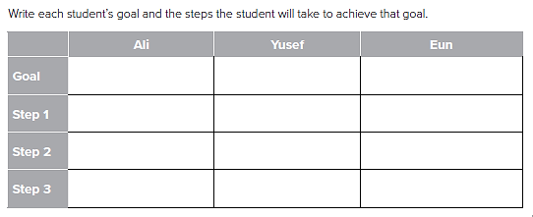
To become a doctor
Study hard
Learn English
Get a scholarship
To play in the national team
Save money to buy shoes
Play on the youth league
Get a scholarship
To become a football player
Practice everyday
Try to join the junior league
Get a scholarship

Slide 37
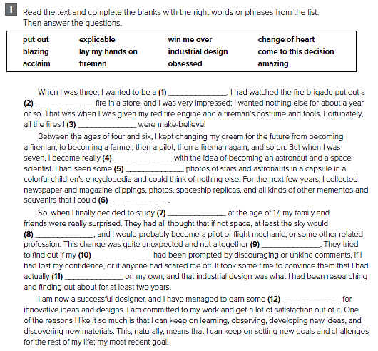
fireman
blazing
put out
obsessed
amazing
lay my hands on
industrial design
win me over
explicable
change of heart
come to this decision
acclaim

Slide 38
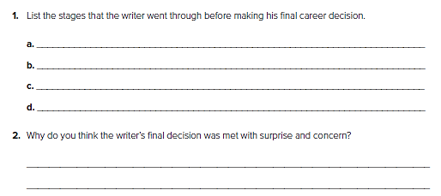
At three he wanted to be a fireman.
Between the ages of four and six he kept changing his mind
At seven his mind was set on becoming an astronaut
At seventeen he chose to become an industrial designer.
Because he had spent years, up to that point being obsessed by space and everyone expected him to pursue a related career. So they were worried that someone might have discouraged him from pursuing his life’s dream.

Slide 39
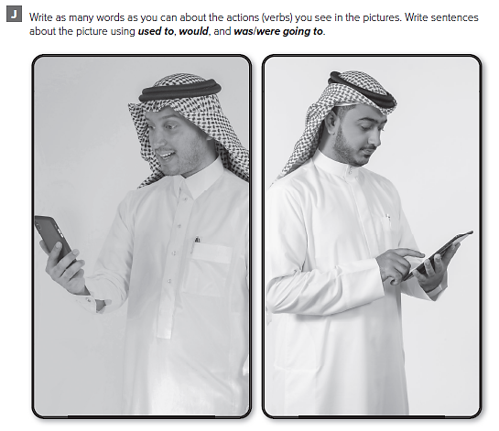

Slide 40
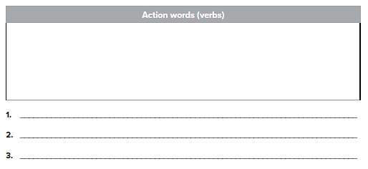
sitting, reading aloud, telling about, laughing, smiling, studying, sitting, texting, watching
The two young men were texting some friends
When they were boys, they didn't have phones
من الممكن أن تختلف الاجابات

Slide 41
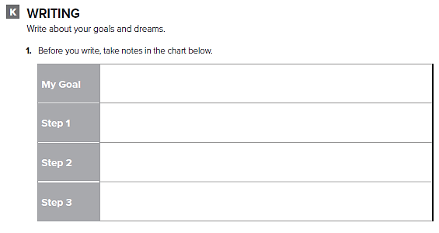
اكتب عن أهدافك في المستقبل

Slide 42
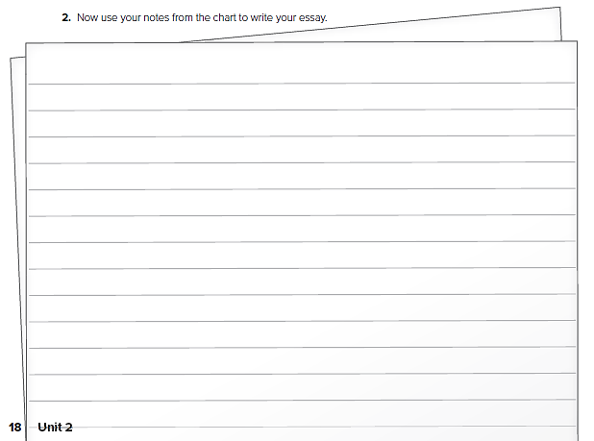
اكتب عن أحلامك في المستقبل

Slide 43
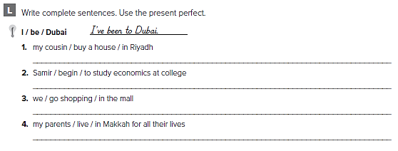
My cousin has bought a house in Riyadh.
Samir has begun to study economics at college.
We have been shopping at the mall.
My parents have lived in Mecca for all their lives.

Slide 44
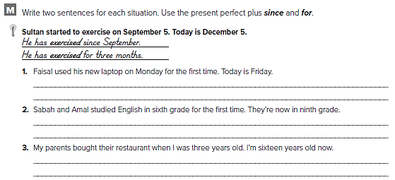
He has used his new laptop since Monday.
He has used his new laptop for four days.
They have studied English since sixth grade.
They have studied English for three years.
They have owned their restaurant since I was three
years old / They have had owned their restaurant for
thirteen years

Slide 45
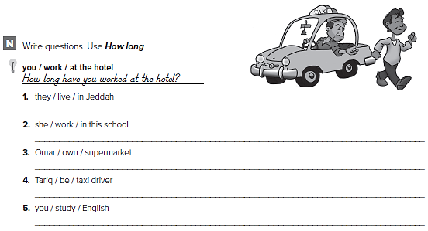
How long have they lived in Jeddah?
How long has she worked in this school?
How long has Omar owned the supermarket?
How long has Tariq been a taxi driver?
How long have you studied English?

Slide 46
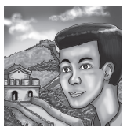
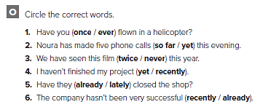

Slide 47
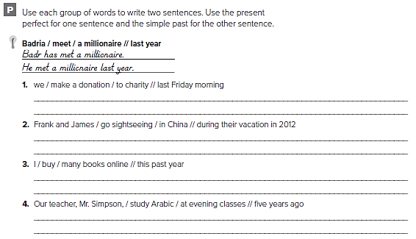
We have made a donation to charity.
We made a donation to charity last Friday morning.
Frank and James have gone sightseeing in China.
They went sightseeing during his vacation in 2012
I have bought many books online.
I bought several many books online this past year.
Our teacher, Mr. Simpson, has studied Arabic at evening classes. He studied Arabic at evening classes five years ago.

Slide 48
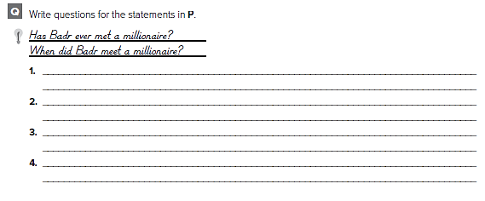
Have you ever made a donation to charity?
When did you make a donation to charity?
Have Frank and James ever gone sightseeing in China?
When did they go sightseeing in China?
Have you ever bought books online?
When did you buy books online?
Has your teacher, Mr. Simpson, ever studied Arabic?
When did he study Arabic?

Slide 49
UNIT 3

Slide 50
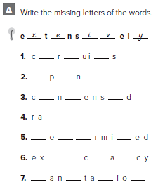
i c t
s a
o d e
n k
d t e n
p e t n
s i t n

Slide 51
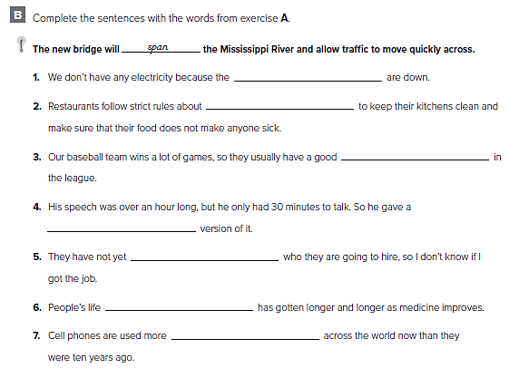
circuits
sanitation
rank
condensed
determined
expectancy
extensively

Slide 52
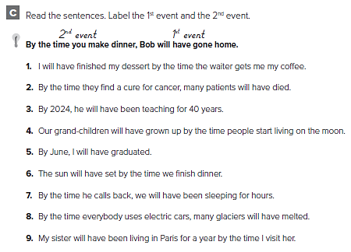
1st 2nd
2nd 1st
2nd 1st
1st 2nd
2nd 1st
1st 2nd
2nd 1st
2nd 1st
1st 2nd

Slide 53
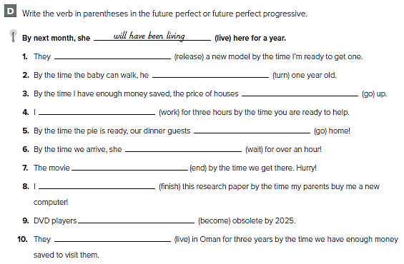
will have released
will have turned
will have gone
will have been working
will have gone
will have been waiting
will have ended
will have finished
will have become
will have been living

Slide 54
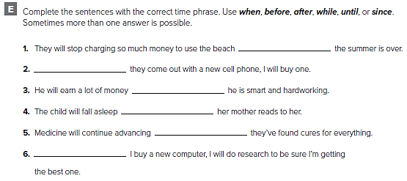
when
When
since
after
until
Before

Slide 55
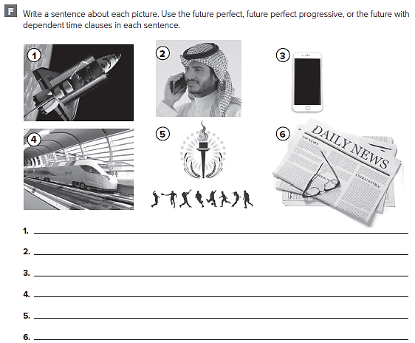
الإجابات من الممكن أن تختلف
By the time space travel becomes affordable, I will have gotten too old
He will turn off his computer after he’s done working

Slide 56
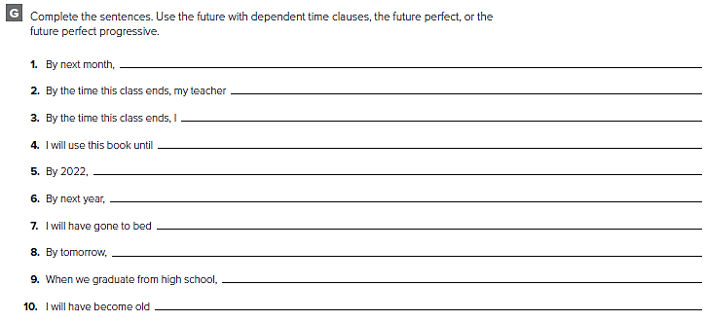
we will have finished unit 4
will have assigned us homework
will have finished this exercise
I move to the next level
I will have started my studies
my parents will have bought me a new computer
by 11 p.m.
I will have gone home
I will be very happy
by the time I have grandchildren

Slide 57
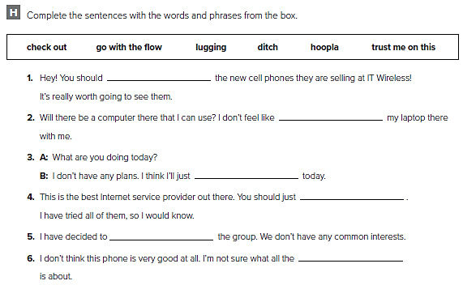
check out
lugging
go with the flow
trust me on this
ditch
hoopla

Slide 59
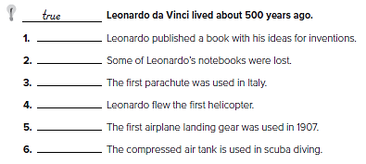
F
T
F
F
F
T

Slide 60
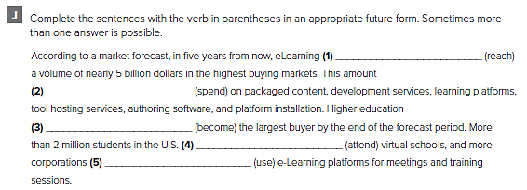
will have reached
will be spent
will have become
will be attending
will be using

Slide 62
He will have been taking exams online for 6 years.
He will have been accessing libraries online for all his assignments.
He will have been ordering books online for all his subjects.
He will have graduated from high school.
He will have completed two years of his university course.
He will have spent 18 years wheelchair-bound.
He will have learnt a lot.
He will have almost completed his studies.

Slide 64
invent new forms of transport, fly a car, achieve high speeds, save space, avoid traffic jams
الإجابات من الممكن أن تختلف
By 2040, we will have invented new forms of transport.
By 2040, we will have flying cars
By 2040, we will have solved the problem of traffic

Slide 65
تحدث عن أحد الاختراعات الحديثة

Slide 66
قم بكتابة مقال عن أحد الاختراعات الحديثة

Slide 67
Do your parents both speak English?
Yes, they do.
Does the hotel have its own website?
No, it doesn’t.
Do you and your brother go to the same school?
No, we don’t.
Does the restaurant offer free a Wi-Fi connection?
Yes, it does.
Do you usually communicate with your friends by email?
Yes, I do.

Slide 68
d
f
a
b
c
e
كل طالب يجيب عن نفسه

Slide 70
EXPANSION 1 – 3

Slide 71
r i g o r o u s
r
e
v
i
n
i n v a l u a b l e
c
a
h
s t r u g g l e s
p
a
o
t
o
l
f
e
t
n
s
w
e
a
t
p r o m i n e n t
c o n d e n s e d
d e v o t e d
e x c e l l e d

Slide 72
another
another
others
another
another
other
another
other
others

Slide 73
Nina does have an iPhone.
I do like surfing the internet.
My brother did get a new TV.
We do have a digital camera.
I did feel sick yesterday.
Jack does work for the
government.

Slide 74
are used to dealing
didn’t use to have
am used to working
used to type
used to get
am not used to speaking

Slide 75
Amina was going to call you, but she got sick.
I was going to buy her a present, but I didn’t have the money.
Hussain was going to visit his grandparents, but he had to work.
They were going to take the class, but they didn’t have time.
We were going to cook dinner, but we ordered from a restaurant
instead.
Farah was going to buy a new computer, but she got her old one fixed.
Sean was going to find a new apartment, but he bought a house.
Hannah was going to study Spanish, but she studied Japanese

Slide 76
we will have driven 200 miles.
will have lived there for fifteen years
he will have been working there for ten years
he will have been studying for five hours
I will have known her for a year
he will have played chess for 20 years
She will have been cooking for an hour and a half
they will have been waiting for 30 minutes

Slide 77
5
2
6

Slide 78
3
4

Slide 80
talk, discuss, argue, agree, disagree
office, headquarters, meeting room
Colleagues
associates
businessmen
recently, now,
a few days
The agenda of the meeting was posted on the Sales Department board
من الممكن أن تختلف الإجابات

Slide 81
تحدث عن احدى المشكلات الاجتماعية

Slide 82
قم بكتابة مقال عن احدى المشكلات الاجتماعية

Slide 83
UNIT 4

Slide 84
c
h
a
g
b
d
f

Slide 85
alteration alter
animation animate animatedly
defective defectively
prominence prominently
prestige
capture
rescuer

Slide 86
That film was neither interesting nor funny.
Either we’ll watch a documentary or we’ll watch the news tonight.
Marlin and Dory are characters in the animated film.
I was neither tired nor hungry.
The detective is not only brave, but also intelligent.
It is not only my favorite biographical film, but also my favorite book.
Either the hero or the villain will win in the end.
The football game was both boring and disappointing

Slide 87
yet
or
and
but
so
but
or
but
and
so

Slide 88
or
like
he
is
and
plan
but

Slide 89
We tried to get away, but the pirates caught us.
Both the house and the garage were ruined.
The princess went out for a walk.
Both the lion and the zebra live in Africa.
The Super Dude is faster and stronger than everyone
من الممكن أن تختلف الإجابات

Slide 90
من الممكن أن تختلف الإجابات
she watched TV
another is planning to be a doctor
they scare me
he still failed the test
we left and went to a restaurant
I went to work anyway
we could just stay home
I didn’t like it

Slide 91
terrible
You must be joking
dozed off
just
a dime a dozen
hard to swallow

Slide 94
كل طالب يكتب قصة لفلم ما
5
3
7
2
5
4
6
8

Slide 95
كل طالب يجيب عن نفسه

Slide 97
students, library , books, papers
Both students seem completely absorbed in work.
They are not only hard working but also very creative.
They haven't noticed the photographer that is taking their photo.

Slide 98
قم بالكتابة عن فلم ما

Slide 99
قم بكتابة تقرير عن هذا الفلم

Slide 100
Science fiction stories are (just) as easy to follow as detective stories.
Ahmed is as talented at writing as his friend Oscar.
A TV antenna isn’t as/so difficult to tune in as a satellite dish.
The Ritz restaurant is (just) as prestigious as the Lime Tree.
The plot of the sequel is not as intriguing as the original film’s plot.

Slide 101
best
funniest
stupidest
bad
better
most boring
realistic
most hilarious
less talented
most popular
most frequent
stronger
cleverer
less similar

Slide 102
كل طالب يجيب عن نفسه

Slide 104
closer
the farthest
smaller
the eldest
better
hotter
icier
the most thrilling
the worst
greater
the most impressive
better
the most favorable
bigger
more poisonous
largest
the greatest
Most celebrated more eager

Slide 105
UNIT 5

Slide 106
brand
admire
revolutionary
exclusive
sophisticated
intended
formula

Slide 107
كل طالب يجيب عن نفسه

Slide 110
كل طالب يجيب عن نفسه

Slide 111
Try our new strawberry blast
You can have redder lips wherever you are.
A new way to stay connected.
It goes everywhere you need to go.
Designed for you.
Try them and you won’t stop!

Slide 112
1. late , we
2. case we need
3. glasses so that he
4. it’s
5. ads in order
6. if he hurries ,
7. refrigerator so that
8. I have a cell

Slide 113
broke
maxed out
blows
beat it

Slide 115
F
T
F
T
T
Bring out
disastrous
foolish mistakes
warning stories
joke

Slide 116
launched
window display hired
were delivered
oblivious
fully equipped
chopping
sliding
revealed
bystanders
mixed reviews
stir

Slide 117
كل طالب يجيب عن نفسه

Slide 119
supermarket shelves, loaded, laden, packaged goods, processed food
من الممكن أن تختلف الإجابات
Large supermarkets offer a very wide selection of goods

Slide 120
اكتب دعاية عن أحد المنتجات الغذائية

Slide 121
اكتب دعاية عن أحد المنتجات الغذائية

Slide 122
buy will be don’t get
will need to
rains won’t be
is will practice
drops changes
stays doesn’t freeze
decides will move
will be makes
drop falls
drops floats
gets will impress shows off
won’t hang out

Slide 123
كل طالب يجيب عن نفسه

Slide 125
unless
Unless
When
unless
when
unless
كل طالب يجيب عن نفسه

Slide 126
UNIT 6

Slide 127
anxiety
stereotype
gender
tedious
restless
temperament
capacity
repetitive

Slide 128
tedious
restless
anxiety
intensity
repetitive
stereotype
gender
temperament

Slide 129
to check
buying
eating
to take
calling
to inform
living
to get
to go
raising

Slide 130
I don’t like being told to do my homework.
He remembers gifts being given to him when he was a child.
He wants to be given the answer.
Sheila wants to be helped by her mother.
Babies like being talked to.
The cat wants to be fed by its owner

Slide 131
to do my homework
كل طالب يجيب عن نفسه

Slide 132
My brother doesn't like talking about work, and neither does my father.
I don’t like arguing, and neither does she.
Sabah is in high school, and Hanan is too.
Jody doesn’t like to cook, but Gwen does.
Tom doesn’t have a job, but his brother does.
We're not going on a trip, and they aren't either.
He’s not old enough to travel on his own, but his brother is.
Our classmates don't enjoy the activity, but we do.

Slide 133
to check
leaving
buying
to think
to reach
being told
being told off
not to speak
to do

Slide 134
I know something for a very long time
I agree with you
من الممكن أن تختلف الاجابات

Slide 136
climate changes to a natural evolutionary process – the destructive factors which destroy Earth.
Mainly industries, scientists and environmentalists
There were environmental changes in the past that had not been caused by human intervention.
The destruction of the rain forests, the depletion of oxygen, the holes in the ozone layer

Slide 137
قارن بين نفسك وبين أحد أفراد العائلة الأكبر سننا

Slide 138
قم بتكوين جمل عن المقارنة السابقة

Slide 140
students, young men, casual clothes, dressed casually, T-shirt, jacket, smiling
They hope to be rewarded for all the work they have done

Slide 141
قم بالتحدث عن فترتين من العمر والفرق بينهما

Slide 142
قم بكتابة مقال عن فترتين من العمر والفرق بينهما

Slide 143
1. haven’t seen
2. have you been
3. Has it been
4. have you been doing
5. have been teaching
6. have got
7. have you been working
8. have been
9. has she made
10. has just finished
11. have spent
12. have been planning
13. have written
14. haven’t got
15. has been waiting
16. have been talking

Slide 144
كل طالب يجيب عن نفسه

Slide 145
enjoyment
happiness
satisfaction
educational
knowledge
competitions

Slide 146
d
c
g
h
e
f
a
b
كل طالب يجيب عن نفسه

Slide 147
EXPANSION 4 – 6

Slide 148
l
i
k
b
g
e
d
a
h
j
c
f

Slide 149
كل طالب يجيب عن نفسه

Slide 150
He doesn’t only worries , but he also tries to avoid conflict.
Neither Ben nor Scott like to play football.
Both Betty and Tara like to talk about their feelings.
They will either have pizza or pasta. They don’t know yet.
Madison likes to speak in formal and informal situations.
Sea turtles can swim and live for a long time
Men don’t like tedious tasks nor talk about their feelings.
The meal can be either served with rice or salad

Slide 151
I take my cell phone wherever I go.
Only if there is an emergency.
So that I can study in the U.S.
Because it’s our National Day.
I have an umbrella in case it rains.
Everywhere you go.

Slide 152
talking
to buy
turning
to tell
paying
to have
seeing
watching

Slide 153
The BMX is sophisticated, but my old car isn’t.
This packaging doesn’t look good , and nor the advertisement
The commercial is good, and the slogan is too.
The uniforms aren’t new, but the sneakers are.
China sells the car, and Mexico does too.
The spokesperson is a scientist, but the sponsor isn’t.
Endorsements are a way to advertise, and the Bandwagon too.
The commercial isn’t funny, and the billboard isn’t either

Slide 154
من الممكن أن تختلف الاجابات

Slide 155
accident
mistake move
act action
Meaning message feelings ideas
idea; behavior reaction
option
move
gesture comment
New cheap
widely

Slide 157
mark, kick, take, score a goal, win, trick, hang on, keep, lose,
من الممكن أن تختلف الاجابات
He’s not going to take the ball away from me

Slide 158
قم بالكتابة عن العادات والتقاليد في فترة الأعياد

Slide 159
قم بكتابة مقال عن العادات والتقاليد في فترة الأعياد

Slide 160
Prepared by
Teacher :
Badr Sayid Al-Shehri

