Slide 1
Unit 3 Games

Slide 2
Who is this … ?
This is my friend Ali .
Nice to meet you .
Nice to meet you too .

Slide 3
My Family

Slide 4
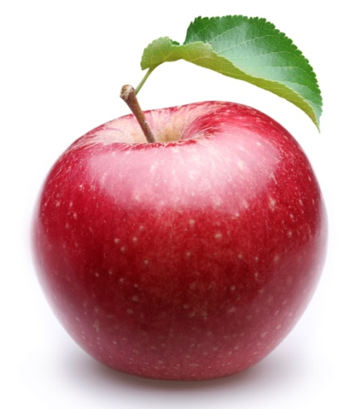
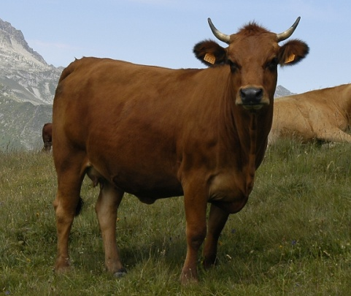
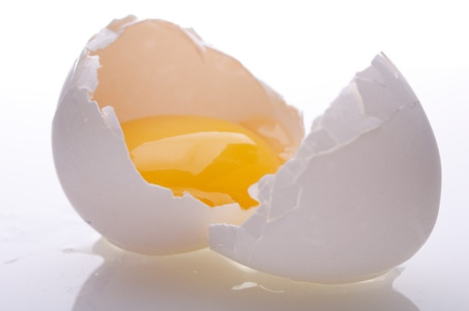
Listen then fill the missing letters :
E - A - C
_ PPLE _ OW _ GG

Slide 5
Catch the word :
Bed
Monkey
Head
Bed
Doctor
Head
Monkey
Doctor

