Slide 1
Unit 1 Games

Slide 2
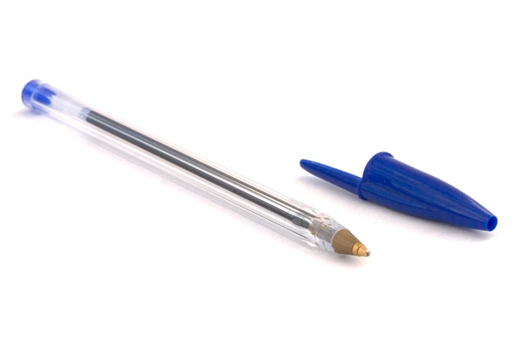
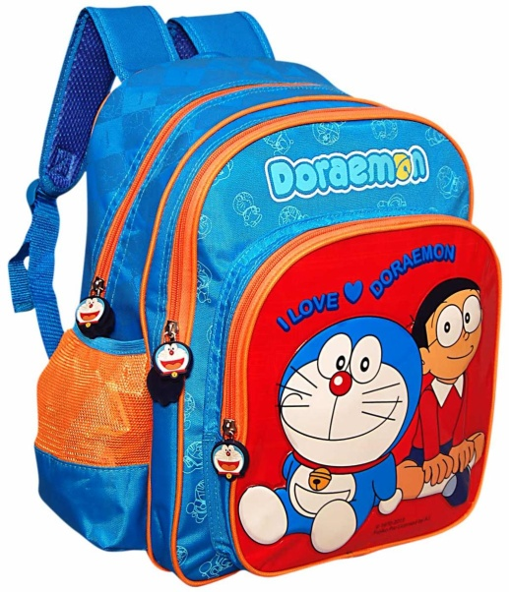
Point to ….

Slide 3
What is this color ?

Slide 4
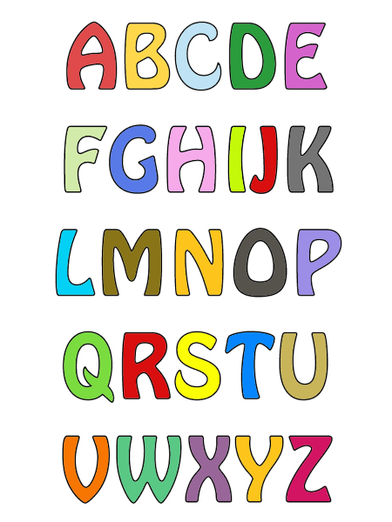
Chant the alphabet

Slide 5
Can you write your name ?
My name’s
…………………

Slide 6
Catch the letter :
H
A
M
S
H
S
D
D
K
K
G
Q
Q
M
A
G

