Slide 1
MEGA GOAL 3

Slide 2
UNIT 1

Slide 3
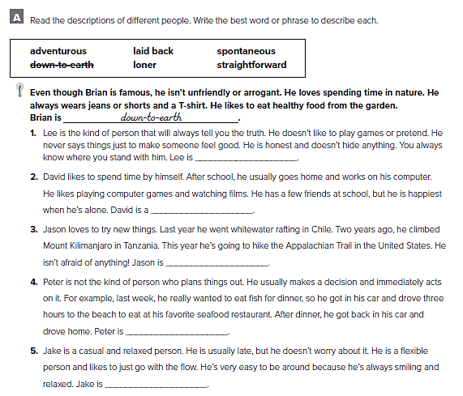
straightforward
loner
adventurous
spontaneous
laid back

Slide 4
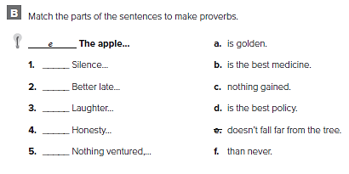
a
f
b
d
c

Slide 5
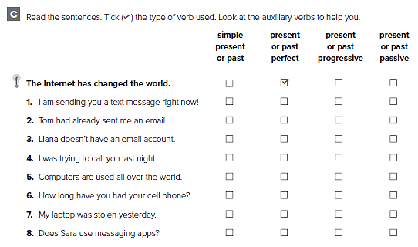

Slide 6
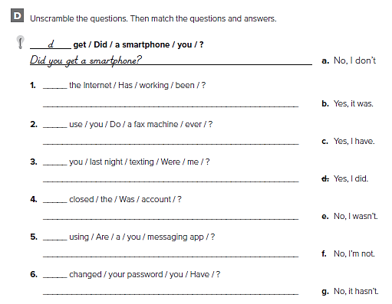
g
Has the internet been working ?
a
Do you ever use a fax machine ?
e
Were you texting me last night ?
b
Was the account closed ?
f
Are you sending an instant message ?
c
Have you changed your password ?

Slide 7
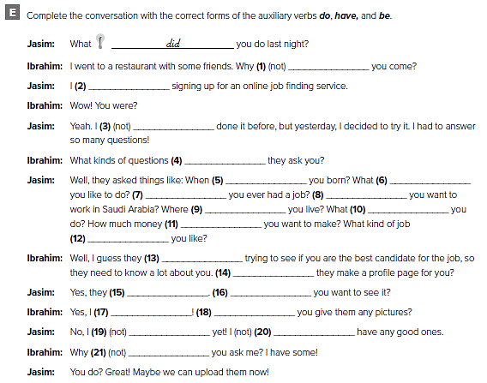
didn’t
was
hadn’t
did
were
do
Have
Do
do
do
do
do
are
Do
do
Do
do
Did
haven’t
don’t
didn’t

Slide 8
الإجابات من الممكن أن تختلف
Do you have a laptop ?
Have you eaten dinner ?
How does it work ?
When was the telephone invented ?
Had you called me before I arrived ?
Is your cell phone working ?
What were you doing last night ?

Slide 9
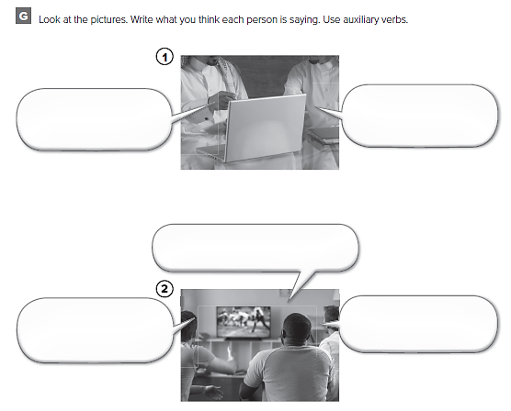
الإجابات من الممكن أن تختلف
When did you get this lap top ?
About a year ago
I’m going to watch the football match , do you want to come over ?
What are you doing tonight ?
Of course

Slide 10
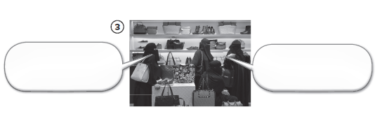
Do you like this bag ?
Yes , I do

Slide 12
Everybody knows when you’re online
It can be dangerous
Don’t give personal information
Don’t open unknown files
Like a real conversation
More private

Slide 13
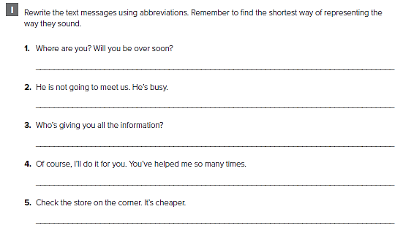
الإجابات من الممكن أن تختلف
WRU ? WU B ovr sn ?
HzNGT meet us . Hz Bzy ?
Wz gvn UL T Informtn ?
OC, ILDI4U. UV helpt me SM Tmz
√ T Str OT Crnr. It’s Chpr

Slide 14
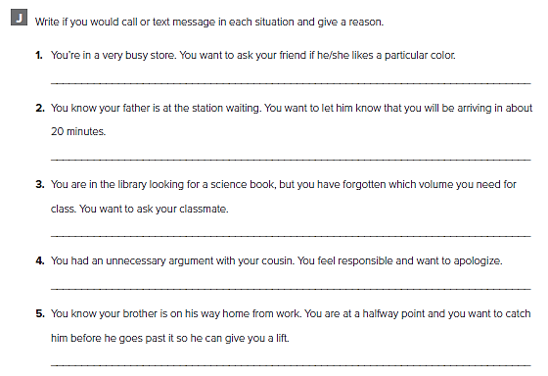
الإجابات من الممكن أن تختلف
I would text message because the shop is busy and noisy
I would text message because he might not hear the phone
I would text message because you’re not supposed to make noise
I would call to apologize
I would call him because he is in his car driving

Slide 16
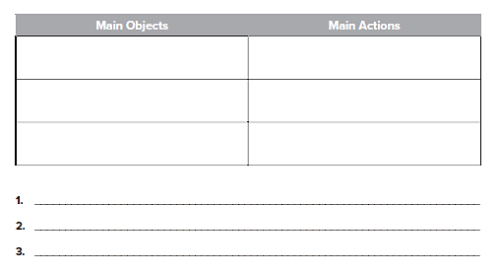
الإجابات من الممكن أن تختلف
Car
Cell phone
Steering wheel
Driving
Waiting
Checking phone
He has just stopped and checking his cell phone
He’s reading a text message
He may send his reply and wait for an answer

Slide 17
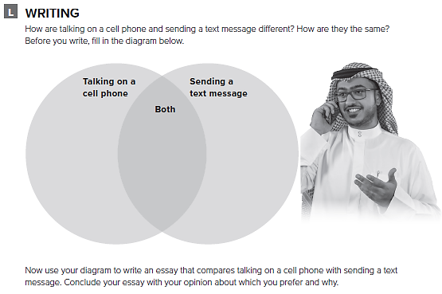
أكمل البيانات عن التشابه والاختلاف بين الاتصال و إرسال الرسائل

Slide 18
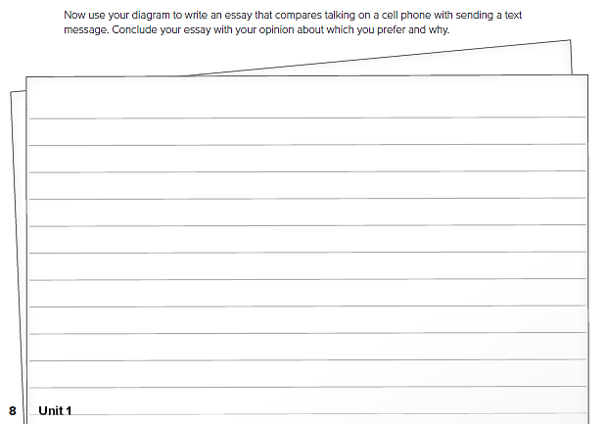
قم بكتابة مقال حول أوجه الشبه والاختلاف بين الاتصال و إرسال الرسائل

Slide 19
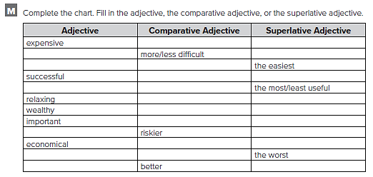
more/less expensive
the most/least expensive
difficult
the most/least difficult
easy
easier
more/less successful
the most/least successful
useful
more/less useful
more/less relaxing
the most/least relaxing
wealthier
the wealthiest
more/less important
the most/least important
risky
the riskiest
more/less economical
the most/least economical
bad
worse
good
the best

Slide 20
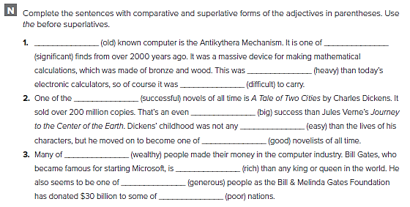
the most significant
The oldest
heavier
more difficult
most successful
bigger
easier
the best
the wealthiest
richer
the most generous
poorest

Slide 21
كل طالب يجيب عن نفسه

Slide 22
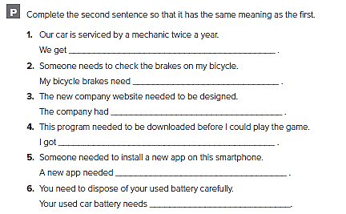
our car serviced twice a year
to be checked
the new website designed
this program downloaded before I could play the game
to be installed on this smartphone
to be disposed of carefully

Slide 23
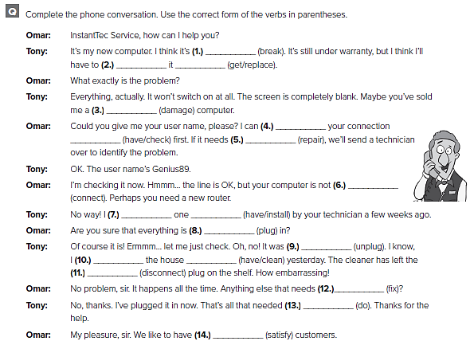
broken
get replaced
damaged
have
checked
to be repaired
connected
had installed
plugged
unplugged
had cleaned
disconnected
to be fixed
to be done
satisfied

Slide 24
UNIT 2

Slide 26
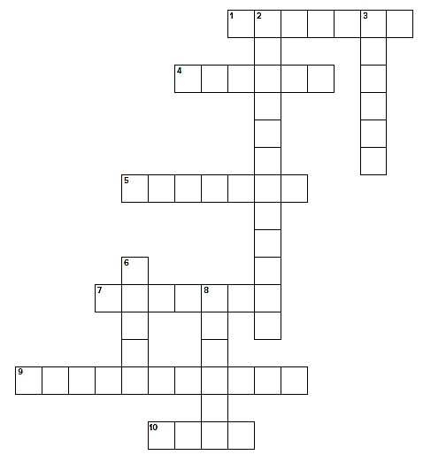
b u r g l a r
n
u
t
h
r
i
z
d
c
c
u
s
e
h i j a c k
a b a n d o n
s
i
z
d e c l i n e
n
m
t
m i s d e m e a n o r
f l e d

Slide 27
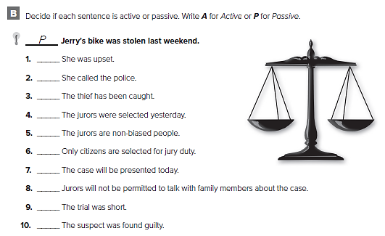
A
A
P
P
A
P
P
P
A
P

Slide 28
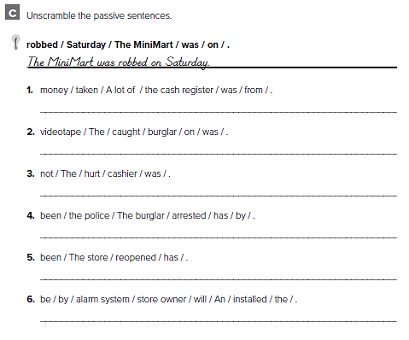
A lot of money was taken from the cash register
The burglar was caught on videotape
The cashier was not hurt
The burglar has been arrested by the police
The store has been reopened
An alarm system will be installed by the store owner

Slide 29
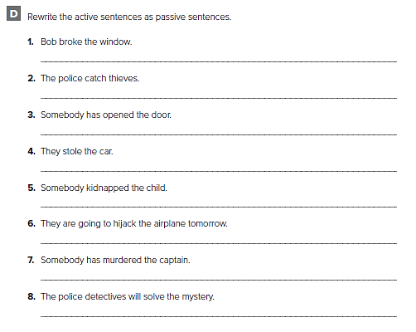
The window was broken by Bob
Thieves are caught by the police
The door has been opened
The car was stolen
The child was kidnapped
The airplane will be hijacked tomorrow
The captain has been murdered
The mystery will be solved by the police detectives

Slide 30
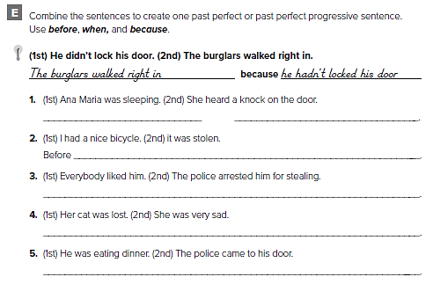
Ana Maria had been sleeping when she heard a knock on the door
it was stolen, I had had a nice bicycle
Before he was arrested for stealing, everybody had liked him
She was very sad because her cat had been lost
He had been eating dinner when the police came to his door

Slide 31
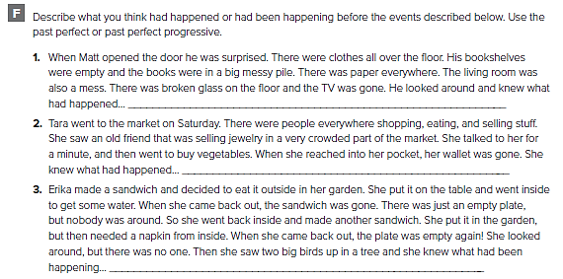
من الممكن أن تختلف الإجابات
Somebody had broken into the house before he got home
Somebody had stolen her wallet when she was talking to her friend
The birds had been eating her sandwiches when she went inside

Slide 32
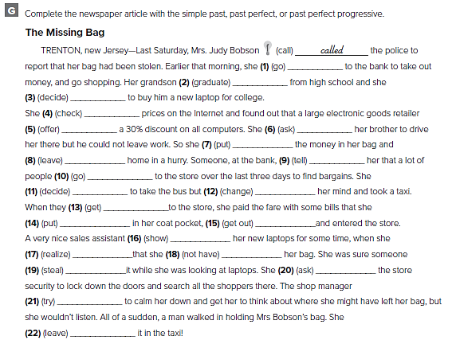
1. had gone
2. had graduated
3. had decided
4. had checked
5. was offering
6. had asked
7. put
8. left
9. had told
10. had been going
11. had decided
12. changed
13. got
14. had put
15. got out
16. had been showing
17. realized
18. did not have
19. had stolen
20. asked
21. tried
22. had left

Slide 33
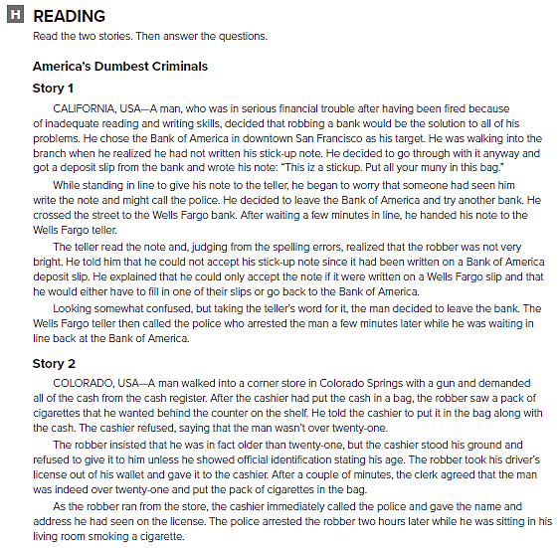

Slide 34
He made mistakes on his stick-up note.
He showed the cashier his driver’s license
It Pays To Be Able To Read And Write
Old Enough But Not Smart Enough
No. He should not have tried to rob the bank.
No. He should not have tried to rob the store

Slide 35
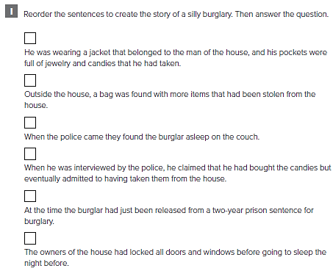
6
7
8
3
1
2

Slide 36
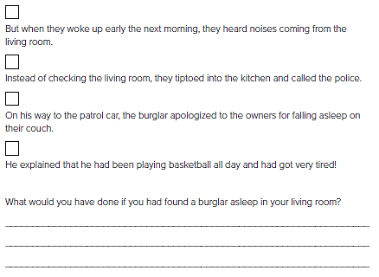
5
4
9
10
من الممكن أن تختلف الإجابات
I would have left the house and called the police.

Slide 38
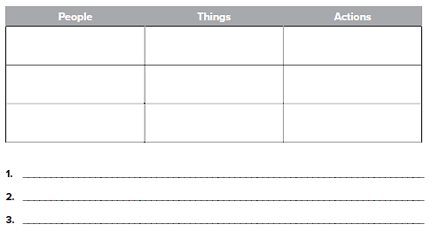
Crime scene tape
Guarding the area
Police
Witnesses
Notebook
Searching
Detectives
Radio
Investigating
من الممكن أن تختلف الإجابات
The crime scene tape is securing the crime area

Slide 39
قم بكتابة مقال عن عبارة
“ Crime Doesn't Pay “

Slide 40
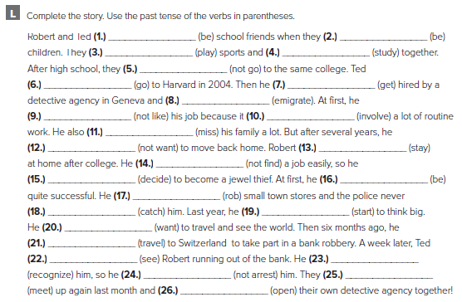
were
were
played
studied
didn’t go
went
got
emigrated
didn’t like
involved
missed
didn’t want
stayed
didn’t find
decided
was
robbed
caught
started
wanted
traveled
saw
recognized
didn’t arrest
met
opened

Slide 41
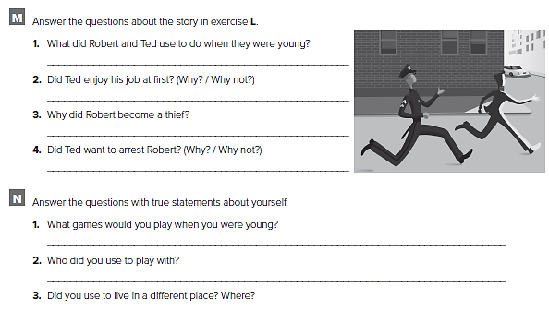
They used to play sports and study together
No, he didn’t because it involved a lot of routine work.
He became a thief because he couldn’t find a job easily.
No, he didn’t, because they were school friends
كل طالب يجيب عن نفسه

Slide 42
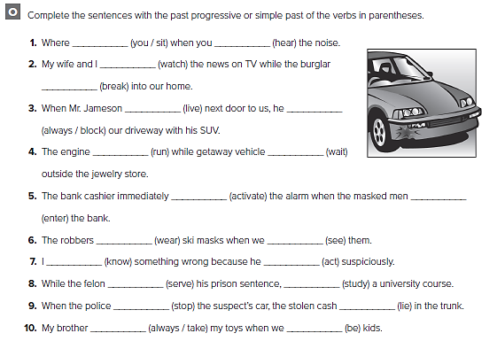
were you sitting
heard
were watching
was breaking
lived
was always blocking
was running
was waiting
activated
entered
were wearing
saw
knew
was acting
was serving
studied
stopped
was lying
was always taking
were

Slide 43
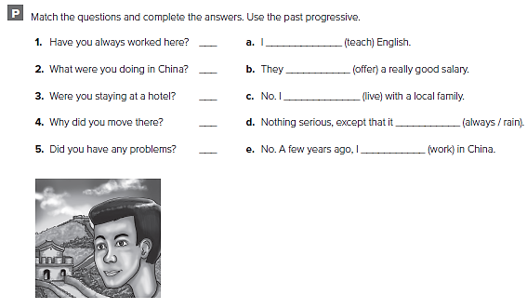
e
a
c
b
d
was teaching
were offering
was living
was always raining
was working

Slide 44
UNIT 3

Slide 45
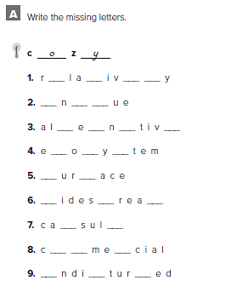
e t e l
u i q
t r a e
c s s
s f
w p d
p e
o m r
u s b

Slide 46
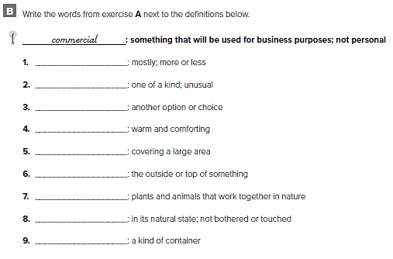
relatively
unique
alternative
cozy
widespread
surface
ecosystem
undisturbed
capsule

Slide 47
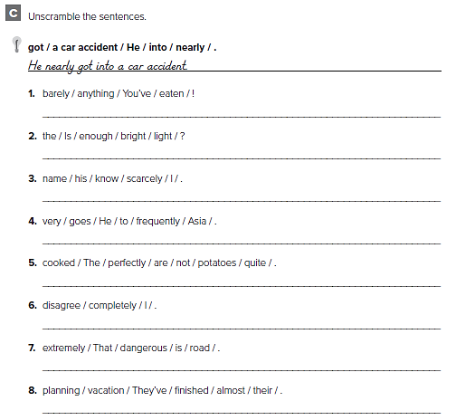
You’ve barely eaten anything!
Is the light bright enough?
I scarcely know his name.
He goes to Asia very frequently.
The potatoes are not cooked quite perfectly.
I completely disagree.
That road is extremely dangerous.
They’ve almost finished planning their vacation

Slide 48
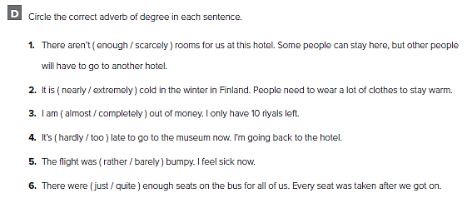

Slide 49
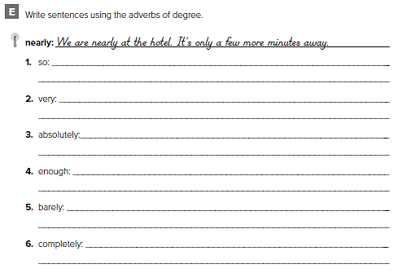
من الممكن أن تختلف الاجابات
It’s so hot in here. Do you have a fan ?
I’m very tired. I want to go to bed now
I’m absolutely sure. I have no questions about it
There isn’t enough tea. I will make more
There’s barely anybody here. Only 3 people
I am completely out of coffee. I don’t have any more

Slide 50
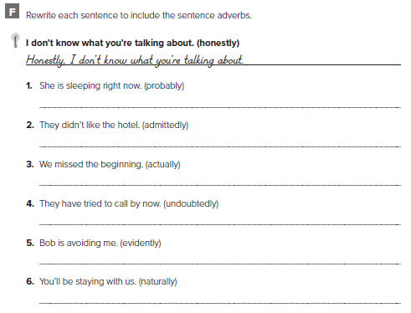
من الممكن أن تختلف الاجابات
She is probably sleeping right now
Admittedly, they didn’t like the hotel
We actually missed the beginning
They have undoubtedly tried to call by now
Evidently, Bob is avoiding me
Naturally, you’ll be staying with us

Slide 51
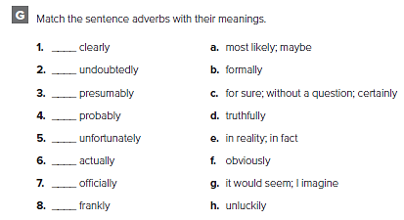
f
c
g
a
h
e
b
d

Slide 52
اقراء عن السكن الشبابي ثم قم بكتابة قطعة عنه

Slide 53
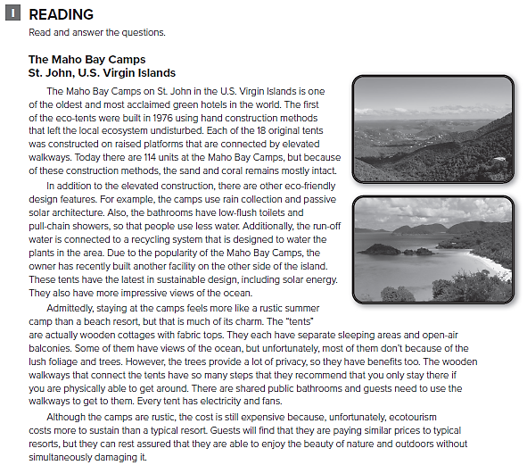

Slide 54
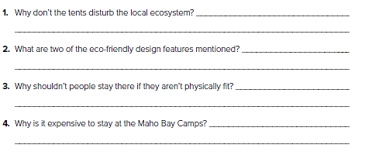
They were built by hand, on raised platforms
Rain collection and passive solar architecture
Because they need to use stairs and walk along walkways
Ecotourism costs more to sustain

Slide 55
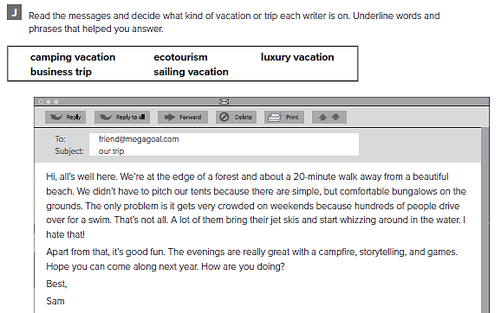
edge of a forest, beautiful beach, pitch tents,
bungalows on the grounds

Slide 56
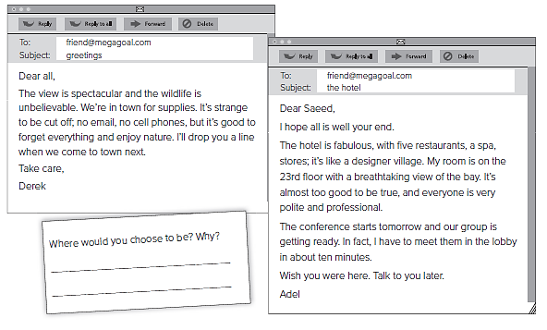
Hotel/fabulous, five restaurants, spa, designer village, breathtaking view of the bay, conference, our group, meet them in the lobby
view/spectacular, wildlife/unbelievable, cut off, no cell phones, nature

Slide 58
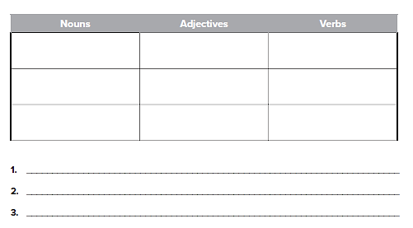
من الممكن أن تختلف الاجابات
Reservoir
Sand
Climate
Hot
Dry
Barren
Evaporate
Dry up
Die
Global warming causes extreme changes in climate
In hot, dry areas, evaporation can result in a huge loss of water

Slide 59
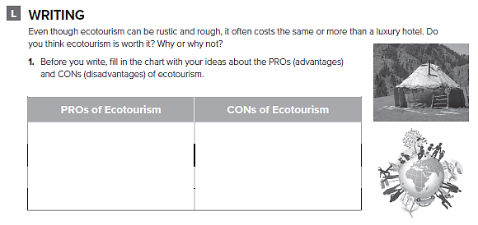
من الممكن أن تختلف الاجابات
Large numbers of ecotourists can damage environment
experiencing nature without causing damage

Slide 60
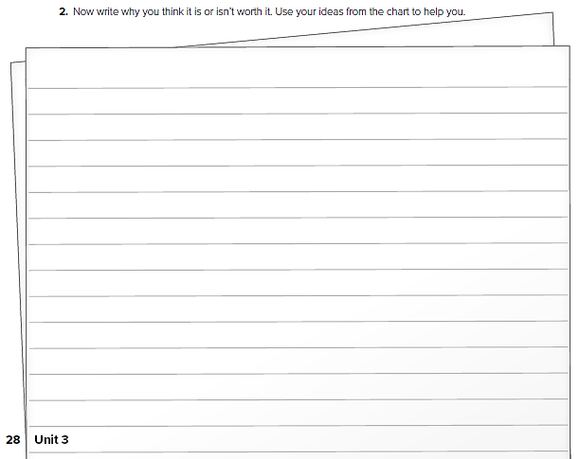
قم بكتابة مقال عن السياحة البيئية

Slide 61
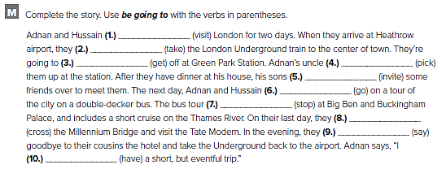
1. are going to visit
2. are going to take
3. are going to get
4. is going to pick
5. are going to invite
6. are going to go
7. is going to stop
8. are going to cross
9. are going to say
1 0 . am going to have

Slide 62
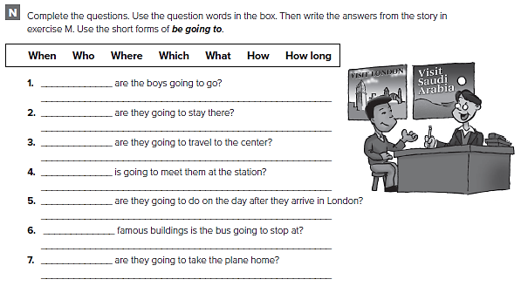
Where
They’re going to go to London.
How long
They’re going to stay for two days
How
They’re going to take the train
Who
Adnan’s uncle
What
They’re going to take a tour of the city
Which
It’s going to stop at Big Ben and Buckingham Palace
When
In the evening on their last day.

Slide 63
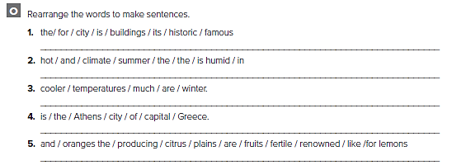
The city is famous for its historic buildings
The climate is hot and humid in the summer
Winter temperatures are much cooler
Ankara is the capital city of Turkey
The fertile plains are renowned for producing citrus fruits

Slide 64
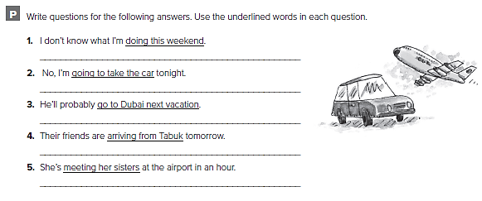
من الممكن أن تختلف الاجابات
What are you doing this weekend?
Are you going to drive home tonight?
Where will he go on his next vacation?
What are their friends doing tomorrow?
Who’s she meeting at the airport in an hour?

Slide 65
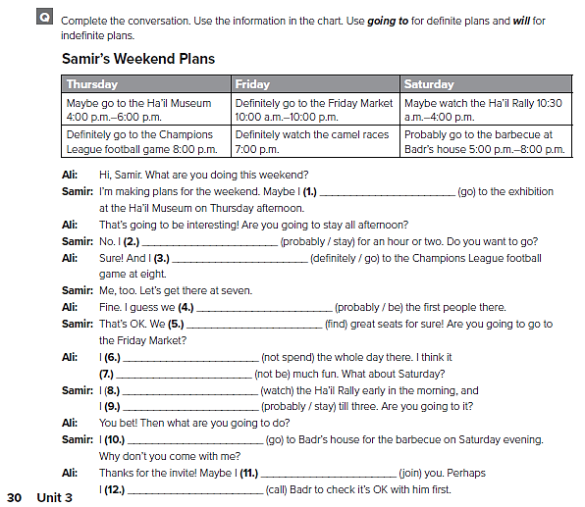
will go
will probably stay
am definitely going to go
will probably be
are going to find
am not going to spend
won’t be
am going to watch
will probably stay
am going to go
will join
will call

Slide 66
EXPANSION 1 – 3

Slide 67
g
e
i
a
j
c
f
l
k
b
d
h

Slide 69
was
didn’t was
is
were
are
has
doesn’t
am
have

Slide 70
A lot of information has been sent by email.
The Internet is going to be used in more remote areas.
A text message was sent to me today.
The Internet was invented in the 1960s.
Computers are purchased for schools by the government.
The mobile phone was invented in 1908 by Nathan Stubblefield.
The first cellular network was launched by the Japanese telephone company.

Slide 72
I had just left the house for 10 minutes
The robber probably saw me leave
Admittedly, I didn’t even lock the door
He must have been extremely fast
When I got back home, all of my electronics were completely gone
I was so upset
Naturally, I called the police right away
They were very nice
Apparently, there have been a lot of robberies lately
They actually think they will find him
I obviously hope they do

Slide 73
حدد الأشياء التي قد تمارسها أثناء سفرك إلى ماليزيا

Slide 76
Laptop
Notes
Flip chart
Listening
Talking
Agreeing
How long have you been in the conference room?
How long has the man been presenting his plan?
من الممكن أن تختلف الاجابات

Slide 77
أجب على الايميل المرسل لك من قبل صديقك

Slide 78
قم بكتابة ايميل إلى صديقك

Slide 79
UNIT 4

Slide 80
broadcast
contestants
version
prosperous
award
plot

Slide 81
1- broadcast
2- plot
3- contestants
4- version
5- award
6- prosperous

Slide 82
1. D.O. = a secret I.O. = me
2. D.O. = the poem I.O. = his wife
3. D.O. = dinner I.O. = us
4. D.O. = a letter I.O. = the producer
5. D.O. = coffee I.O. = me
6. D.O. = the prize I.O. = the best athlete
7. D.O. = the show I.O. = them
8. D.O. = a present I.O. = me
9. D.O. = SR 100,00 I.O. = the winner
1 0 . D.O. = the email I.O. = me

Slide 83
They bought a new DVD player for her.
Could you give the remote control to me?
Not possible
He lent a friend his car.
Matt gave his fans pictures.
Not possible
Not possible
The host gave a cup of coffee to the guest star.

Slide 84
to
to
to
for
to
for
for
to
for
to

Slide 85
1. He sold it to me.
2. Maria opened the box for him.
3. My parents bought a computer for me.
4. Can you cash the check for me?
5. John turned on the TV for his dad.
6. They gave the part to him.
7. Will you tell me a story?
8. Andrew passed it to me.

Slide 86
كل طالب يضع اجاباته الخاصة

Slide 87
bug
c’mon
Get a kick out of
couch potato
all
Nah

Slide 89
No No No
The situations Bad decisions A waste of
Are boring time
The news Films Shows

Slide 90
أكمل الاستبيان ثم قم بجمع نقاطك

Slide 91
من الممكن أن تختلف الإجابات
The ideal game show contestant likes speaking in public. He can work with people he has met recently and can control his feelings. He is keen to win but he is also a good loser who doesn’t hold grudges. He can take criticism and follow instructions. He is competitive and likes being in front of a camera, a video or strong lights

Slide 93
Men
Pens
Office
Sit
Talk
Smile
Office
Company
City
Morning
Noon
Evening
They are sitting in their office or meeting room
One of them is about to write or sign something
من الممكن أن تختلف الإجابات

Slide 94
تحدث عن نوع برنامج المسابقات الذي تحبه

Slide 95
اكتب مقال عن نوع برنامج المسابقات الذي تحبه

Slide 96
the
the
The
the
the
the
The
the
the
the
the
the
the

Slide 97
the
the
the
a
the
the
a
the
the
a
the
the
the
the
A
a
an
an
a
an
a

Slide 98
which
that
which
that
which
that
who
that
which
that
who
that
who
that

Slide 99
which that
which/that/Ø
who/that
which that
who/that/ Ø;
which that Ø
who/that
who/that/ Ø;

Slide 100
UNIT 5

Slide 101
c
e
b
f
a
d

Slide 102
satisfaction
income
appreciated
entail
entire
cooperate
respectful
status

Slide 103
الإجابات من الممكن أن تختلف
take this medicine every day
to do your homework
stay out of the street
to stay still
vote for me
not play with matches
send this first-class mail
wear a seatbelt

Slide 104
I recommend that you bring your résumé.
It is important that you dress nicely.
It is imperative that you make eye contact.
It is essential that you shake the interviewer’s hand.
It is important that you sit up straight.
I suggest that you use a confident voice.
It is essential that you answer all of the questions.
I recommend that you ask them questions, too.
I suggest that you write a thank-you note afterwards

Slide 105
that you put
give
that you give
that you list
that you be clear
talk
that you include
want you to call

Slide 106
الإجابات من الممكن أن تختلف
It is important that they know how to sew.
It is necessary that they go to medical school.
It is essential that they like to cook.
I recommend that they like talking to people.
It is important that they are good at math.
It is important that they like working outside.
It is essential that they be good with children.
It is necessary that they be healthy and strong

Slide 107
الإجابات من الممكن أن تختلف
I want you to clean your teeth.
It is important that you don't eat sweets.
It is necessary to wear a seatbelt.
It is important that you not use a phone

Slide 108
in a bind
Keep it to yourself
will do
jumped ship
take off
cover
No kidding

Slide 110
F
T
T
F
T
F

Slide 111
accountants
It is necessary that they keep records meticulously
medical doctors
We expect them to cure us
architect
It is essential that they have an eye for style and design

Slide 112
teachers
It is necessary that they take work home
flight attendants
It is imperative that they be courteous and efficient
TV presenters
They need to pay attention to the way they look
consultants
It is important that they listen carefully
photographers
It is necessary that they have an eye for details
reporters
It is imperative that they check information before using it

Slide 114
First name
Family name
Address
Have you ever worked in this kind of area before?
Where were you trained?
Why did you leave your last job?
الإجابات من الممكن أن تختلف

Slide 115
تحدث عن أحلامك المهنية

Slide 116
قم بكتابة مقال عن أهدافك في الحياة

Slide 117
wasn’t it
doesn’t he
are you
didn’t they
isn’t there
will we

Slide 118
الإجابات من الممكن أن تختلف
Could I have an application form?
Could/Can I take a short break?
Excuse me, can you tell me where the manager’s office is?
Would you mind telling me your address, and phone number?
Would you be able to lend me your phone to send a text?

Slide 120
doesn’t have to
mustn’t
has to
must
mustn’t
have to
has to
mustn’t

Slide 121
didn’t have to
had to
didn’t have to
needn’t
had to
needn’t
had to
needn’t
didn’t need to
needn’t

Slide 122
UNIT 6

Slide 123
tap water
crank up
pesticides
thermostat
conserve
plastic

Slide 124
consumption
source
efficient
recycle
Pesticides keep bugs and animals away. They can hurt the environment
You can crank up the radio, the TV
Bottles, silverware, and furniture are commonly made of plastic
plastic and glass bottles, tin cans
They want to save money on gas

Slide 126
consider can’t stand agree
finish continue decide
imagine hate offer
keep love plan
recommend prefer promise
suggest start want

Slide 127
getting
watering
to get
separating
to conserve
to have
insulting
to eat

Slide 128
الإجابات من الممكن أن تختلف
I recommend eating fruits and vegetables every day.
I hate eating old vegetables from the supermarket.
I attempt to recycle everything possible.
I recommend getting two recycle bins.
I like knowing that I’m helping the earth.
We like biking to work
We hate paying for parking in the city.
We prefer to bike to work on rainy days

Slide 129
The farmer began using organic methods.
We decided to get solar panels.
I prefer to eat organic food.
We expect to see her soon.
She quit smoking.

Slide 130
a hassle
a piece of cake
chuck
lame
I guess
a no-brainer

Slide 132
b
a
a
b
a

Slide 133
To protect them from damage, make packing and transport easier
Only certain types of packaging
Packaging is used to promote products
To avoid polluting the environment
كل طالب يجيب عن نفسه

Slide 134
كل طالب يجيب عن نفسه

Slide 136
Boys Carry Friendly
Children Collect Happy
Gloves Sort Active
They are proud to be active participants in “green” projects.
They often participate in “clean the forest” campaigns

Slide 137
تحدث عن الطعام ومصدره

Slide 138
قم بكتابة مقال عن الطعام

Slide 139
grow
is changing
goes
work
are considering
does he work
are melting
doesn’t have
are currently researching
Do you believe

Slide 140
boils is boiling
studies is studying
are living
live
is depleting
depletes
doesn’t look are looking

Slide 141
heat will melt
replant will take
won’t improve don’t stop
install will cut
don’t water won’t grow
will ask don’t obey
teach will treat
will be don’t reduce

Slide 142
كل طالب يجيب عن نفسه

Slide 143
EXPANSION 4 – 6

Slide 145
for
to
for
to
to
for
to

Slide 146
helping
to start
to get
to work
going
working
to apply
to bring

Slide 147
hanging out with my friends
to pay a lot of money for clothes
to go to the store today
waiting in line
to vacation close to home
to get a job for the summer
going to a university that is far away
to do very well in this class

Slide 148
He suggested that I buy a hybrid car.
I want you to buy a stainless steel water bottle.
It is essential that we all try to save water.
Environmentalists request that we eat locally grown food.
It is important that everyone try to conserve energy.
Environmentalists recommend that you turn off the lights
I’d like you to recycle all of that paper.
They asked that she reuse containers as much as possible

Slide 149
you to become
ordered it for me
for us
decided to take
important that you
a table for me
bring
suggested coming
to eat out
demand that you tell

Slide 151
To meet the demand during the festival season.
Dark, light, white, bitter, semi-sweet, sweet.
Post-Ramadan period because of the numerous orders
c
f
a
d
e
b

Slide 153
Happy Gift
Surprised Give
Shocked See
Children get really excited with celebrations.
Most people are delighted to have surprise gifts
كل طالب يجيب بإجابته الخاصة

Slide 154
تحدث عن أحد الأعياد في وطنك

Slide 155
اكتب مقال عن أحد الأعياد في وطنك

Slide 156
Prepared by
Teacher :
Badr Sayid Al-Shehri

