Slide 1
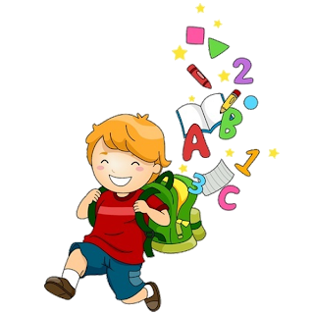
2
Unit 3

Slide 3
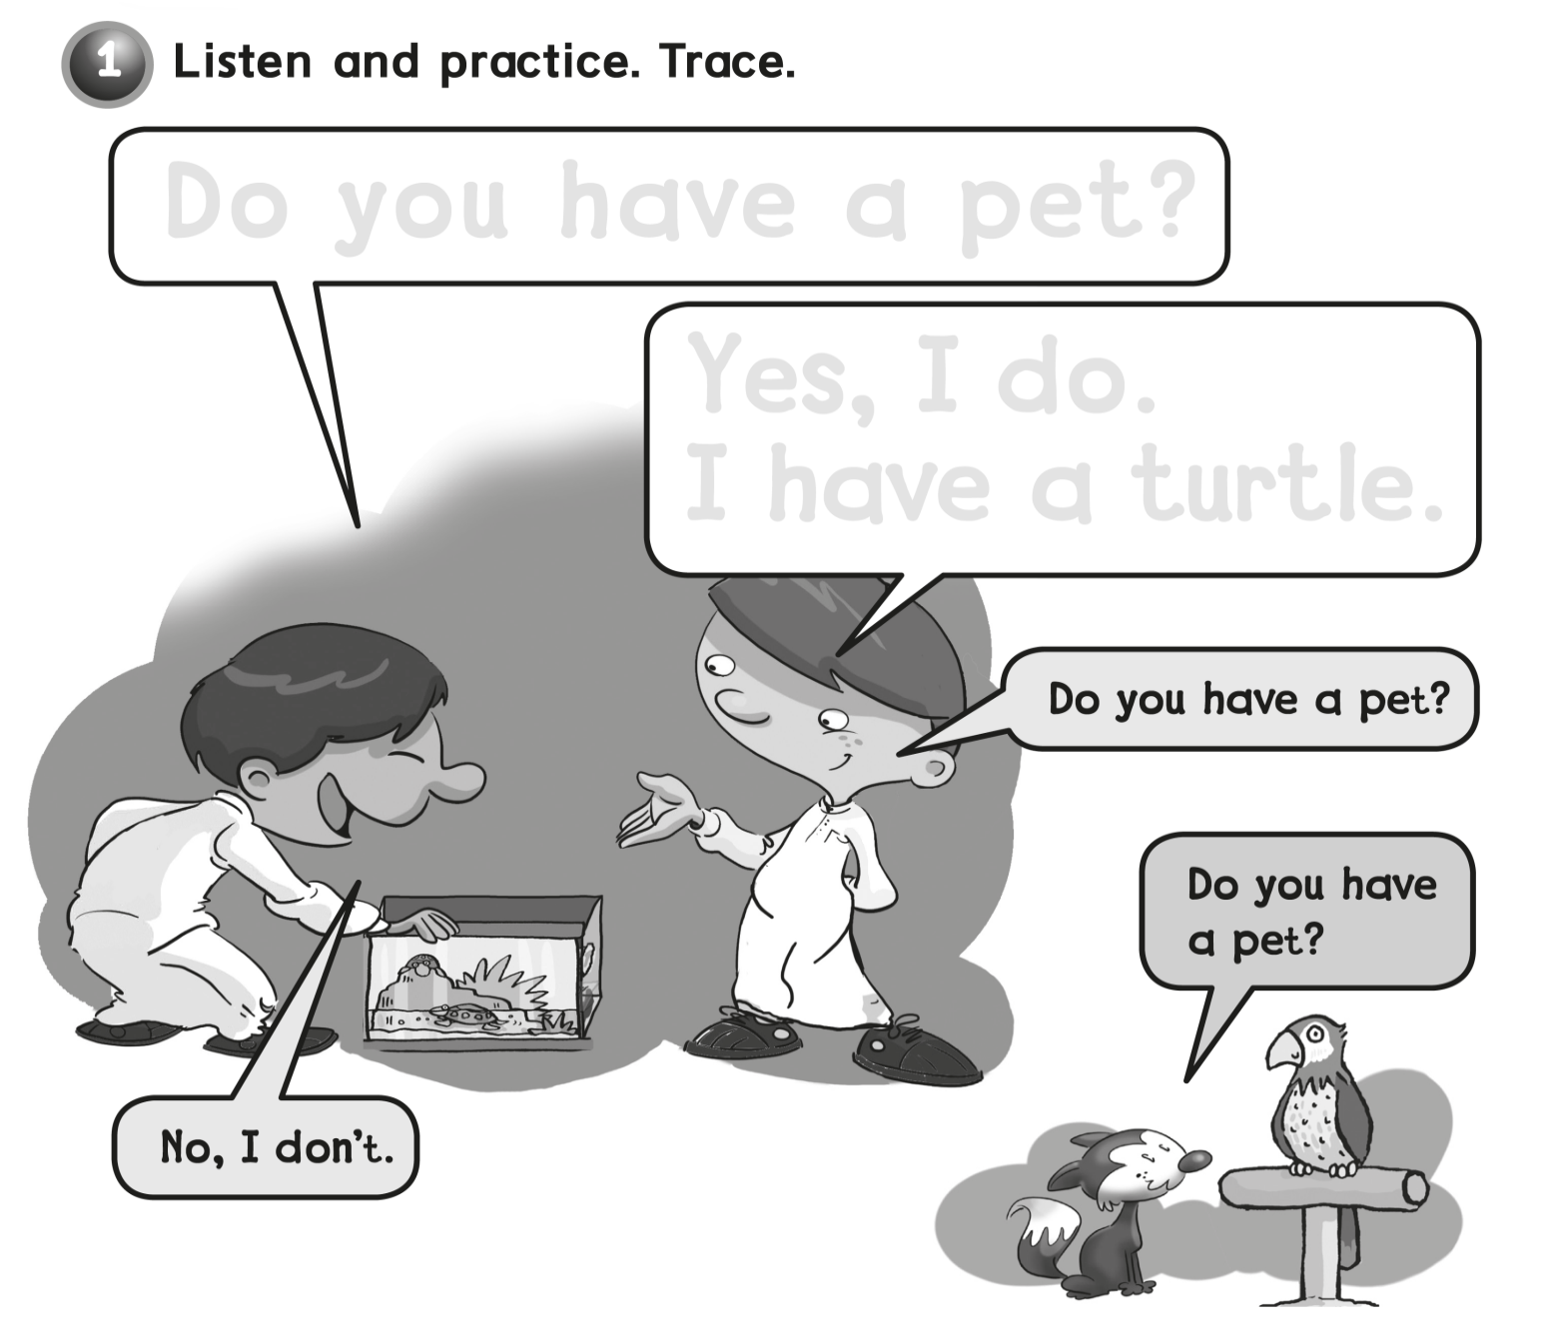
Do you have a pet ?
Yes , I do
I have a turtle .

Slide 4
w w w w

Slide 6
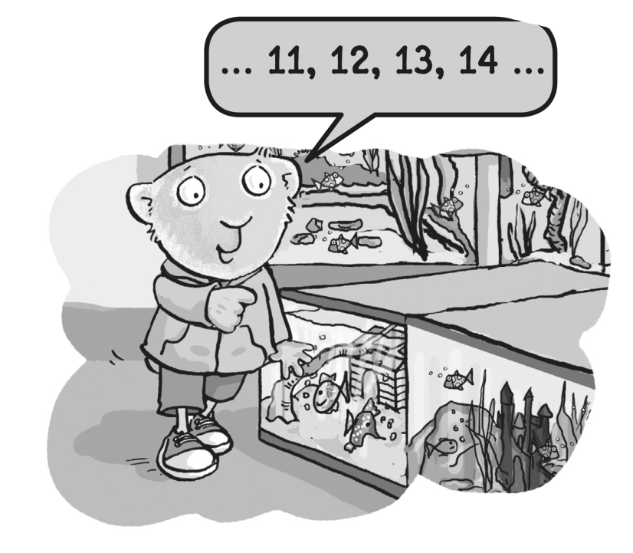
11 12 13 14 15
16 17 18 19 20

Slide 7
x x x x

Slide 9
There was a farmer
who had a horse ,
and Paco was
his name-oh !

Slide 10
y y y y

Slide 12
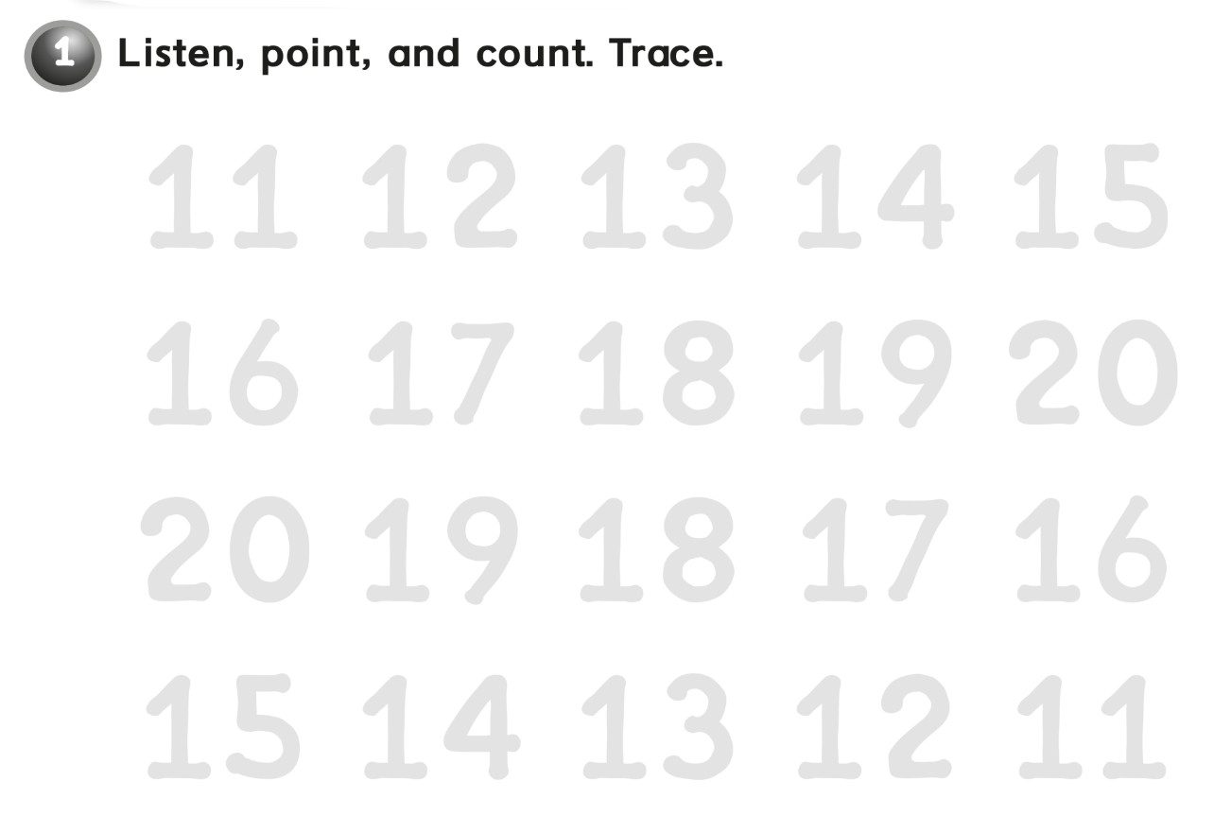
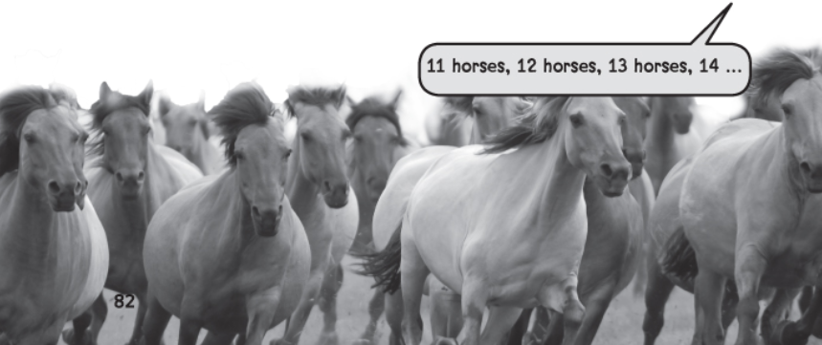
11 12 13 14 15
16 17 18 19 20
20 19 18 17 16
15 14 13 12 11

Slide 14
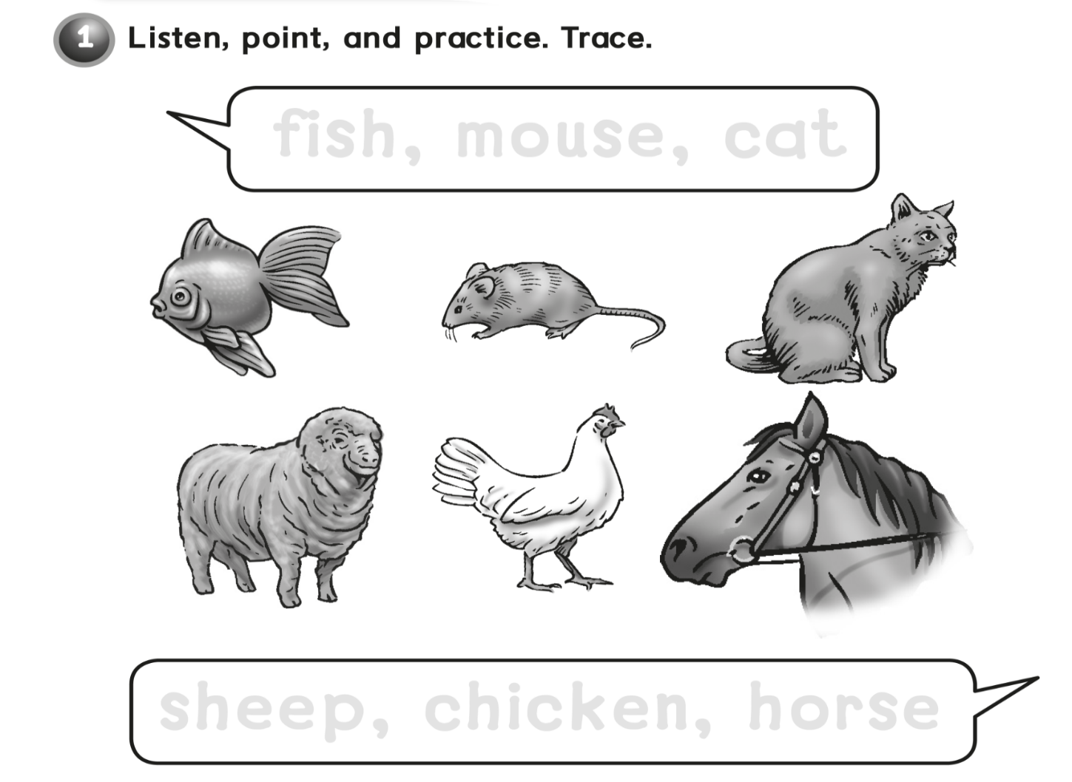
Fish, mouse, cat
Sheep, chicken, horse
Aa Aa Aa Bb Bb Bb

Slide 16
Moo!
Moo!
Neigh! Neigh!
Tweet !
Tweet !
Cluck !
Cluck !
Baa ! Baa !

Slide 17
Cc Cc Cc Dd Dd Dd

Slide 19
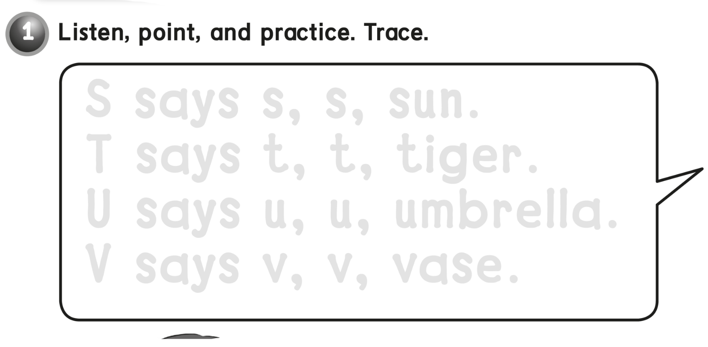
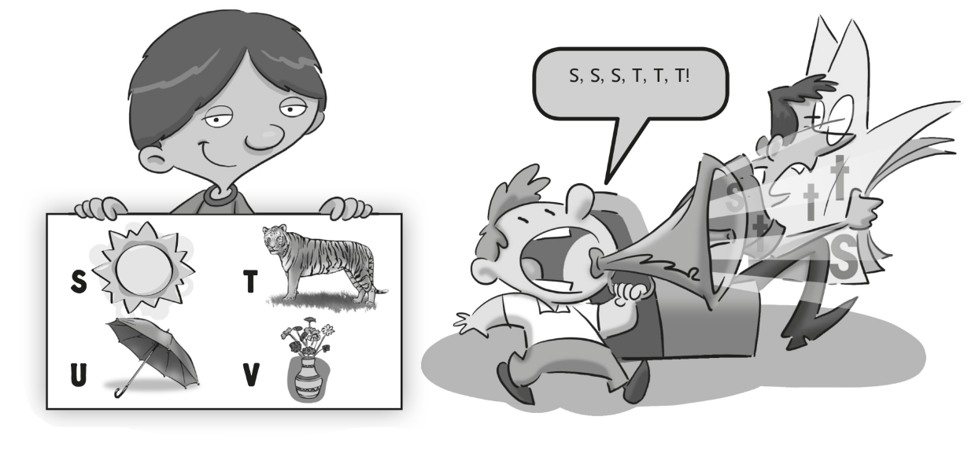
S says s, s, sun.
T says t, t, tiger .
U says u, u, umbrella .
V says v, v, vase .

Slide 20
Ee Ee Ee Ff Ff Ff

Slide 22
20 21 22 23
25 26 27
28 29 30
30 29 28 27
26 25 24 23
22 21 20

Slide 23
G g Gg Gg Hh Hh Hh

Slide 24
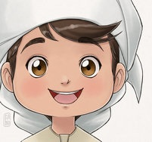
See you later
and Goodbye
Teacher :
Badr Sayid
Al-Shehri

