Slide 1
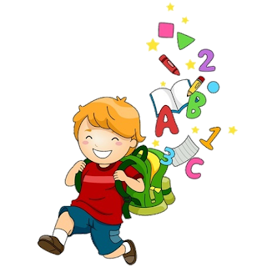
2
Unit 5

Slide 3
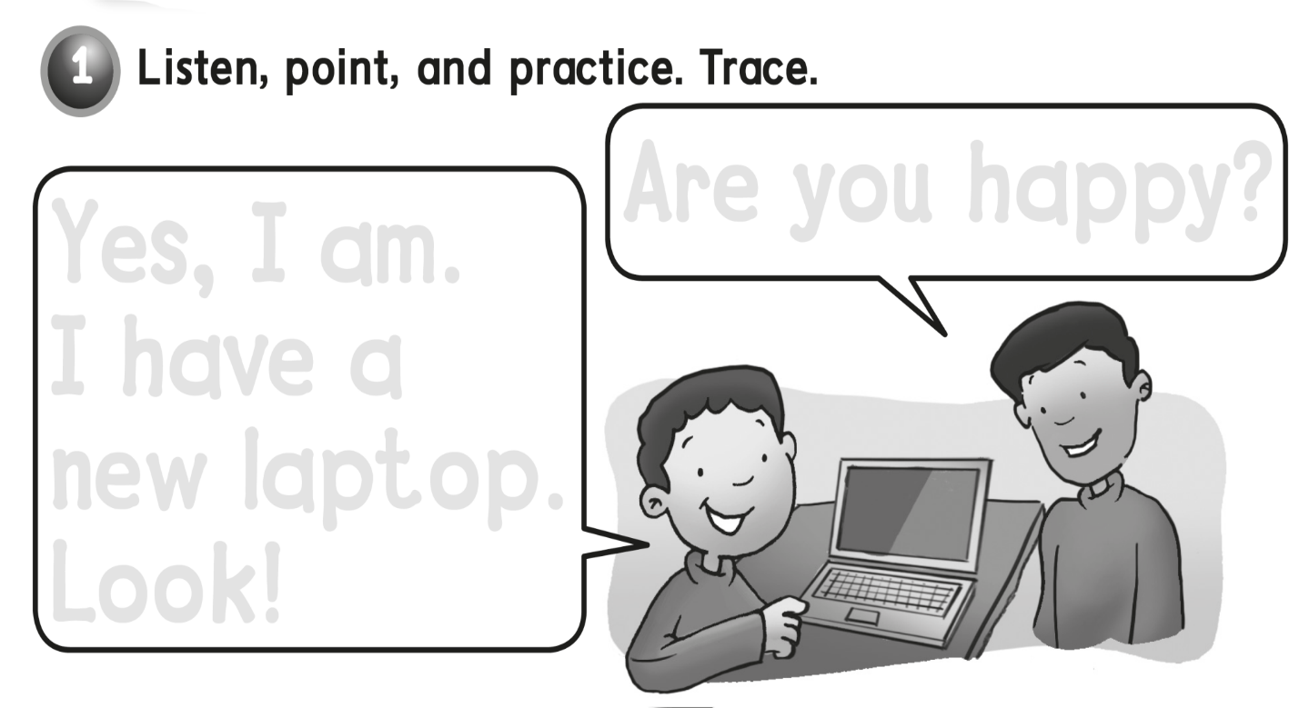
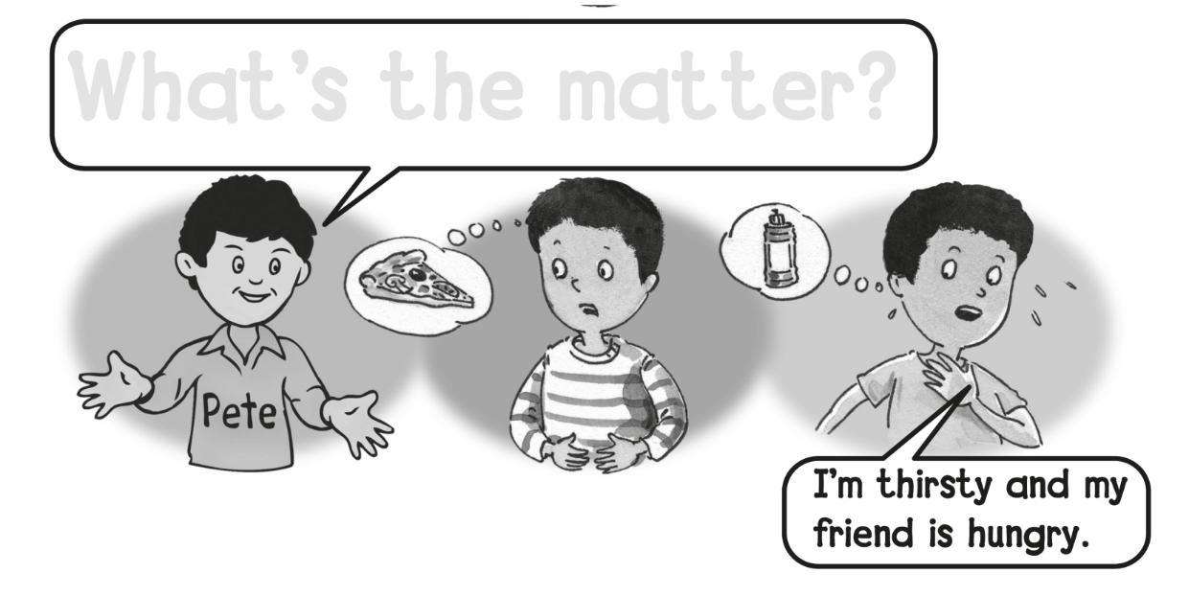
Are you happy ?
Yes, I am.
I have a
new laptop .
Look !
What’s the matter ?

Slide 4
hungry and thirsty
Yes , we are .

Slide 6
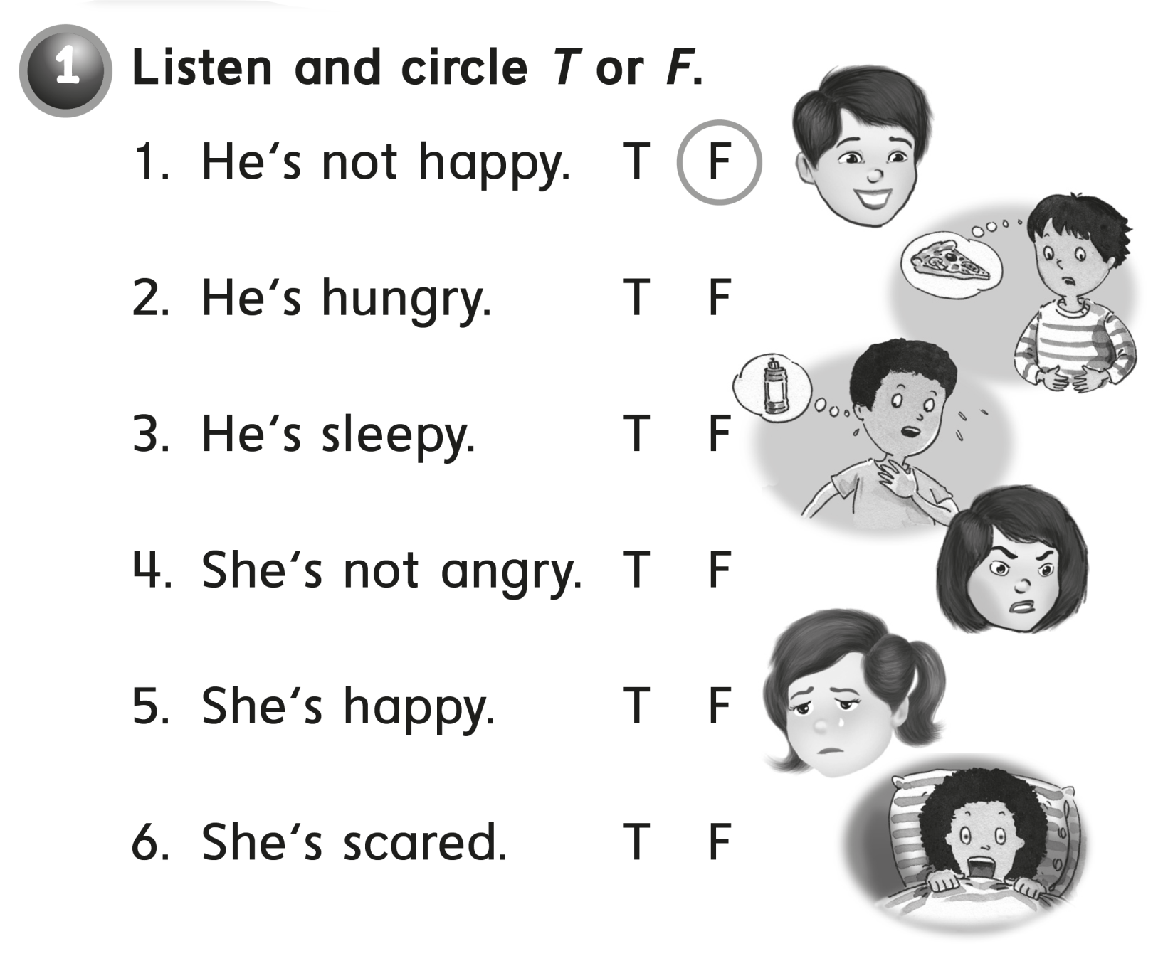

Slide 7
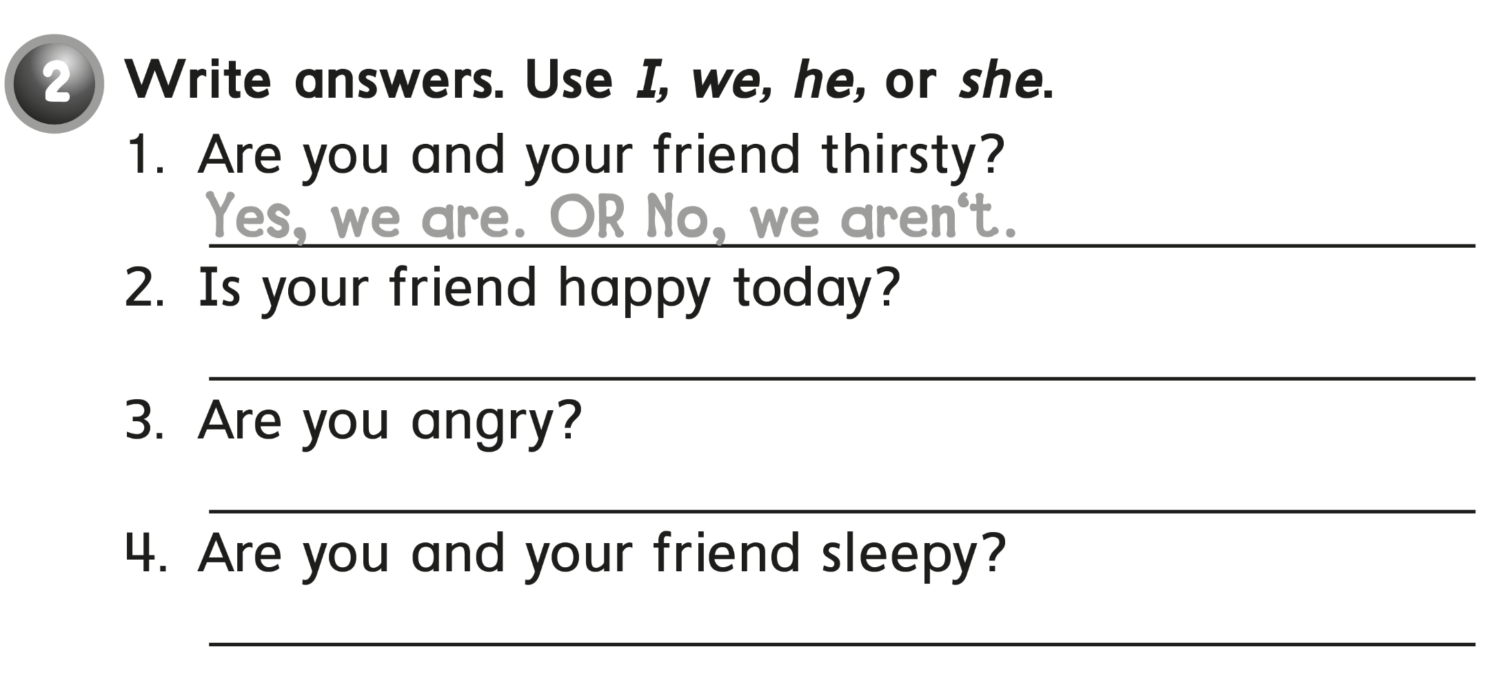
Yes , he is .
NO , I am not .
No , we are not .

Slide 9
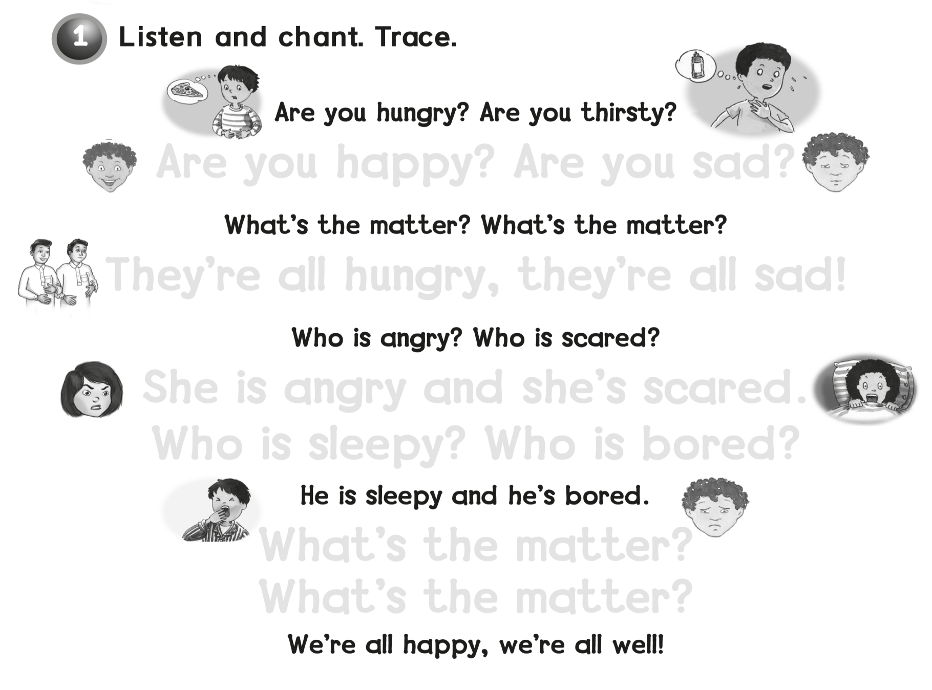
Are you happy ? Are you sad ?
They’re all hungry, they’re all sad !
She is angry and she’s scared
Who is sleepy? Who is bored ?
What’s the matter ?
What’s the matter ?

Slide 10
are watches .
The boys are happy .

Slide 12
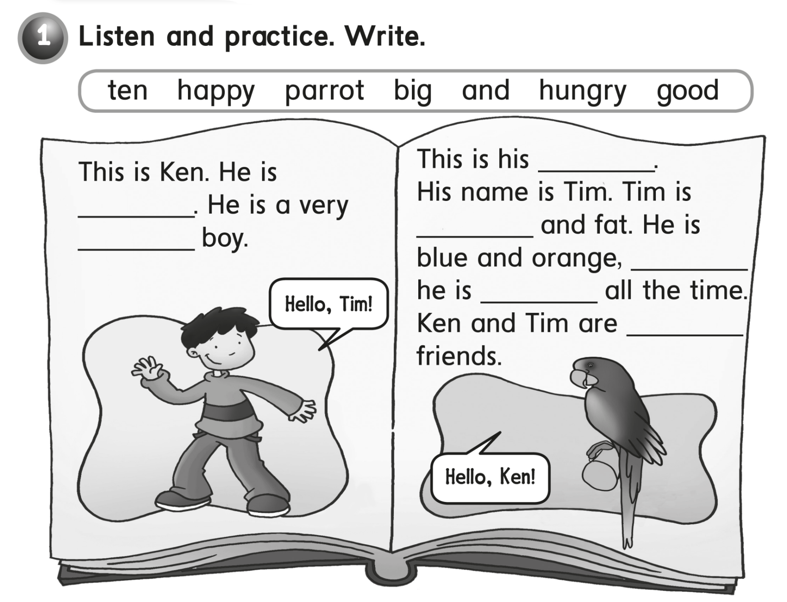
Parrot
ten
happy
big
and
hungry
good

Slide 13
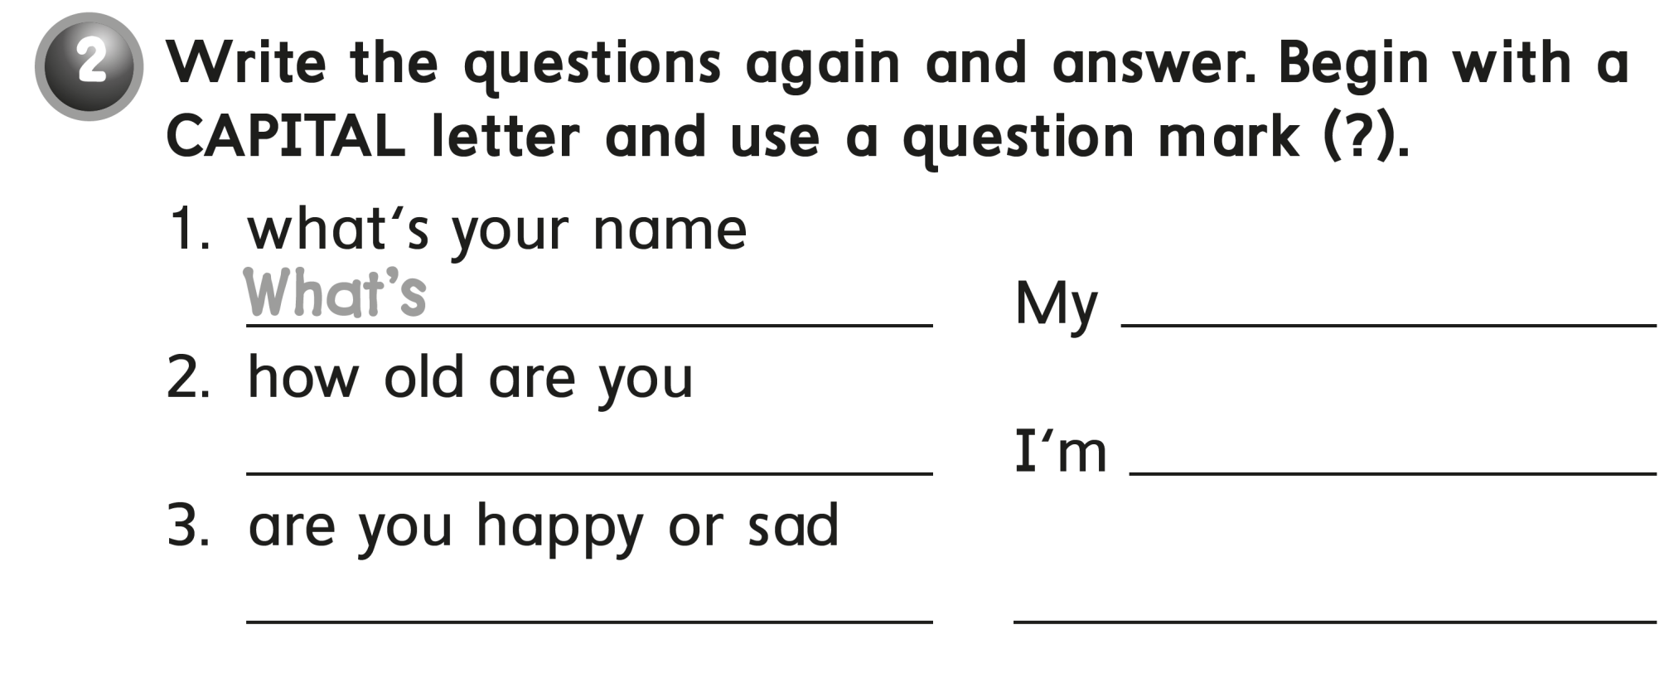
your name ?
name is ………
How old are you ?
10 years old .
Are you happy or sad ?
I am happy .

Slide 15
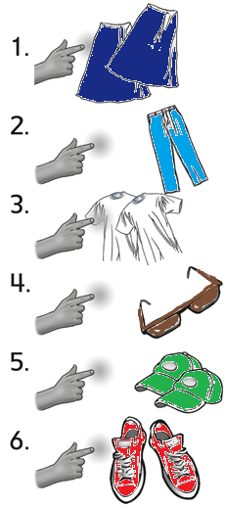
These
Those
Those
These

Slide 16
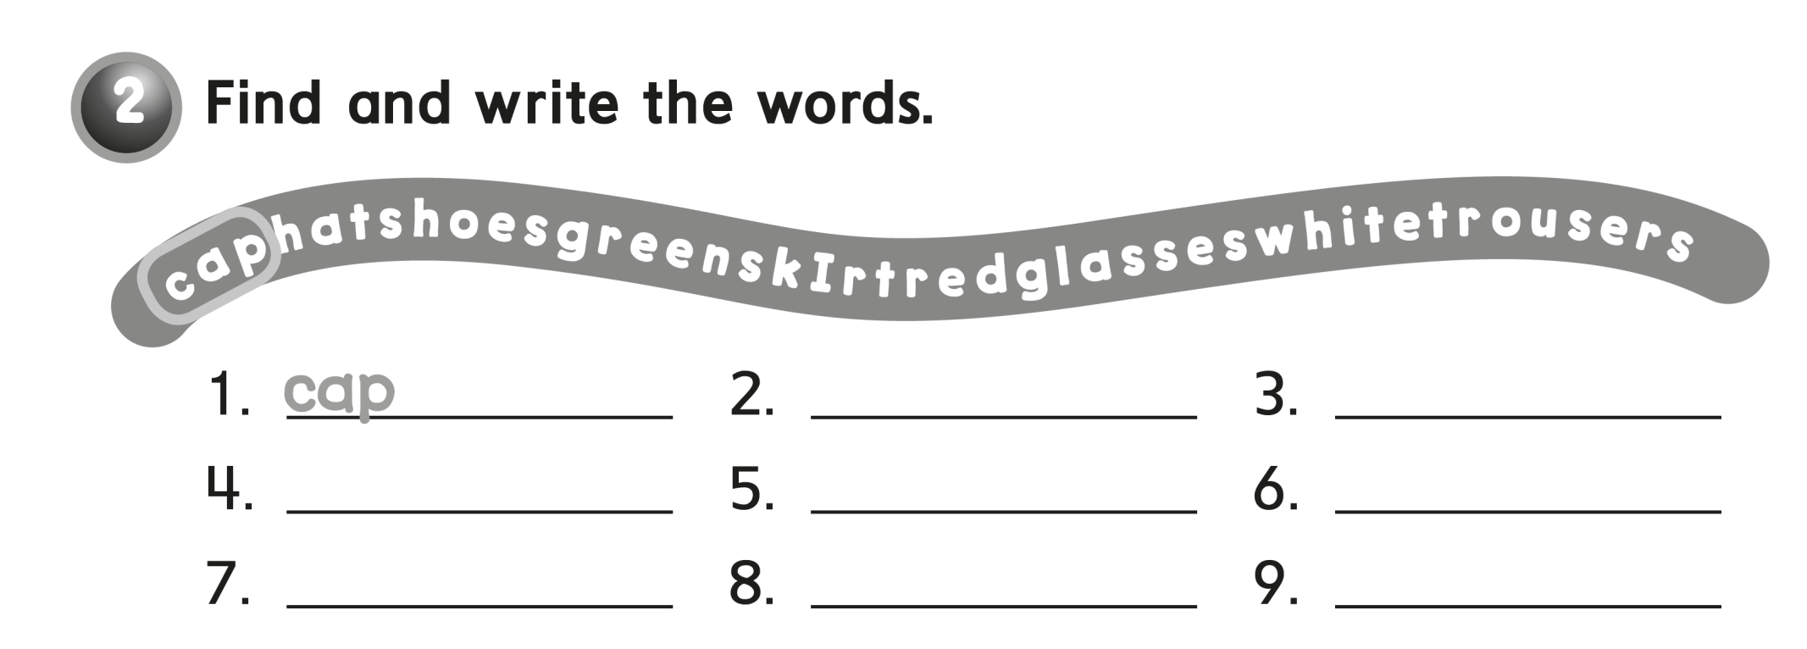
hat
shoes
green
skirt
red
glasses
white
trousers

Slide 18
I’m happy My friend,
is here for the day ! We have many
toys and games
in my room
is on the desk .
our computer games are on the
desk

Slide 19
on
in
In my bag
On my desk

Slide 21
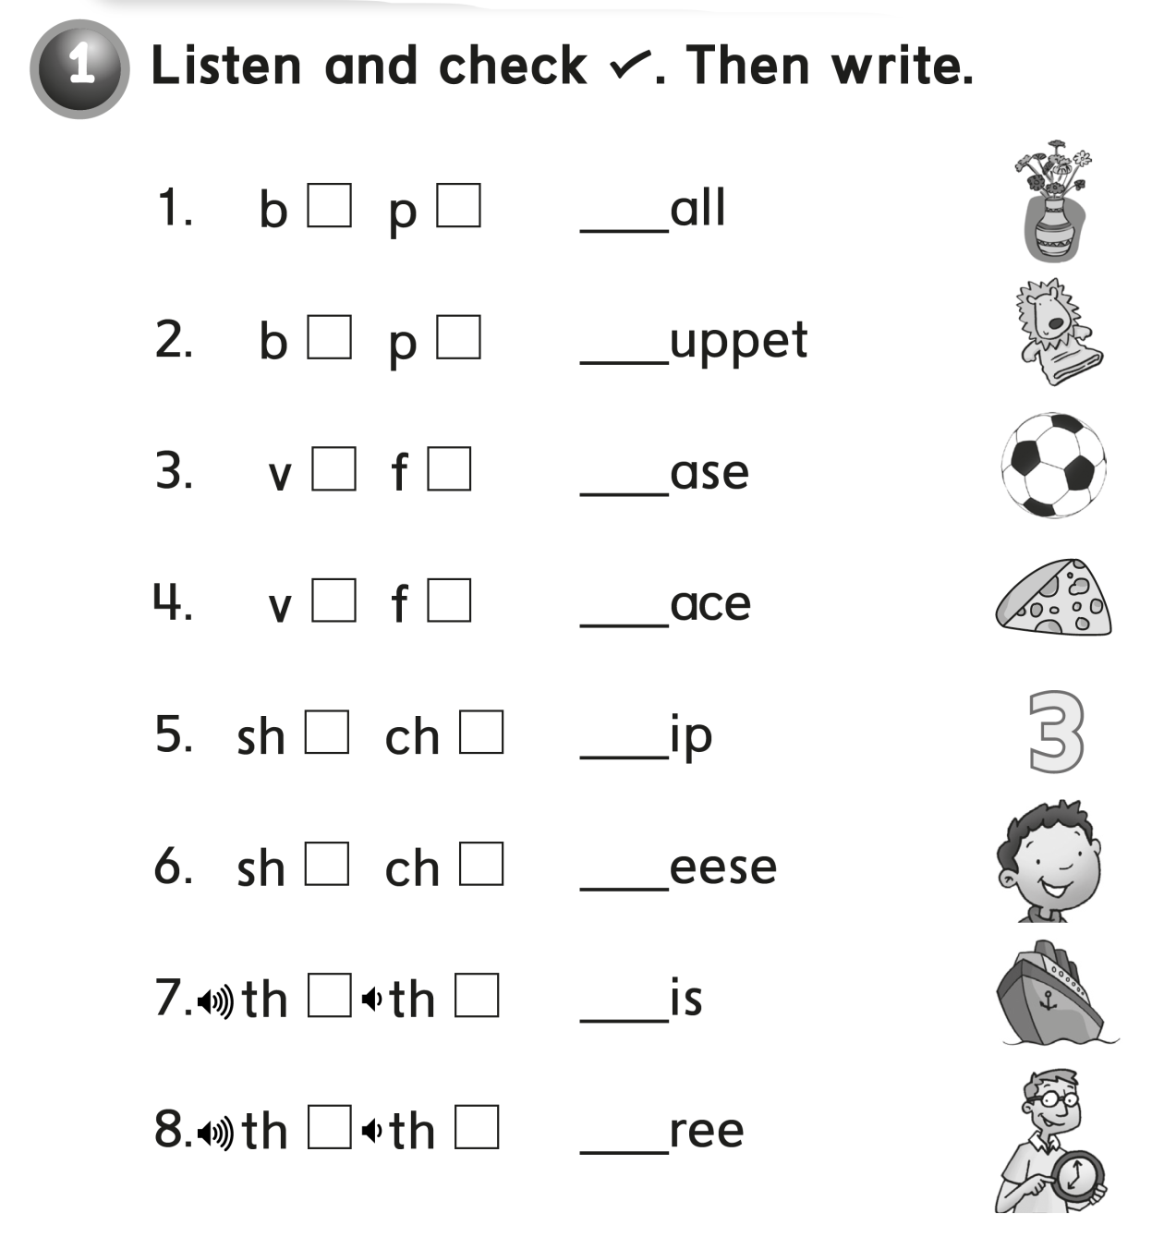
b
p
v
f
sh
ch
th
th

Slide 22
√
√
√
√
√

Slide 25
is happy .
He likes math .

Slide 26
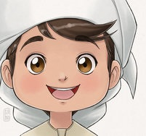
See you later
and Goodbye
Teacher :
Badr Sayid
Al-Shehri

