Slide 1
2
Unit 4

Slide 2
Days and Weather
الأيام والطقس

Slide 3
Rhythms and Sounds
الايقاعات والأصوات

Slide 4
Materials :
Classroom English poster
A calendar
Shapes flashcards

Slide 5
Strategy :
Four Corners “I like” Relay :
Place each set of cards in a different corner of the room. First, demonstrate the game by going to the first corner, choosing a card, showing it to the class, and saying, “I like (thing on card),” and then setting the card down. Go to the next corner and repeat the process. Do the same with the third and fourth corners. Have the students make a line. Send the first student to the first corner of the room. They must choose a card, show it to the class, and say, “I like (thing on card),” just like the teacher did. Then move on to the second card student after one another until all of the students have played and went through all of the cards .

Slide 6
أنا أستطيع ...
ترديد الأنشودة باللحن الصحيح
أذكر الأيام من الأحد إلى السبت بالشكل الصحيح

Slide 7
Review the previous lesson
مراجعة سريعة للدرس السابق

Slide 8
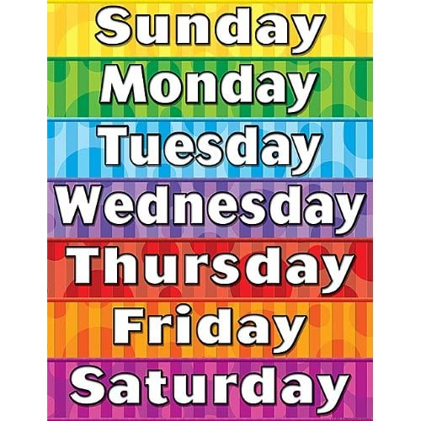
What day do you like ?

Slide 9
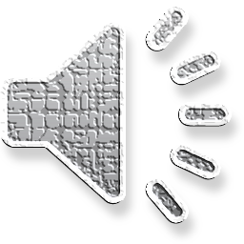
1
Listen and chant
استمع ثم ردد الأنشودة

Slide 10
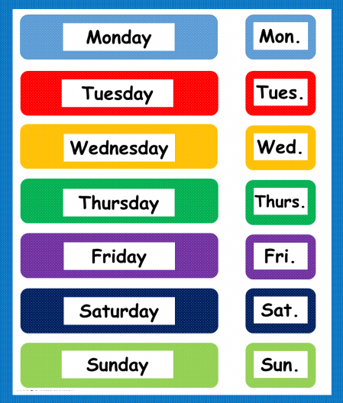
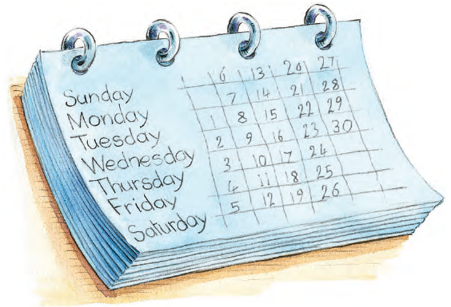
2
Listen, point, and pronounce . استمع ، تبع ، ثم كرر

Slide 11
وقت المرح

Slide 12
3
Chant and do
ردد الأنشودة مع الحركات
Make the letter shapes
ارسم أشكال الحروف

Slide 13
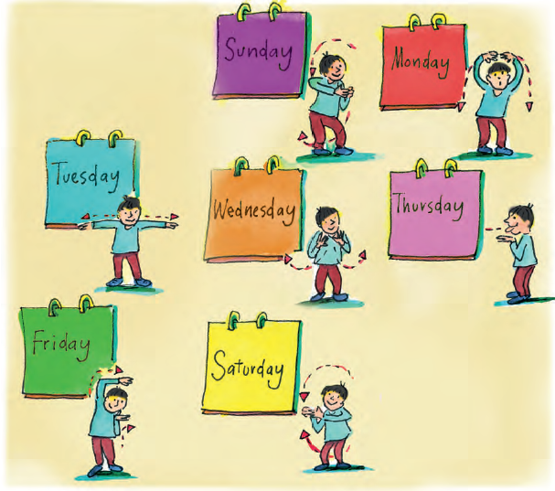

Slide 14
Goal Check
التحقق من الهدف

Slide 15
الهدف
أن يردد الطالب الأنشودة
أن يذكر الطالب الأيام من الأحد إلى السبت بشكل صحيح

Slide 16
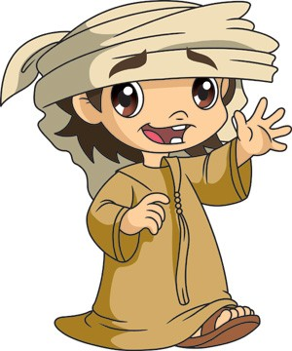
Have a nice day
See you next class

