Slide 1
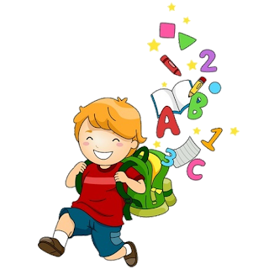
2
Unit 4

Slide 3
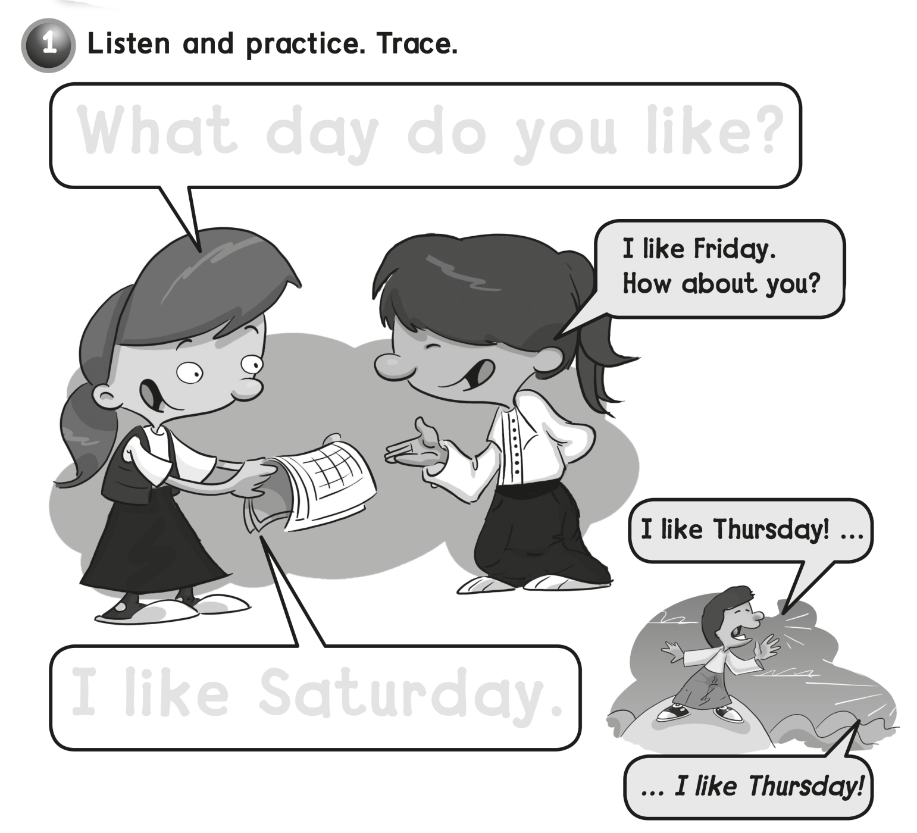
What day do you like?
I like Saturday .

Slide 4
Ii Ii Ii Jj Jj Jj

Slide 6
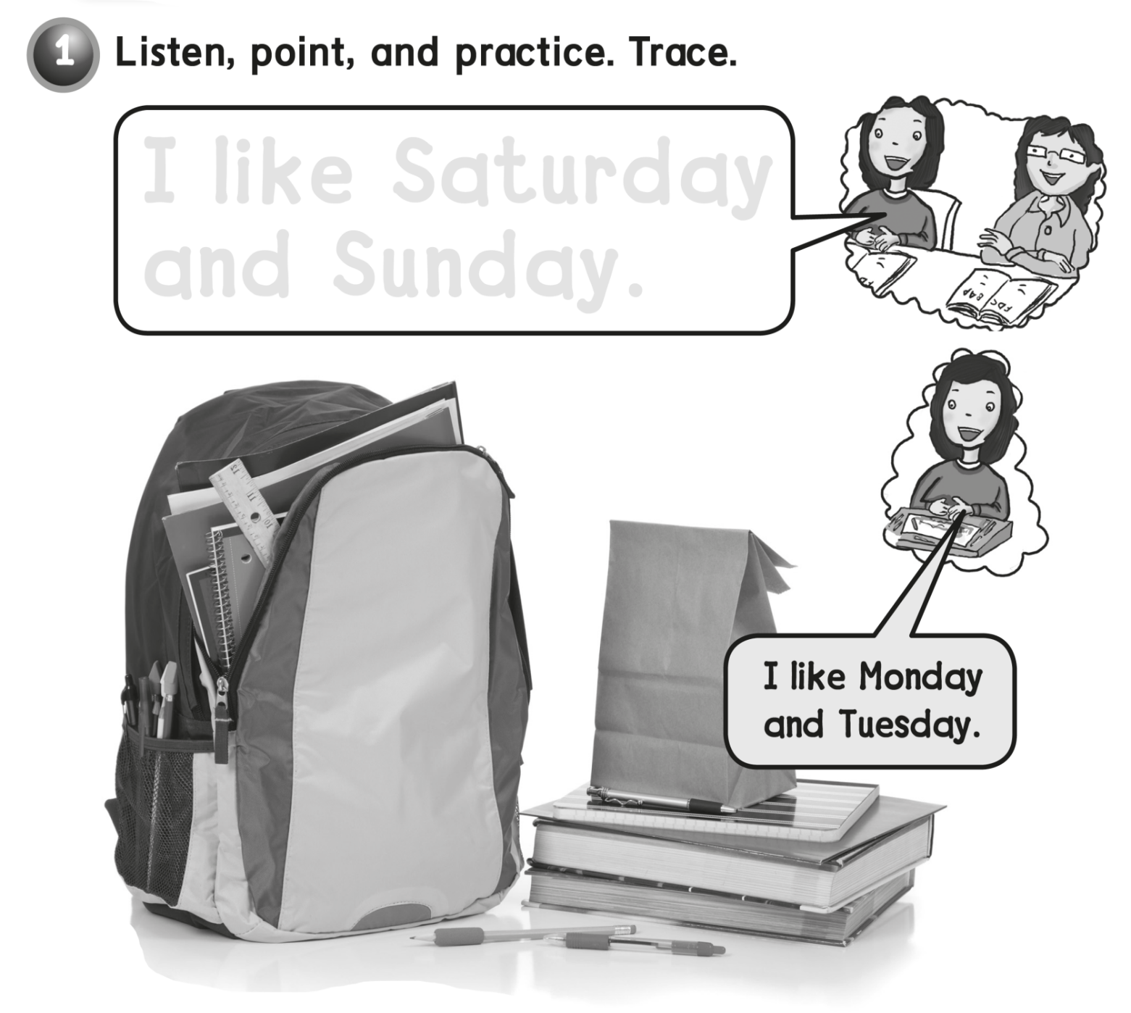
I like Saturday
and Sunday .

Slide 7
Kk Kk Kk Ll Ll Ll

Slide 9
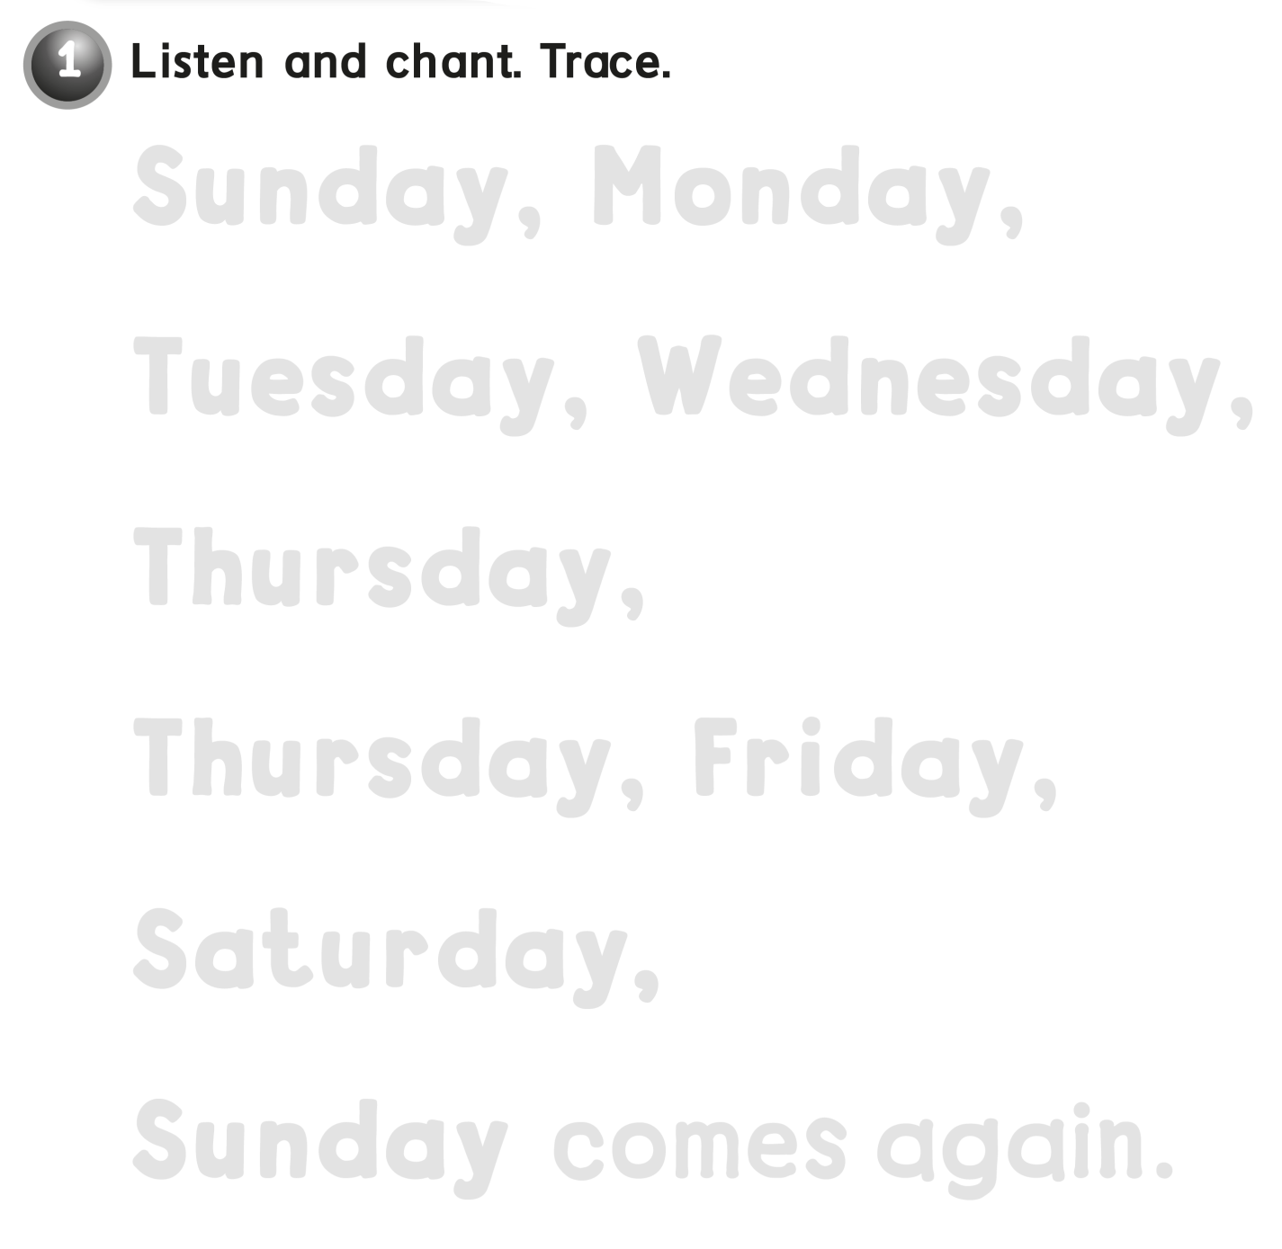
Sunday, Monday,
Tuesday Wednesday,
Thursday,
Thursday, Friday,
Saturday,
Sunday, comes again

Slide 10
Mm Mm Nn Nn Nn

Slide 12
Sunday , Monday,
Tuesday , Wednesday ,
Thursday , Friday ,
Saturday

Slide 13
Oo Oo Oo Pp Pp Pp

Slide 15
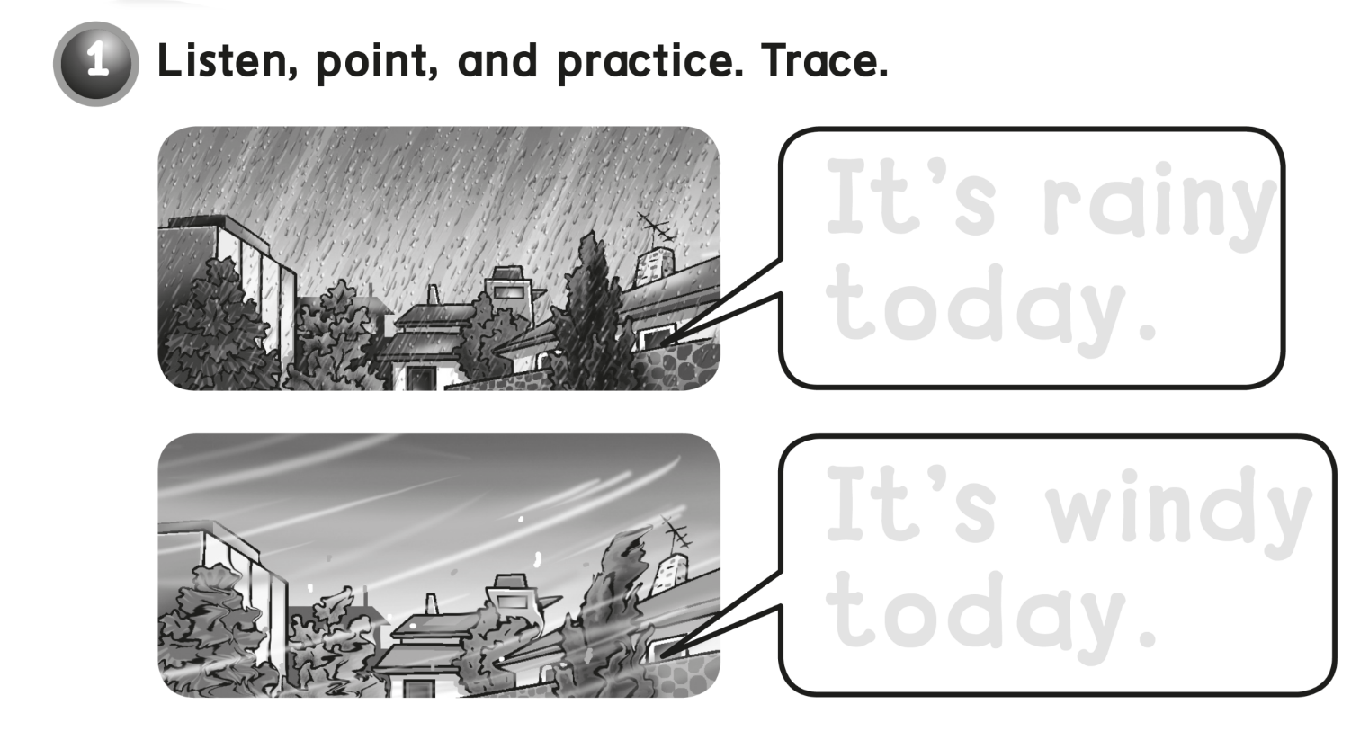
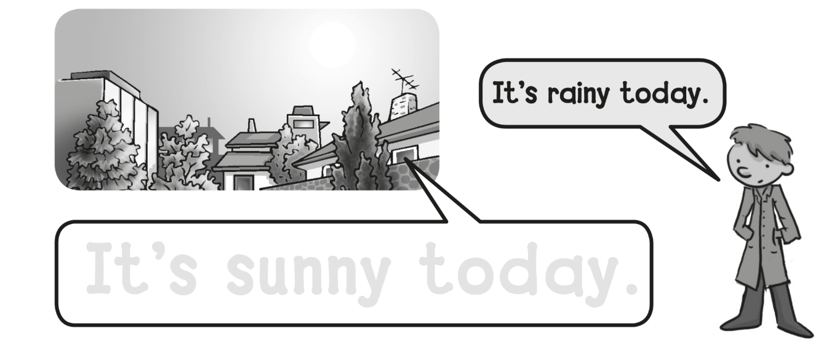
It’s rainy
today .
It’s windy
today .
It’s sunny today .

Slide 16
Qq Qq Qq Rr Rr Rr

Slide 18
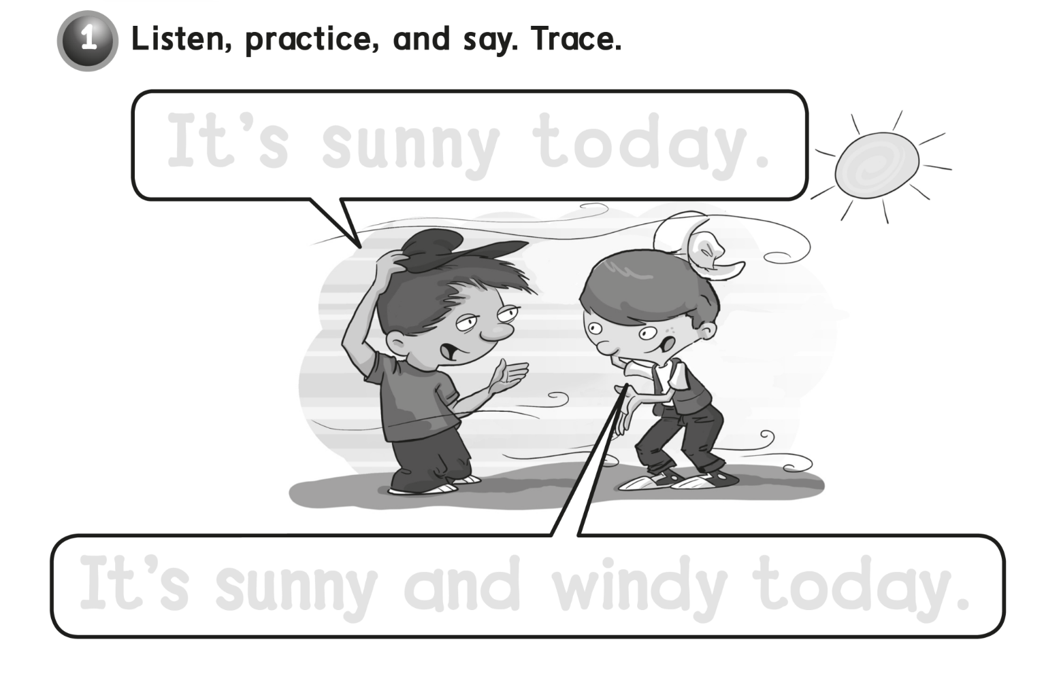
It’s sunny today .
It’s sunny and windy today .
Sunny

Slide 19
Ss Ss Ss Tt Tt Tt

Slide 21
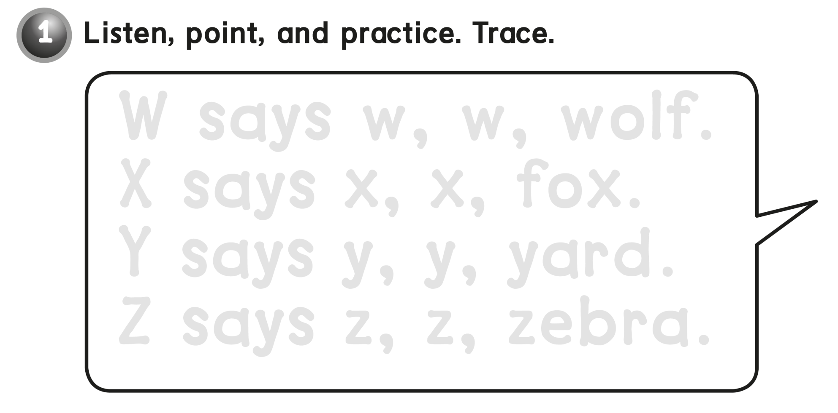
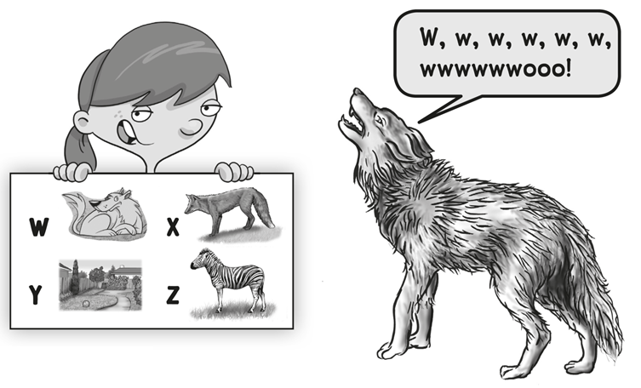
W says w, w, wolf .
X says x, x, fox .
Y says y , y, yard .
Z says z , z, zebra .

Slide 22
Uu Uu Vv Vv Ww Ww

Slide 24
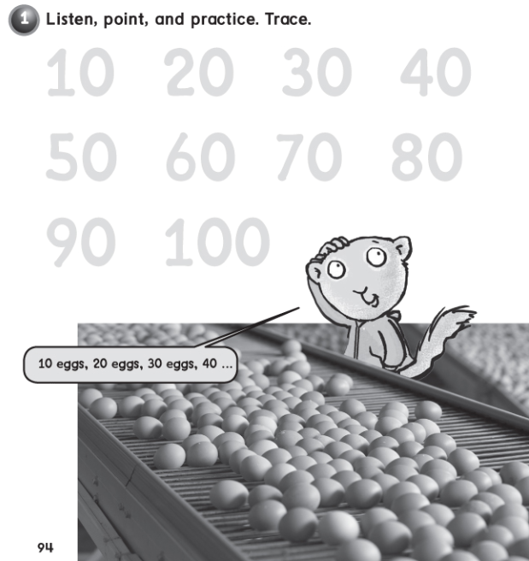
10 20 30 40
60 70 80
90 100

Slide 25
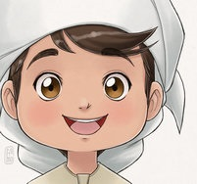
See you later
and Goodbye
Teacher :
Badr Sayid
Al-Shehri

