Slide 1
Mega goal 4

Slide 2
Unit 1

Slide 3
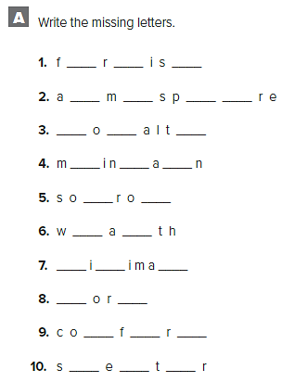
u n h
t o h e
l y y
a t i
r w
e l
m n l
w n
m o t
h l e

Slide 4
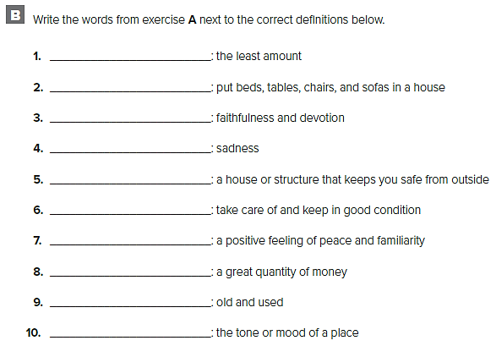
minimal
furnish
loyalty
sorrow
shelter
maintain
comfort
soul
worn
atmosphere

Slide 5
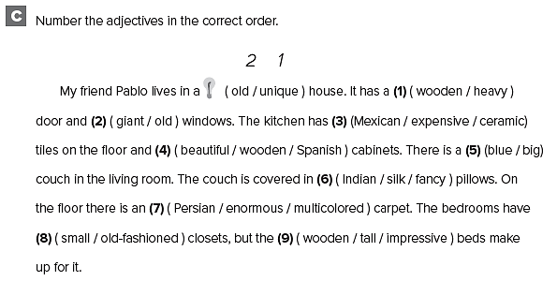
2 1
1 2
2 1 3
1 3 2
2 1
2 3 1
3 1 2
1 2
3 2 1

Slide 6
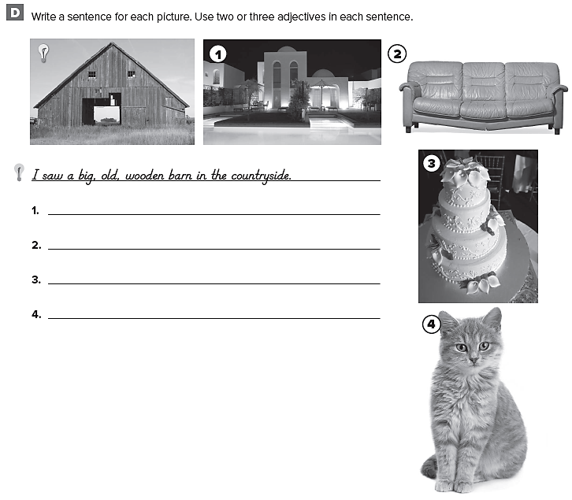
قد تختلف الإجابات
I live in a house with a beautiful, new, swimming pool.
I have an ugly, old, leather couch.
There was a delicious, tall, white cake at the wedding.
That’s a big, fat, old cat.

Slide 7
1. You’re driving quickly enough.
2. They have enough bathrooms for everybody.
3. I’m not rich enough to buy that house.
4. You’re walking too slowly.
5. That couch isn’t big enough.
6. You’re too short to play basketball.

Slide 8
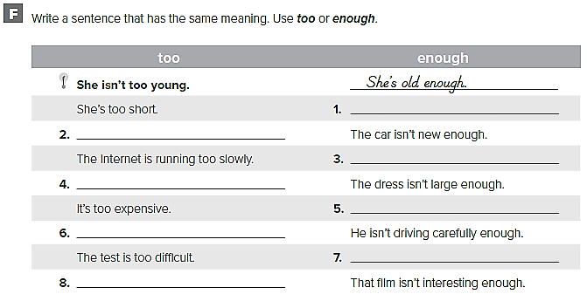
She’s not tall enough.
The car is too old.
The Internet isn’t running fast enough.
The dress is too small.
It’s not cheap enough.
He’s driving too dangerously.
The test isn’t easy enough.
That film is too boring.

Slide 9
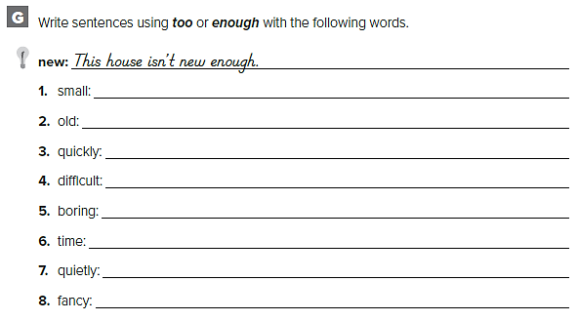
قد تختلف الإجابات
The earrings are not big enough.
That house is too old.
You aren’t walking quickly enough.
The test was too difficult for me.
This film is too boring to watch.
I don’t have enough time to play today.
You’re talking too quietly.
This dress is fancy enough for the dance.

Slide 10
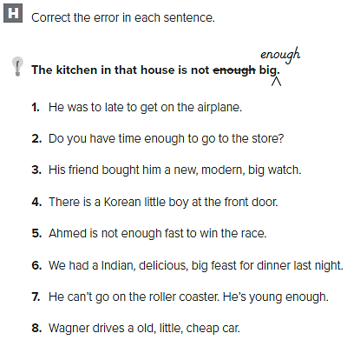
1. He was too late to get on the airplane.
2. Do you have enough time to go to the store?
3. His friend bought him a big, new, modern watch.
4. There is a little Korean boy at the front door.
5. Ahmed is not fast enough to win the race.
6. We had a delicious, big, Indian feast for dinner last night.
7. He can’t go on the rollercoaster. He's too young.
8. Wagner drives a little, old, cheap car.

Slide 11
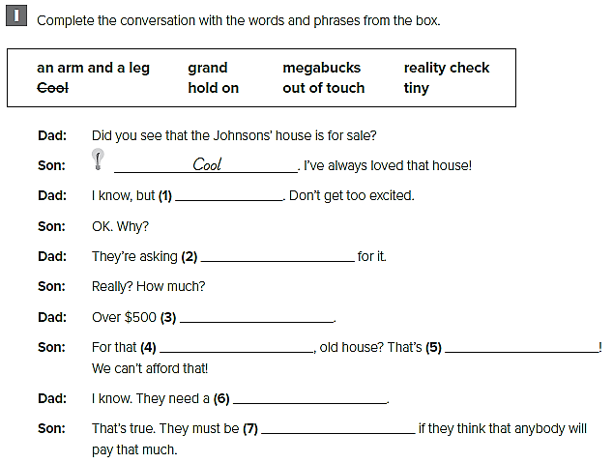
hold on
an arm and a leg
grand
tiny
megabucks
reality check
out of touch

Slide 13
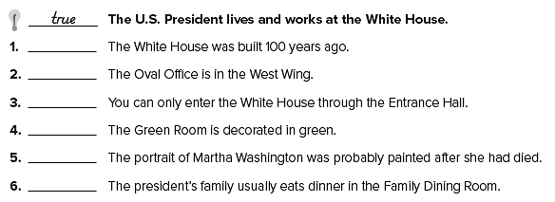
F
T
F
T
T
F

Slide 14
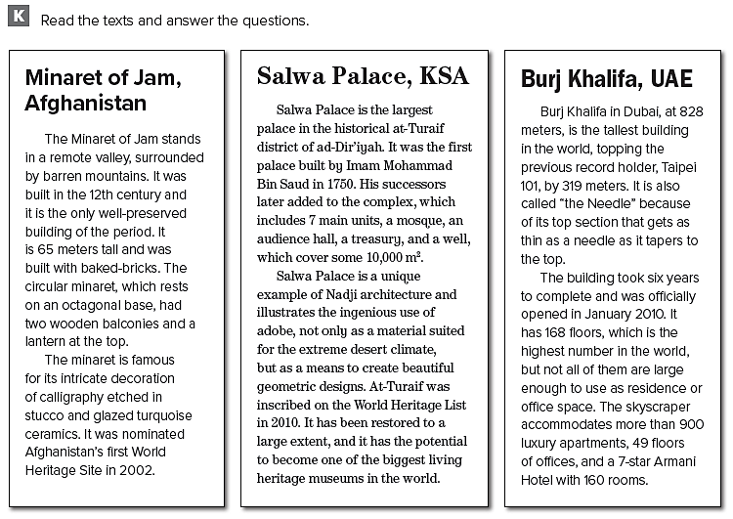

Slide 15
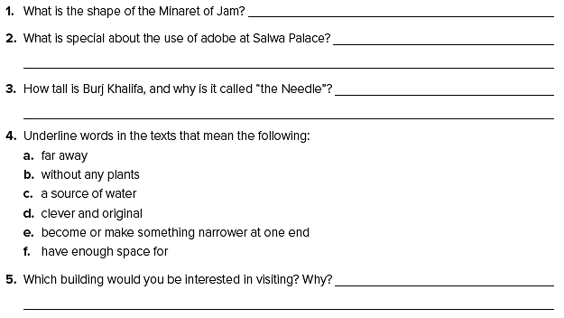
a circular minaret which rests on an octagonal base.
The section for visitors and the section for the family members.
828 meters , because its top section gets as thin as a needle
a. remote,
b. barren Qavam House
c. a detention house
d. porch Burj Khalifa
e. taper
f. accommodate

Slide 17
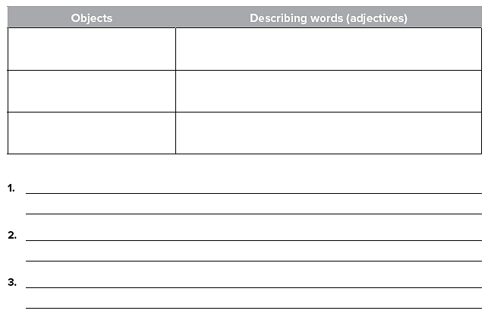
Door
Columns
Turret
heavy – wooden – ornate
slim – tall – white
narrow – beautiful - intricate
The palace walls are dotted with small, white-framed, square windows.
An ornate, heavy wooden door is placed in the middle of the structure.
Elegant, slim, white columns hold a series of arches along the façade.

Slide 18
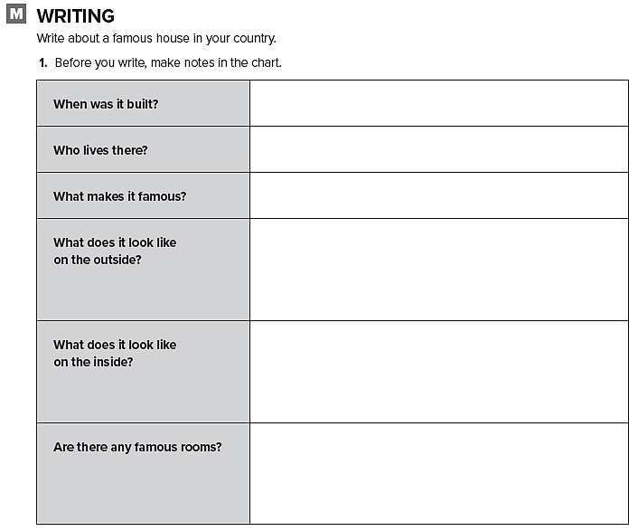
قم بالكتابة عن منزل مشهور

Slide 19
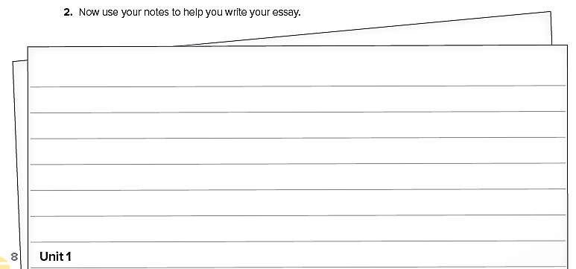

Slide 21
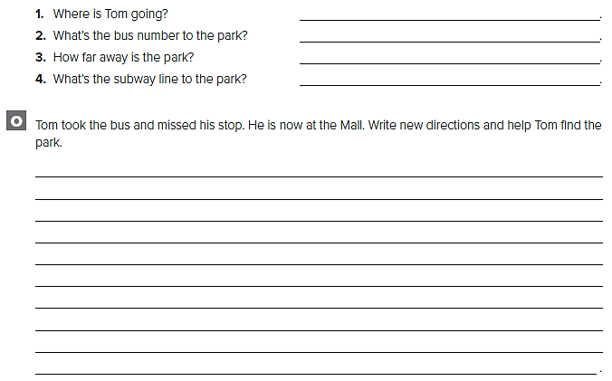
Tom is going to the park.
The bus number is 20.
The park is 15 minutes away.
The subway line to the park is F.
Turn left and walk to the end of the road. Turn right and walk down Franklin Street. Keep going until you see the restaurant. When you get to the restaurant, take a right and walk down Park Avenue. The park entrance is on Park Avenue.

Slide 22
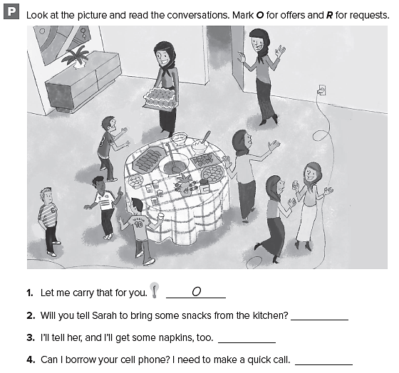
R
O
R

Slide 23
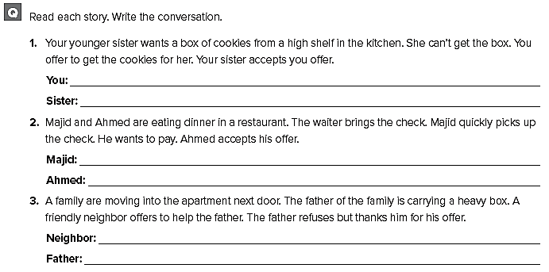
Let me get that for you.
Thanks!
I’ll pay the check.
Thank you very much!
Can I help you with that?
No, that’s all right. Thank you.

Slide 24
Unit 2

Slide 25
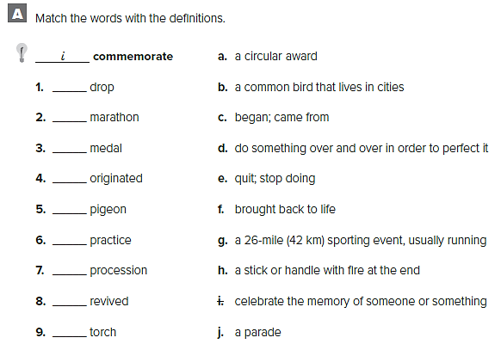
e
g
a
c
b
d
j
g
h

Slide 26
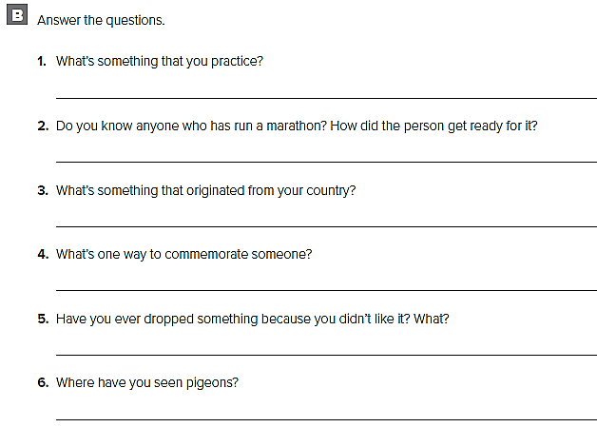
I practice playing football and playing tennis.
My friend Pat ran a marathon. He trained for it for months.
Chocolate originated from my country.
A way to commemorate someone is to have a parade or a party.
I dropped playing video games because I didn’t have time for it anymore.
I have seen pigeons in the city square

Slide 27
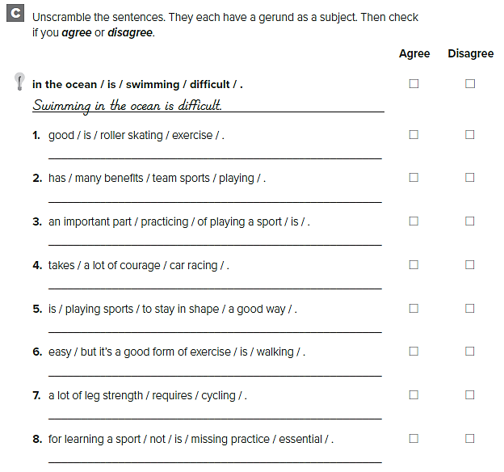
Roller skating is good exercise.
Playing team sports has many benefits.
Practicing is an important part of playing a sport.
Car racing takes a lot of courage.
Playing sports is a good way to stay in shape.
Walking is easy, but it’s a good form of exercise.
Bike racing requires a lot of leg strength.
Not missing practice is essential for learning a sport.

Slide 28
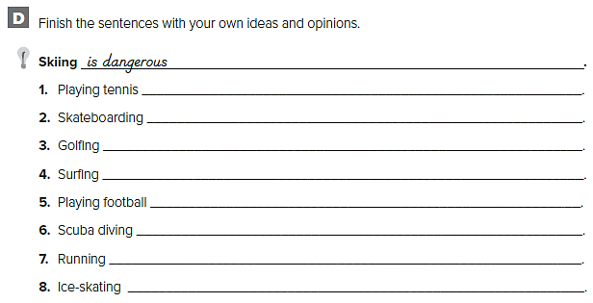
قد تختلف الإجابات
requires two people
is difficult but fun
takes a lot of patience
is difficult
is so much fun
requires training and certification
is exhausting
is my favorite sport

Slide 29
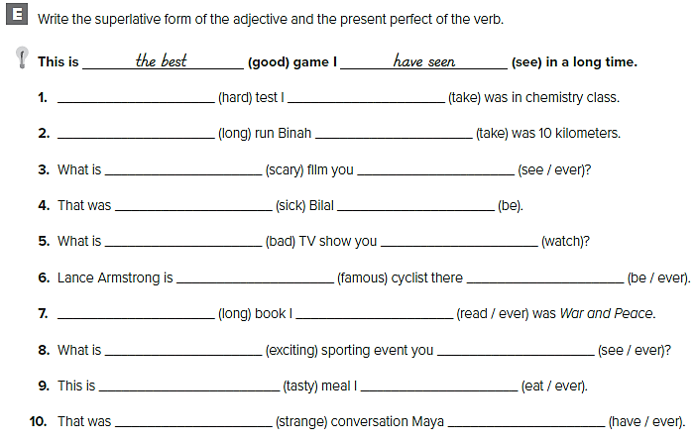
The hardest have taken
The longest has taken
the scariest have ever seen
the sickest has been
the worst have watched
the most famous has ever been
The longest have ever read
the most exciting have ever seen
the tastiest have ever eaten
the strangest has ever had

Slide 30
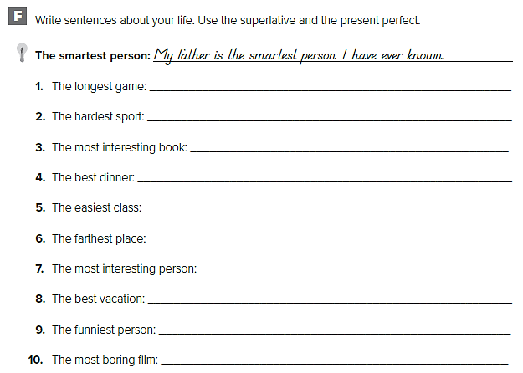
The longest game I’ve watched was the tennis game
The hardest sport I’ve ever played is tennis.
The most interesting book I’ve read was about Africa.
This is the best dinner I’ve ever been to.
The easiest class I’ve ever taken is Health.
Egypt is the farthest place I’ve ever been.
The most interesting person I’ve ever met is Aguilar.
My trip to Tokyo was the best vacation I’ve ever had
The funniest person I’ve ever known is Eric.
The most boring film I’ve ever watched was ………

Slide 31
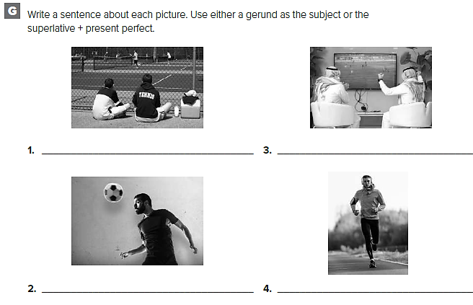
قد تختلف الإجابات
This is the most exciting tennis match I’ve ever seen.
Watching football at home can be really fun.
He’s the best goalie we’ve had for years.
Running is a great way to stay in shape.

Slide 32
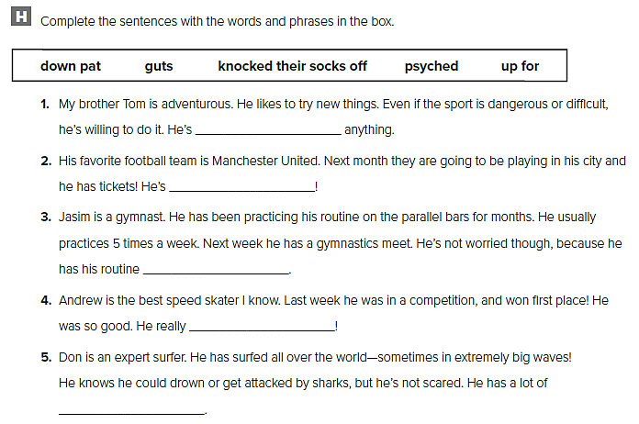
up for
psyched
down pat
knocked their socks off
guts

Slide 33
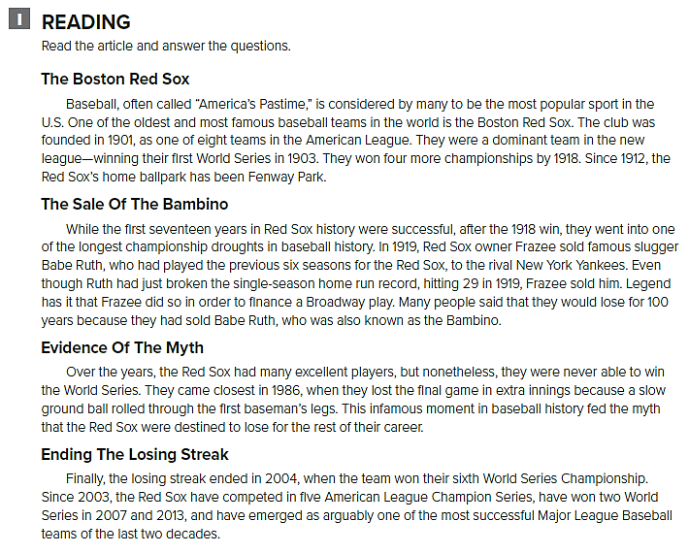

Slide 34
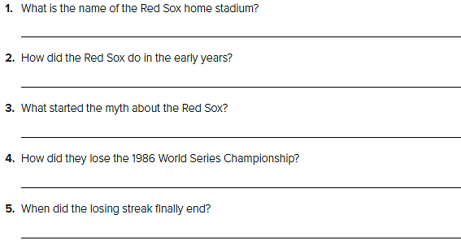
The name of the Red Sox home stadium is Fenway Park.
They did well. They won the World Series five times.
Selling Babe Ruth to the New York Yankees started the curse
The ball rolled through the first baseman’s legs.
It finally ended in 2004.

Slide 35
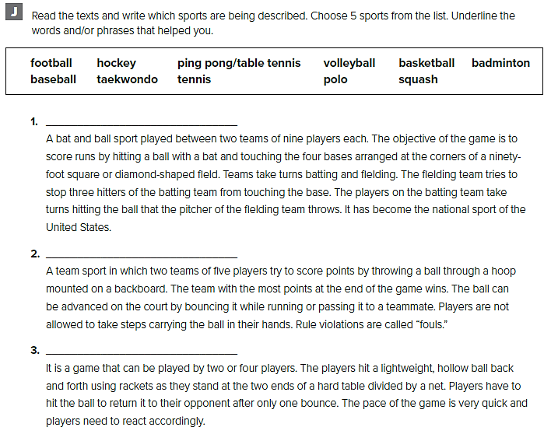
baseball
basketball
ping pong/table tennis

Slide 36
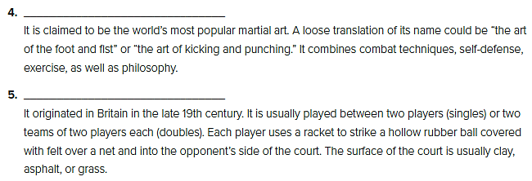
Taekwondo
Tennis

Slide 38
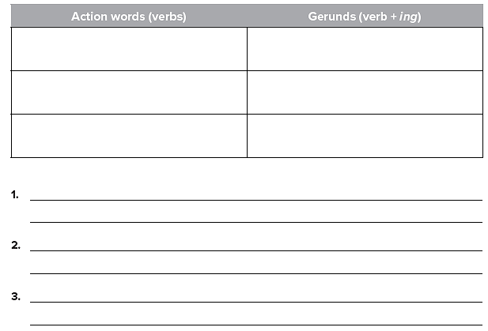
قد تختلف الإجابات
Sit
Smile
Look
Sitting
Smiling
Looking
Sitting on the grass and watching the children play on a sunny morning is one of the most enjoyable things for parents.
Playing with my sister when we were little used to be a lot of fun.

Slide 39
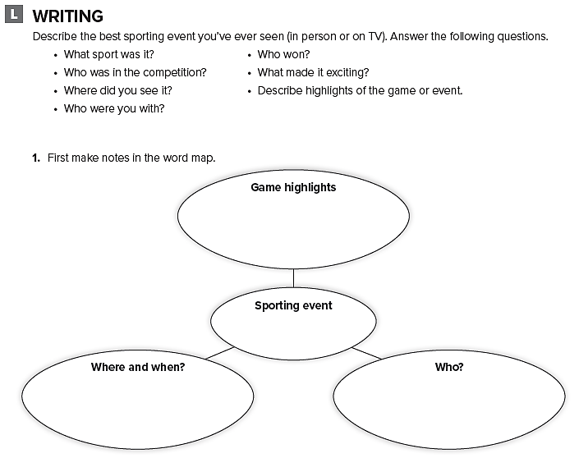
قم بالكتابة عن حدث رياضي شاهدته

Slide 40
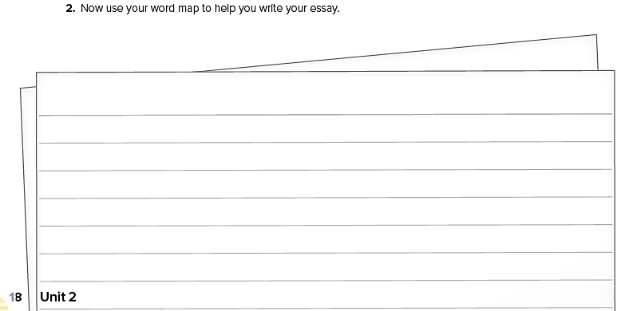

Slide 41
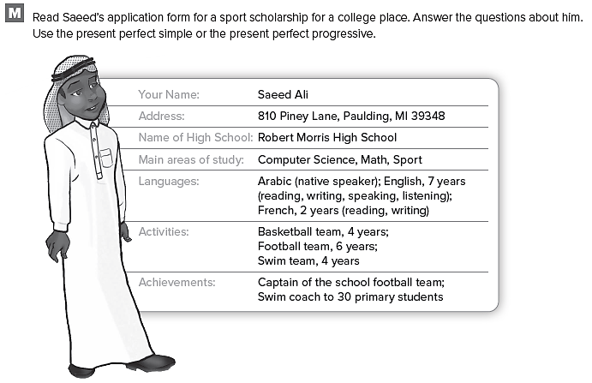

Slide 42
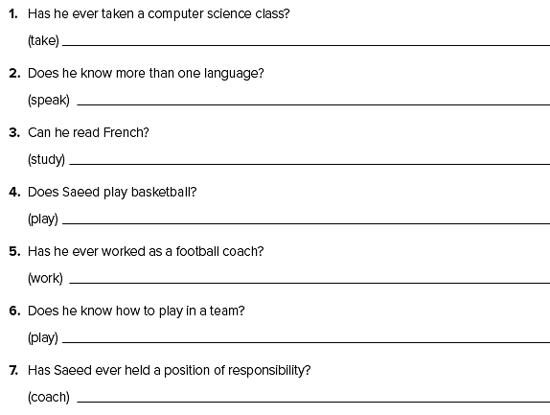
Yes, he has taken a computer science class.
Yes, he does. He has been speaking Spanish for 3 years.
Yes, he can. He has been studying French for 2 years.
Yes, he does. He has been playing basketball in the school team for 4 years.
No, he hasn’t worked as a football coach. He’s the captain of the school football team.
Yes, he does. He has been playing football for 6 years.
Yes, he has. He has coached 30 primary children in swimming.

Slide 43
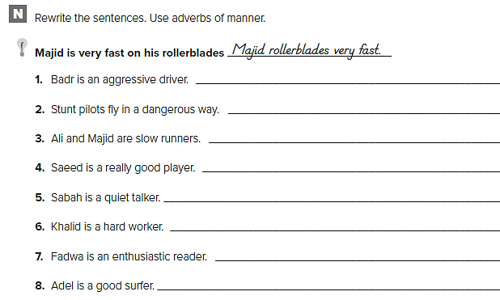
Badr drives aggressively.
Stunt pilots fly dangerously.
Ali and Majid run slowly.
Saeed plays well.
Sabah talks quietly.
Khalid works hard.
Fadwa reads enthusiastically.
Adel surfs well.

Slide 44
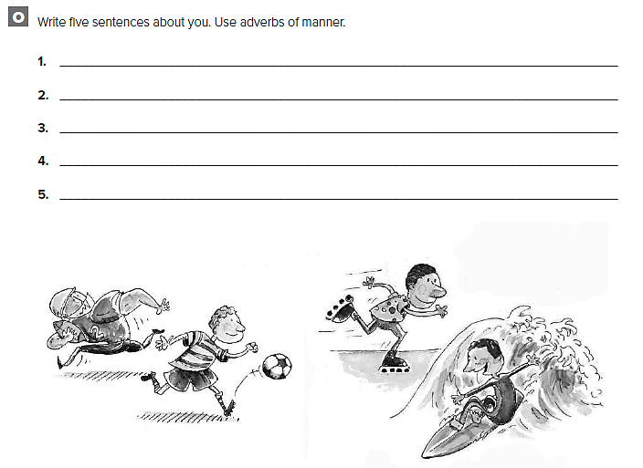
كل طالب يجيب بعباراته

Slide 45
Unit 3

Slide 46
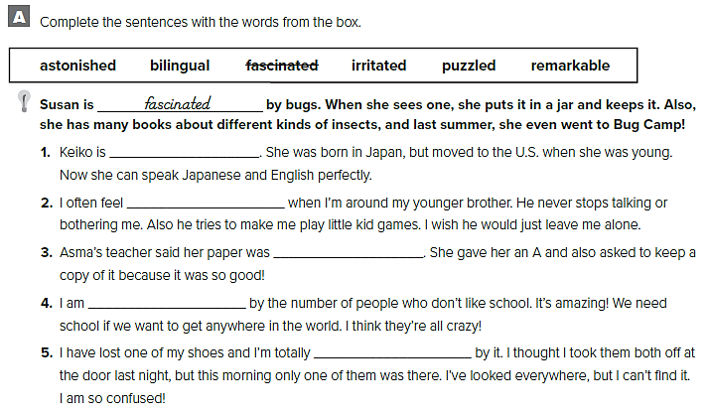
bilingual
irritated
remarkable
astonished
puzzled

Slide 47
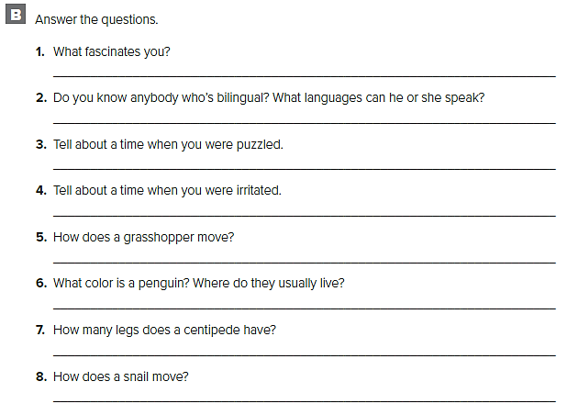
The Internet fascinates me. I don’t understand how it works!
My friend can speak Spanish and English.
I was puzzled this morning when I couldn’t find my car keys.
I was irritated last night when I wanted to watch TV, but my sister was already watching a game show.
It hopes.
Penguins are black and white. They live in cold places, such as Antarctica.
Some centipedes have 100 legs, but not all of them.
Snails move very slowly.

Slide 48
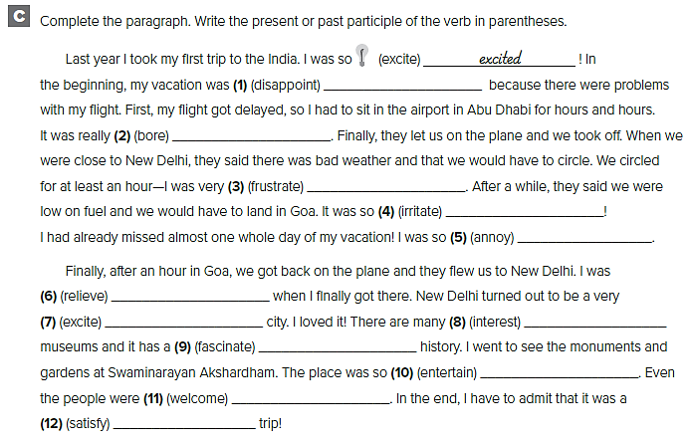
disappointing
boring
frustrated
irritating
annoyed
relieved
exciting
interesting
fascinating
entertaining
welcoming
satisfying

Slide 49
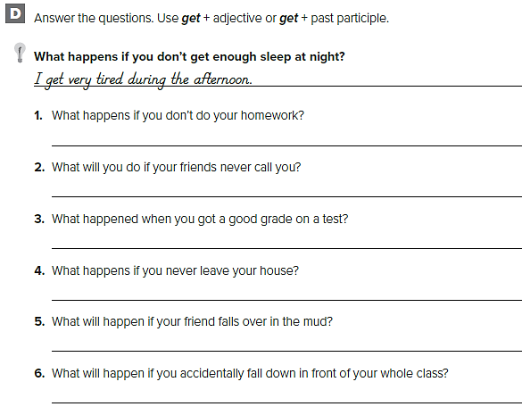
قد تختلف الاجابات
My teacher will get angry
I will get upset
I got excited
I get bored
She’ll get dirty
I’ll get embarrassed

Slide 50
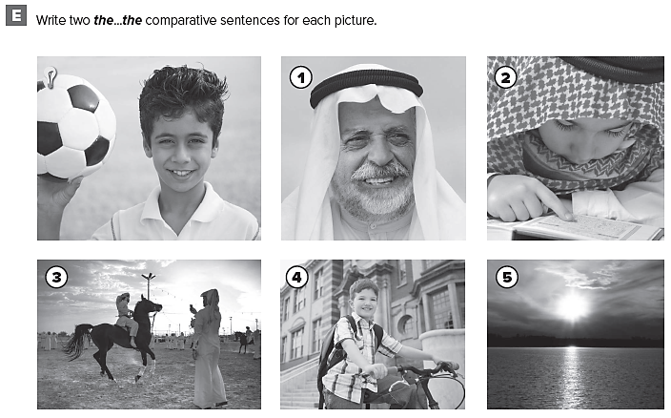

Slide 51
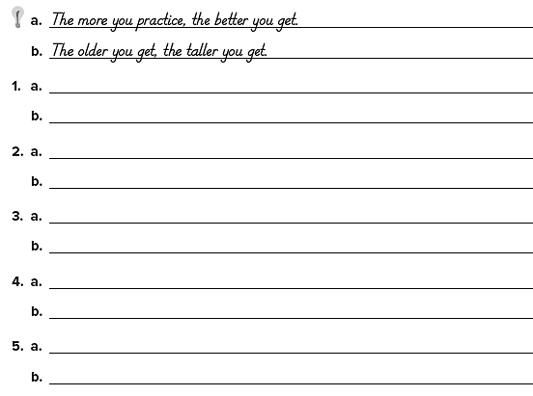
قد تختلف الاجابات
The older you get, the happier you get.
The more time you spend with your family, the happier you are.
The more you read, the smarter you get.
The more you study, the more bored you get.
The faster you ride, the better it feels.
The warmer it gets, the less you want to ride.
The more you cycle, the stronger you get.
The less it rains, the more you can cycle.
The lower the sun gets, the prettier the sunset.
The later it gets, the lower the sun gets.

Slide 52
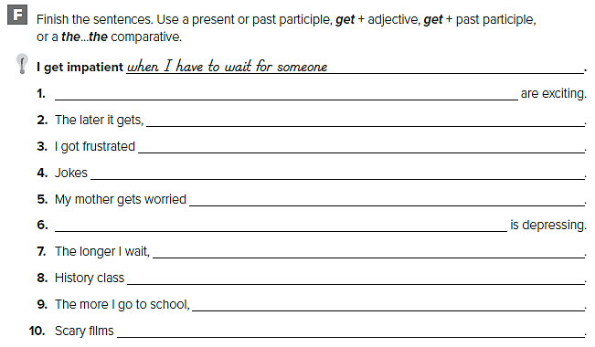
قد تختلف الاجابات
Roller coasters
the more tired I get
by my homework
are entertaining
if I stay out late
Cold, snowy weather
the more frustrated I get
is boring
the smarter I get
are frightening

Slide 53
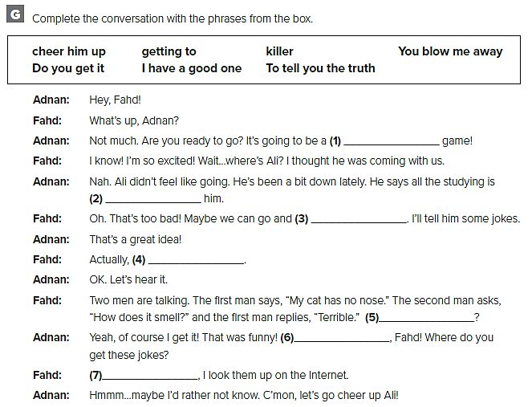
killer
getting to
cheer him up
I have a good one
Do you get it?
You blow me away
To tell you the truth

Slide 54
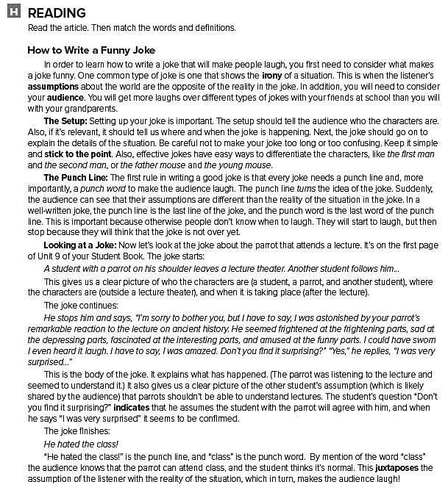

Slide 55
b
c
e
f
a
d

Slide 56
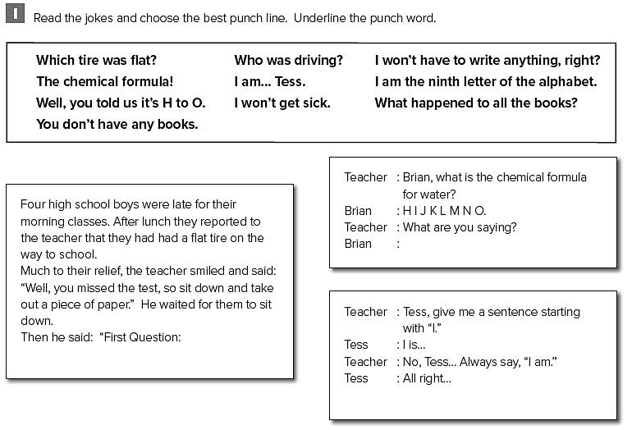
Well, you told us it’s H to O.
Who was driving?
I am the ninth letter of the alphabet

Slide 57
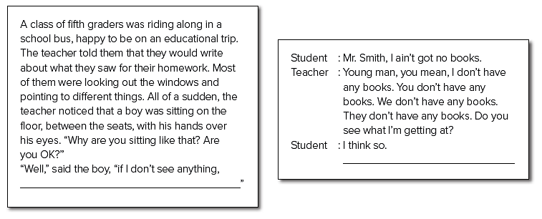
What happened to all the books?
I won’t have to write anything, right?

Slide 58
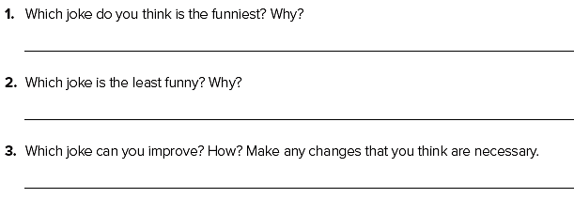
كل طالب يجاوب عن نفسه

Slide 60
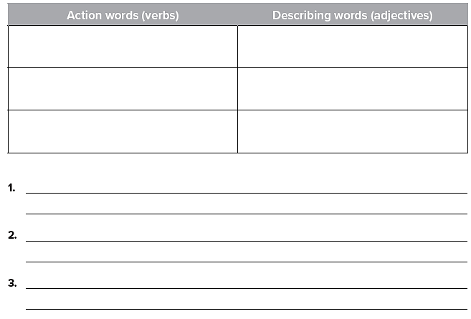
قد تختلف الاجابات
Sit
Think
Study
Careful
Quiet
Empty
The more I study physics the more questions I have.
The more challenging the topic, the more interested I get.
The more I concentrate, the more analytical I become.

Slide 61
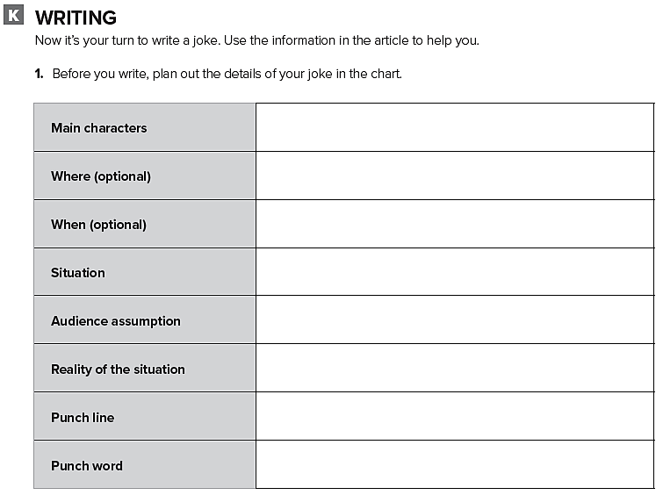
فكر في نكتة ثم قم بالكتابة عنها

Slide 63
Fatima wishes she knew some funny jokes.
Nawal regrets telling her sister the joke.
Aisha wishes her father would tell her funny stories
Badria wishes she could feel happy again

Slide 64
Khaled wishes Hameed and Jassem would stop telling terrible jokes

Slide 66
كل طالب يجيب بعباراته

Slide 67
Expansion 1- 3

Slide 68
downsize
claustrophobic
reality check
psyched
spectators

Slide 69
quirky
irritated
killer
pediatric
genuine
shelter

Slide 70
That’s a nice, new car!
I can’t find my black, leather shoes.
The cute, little, black and white penguin jumped into the water
I bought a beautiful, French, velvet chair.
The frightened, little, gray mouse ran into a hole.
My old, blue, racing bike is ready to retire.

Slide 71
There are too many practices. I don’t have enough time to study
He tells too many jokes. He’s not serious enough.
The house is too big. My parents aren’t close enough to me

Slide 72
قد تختلف الاجابات
is exciting
is entertaining
falling down
getting a bad grade
is amazing
watching news

Slide 73
the biggest have ever seen
the most irritated has felt
the most annoying has ever met
the coolest have ever seen
the most uncomfortable have owned
the worst has ever been
the most tired have been
the most frustrated have ever seen

Slide 76
At a doctor’s office.
The doctor and a patient.
The banging on the desk and a loose nail.
No, not really.
He was livid with anger.
Seeing himself in the mirror, collared by the painting with his head sticking out.
to remind him of the incident
كل طالب يجيب عن نفسه

Slide 78
People
Crowd
Stores
Walk
Look at
Watch
Busy
Noisy
Expensive
Mall
Stores
Staircase
Midday
Early
Late
The shopping mall was very crowded last Saturday at midday.
There were people standing, walking, talking, and hurrying about.
The mall has been decorated with lots of twinkling lights. Even the palm trees are covered in lights.

Slide 81
Unit 4

Slide 82
toxins
licensed
peak
bitter
locks in
aroma
distinguish

Slide 83
People need to be licensed to fish and drive.
I like the aroma of roses. I don’t like the aroma of gas.
Coffee and dark chocolate are bitter foods.
Lemons and limes are sour foods
Two examples of delicacies are fish eggs and chicken feet.
Toxins are poisons.

Slide 84
V
P
O
O
V
P
Prep
V
P
O
V
P
O
O
P
V
V
P
O
V
P
O
V
P
O

Slide 85
give up meat
cut down on foods
run out of energy
come down with a cold
load up on other foods
turn into a health nut
whip up lots of delicious foods
think it over

Slide 86
Bill’s tired of it.
It’s difficult to tell them apart.
She’s trying to cut down on it.
Tom sent them back to the kitchen.
Yesterday, I came across it.
Jake is taking them out for dinner tonight.

Slide 87
put you out
whip them up in no time
have a sweet tooth
come to think of it
spread
quite the

Slide 89
قد تختلف الاجابات
Please turn the volume down!
Please turn it down!
Adel is on the phone talking the problem with Greg.
Adel is on the phone talking it with Greg.
She is trying to give up sweets.
She is trying to give them up.
Tom is trying to figure out the answer.
Tom is trying to figure it out.
Ali ran into Omar while walking towards his office.
Ali ran into him while walking towards his office.

Slide 91
1- They were from New Hampshire, U.S.A.
2- They served beef burgers
3- They only served food that could be eaten without utensils, had no variations, and required only paper products. They used an assembly line like in a factory.
4- Ray Kroc
5- That they serve fattening food and target children in their advertising.

Slide 93
5
6
9
2
8
3
7
4

Slide 94
كل طالب يجيب عن نفسه

Slide 96
Go out
Dig into
Drink up
Sit down to
Get taken out
Catch up over
The boy’s father suggested they go out and catch up over dinner.
The boy’s father expected him to pick at his food, but he was hungry and dug in with enthusiasm.
When they had eaten up and drank up, they paid the check and left.

Slide 97
قم بالكتابة عن طبق مشهور في دولتك

Slide 99
N
C
C
N
N
C
N
N
C

Slide 100
Is there any meat?
Yes, there is some meat.
Is there any ice cream?
No, there isn’t any ice cream.
Are there any eggs?
Yes, there are some eggs.
Is there any sugar?
Yes, there is some sugar.

Slide 101
spoon
chop
eggs
taste

Slide 102
bowl
add
pan
oven
minutes

Slide 103
Unit 5

Slide 104
residence
pampered
abstract
released
embraced
bond
duration
adapted

Slide 105
كل طالب يجيب عن نفسه

Slide 106
be fed
get
be purchased
buy
be fed
be kept
clean
open

Slide 107
Bear Spray can be used if a bear approaches you in the wild.
Wild animals should not be fed.
A bear may be warned by a bell.
Food must be kept up in the trees.
Food has to be cleaned up from your campsite.
Garbage must not be left behind.
It is said that bears follow the scent of food.
The trail should not be left at any time.
It is believed that running from bears is more dangerous than standing still.

Slide 109
قد تختلف الاجابات
Polar bears must not be approached in the wild.
It is said that polar bears are very fierce.
Ostriches are said to be the largest birds
Ostriches must be given a lot of room to roam.
sharks are thought to be the most ferocious sea animals.
Areas where sharks swim should be avoided
Kittens should be kept with their mothers
Kittens are said to make good pets.
It is said that koala bears sleep up to 18 hours a day.
Koala bears are considered to be cute animals.

Slide 110
1. Dolphins are considered to be one of the most intelligent animals.
2. It is said that dolphins evolved 10 million years ago.
3. Even though dolphins are friendly, people should be careful when swimming near them.
4. Sounds from very far away can be heard by dolphins.
5. It is believed that dolphins need to live in groups to be happy.
6. Tricks can be taught to dolphins.
7. Dolphins must be kept in salt water.
8. Tuna should be bought from companies that practice dolphin-safe fishing.

Slide 111
back to the drawing board
24/7
calling the shots
get to the point
hang in there

Slide 113
F
T
F
F
T
F

Slide 114
Hydra
The Sphinx
Unicorns
Dragons
Pegasus

Slide 115
poisonous, devour
mysterious, intellectual, guardian, riddles
gentle, horn, purity, goodness, rainbow
winged, protector, goodness, purity
wise, terrifying, guardian

Slide 116
قد تختلف الإجابات
Hydra was a multi-headed creature that devoured anyone that came near her. Each of Hydra’s heads seemed to have a will and a movement of its own.

Slide 118
قد تختلف الإجابات
Loyal, family-oriented, packs, support each other
Naughty, possessive, highly emotional, agile
Dangerous when hungry, vicious when there are cubs
Elephants are very loyal to their friends and family.
They can lift heavy weights with their trunks.
Chimps are very sociable animals
Like most monkeys chimps like to eat fruit and nuts.

Slide 119
قم بالكتابة عن حيوان أسطوري

Slide 122
The great white shark.
up to 20 feet (or 6 meters).
up to 4,400 pounds (or 2,000 kg).
The sense of sound and smell.

Slide 123
قد تختلف الإجابات
A dolphin is a very intelligent animal. Even though it is quite a big animal, a dolphin can swim quite fast. It is not a dangerous animal; it is very friendly.

Slide 125
Both cats and mice can run fast.
Neither Jon nor Adel joined the after-school Computer Club. They joined the after-school Creative Workshop instead.
Both Sam and Ali like fishing. Ali caught a fish but Sam didn’t.

Slide 126
Unit 6

Slide 127
morally
motivate
vanish
dread
get away with it
responsible
reason

Slide 128
tempted
dread
vanish
reason
Motivate
get away with it
morally

Slide 129
had
might not have been cancelled
had gotten
were
could have remembered
would stay
would learn
hadn’t slept

Slide 130
1. I wouldn’t be in this class
2. you would have done better on the test
3. If I could go anywhere
4. If she had worn a jacket
5. I would call him
6. he wouldn’t have been so full
7. I would be a gardener
8. she wouldn’t have gotten lost
9. If I had studied
10. I would call the police
11. I would have returned it to you
12. there wouldn’t be any crime
13. I would have been on time
14. If I were rich

Slide 131
had known
hadn’t been
was
was
had thought
had rained
had lived
had been

Slide 132
قد تختلف الإجابات
He acts as if he were a baby.
He drives as if he were a race driver
It smelled as if we were in a garden
He acts as though he were the king
It looked as if it had snowed.

Slide 133
قد تختلف الإجابات
If I hadn’t driven so fast, I would still have a new car
If you hadn’t driven so recklessly, you wouldn’t have broken your leg.
I would ask if I could wash dishes.
I would drive away.

Slide 134
قد تختلف الإجابات
If I hadn’t driven away, I wouldn’t have gotten arrested.
I would tell the teacher.
I would ask the woman if she lost something
I would tell my friend that he can only copy my homework during football season.

Slide 136
If I were Heinz, I would also probably try to steal the drug for my wife
I think that I am in Stage 2: Self-Interest. I think it is more important that Heinz first saves his wife and worries about the consequences later.

Slide 138
1. She assumed that Sid had taken the car without telling Carl.
2. Whether he should tell his mother that he had given the model car to Sid himself.
3. He did, partly. He kept an eye on Sid and tried to feed him and then put him to bed but was not prepared to take the time needed
4. In Sid’s eyes he probably didn’t, because he had given him the car.

Slide 139
gave Sid milk
Carl gave him a model car
Sid dropped the cup on Carpet
Sid choked on a small part
كل طالب يجيب بعباراته

Slide 141
قد تختلف الإجابات
Didn’t pay attention
Didn’t study
Studied through the night
Found the test difficult
Failed the test
Made mistakes
If they had studied, they would have answered more questions.
If they hadn’t stayed up through the night they wouldn't be sleepy.

Slide 142
قم بالكتابة عن مأزق وقعت فيه

Slide 144
2. will have become
3. will be attending
4. will be using
5. will have developed
6. will have reached

Slide 145
By 2022, many households will have bought a smart robot.
كل طالب يجيب عن نفسه

Slide 146
used to be
would always listen
wasn’t going to
used to be
are used to him

Slide 147
قم بكتابة محادثة مشابهة

Slide 148
Expansion 4 – 6

Slide 150
Across
3. substitute
4. toxins
6. controversial
8. hassle
9. disturbed
10. delectable
12. delicacy
14. vendor
15. duration
16. aroma
Down
1. inherited
2. deliberately
5. vanish
7. quandary
11. domesticated
13. crummy

Slide 151
looks down on people
figure it out
talk the problem over
take care of him
burn that big meal off
run into her
figure him out
take the butter out
throw it out
ran into them

Slide 152
Milk must be stored in the refrigerator.
Yogurt can be made at home.
Unwashed fruit should not be eaten.
Meats don't have to be fried in oil.
Butter may be kept out of the refrigerator for a few days.
The doughnuts should be served with coffee or orange juice.
Ice cream shouldn’t be eaten every day.
Soy milk can be drunk as a substitute for milk.

Slide 153
قد تختلف الإجابات
I wouldn’t tell anybody else
I would not have learned how to use a computer
I would give it to the principal
I would be a bear
I would have called the police
I would tell the teacher
I would have worn my blue shoes
I wouldn’t have gotten in trouble
you, I would be very careful
gotten up early, I would have been very tired

Slide 155
tested
destroyed
demonstrated
substance
noticed
referred
nutrition
yield

Slide 156
Penicillin was originally tested
Penicillin was rediscovered
Penicillin's ability to kill infectious bacteria was noticed
the yield of penicillin was increased ten times.
penicillin was proved the most effective antibacterial agent.
because microbes have developed a resistance to Penicillin.

Slide 158
قد تختلف الإجابات
change one’s mind
call to mind
be of two minds
The men are trying to make up their minds whether to go ahead with the project.
The men must have in mind the business plan when coming to important decisions.

Slide 159
قم بالكتابة عن عقار أو لقاح تم تطويره مؤخراً

Slide 161
Prepared by
Teacher :
Badr Sayid Al-Shehri

