Slide 1
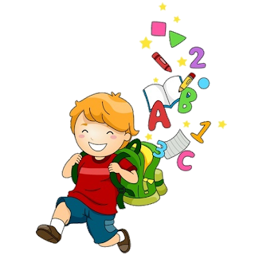
6
Unit 2

Slide 3
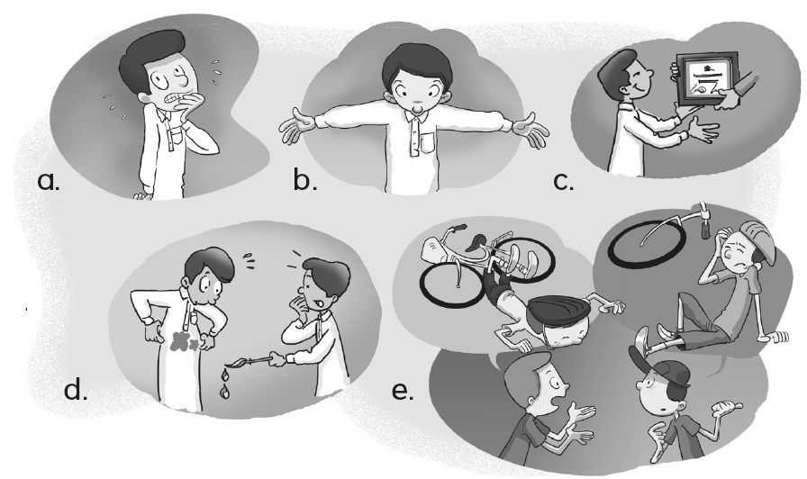
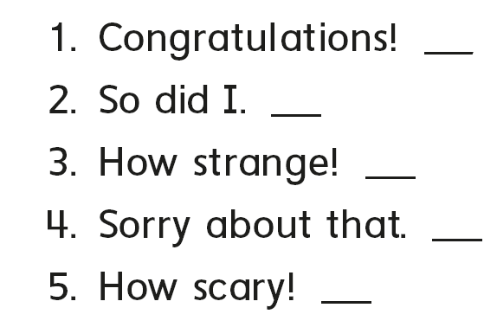
c
e
b
d
a

Slide 4
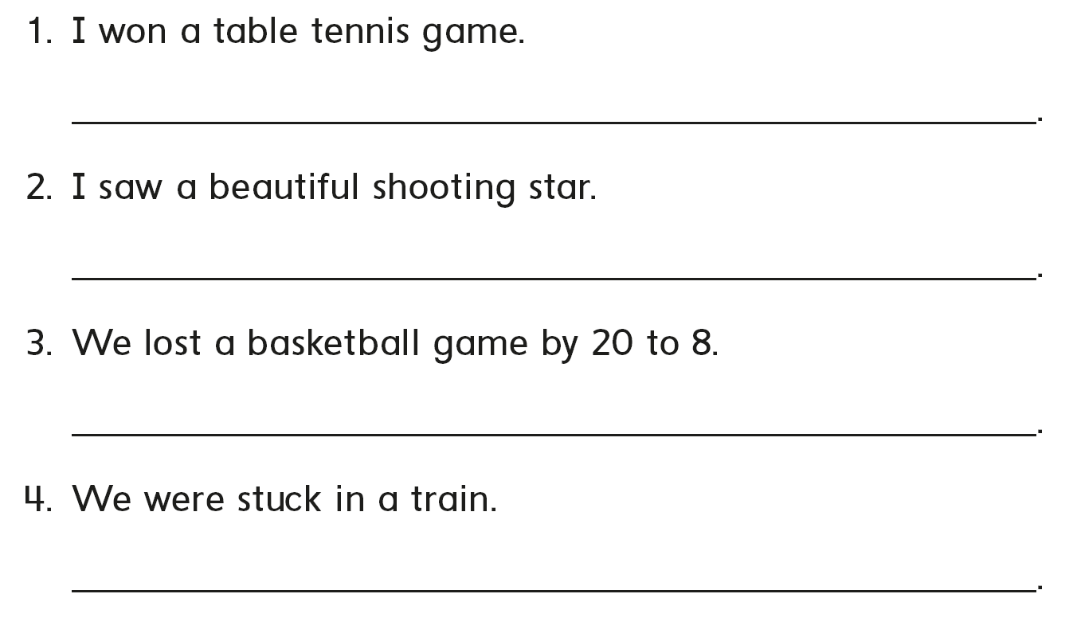
Congratulations!
So did I
Sorry to hear that
How scary

Slide 5
B
C
A

Slide 7
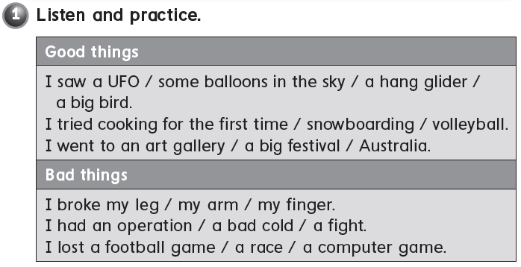

Slide 8
I saw a rainbow
I learned swimming
I lost a basketball game
I broke my arm

Slide 9
C
B
A

Slide 11
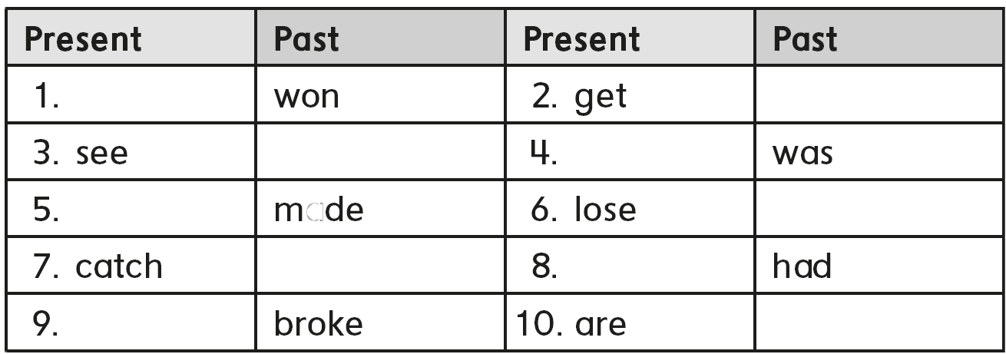
Win
got
Saw
is
Make
Lost
Caught
has
break
Were

Slide 12
I was happy
I was excited
I was sad
I was worried
I was scared

Slide 13
A
C
B

Slide 15
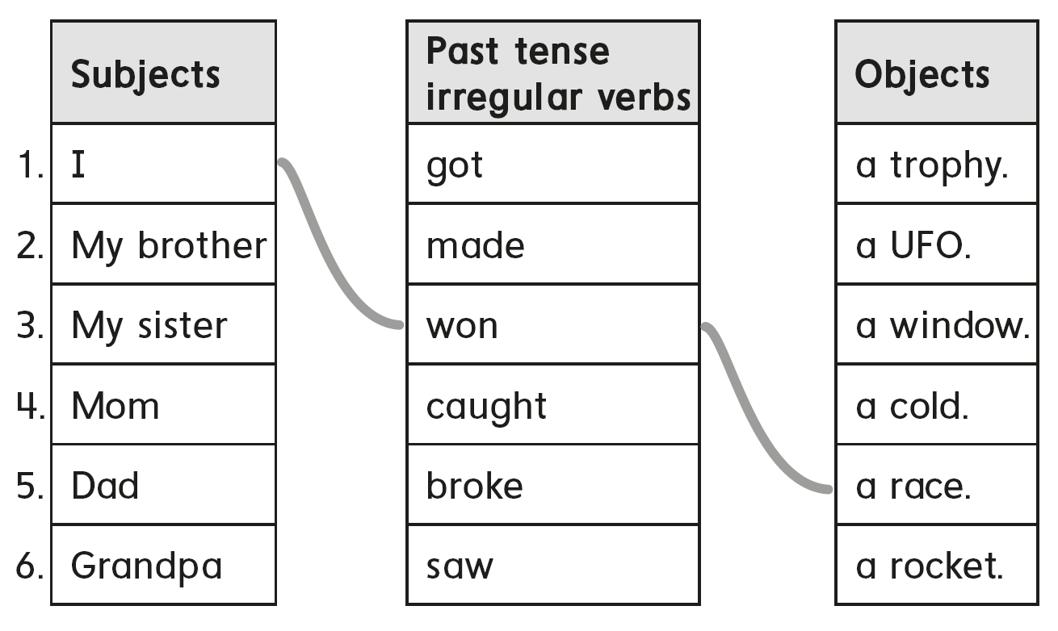

Slide 16
I saw a shooting star yesterday
I played basketball last week.
I broke my laptop , last month.
I went to Dubai , last year.

Slide 17
B
C
A

Slide 19
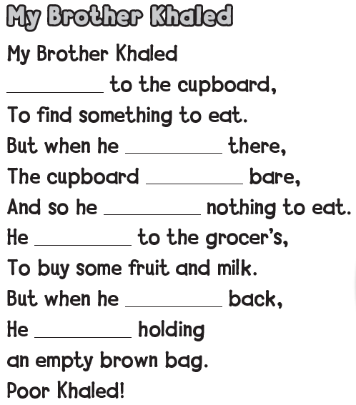
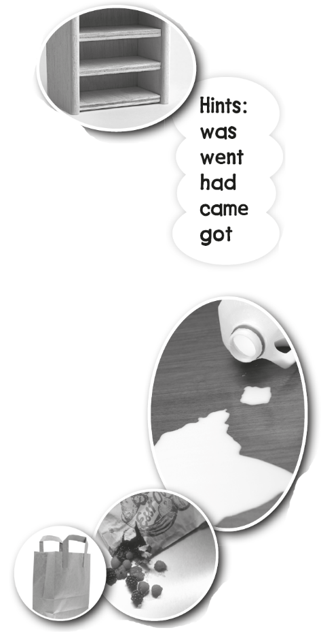
went
got
was
had
went
came
was

Slide 20
B
C
A

Slide 23
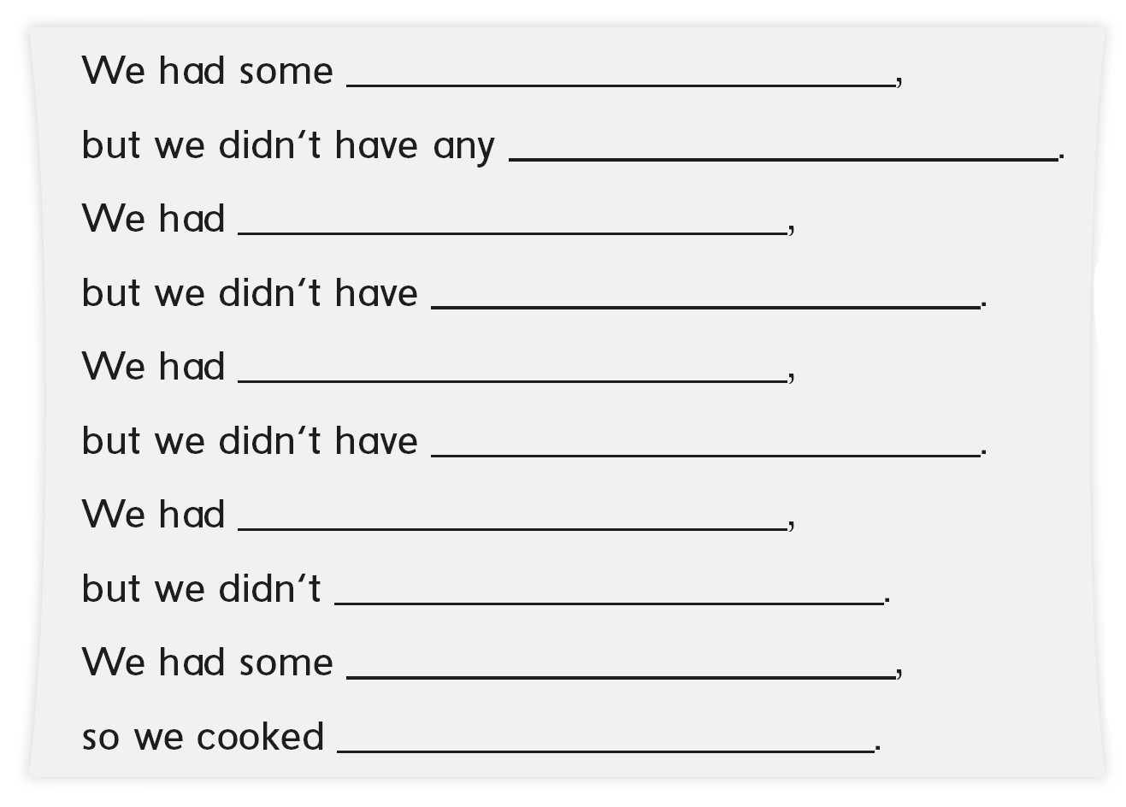
chicken
onions
some rice
any cheese
some tomato
any pepper
some oil
have any cheese
some potato
kabsa

Slide 24
C
A
B

Slide 26
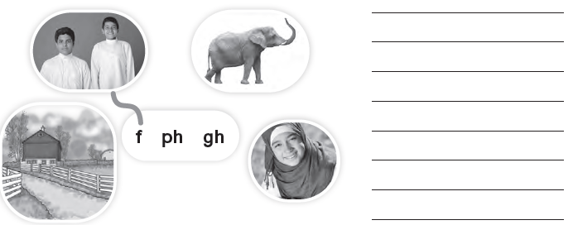
friends
elephant
laugh
farm

Slide 27
2
4
3
fish
phone
tough
fruit
photo
enough
father
elephant
rough

Slide 28
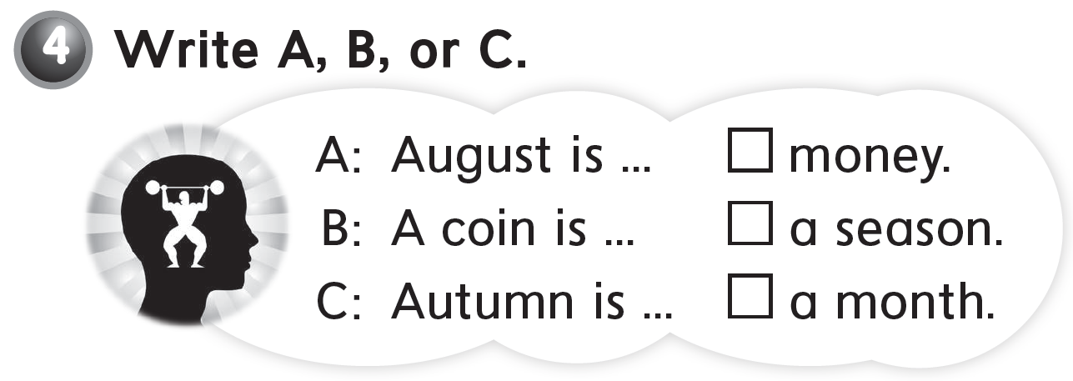
B
C
A

Slide 30
we
our
us
my
them
our
me
he
her
us

Slide 31
We went to an adventure park
My brother an I played with our friends
We got pizza
B
C
A

Slide 32
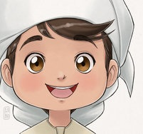
See you later
Goodbye
Teacher :
Badr Sayid
Al-Shehri

