Slide 1
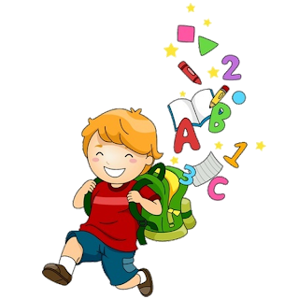
6
Unit 5

Slide 3
post office
left
right
minutes

Slide 4
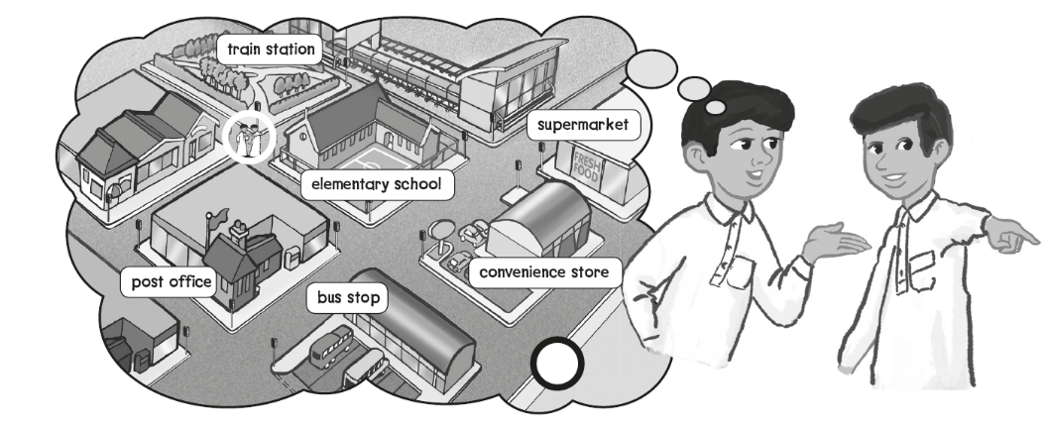
Turn left and go straight
Go straight then turn right
It’s right over there

Slide 5
It’s a supermarket

Slide 7
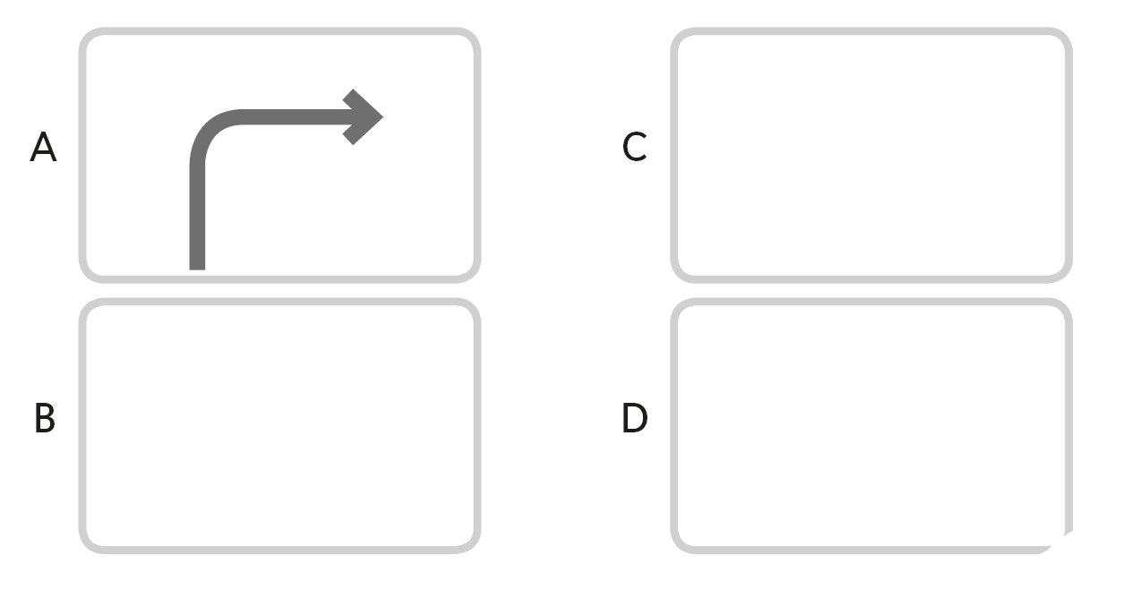

Slide 8
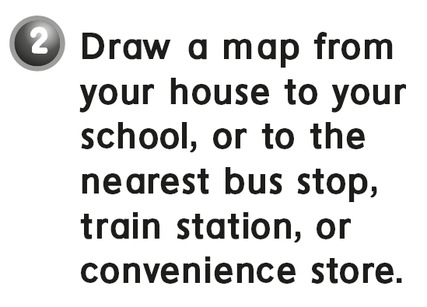

Slide 9
A school

Slide 11
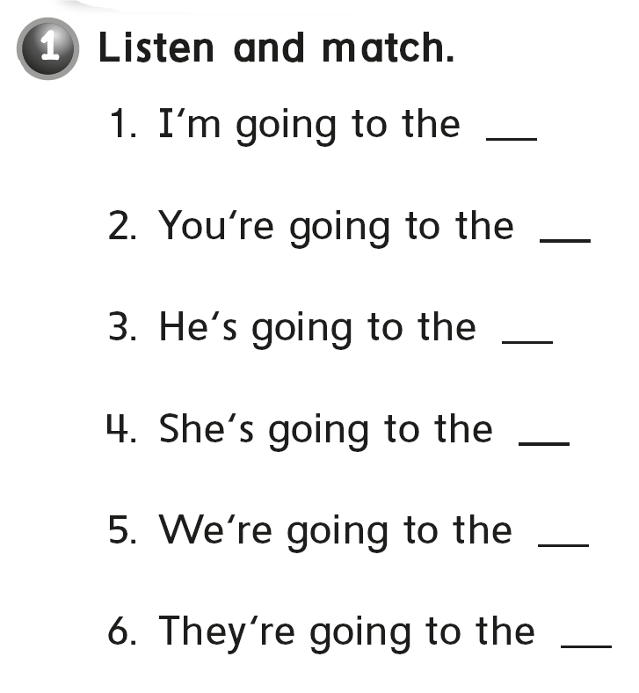
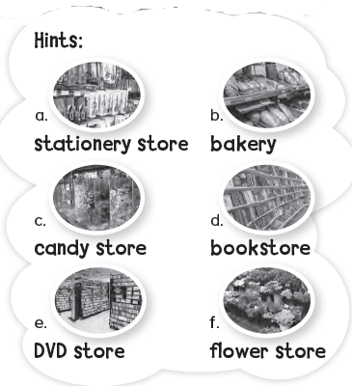
b
d
a
f
e
c

Slide 12
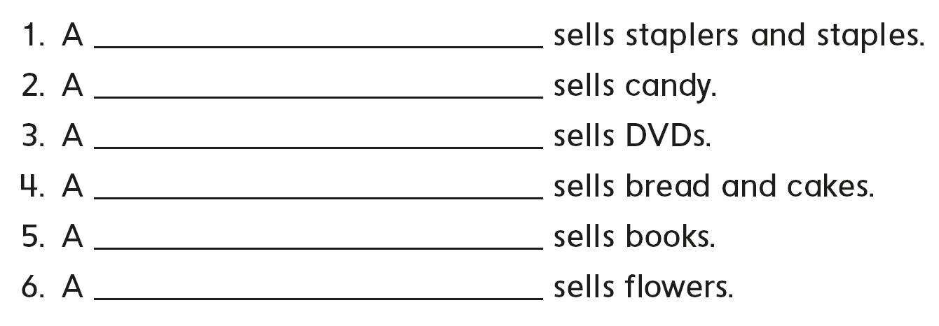
stationery store
candy store
DVD store
bakery
bookstore
flower store

Slide 13
the bakery

Slide 15
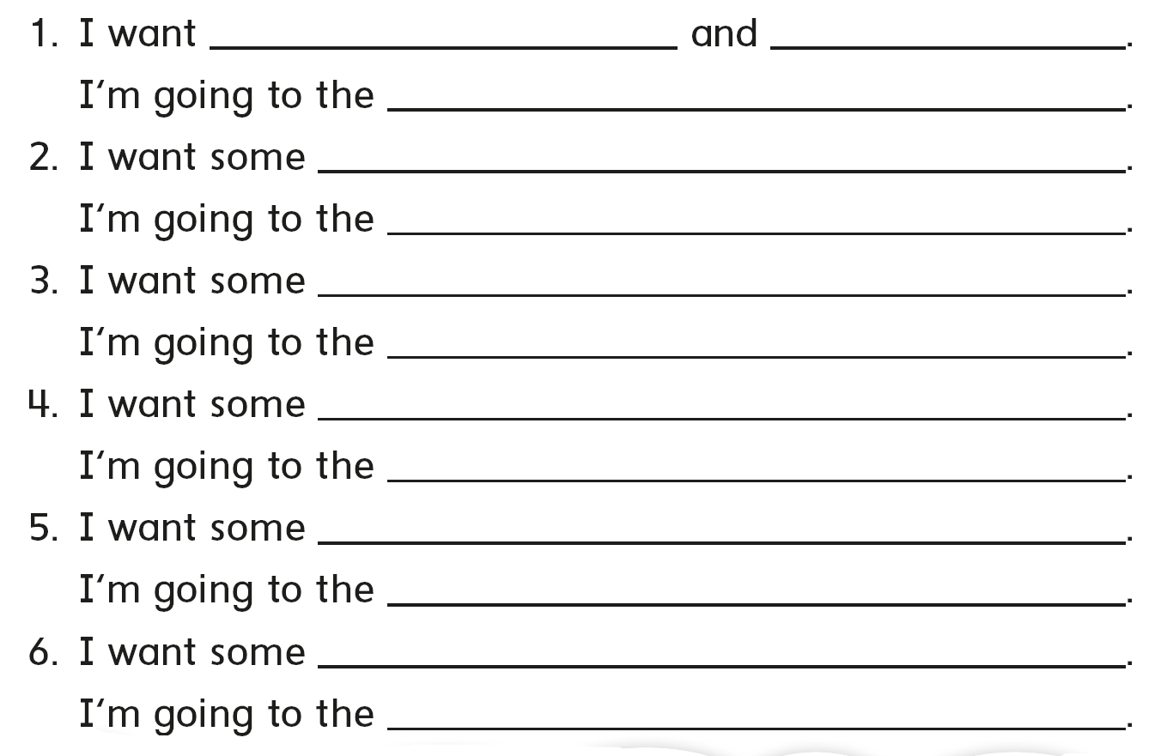
pens pencils
stationary store
chocolate
candy store
DVD’s
DVD store
bread
bakery
magazines
bookstore
plants
flower store

Slide 16
pens pencils
stationary store
chocolate
candy store
DVD’s
DVD store
bread
bakery
magazines
bookstore
plants
flower store

Slide 17
It’s a fast food restaurant

Slide 20
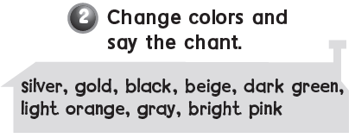

Slide 21
The heart

Slide 23
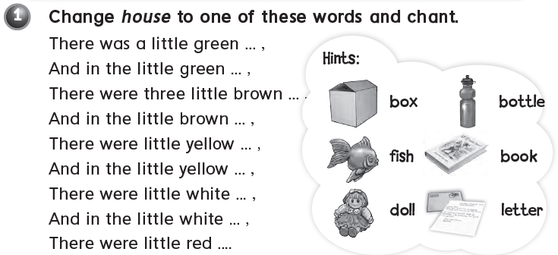

Slide 24
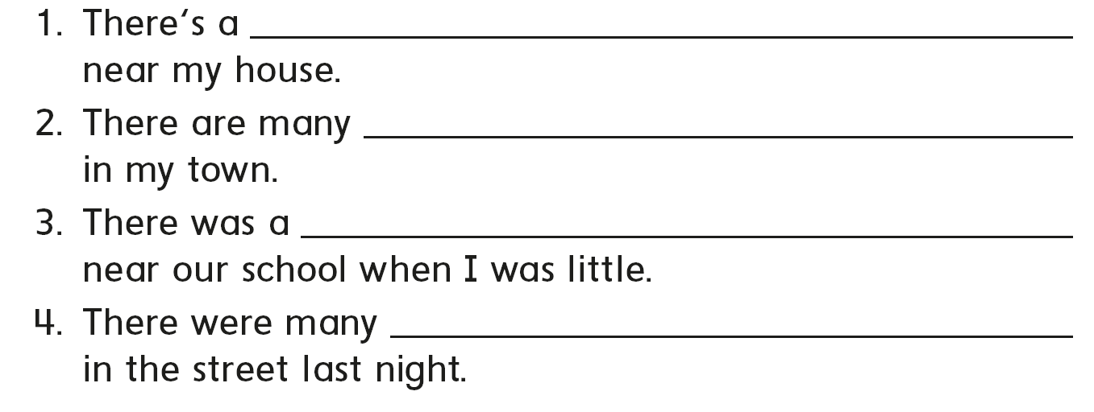
post office
convenience stores
candy store
people

Slide 25
A crocodile

Slide 27
u e
u e
u e
u e
u e
u e

Slide 28
h
d
g
b
f
a

Slide 29
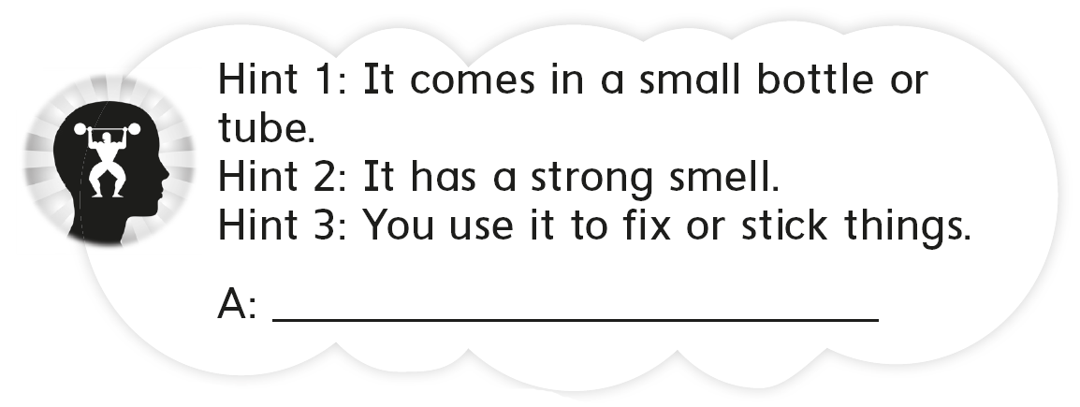
A glue

Slide 31
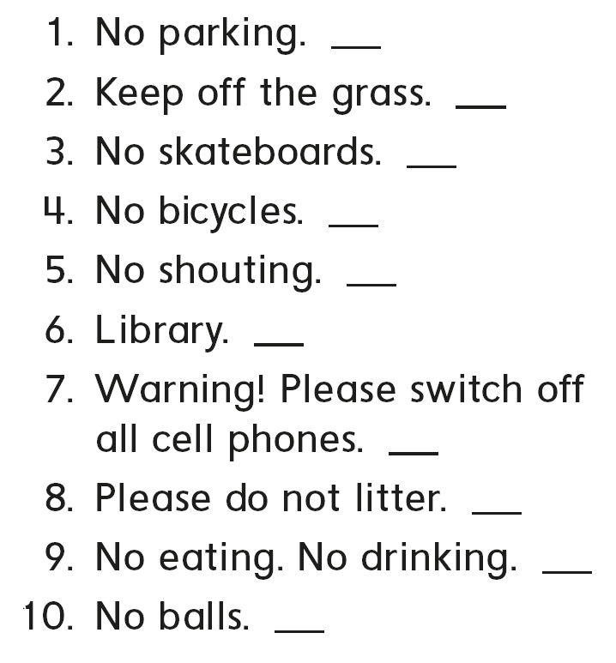
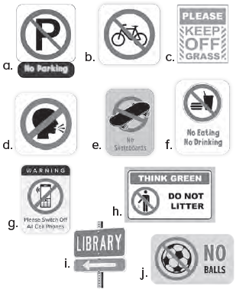
a
c
e
b
d
i
g
h
f
j

Slide 32
Entrance
Police station
Exit
Bus stop
Library
Train station

Slide 33
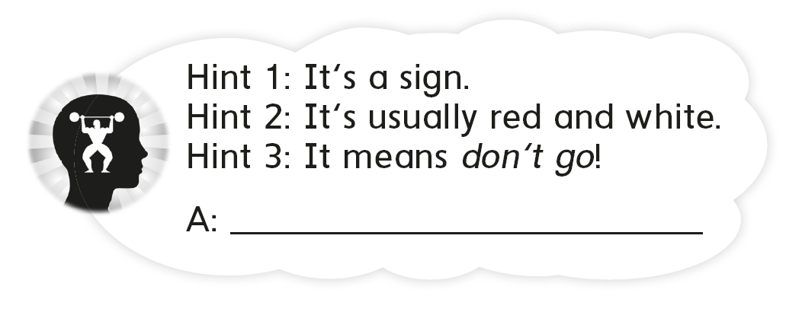
stop

Slide 34
See you later
Goodbye
Teacher :
Badr Sayid
Al-Shehri

