Slide 1
6
Unit 1

Slide 2
Fun on the Weekend
وقت ممتع خلال العطلة الأسبوعية

Slide 3
Finding OUT Time
وقت الاستكشاف

Slide 4
Materials :
A calendar
Activities flash cards
Emoji poster

Slide 5
Strategy
Verb guessing game :
Review the sentences and past tense verbs on page 2 using the pictures in the book, or your own photos or pictures. Review the present and past tense forms of the verbs. Make verb flashcards on cards or pieces of paper. Next, secretly choose a verb flashcard. The students have to guess which verb flashcard you are holding by saying one of the sentences on the page. When a student says the correct sentence, say “Yes!” and show him/her the verb on the card. Then, have that student say the present and past tense forms of the verb. Invite that student to the front to choose a card and continue playing the game. Continue the game until all students have had a chance to come to the front and choose a verb card.

Slide 6
اسأل صديقي عن ما فعله خلال العطلة الأسبوعية
استمع إلى إجابة شخص ما عن ما فعله خلال العطلة الأسبوعية واعطي تعليقي

Slide 7
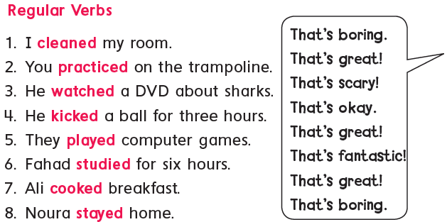
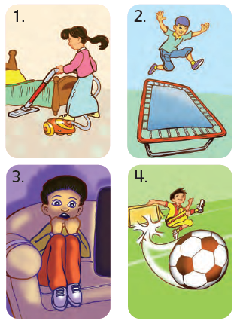
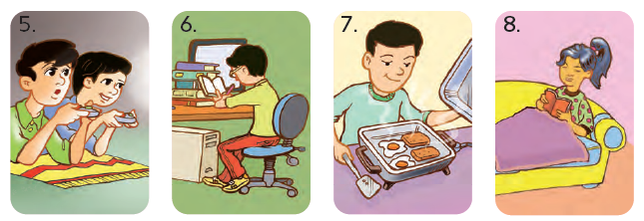
1
Listen and practice. Then do it in pairs.
استمع ثم تدرب مع زميلك

Slide 8
وقت التحدي

Slide 9
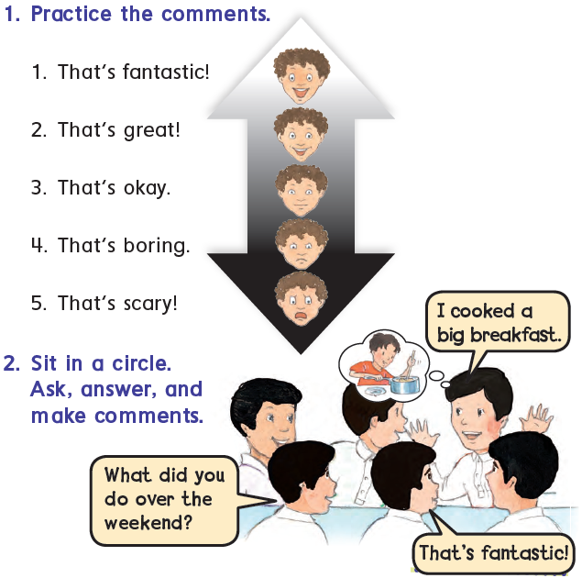
2
Ask , listen , and comment
اسأل ، استمع ، ثم ضع تعليقك

Slide 10
Goal Check
التحقق من الهدف

Slide 11
الهدف :
أن يطبق الطالب المحادثة والاسئلة مع زميله
أن يستمع الطالب إلى إجابة زميله ويعطي التعليق المناسب

Slide 12
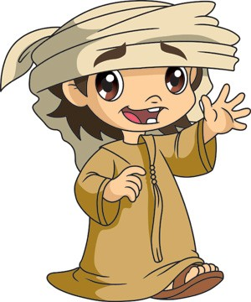
Have a nice day
See you next class

