Slide 1
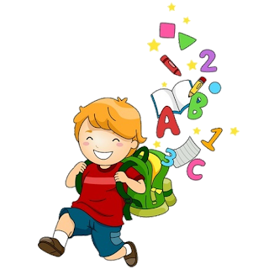
6
Unit 1

Slide 3
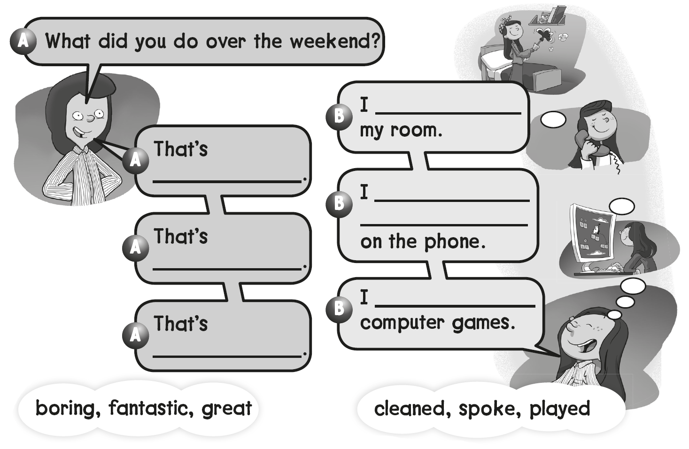
cleaned
boring
spoke with my friends
Fantastic
played
great

Slide 4
B
A
C

Slide 6
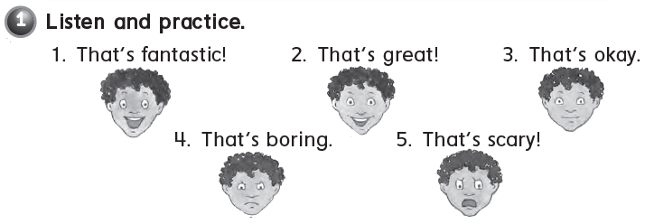

Slide 7
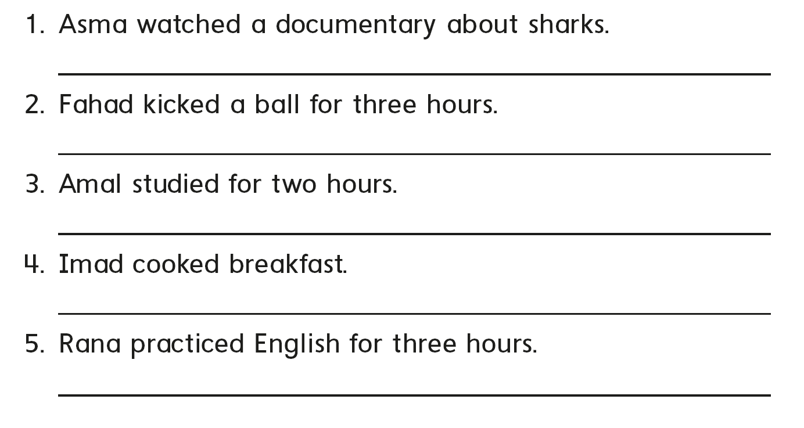
That’s scary
That’s boring
That’s okay
That’s great
That’s fantastic

Slide 8
B
A
C

Slide 11
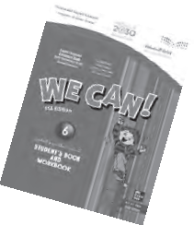
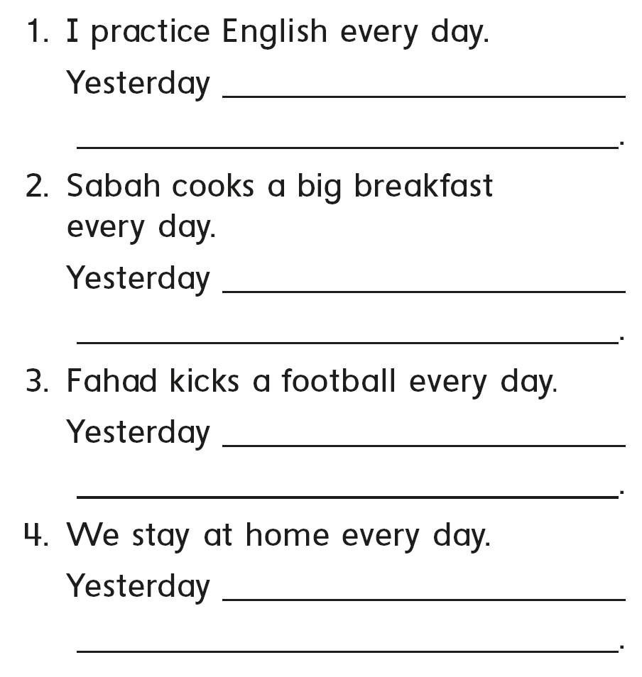
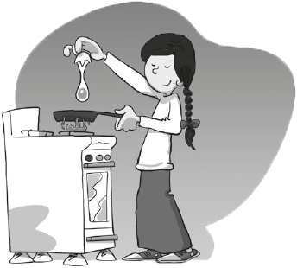
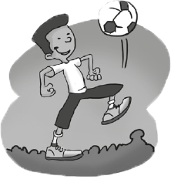
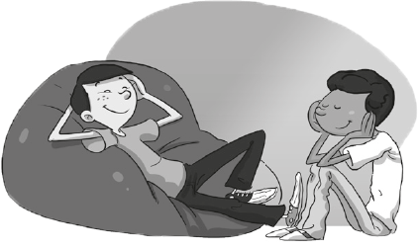
I practiced English
she cooked a big breakfast
he kicked football
We stayed home

Slide 12
B
C
A

Slide 14
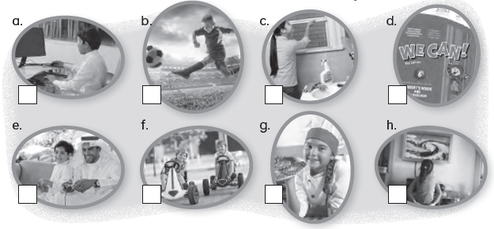
8
4
5
1
6
7
3
2

Slide 15
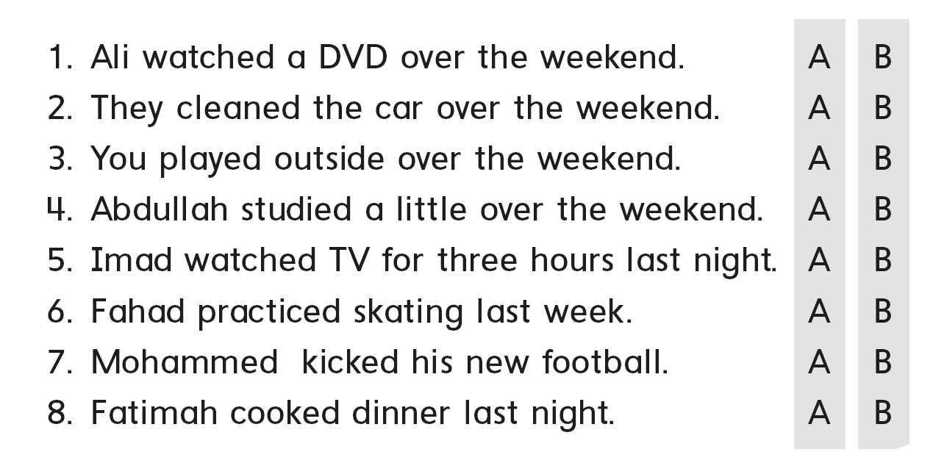

Slide 16
B
A
C

Slide 18
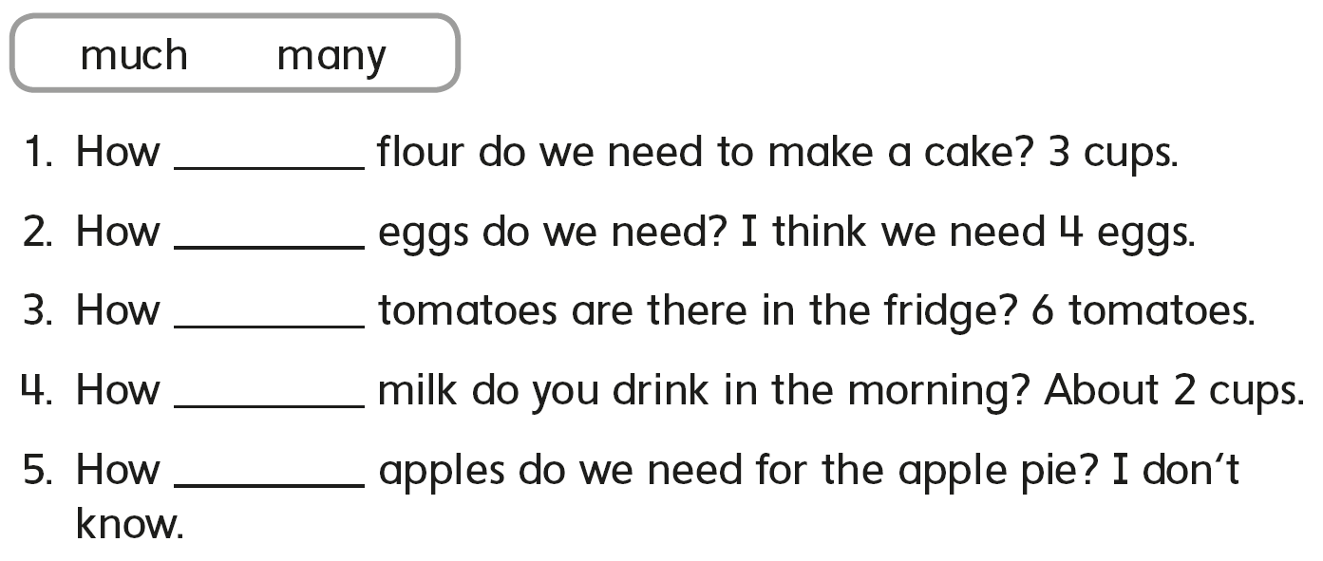
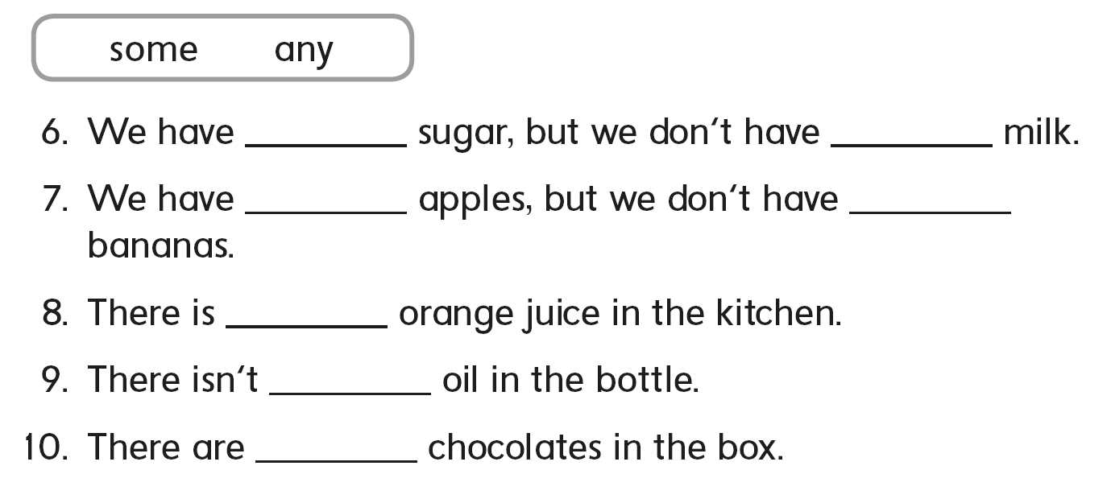
much
many
many
much
many
some
any
some
any
some
any
some

Slide 19
B
A
C

Slide 21
would
burger
fries
moment

Slide 22
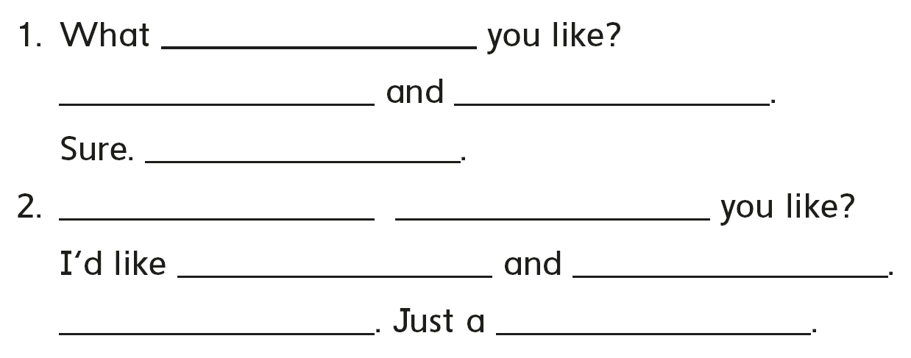
would
I’d like kabsa
soda please
Just a moment
What
would
pizza
a salad please
sure
moment

Slide 23
B
C
A

Slide 25
sand
tent
paint
plant
stand
hand

Slide 26
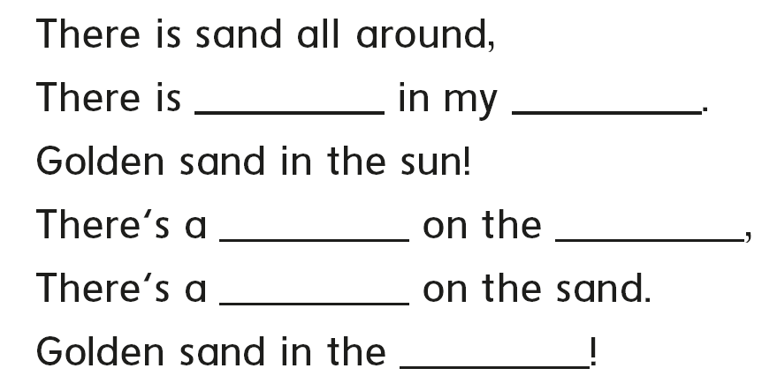
sand
hand
tent
land
tent
land

Slide 27
C
A
B

Slide 30
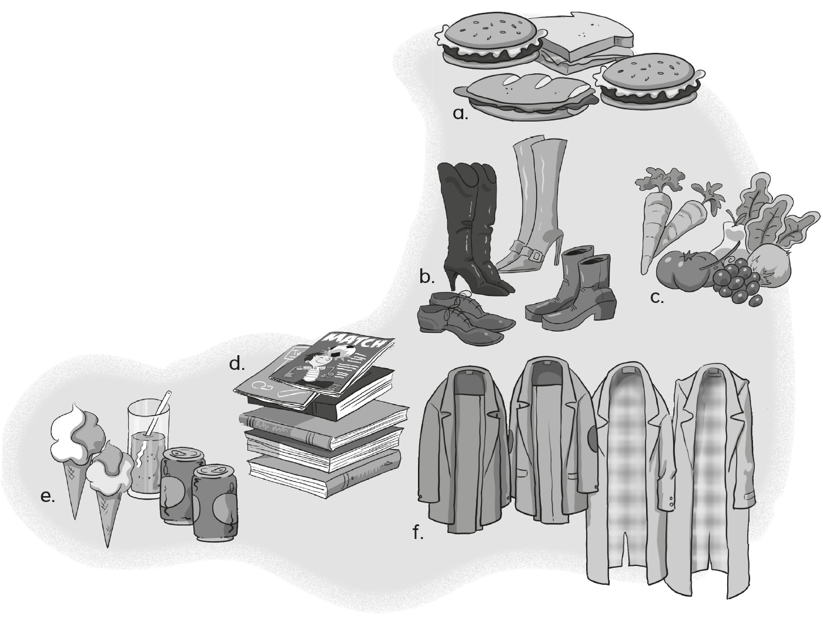
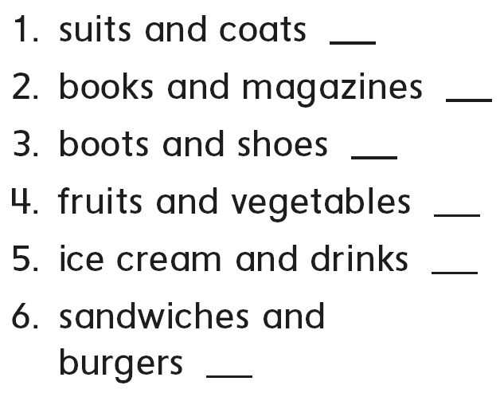
f
d
b
c
e
a

Slide 31
C
B
A

Slide 32
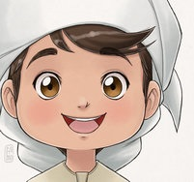
See you later
Goodbye
Teacher :
Badr Sayid
Al-Shehri

