Slide 1
MEGA GOAL 6

Slide 2
UNIT 1

Slide 3
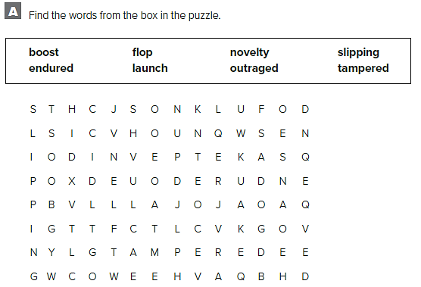
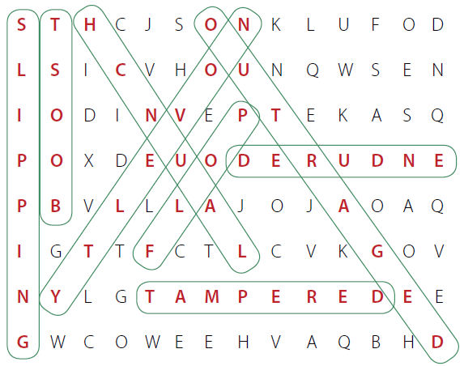

Slide 4
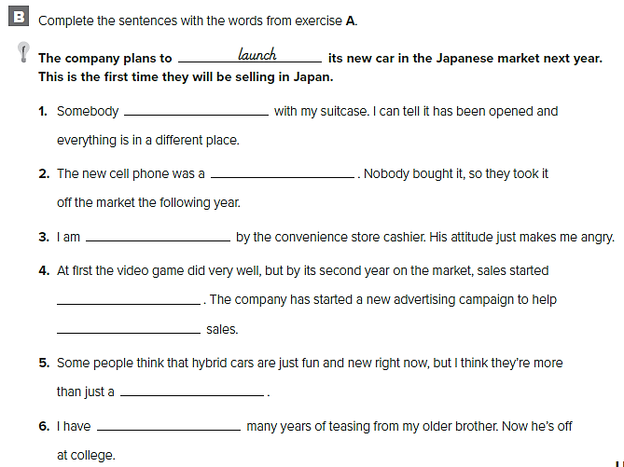
tampered
flop
outraged
slipping
boost
novelty
launched

Slide 5
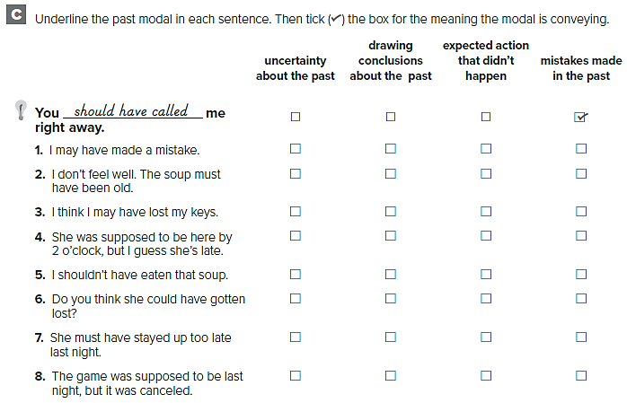

Slide 6
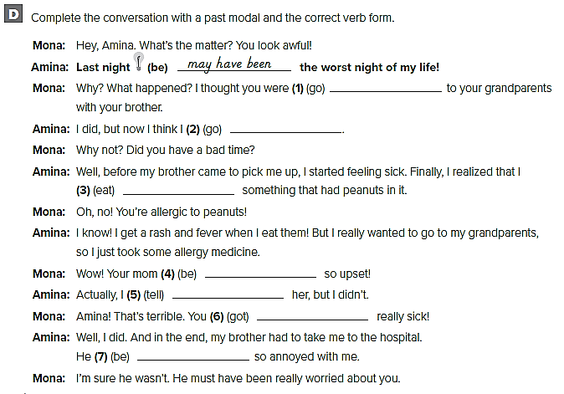
supposed to go
shouldn’t have gone
must have eaten
must have been
should have told
could have gotten
must have been

Slide 7
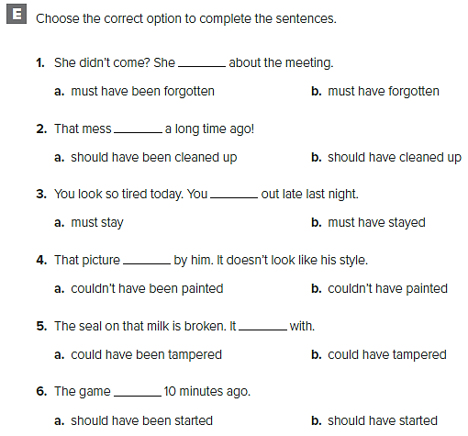

Slide 8
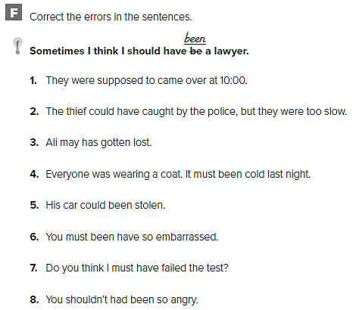
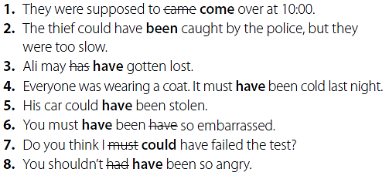

Slide 9
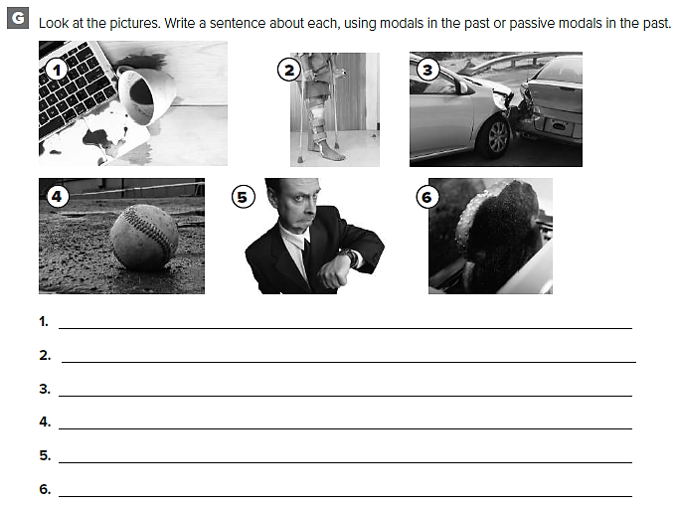
قد تختلف الإجابات
Spilling the coffee on the keyboard may have broken it.
He might have broken his leg in a car accident.
The driver of the car must not have been paying attention.
It must have been a home run.
He could have remembered that he is late for an appointment.
The toast must have been forgotten.

Slide 10
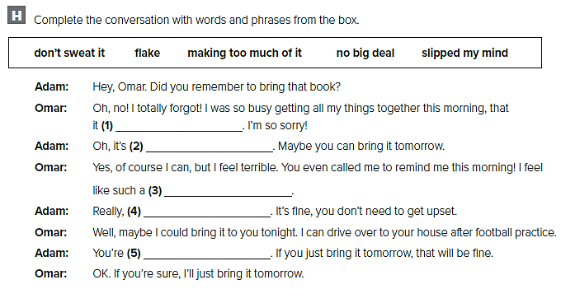
slipped my mind
no big deal
flake
Don’t sweat it
Making too much of it

Slide 11
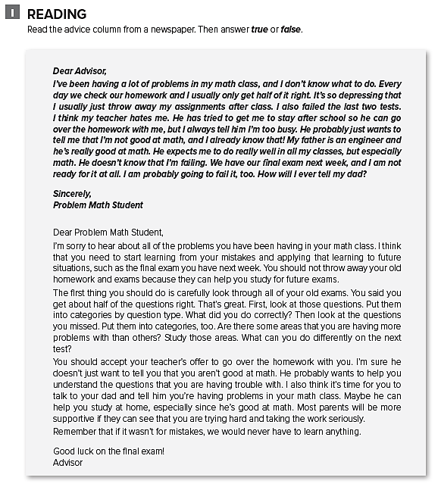

Slide 12
F
T
F
F
T

Slide 13
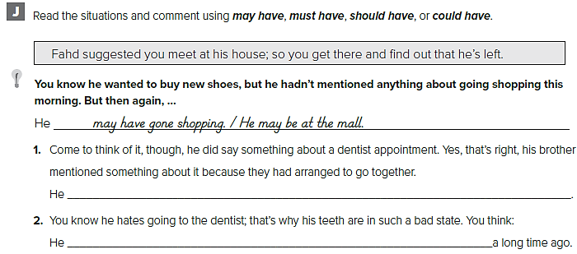
must have gone to the dentist. / He must be at the dentist’s
should have gone to the dentist

Slide 14
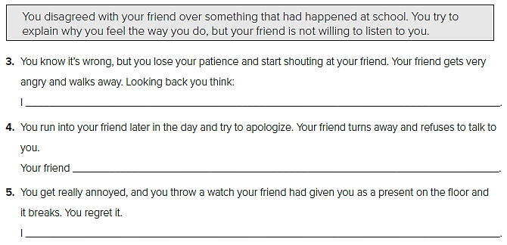
shouldn’t have lost my patience / I shouldn’t have shouted at my friend
shouldn’t have turned away / She shouldn’t have refused to talk to me
I shouldn’t have thrown the watch away / I could have thrown something else down.

Slide 15
قد تختلف الإجابات
You couldn’t have charged it recently.
You should have studied harder.
There must have been a reason for it.

Slide 16
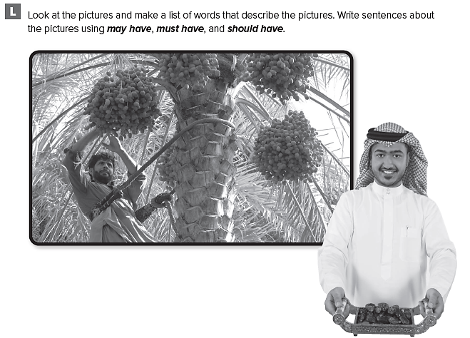

Slide 17
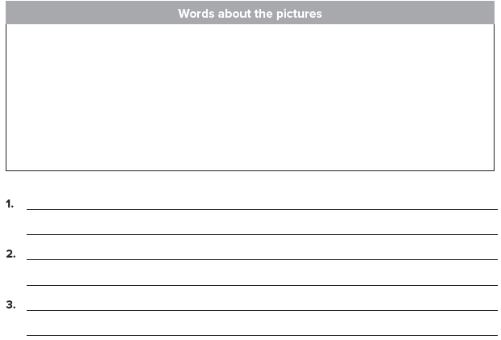
قد تختلف الإجابات
trees, garden, picking , collecting fruit, sunshine, hot climate, workers
The men must have been employed to work in the gardens.
They may have brought lots of water

Slide 18
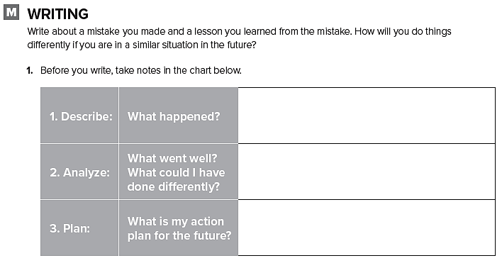
تحدث عن أخطاء قمت بارتكابها في الماضي

Slide 19
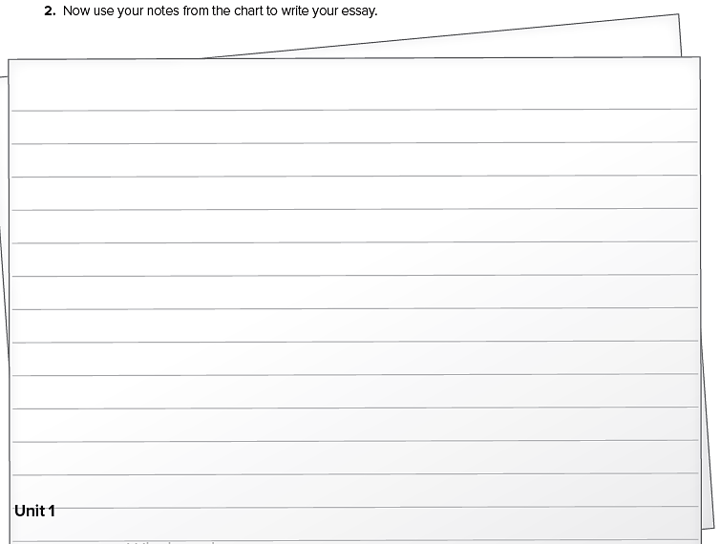

Slide 20
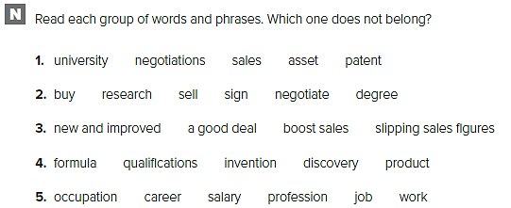

Slide 21
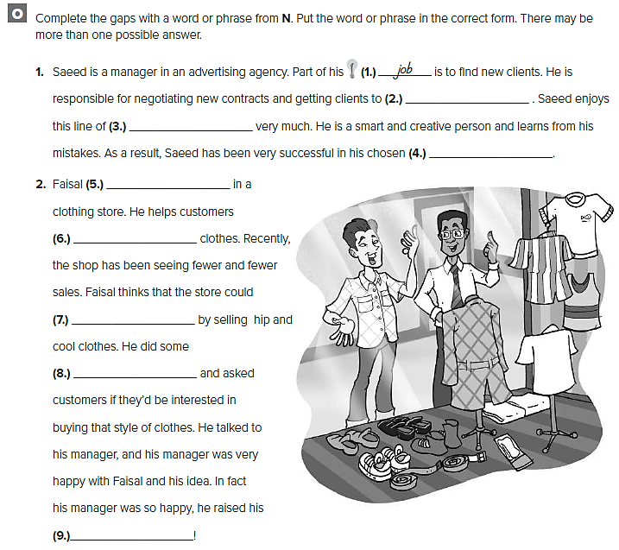
sign
work
occupation
works
buy
boost sales
research
salary

Slide 22
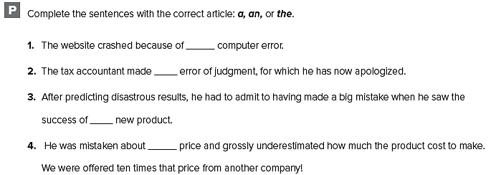
a
an
the
the

Slide 23
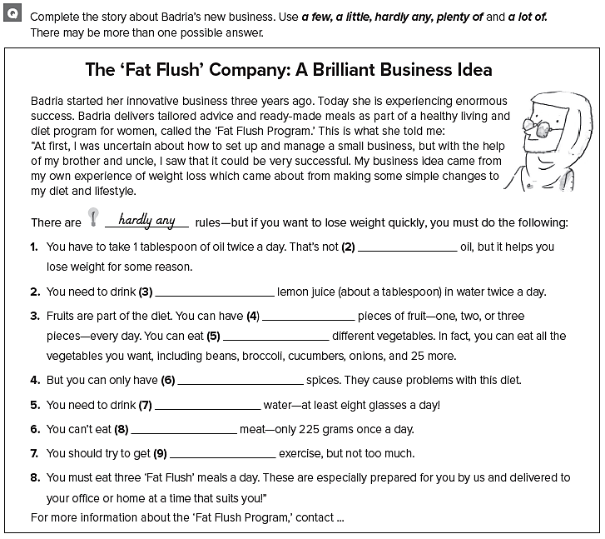
a lot of
a little
a few
a lot of
a few
a lot of
a little
a lot of

Slide 24
UNIT 2

Slide 25
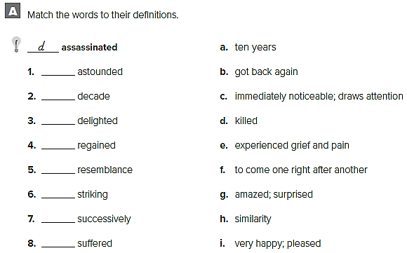
g
a
i
b
h
c
f
e

Slide 26
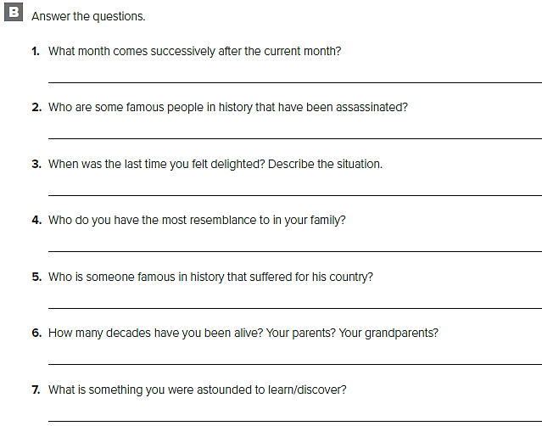
قد تختلف الإجابات
March comes successively after February.
John F. Kennedy and Abraham Lincoln were both assassinated
When my country’s team was in the World Cup
I resemble my father. We have the same nose and eyes.
Gandhi
I’ve been alive for 2 decades, my parents 4 decades, and my grandparents 6 decades.
I was astounded to discover a valuable statue in the attic.

Slide 27
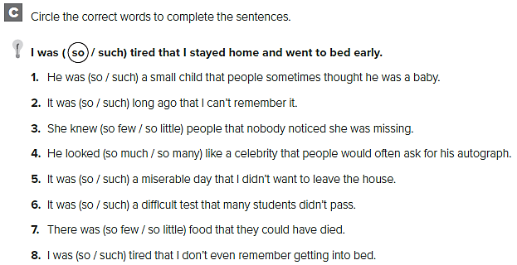

Slide 28
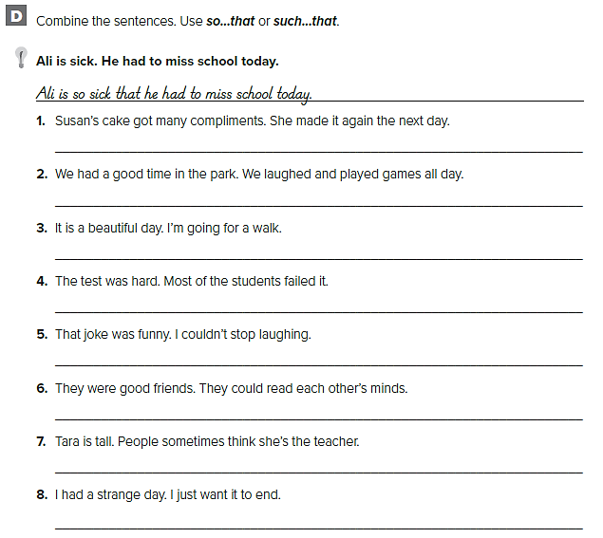
Susan’s cake got so many compliments that she made it again the next day.
We had such a good time in the park that we laughed and played games all day.
It’s such a beautiful day that I’m going for a walk.
The test was so hard that most of the students failed it.
That joke was so funny that I couldn't stop laughing.
They were such good friends that they could read each other’s minds.
Tara is so tall that people sometimes think she’s the teacher.
I had such a strange day that I just want it to end.

Slide 29
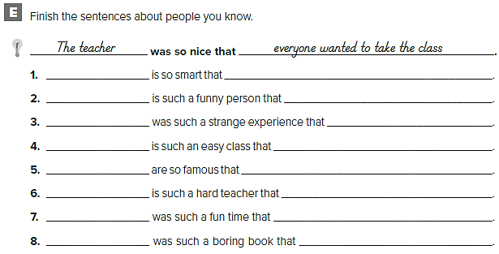
قد تختلف الإجابات
My sister
Jerry Seinfeld
That play
Art
These players
Mr. Frank
That party
………
she got into Harvard
he makes everybody laugh.
That I didn’t like
I never have to study
everybody like them
I don’t like his classes
I will remember forever
.………

Slide 30
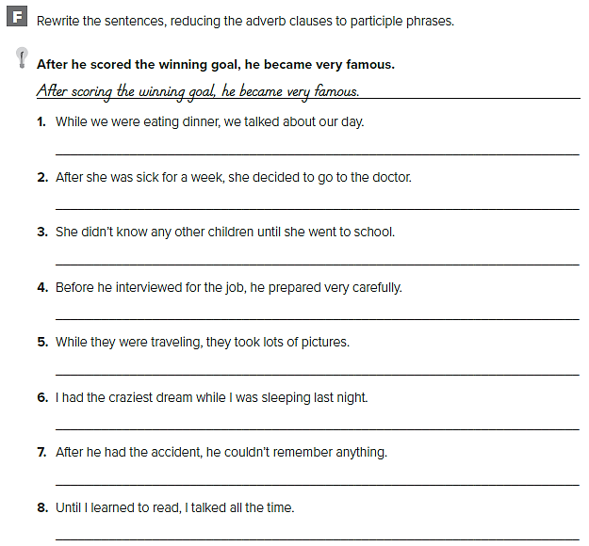
While eating dinner, we talked about our day
After being sick for a week, she decided to go to the doctor.
She didn’t know any other children until going to school.
Before interviewing for the job, he prepared very carefully.
While traveling, they took lots of pictures.
I had the craziest dream while sleeping last night.
After having the accident, he couldn’t remember anything.
Until learning to read, I talked all the time.

Slide 31
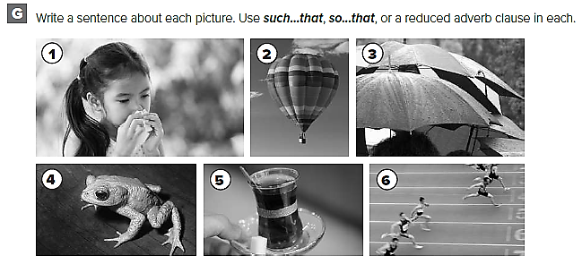

Slide 32
She was so sick that she couldn’t go skiing.
Before getting a hot air balloon, we used to fly kites.
It was such a rainy day that we all needed umbrellas.
The frog was so little that I almost didn’t see it.
My hands were so cold that I warmed them up with a cup of tea.
After winning the race, he went to celebrate with his friends.

Slide 33
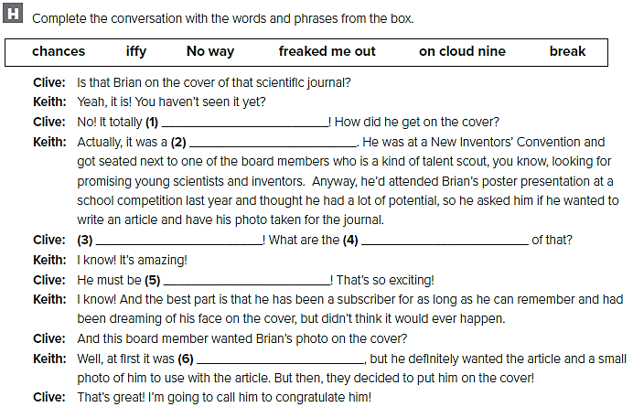
freaked me out
break
No way
chances
on cloud nine
iffy

Slide 34
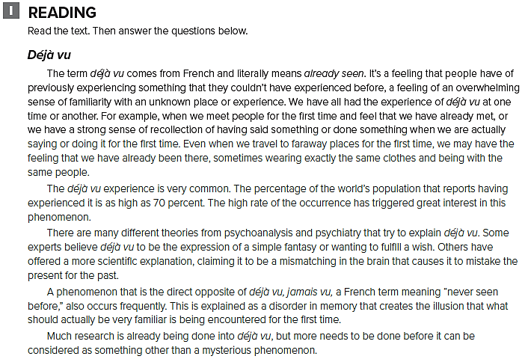

Slide 35
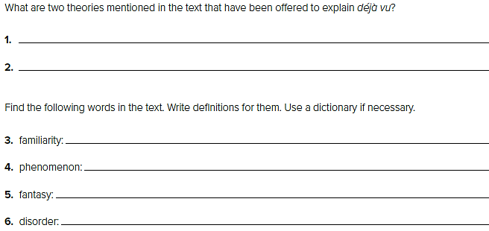
It is a fantasy or wish.
The brain is mismatching the past and the present.
unusual, rare
an occurrence; happening
dream
chaos; confusion

Slide 36
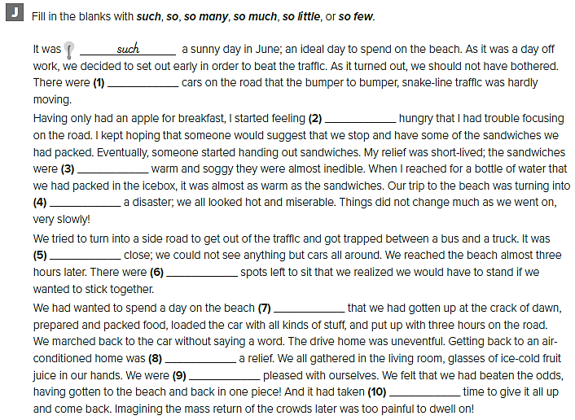
so many
so
so
such
so
so few
so much
such
so
so little

Slide 37
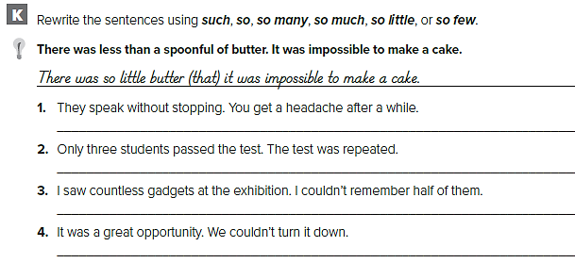
They speak so much (that) you get a headache after a while.
So few students passed the test (that) it was repeated.
I saw so many gadgets (that) I couldn’t remember half of them.
It was such a great opportunity (that) we couldn't turn it down.

Slide 39
قد تختلف الإجابات
cars, SUV, drifting, sand, sand dunes, desert, racing, capsize, drive, activity, test drive, test, engine, wheels, tires, speed
Driving in the desert is such an exciting activity that most people spend part of the weekend there.
Sand dunes can be so treacherous that you’re fine one minute and suddenly you feel as if you’re sinking in the sand

Slide 40
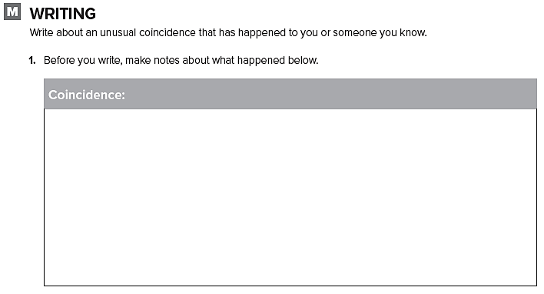
قم بالكتابة عن صدفة حدثت لك أو لشخص تعرفه

Slide 41
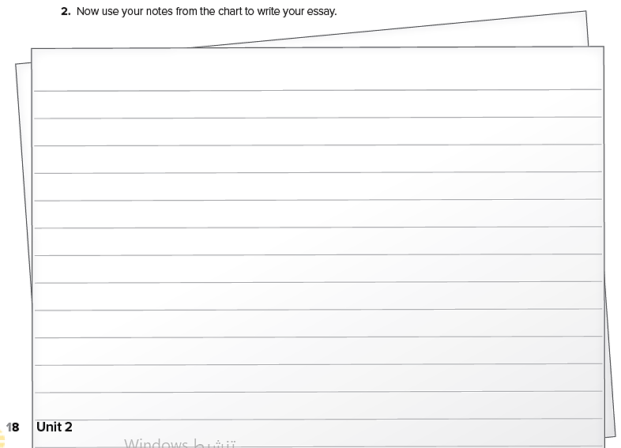

Slide 42
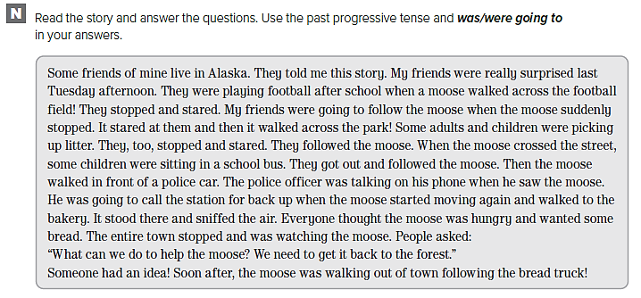

Slide 43
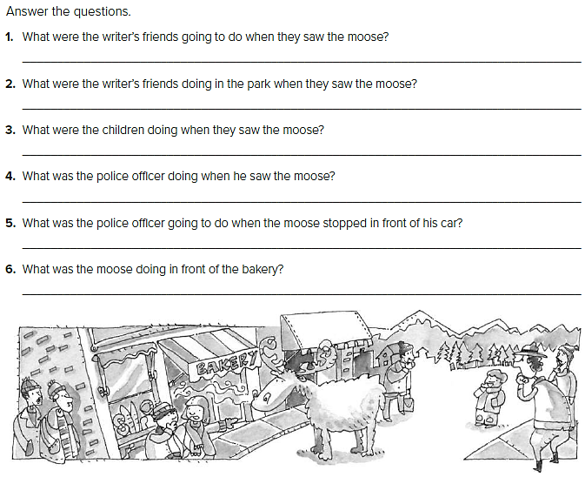
The writer’s friends were going to follow the moose.
They were playing football.
The children were picking up litter.
The policeman was talking on the phone.
The police officer was going to call the station for help.
The moose was sniffing the air.

Slide 44
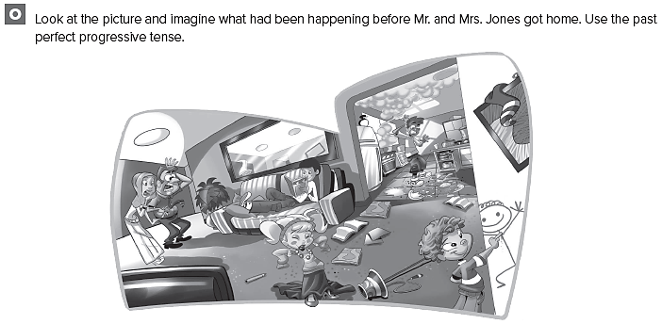

Slide 45
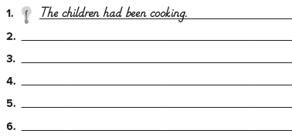
قد تختلف الإجابات
The boy had been searching for crayons.
The children had been running around the house

Slide 46
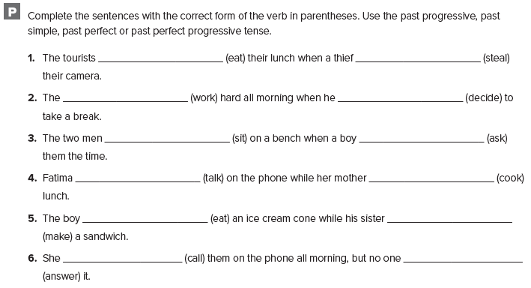
were eating stole
had been working stole
were sitting asked
was talking was cooking
was eating was cooking
had been calling answered

Slide 47
UNIT 3

Slide 48
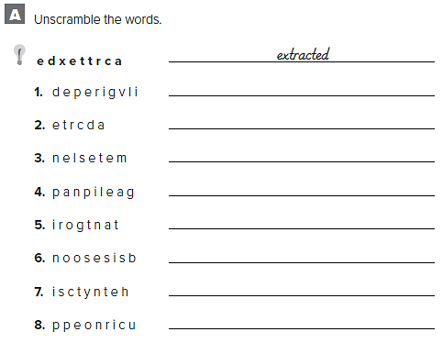
privileged
traced
elements
appealing
rotating
obsession
synthetic
porcupine

Slide 49
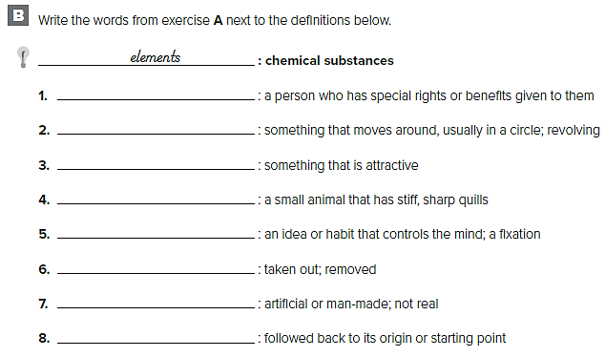
privileged
rotating
appealing
porcupine
obsession
extracted
synthetic
traced

Slide 50
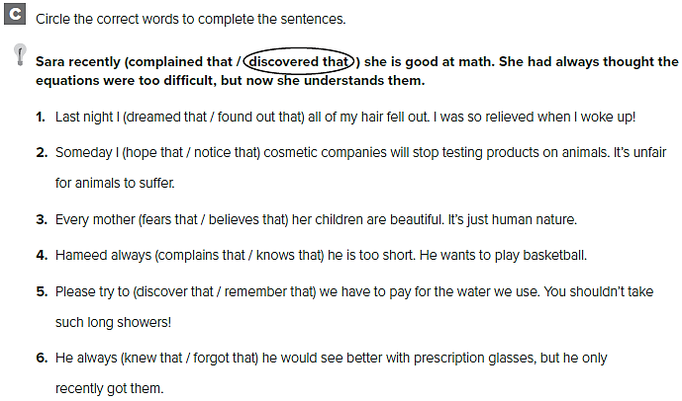

Slide 51
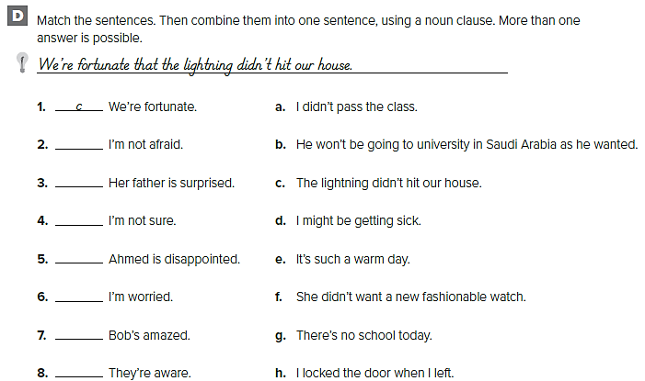
a
f
h
b
d
e
g

Slide 52
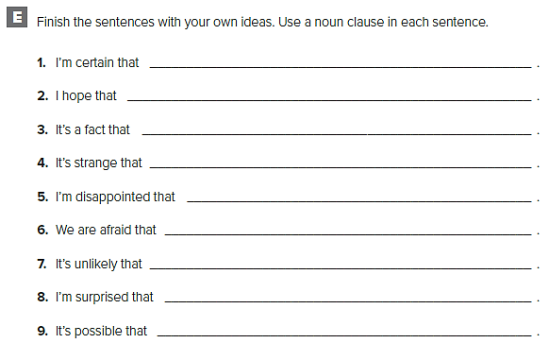
قد تختلف الإجابات
it won’t snow today
I get an A in English class
technology has advanced our world
he still hasn’t called
I didn’t get to exercise today
we won't have food to eat
There can be a life on Mars
it didn’t rain today
I’ll get into every college I applied to

Slide 53
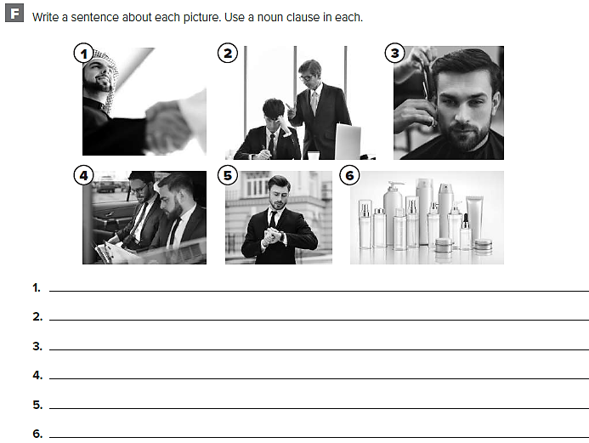
It is obvious that they are great friends.
The teacher is disappointed that he didn’t do the homework.
He is worried that his hair won't look good.
He realized that they are going to be late for the meeting.
He is certain that his friend forgot their appointment.
It’s surprising that some people use so many beauty products.

Slide 54
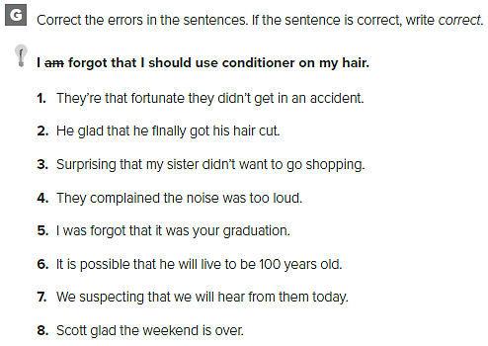
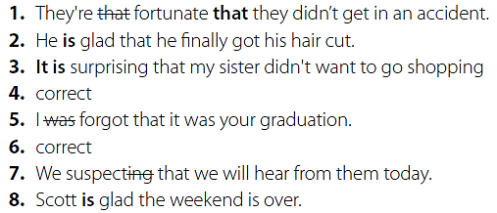

Slide 55
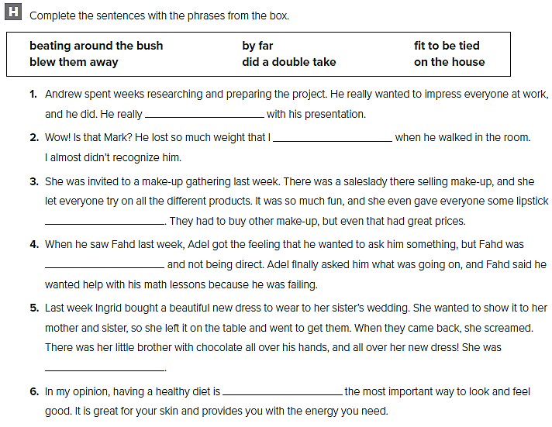
blew them away
did a double take
on the house
beating around the bush
fit to be tied
by far

Slide 56
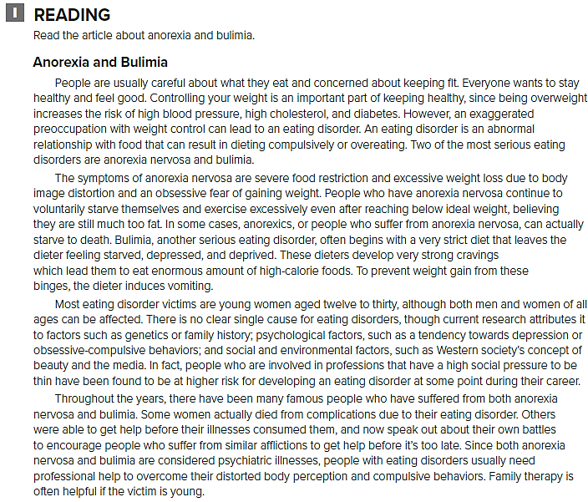

Slide 58
It is obvious that he is not aware of the difficulty involved in this undertaking.
There is a good chance that he’s going to get his license immediately.
It is disappointing that they are not going to attend our presentation.
It is very possible that a new policy will be introduced.
It is surprising that they accepted the job offer and move to Canada.
It is true that most people don’t watch what they eat.
It is strange that after years of research he decided to give it all up and become a farmer.

Slide 59
notice
found out
feel
discovered
suspected
complain

Slide 61
Tall
Modern
Stunning
not very many green spaces
many offices
safe
lack of parking spaces
Heart of the city
pictures of cities
Wealthy ambitious
It is obvious that this is a wealthy and prosperous place to live.
I am amazed at the excellent city planning and the tall, modern buildings.
I am certain that this a safe and prosperous place to live and work.

Slide 62
قم بكتابة مقال عن الموضوع التالي :
Is it a good idea to watch what you eat?

Slide 64
broken
sown
damaged
scratched
stained
torn
repaired
painted
cleaned

Slide 66
قد تختلف الإجابات
Interviewer: What about the interior?
Host: Well, the curtains are torn so we will have those sown. The walls are stained so we will get the whole interior painted. Also, any broken or scratched furniture will be replaced

Slide 67
damaged
repaired
cracked
redesigned
broken
decorated
scratched
torn

Slide 68
exciting
exhausting
aching
growing
interesting

Slide 69
EXPANSION 1 – 3

Slide 72
must have gotten
should have slept
may have left
must have been
shouldn’t have stayed
might have developed
were supposed to be
may have thought
must have gone

Slide 73
I was so lost that I had to stop and ask for directions.
It was such an icy day that I slipped and fell outside my house.
They were so late that she called us to say we should start without them.
He is such a helpful person that he did all the dishes after we ate.
Adel has been so sick that he hasn’t been to school in a week.
It was such a big mistake that he sent a note to apologize for it.
It was such a funny film that I laughed the whole time.

Slide 74
After falling down, he was embarrassed.
Since forgetting the last meeting, she started using a calendar with email reminders.
After losing my keys, I had to get new ones made.
He had had a perfect driving record before getting in the car accident.
While cleaning my room, I knocked over my fish tank.
She never studied until failing the first test.
Before going to the conference, he practiced his speech many times.
He has started saving money since getting a job.

Slide 75
I will always remember that my father was born in Sep
I’m afraid that I won’t get an A in English class.
I hope I'll get an A in English.
I’m sure that it’ll rain today.
I expect that I will go to work tomorrow.
I have dreamed that I was in an elevator more than once.
I was disappointed that we lost the game last week.
I learned that modals can be used in the past.

Slide 77
b
c
f
e
d
a

Slide 78
قد تختلف الإجابات
If he hadn't hurt his leg, the doctors wouldn't have diagnose a life-threatening condition.
He might not have been able to have the transplant.

Slide 80
قد تختلف الإجابات
Concrete
Steel
Glass
Simple
Spacious
Square
Offices
Studious
Lap
The building is very modern in its use of aluminum and insulated glass panels

Slide 81
اكتب مقال عن حالة طبية أو مرضية

Slide 83
UNIT 4

Slide 84
rumor
praise
circulated
criticism
virtues
brilliant
ridicule
scandal

Slide 85
كل طالب يجيب بعباراته

Slide 86
1. My sister said, “Asma called the department store last week.”
2. no change
3. no change
4. He said, “Ali's not going to finish his research paper this term.”
5. no change
6. He said, “he’s the cleverest student I have ever known.”
7. My father said, “Don’t be home late.”
8. no change

Slide 88
Majid said he was trying out for the football team this year.
My father told me not to forget to do my homework.
The teacher said that the test will be on Sunday.
Amy is saying that Jennifer is conceited.
My sister asked whether I was joking.
The coach told me to be on time to practice tonight.
Dr. Thomas says that he’s a healthy baby.
My mother asked whether Tom was married.

Slide 89
قد تختلف الإجابات
My parents said I could play them.
My mother says I can have all the dessert I want.
My parents said I could watch more TV tonight.
My mother told me I could stay up until 9:00.
My parents say I don’t have to shower every day.
My father said I could read three books before bedtime

Slide 91
split up
backstabbers
bad mouthing
behind
back
on again, off again
for good
lips are sealed
set things right

Slide 93
F
F
T
F
T
F

Slide 98
قد تختلف الإجابات
drink some juice
eat an apple
Do you want .. ?
Would you like .. ?
You can have … after the meal
You had better listen to me
She asked him if he would like some orange juice.!

Slide 99
قم بكتابة مقال حول الصحف التي تتدخل بالحياة الخاصة للمشاهير

Slide 101
head
ear
neck
shoulder
arm
hand
nose
mouth
stomach
leg
knee
feet

Slide 102
قد تختلف الإجابات
You should go to bed now and wake up early
You should go to school and confront Fatima
She ought to go the dentist
You must not eat anything at the restaurant
They had better not play football

Slide 103
I can’t play basketball
I can play basketball

Slide 104
I can’t skateboard
I can skateboard

Slide 105
I can’t ride a bike
I can ride a bike

Slide 106
UNIT 5

Slide 107
extinct
immense
rhyme
routinely
currently
consecutive
solitary
acquire

Slide 108
I’m currently taking five classes.
I routinely do my homework.
the word balloon has two . The word bookkeeper has three.
In my country, you can find English in books, on TV, on the radio, and on advertising

Slide 109
who / that
which / that
who / that
which / that
which / that
which / that
who / that
who / that

Slide 110
that, which
that, which
that, who
that, which
that, who, whom
that, which
that, who
that, who, whom

Slide 111
The pill that I took made me sick.
The soup that I had for lunch was too salty.
A bird is an animal that can fly.
The man who is wearing a shomag is my father.
Where can I find a store that sells clothes?
The doctor that I met in the hospital was nice.
Aziz bought the book that he wanted.
My father who gave me some good advice and support, helped me succeed in my studies.
I have a class that begins at 1:00 p.m.
A chef is a person who cooks in a restaurant.

Slide 112
قد تختلف الإجابات
An adjective is a word that describes a noun.
A television is a machine we use to watch programs.
A snake is a reptile that slithers on the ground.
Coffee is a drink that wakes you up.
A teacher is a person who teaches us.
A mother is a woman who has children.
Arabic is a language that is spoken in Saudi Arabia.
The sun is a star that warms the Earth.

Slide 113
A cell phone is a tool we use to talk to other people.
A car has four wheels and helps people to travel
School is a place that we go to learn.
A computer is a machine that people can instruct to do what they want.
You can borrow the books that are in the library.

Slide 114
jam packed
elbow our way
deal with
bite
ridiculously
munchies

Slide 117
قد تختلف الإجابات
a written message that is sent or received on a cell phone.
a mobile phone.
a professional who makes designs and plans
someone who makes sure that the rules are followed
the name of a company that produces and sells cosmetics.
when things happen at the same time, in the same place
professional who works in a library

Slide 118
Algeria, Bahrain, Egypt, Iraq, Jordan, Kuwait, Lebanon, Libya, Morocco, Oman, Kingdom of Saudi Arabia Sudan, Syria, Tunisia, Yemen … etc.1
Yes, there are
إجابات متنوعة من قبل الطلاب

Slide 120
قد تختلف الإجابات
Cook
Doctor
Firefighter
Researcher
Cook
Examine
Put out
Research
Stove
Coat
Hose
Dish
A doctor is a person who examines patients.
A cook is a person who prepares food.

Slide 121
اكتب مقالًا حول أصول لغتك الأم واستخدامها

Slide 124
Business people from around the world will be able to hold a meeting online and speak in their own language.
By 2020, people will not need to learn the lingua franca to communicate internationally.
When people travel abroad, they will only need to take their smartphones or wearable glasses.
People will no longer need a dictionary to translate words abroad.

Slide 125
weren’t going to Dubai, I’d be able to go on the trekking holiday.
my grandparents could speak Arabic.
my grandparents weren’t going to Dubai.

Slide 126
I had more money.
I had the cash, I’d buy a new cell phone.
I had enough money for a new cell phone.
didn’t have an English test, they’d be able to go on with us.
didn’t have an English test, he’d go on the trip with us.
that Ahmed and Mahmoud could go with them on the trip.

Slide 127
UNIT 6

Slide 128
r r n r
t e t c
n t r s
e s r
r a u
h o y
t e t
i v u l

Slide 129
invaluable
surrender
attempt
theory
revenge
notorious
treasure
preserve

Slide 130
where
School is a place in which we learn.
when
Dusk is the time of day at which the sun sets.
where
My bedroom is the one place in our house that I can be alone in.
where
The restaurant that we had dinner at last night was wonderful.
when
Morning is the time of day in which we wake up.
when
Fall is the time of year that we rake leaves in.
where
Cities are places that many people live and work in.

Slide 131
Summer is the time of year when it’s hot.
Summer is the time of year in which it’s hot.
Childhood is a time in a person’s life when it’s easy to make friends.
Childhood is a time in a person’s life that it’s easy to make friends
The city where we spent our vacation was crowded.
The city in which we spent our vacation was crowded.
Germany is a country in Europe where they speak German.
Germany is a country in Europe that they speak German in.
Dinner is the time of day when our whole family gets together to talk.
Dinner is the time of day at which our whole family gets together to talk.

Slide 132
The family whose house we bought moved to Abha.
The girl whose cell phone was stolen was disappointed.
Ahmed is my cousin whose brother is a pilot.
The people whose tickets we bought were crazy to sell them.
Gandhi is the person whose work and life are most interesting to me.
My mother is the person whose cooking I love the most.
Bill is the guy whose father won the prize.

Slide 134
قد تختلف الإجابات
A resort is a place where we go to relax.
Vacation is the time of year when we can relax.
The person whose cell phone got lost must be angry .
The guy whose snowboard I borrowed was home sick.
The game will be held at the field where they practice.
When it’s not too windy, we go to a beach where we sit

Slide 135
bent out of shape
what a shame
vanished into thin air
down in the dumps
eating
hit the roof

Slide 137
T
F
F
F
T

Slide 138
pottery
drove
artifacts
meticulously
assembled
funerary art
commissioned
finding

Slide 139
They employed the person whose father was a famous author.
They visited the site where the excavation took place.
Do you remember when they told us that we would be in the same class?
She would never badmouth someone who had helped her in the past.
The book which was reprinted had been sold out.

Slide 141
قد تختلف الإجابات
in the morning
in the evening
in the afternoon
the mall
the floor
the elevator
shops
first floor
the elevator
The mall where we shop has an impressive domed roof
When we got out of the elevator, we ran into some friends

Slide 142
قم بكتابة مقال حول اكتشاف مهم

Slide 145
قد تختلف الإجابات
he hadn’t overslept, he wouldn’t have missed the bus.
she hadn’t forgotten her umbrella, she wouldn’t have gotten wet.
they hadn’t forgotten the camera, they would have been able to take pictures of the animals.

Slide 146
art museums
famous paintings
piece of art

Slide 147
artist
breathtaking

Slide 148
EXPANSION 4 – 6

Slide 149
g
h
j
k
c
b
i
l
a
f
d
e

Slide 150
كل طالب يجيب عن نفسه

Slide 151
They said they found your sweater. It had been in the locker room.
Amina asked if they were coming to visit them.
Her mother told her not to say anything unless she had something nice to say.
Ahmed said that more people speak English in China than in the U.S.
The teacher told me to close the door.
Asma said that Fatima had been speaking Arabic during English class.
He asked whether any of us had seen his cell phone.
They said Fahd was eating dinner at the cafeteria right now.

Slide 153
The man that Adel sat next to is new to our club
Abdullah has a friend who lives in Dubai.
A rest area is a place where you can get gasoline.
Layla is my sister who just got married.
Spring is the season when all of the flowers bloom.
The place where I used to go camping was very beautiful.
The rug that I bought last week got ruined.
The man who my brother is working with is difficult.

Slide 155
4. b
6. c
2. b
5. b

Slide 156
3. b
كل طالب بعباراته

Slide 158
sand
sand dunes
water
desert
unexpected
opposite
oasis
illusion
mirage
amazed
afraid
cope with
The jade green oasis in the middle of masses of sand was awe inspiring.
It was so unexpectedly green and cool-looking that I thought it was an illusion

Slide 159
قم بالكتابة عن أحد هذه الاختراعات

Slide 161
Prepared by
Teacher :
Badr Sayid Al-Shehri

