Slide 1
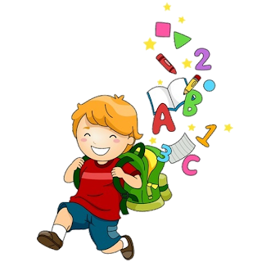
6
Unit 4

Slide 3
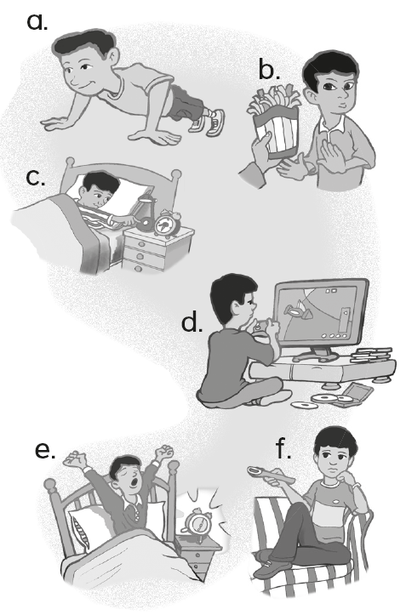
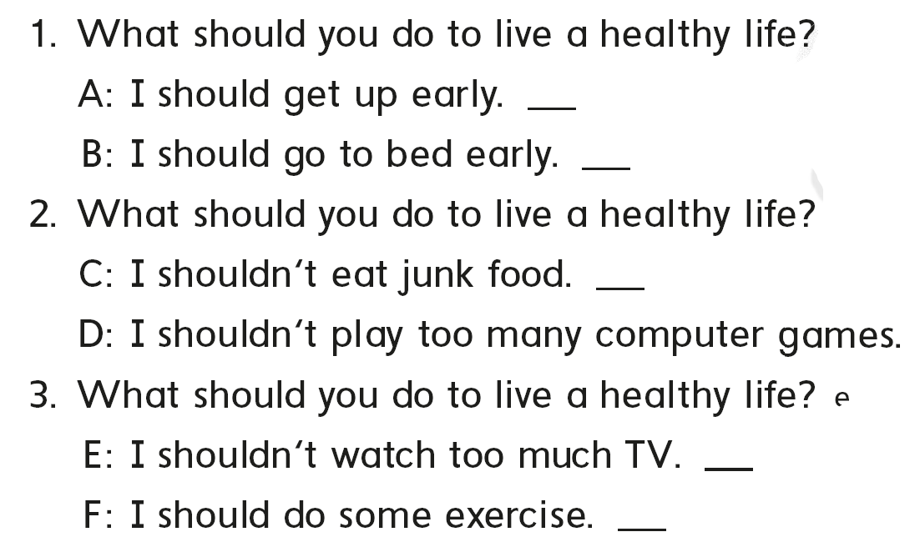
e
c
b
d
f
a

Slide 4
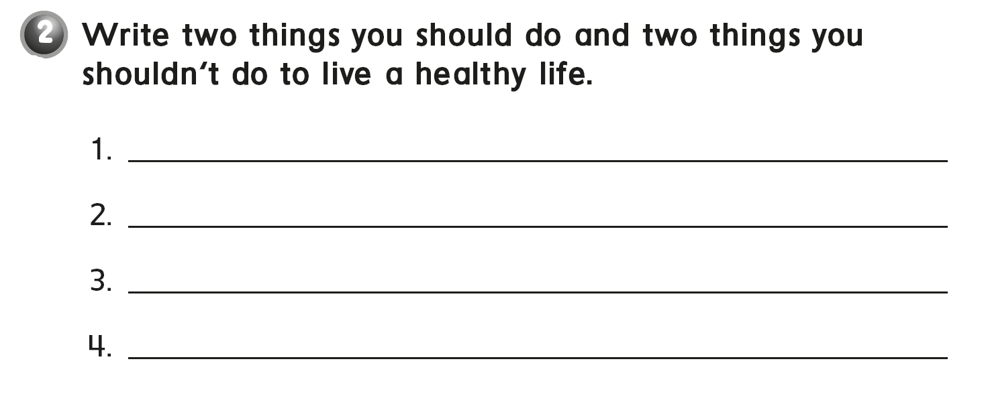
I should eat three meals a day.
I should do some exercise.
I shouldn‘t watch too much TV.
I shouldn‘t play too much computer games.

Slide 5
soda

Slide 8
Charlie
52
do some exercise
eat too much junk food
an egg

Slide 10
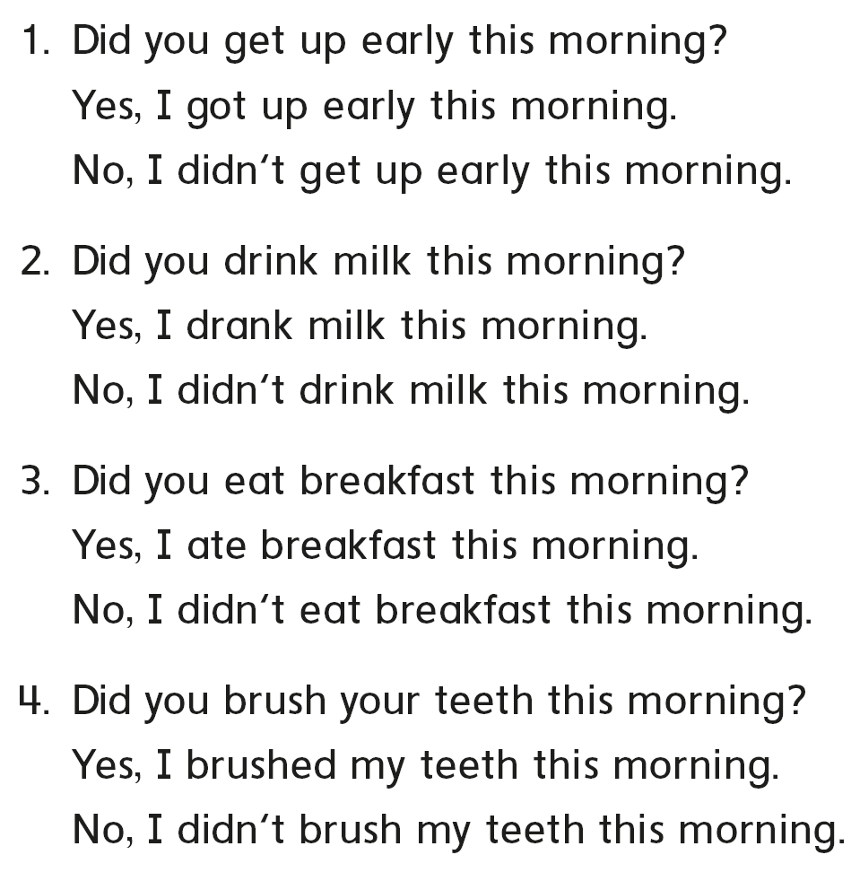
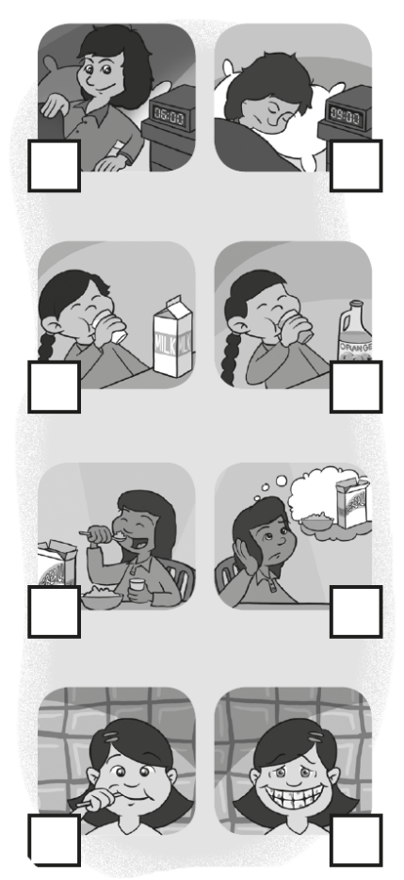
√
√
√
√

Slide 11
I prayed at the mosque .
I eat breakfast .
tea

Slide 13
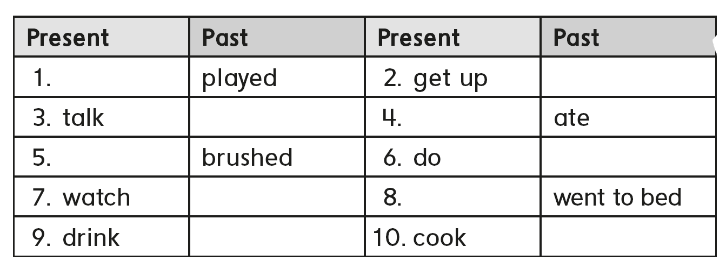
you eat breakfast this morning
you watch the movie last night
play
got up
talked
eat
brush
did
watched
go to bed
drank
cooked

Slide 14
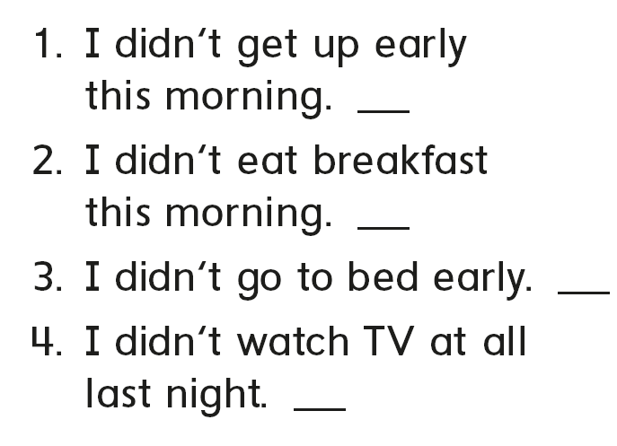
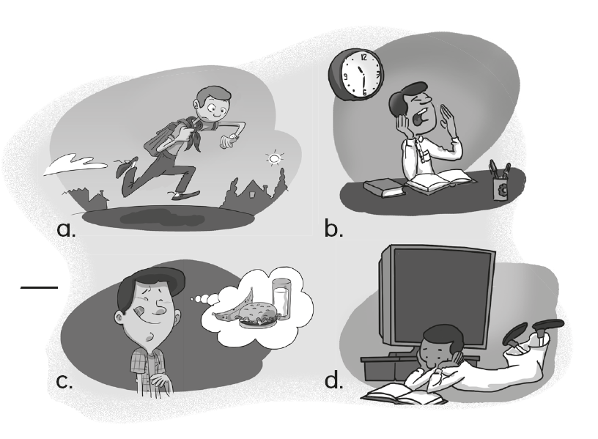
a
c
b
d

Slide 15
Good night

Slide 17
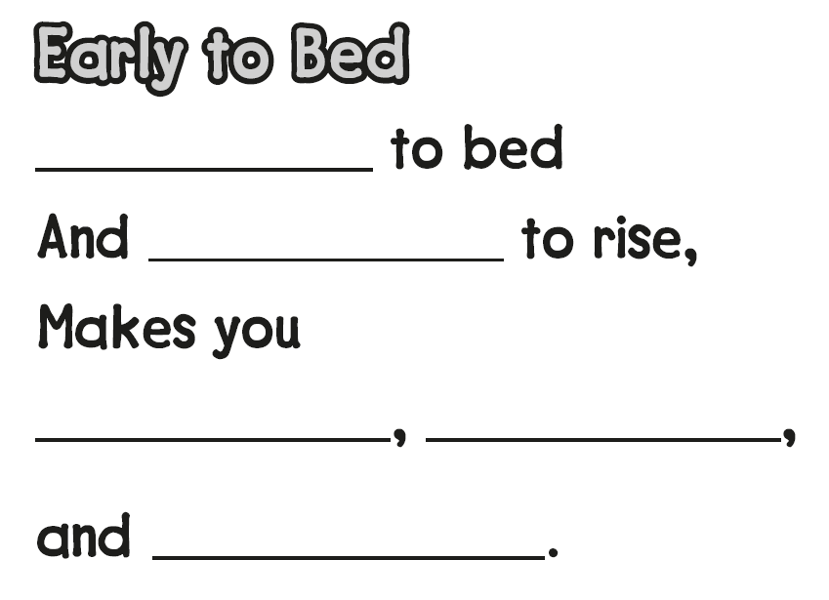
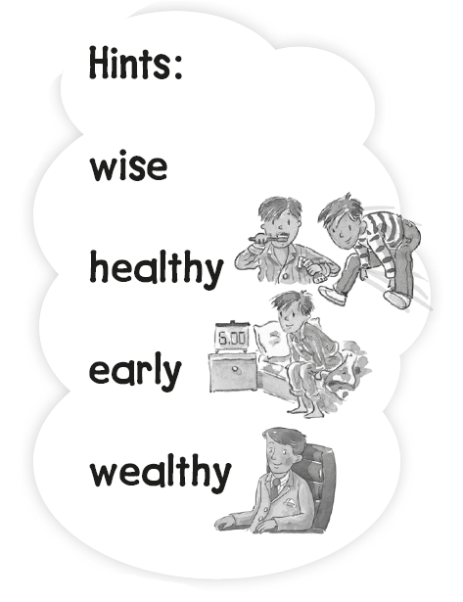
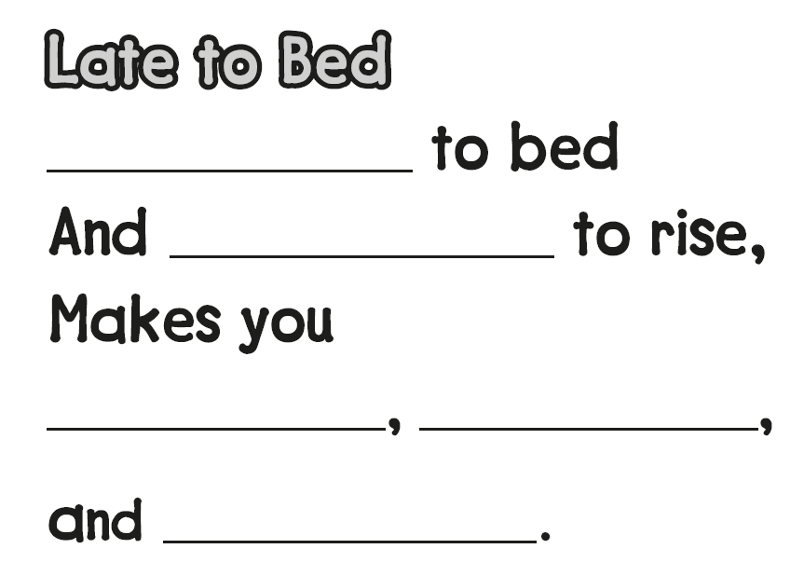
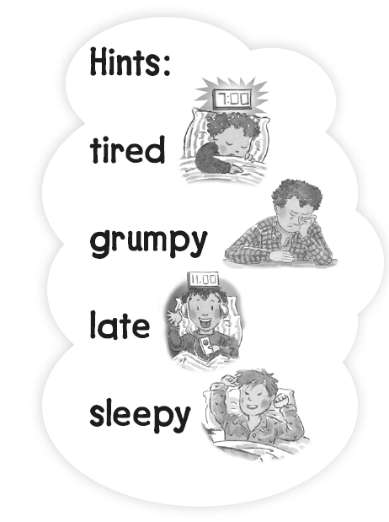
Early
early
healthy
wealthy
wise
Late
late
sleepy
grumpy
tired

Slide 18
ealthy

Slide 20
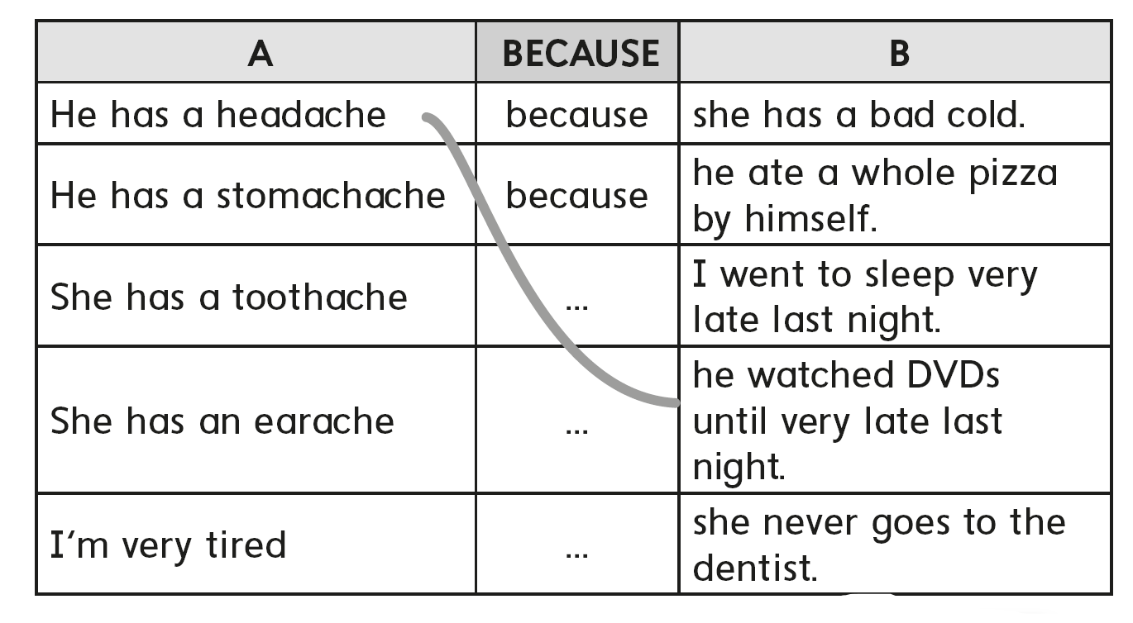

Slide 21
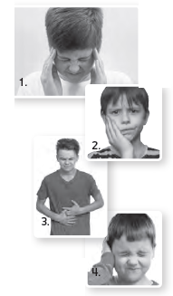
He has a toothache. He should brush his teeth everyday
He has a stomachache. He shouldn’t drink too much soda
He has a earache. He should not listen music too much

Slide 22
doctor

Slide 24
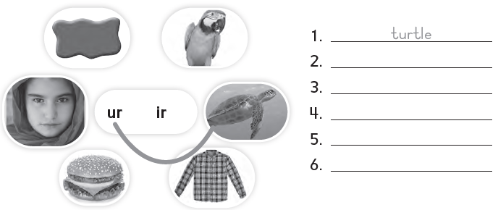
shirt
burger
girl
purple
bird

Slide 25
farm
purple
park
bird
Flew away

Slide 26
It’s a garden

Slide 28
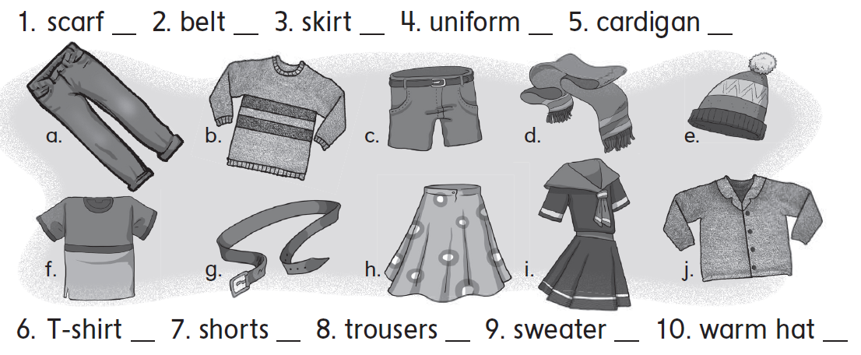
d
g
h
i
j
f
c
a
b
e

Slide 29
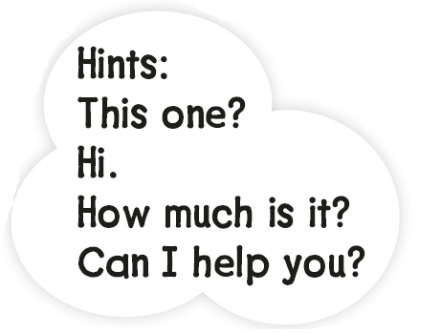
Hi
Can I help you ?
a scarf
This one ?
How much is it ?

Slide 30
a cardigan

Slide 31
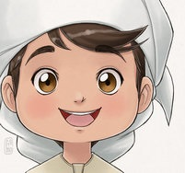
See you later
Goodbye
Teacher :
Badr Sayid
Al-Shehri

