Slide 1
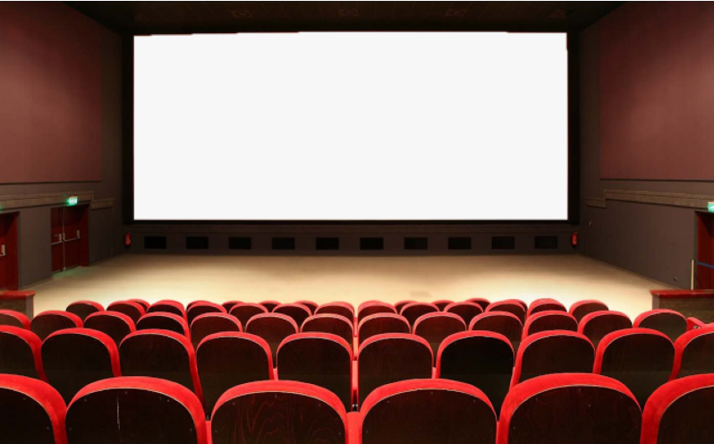
U : 2 conversation
What are they making ?
By : ET Asma Almjlad

Slide 2
Read the conversation correctly
Use the real talk phrases in a conversation
Objectives

Slide 4
New Words

Slide 5
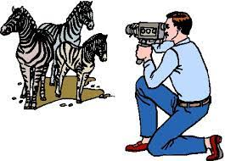
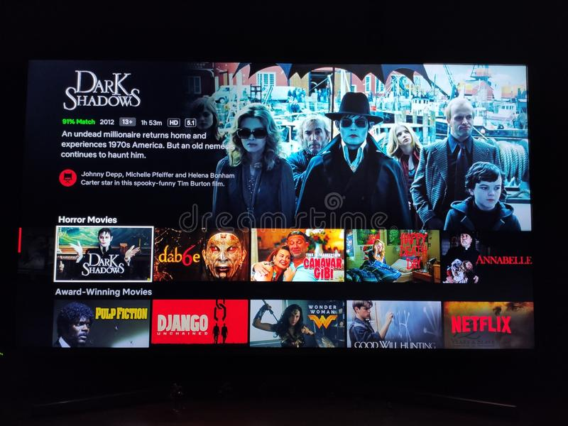
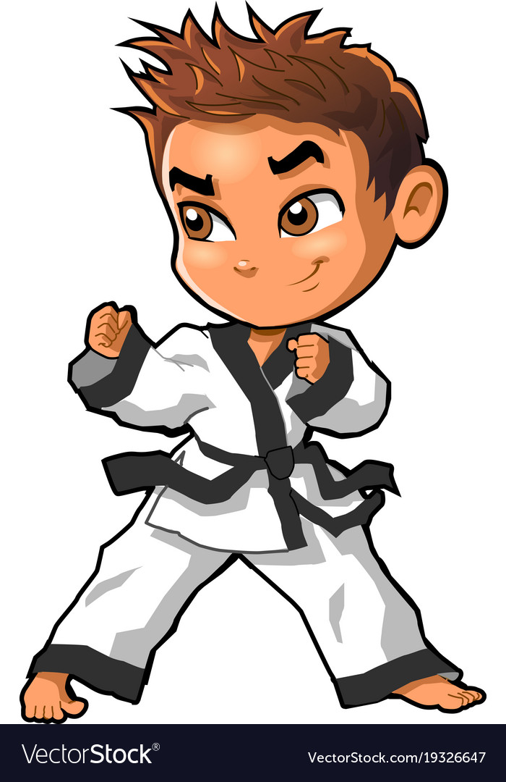
documentary
location
Martial arts
episodes

Slide 6
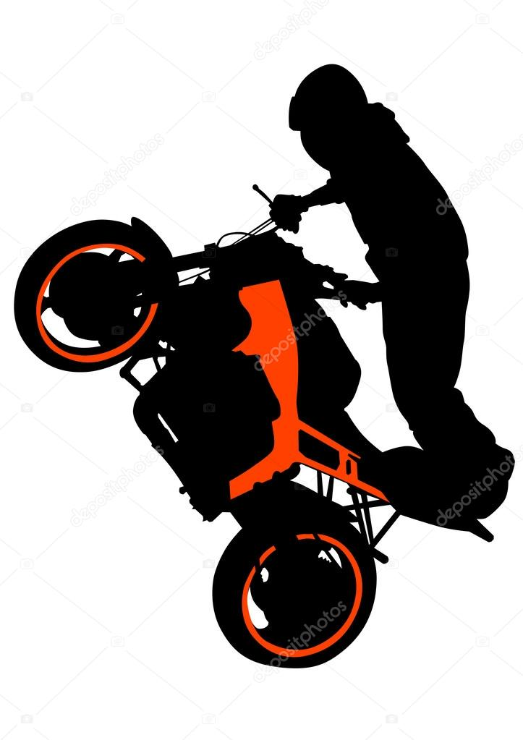
stunt
stuntman

Slide 7
Open your book page 6
Listen

Slide 8
Let’s discuss
How many characters in this conversation ?
Who are the people?
What are they probably talking about?

Slide 11
Who says So?
What does he want to talk about with Jet?
Who says all by myself
What can you do all by yourself?
Who says Not at all

Slide 12
1. He’s working on a documentary series about martial arts
2. They are filming the documentary in the studio in Hong Kong and in locations all over Asia.
3. No, he isn’t.
4. Karate isn’t about fighting. It’s about physical strength and balance.
5. Yes, they are, if the first episode is a success

Slide 13
Let’s practice

