Slide 1
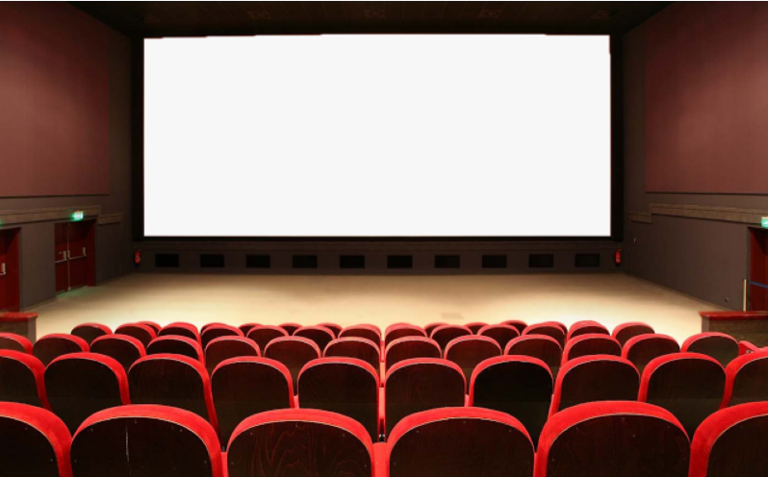
U : 2 Reading
What are they making ?
By : ET Asma Almjlad

Slide 2
Rearrange the main ideas of the text
answer some questions about the text
Find the meaning of new words in the text
Objectives

Slide 4
How can you complete your learning without go to school?
Do you think e-learning is easy ?
What do you need for e- learning?
Do you prefer e-learning or face to face learning?
Do you use Ein or web videos to get more information about your learning?

Slide 5
What are the differences between e-learning and classroom learning?

Slide 6
New Words

Slide 7
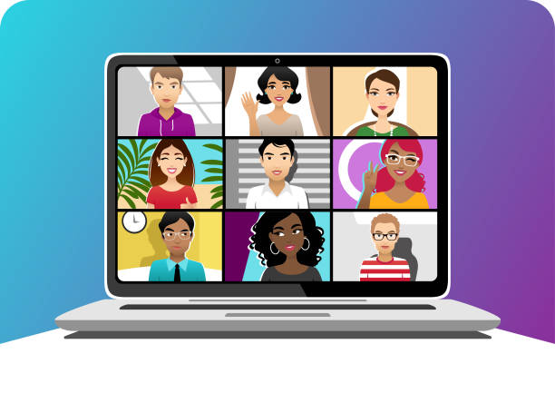
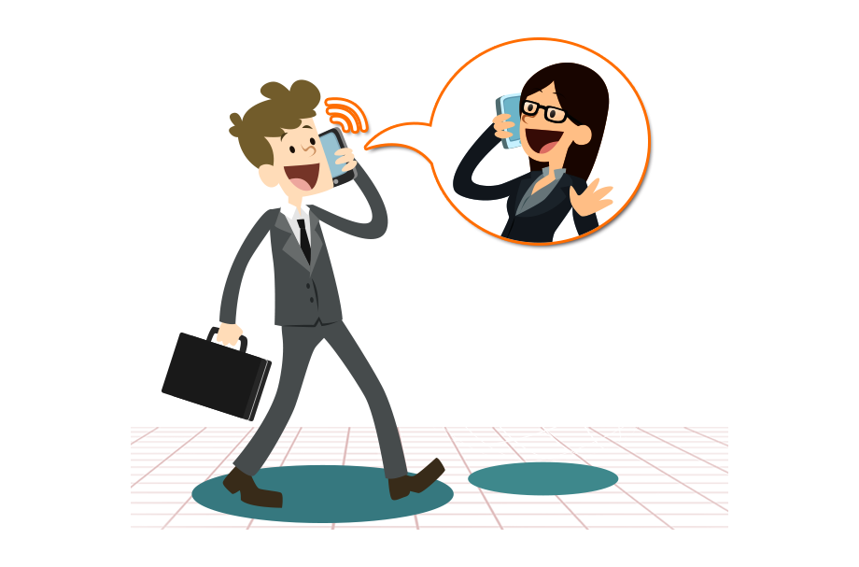
webcam
communicate
volcano

Slide 8
Open your book page 15
What do you see in the first picture?
What do you see in the second picture?
What is the man in the third picture doing?
What do you think it is about?

Slide 9
Listen
What do you know about web videos and e-learning?
What is the title of the reading?

Slide 11
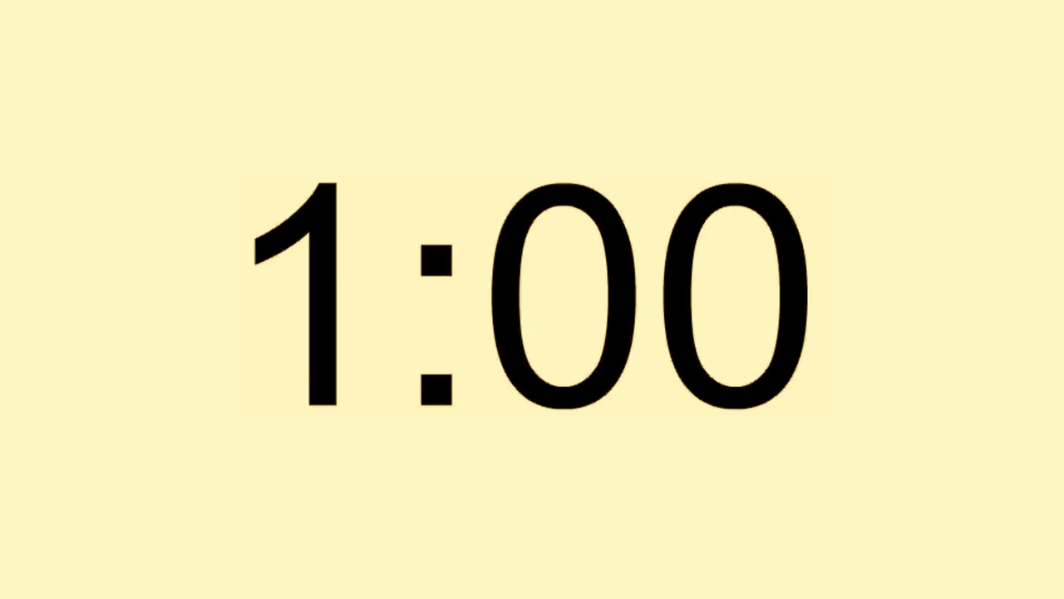
no
yes
no
yes

