Slide 2
Day
Sunday
Date
26 Sep2021
Subject
We can 1
Lesson
RevisionU1

Slide 3
Lesson 1 Pg. 4-5

Slide 5
Choose the correct answer:
Hello
1
I’m fine thank you.
2
Hi
3
Nice to meet you, too.

Slide 6
Choose the correct answer:
How are you?
1
I’m fine thank you.
2
Hi
3
Nice to meet you, too.

Slide 7
Choose the correct answer:
Nice to meet you
1
I’m fine thank you.
2
Hi
3
Nice to meet you, too.

Slide 9
The girl with the green shirt is the ……?
Complete the sentence with the correct word:
First
Second
Third
Fourth
Fifth
Sixth
Seventh

Slide 10
The boy with the blue shirt is the ……?
Complete the sentence with the correct word:
First
Second
Third
Fourth
Fifth
Sixth
Seventh

Slide 11
The girl with the pink shirt is the ……?
Complete the sentence with the correct word:
First
Second
Third
Fourth
Fifth
Sixth
Seventh

Slide 12
The boy with the red shirt is the ……?
Complete the sentence with the correct word:
First
Second
Third
Fourth
Fifth
Sixth
Seventh

Slide 13
The boy with the orange shirt is the ……?
Complete the sentence with the correct word:
First
Second
Third
Fourth
Fifth
Sixth
Seventh

Slide 14
The girl with the purple shirt is the ……?
Complete the sentence with the correct word:
First
Second
Third
Fourth
Fifth
Sixth
Seventh

Slide 15
Lesson 1 Pg. 8-9

Slide 16
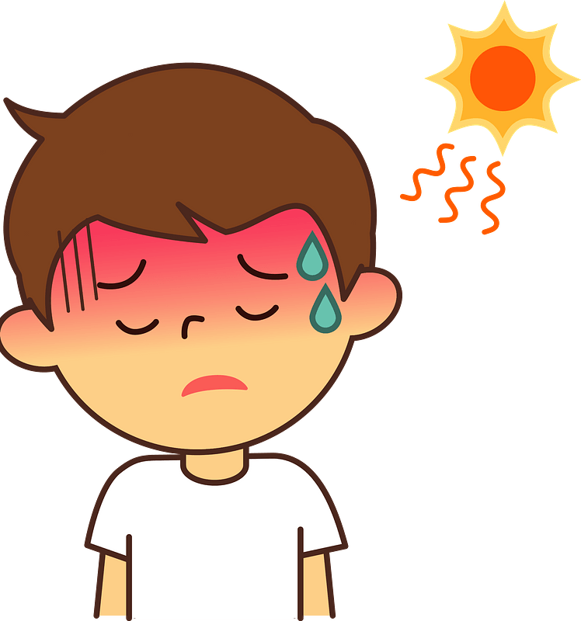
What’s the matter?
He’s ………….
hot
cold
scared
thirsty
hungry
sleepy

Slide 17
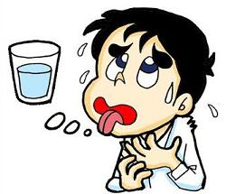
What’s the matter?
He’s ………….
hot
cold
scared
thirsty
hungry
sleepy

Slide 18
What’s the matter?
He’s ………….
hot
cold
scared
thirsty
hungry
sleepy

Slide 19
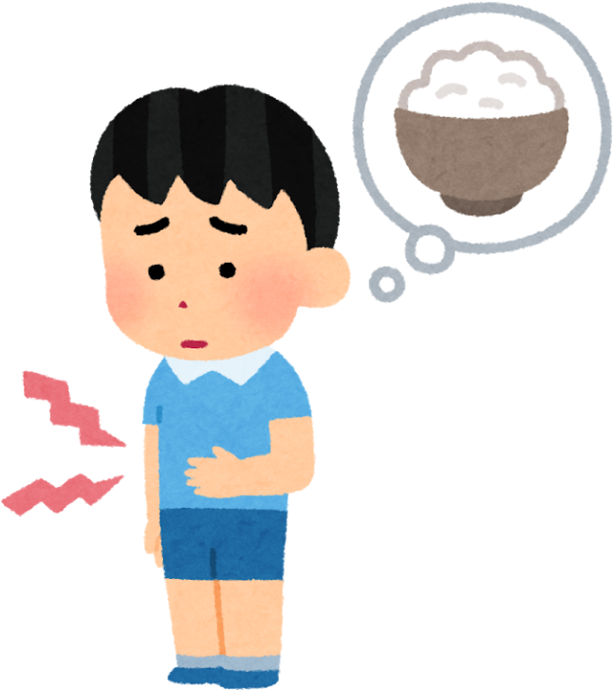
What’s the matter?
He’s ………….
hot
cold
scared
thirsty
hungry
sleepy

Slide 20
What’s the matter?
He’s ………….
hot
cold
scared
thirsty
hungry
sleepy

Slide 21
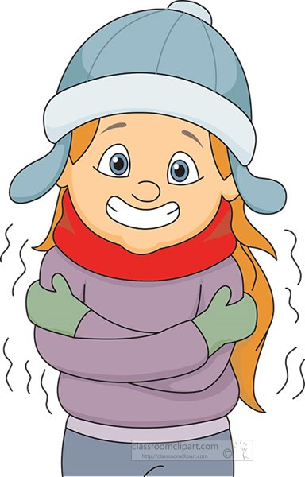
What’s the matter?
He’s ………….
hot
cold
scared
thirsty
hungry
sleepy

Slide 22
Lesson 1 Pg. 10-11

Slide 24
Choose the missing letters:
C _ p
1
e
2
a
3
i

Slide 25
Choose the missing letters:
P _ n
1
e
2
a
3
i

Slide 26
Choose the missing letters:
C_k_
1
a-e
2
i-e
3
o-e

Slide 27
Choose the missing letters:
T_m_
1
i-e
2
a-e
3
o-e

Slide 28
Choose the missing letters:
C _ t
1
e
2
a
3
i

Slide 29
Choose the missing letters:
F_c_
1
o-e
2
i-e
3
a-e

Slide 31
Skill: Recognize and match sounds to letters.
Choose and fill in the missing letter.
_ pple
A
1
A
2
E
3
I

Slide 32
Skill: Recognize and match sounds to letters.
Choose and fill in the missing letter.
_ et
J
1
G
2
J
3
K

Slide 33
Skill: Recognize and match sounds to letters.
Choose and fill in the missing letter.
Z
_ ebra
1
S
2
C
3
Z

Slide 34
Skill: Recognize and match sounds to letters.
Choose and fill in the missing letter.
_ en
P
1
P
2
B
3
M

Slide 35
Skill: Recognize and match sounds to letters.
Choose and fill in the missing letter.
C
_ ow
1
D
2
C
3
K

Slide 36
Skill: Recognize and match sounds to letters.
Choose and fill in the missing letter.
_ at
H
2
S
1
H
3
V

Slide 37
Skill: Recognize and match sounds to letters.
Choose and fill in the missing letter.
S
_ un
2
C
3
Z
1
S

Slide 38
Skill: Recognize and match sounds to letters.
Choose and fill in the missing letter.
_ ase
V
1
V
2
F
3
H

Slide 40
دعواتكم لي ولوالدي عهود ال هادي

